Slide 1



CS4352 Operating Systems
Lecture 10
Instructor: Tommy Dang, Ph.D.
Assistant Professor
Department of Computer Science
Texas Tech University

Slide 2
Outline
Questions?
Memory Abstraction: Address Space
Managing Free Memory
Virtual Memory
Paging
Page tables
Speeding up paging
Page tables for large memories

Slide 3
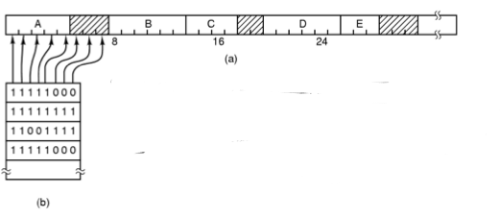
Memory Management with Bitmaps
Memory divided into allocation units and mapped to a bitmap
Size of allocation unit needs a balance (bitmap storage v.s. waste of allocation unit)
Drawback: need search (slow) to find out available memory
Figure 3-6. (a) A part of memory with five processes and three holes. The tick marks show the memory allocation units. The shaded regions (0 in the bitmap) are free. (b) The corresponding bitmap.
Notes:
Drawback: need search (slow) to find out available memory: bring a k-unit process into memory -> search for k consecutive bit of 0

Slide 4
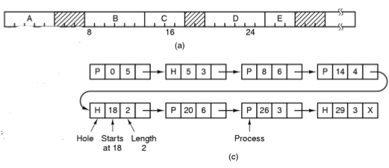
Memory Management with Linked Lists (1)
Linked list of segments
P: Process
H: Hole
Figure 3-6. (c) The same information as a list.

Slide 5
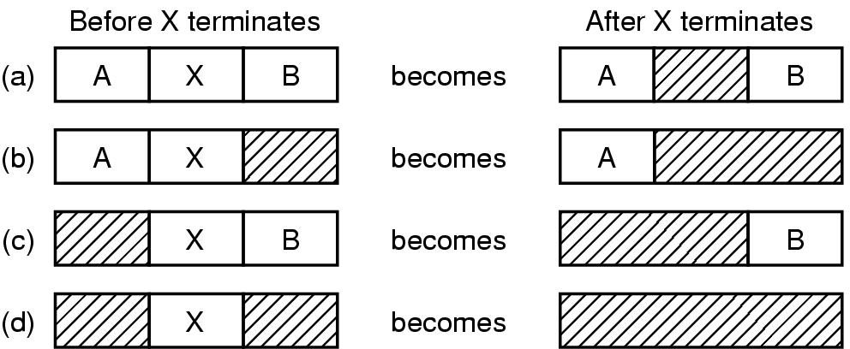
Memory Management with Linked Lists (2)
Memory merge for process termination/swapped out
Double-linked list preferred rather on single-linked list
Figure 3-7. Four neighbor combinations for the terminating process, X.
Notes:
- Memory merge for process termination/swapped out: 4 situations are depicted in the Figure
- Double-linked list: to find the previous item since the process table only point to processes

Slide 6
Memory Management with Linked Lists (3)
Memory allocation for process creation/swapped in
First fit (searches from the beginning of the linked list)
Next fit (Similar to first fit, but searches from left off last time)
Best fit (take the smallest adequate hole, widely used, example fitting a process of size 2 into Fig 3-6)
Worst fit (takes the largest hole, example fitting two processes of size 1 and then 2 into Fig 3-6)
Quick fit (quick allocation for common sizes, e.g. maintaining extra lists of points to 4KB, 8KB … time and space trade-off )
Notes:
We assume that memory management know how much memory to allocate for the process

Slide 7
Outline
Questions?
Memory Abstraction: Address Space
Managing Free Memory
Virtual Memory
Paging
Page tables
Speeding up paging
Page tables for large memories

Slide 8
Virtual Memory
Driven by the need of running programs that are too large to fit in memory (or collectively with multiple programs)
Each process has its own address space, divided into pages
Pages mapped onto physical memory (not all)
When a process refers part of address space in physical memory, a hardware/software performs mapping on the fly
When not in memory, the OS load and re-execute instruction
Notes:
Designed by John Fotheringham in 1961

Slide 9
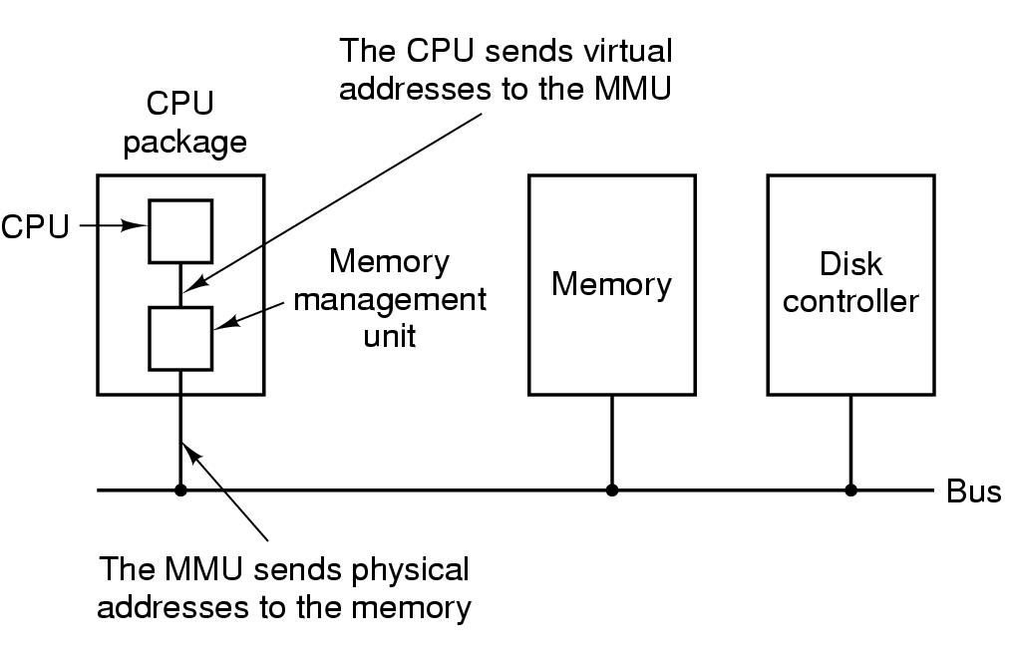
Paging (1)
Paging
Virtual address (CPU generated)
Virtual address space
MMU (Memory Management Unit)
Figure 3-8. The position and function of the MMU – shown as being a part of the CPU chip (it commonly is nowadays). Logically it could be a separate chip, was in years gone by.

Slide 10
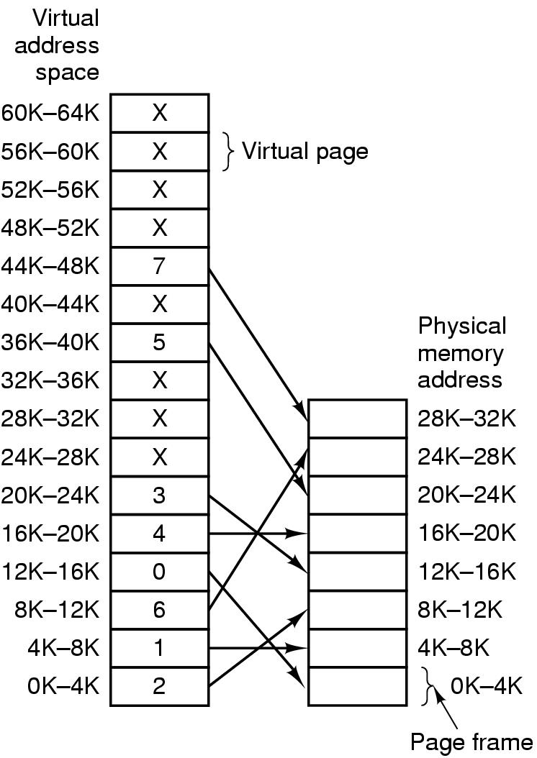
Paging (2)
Pages
Page frames
Page table (mapping function)
Page fault
Present/absent bit
Figure 3-9. Relation between virtual addresses and physical memory addresses given by page table.
Notes:
Where is the physical memory located? Where is the virtual memory located?
What is the size of the physical memory in the picture? = 32K
Examples in the text book

Slide 11
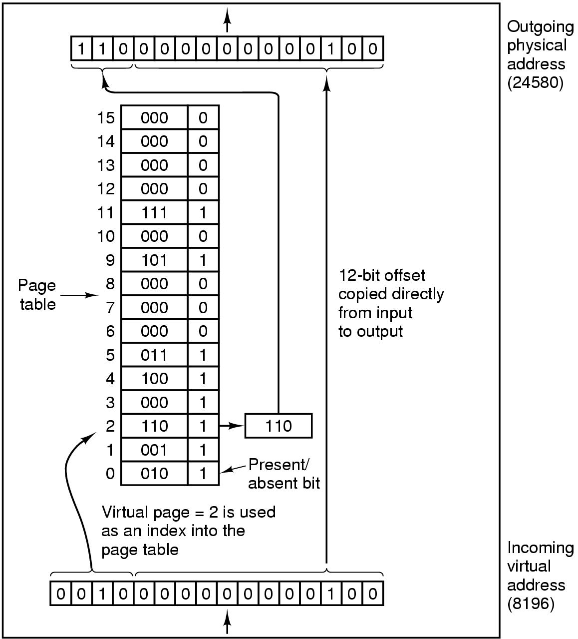
Paging (3)
64KB of virtual address space (16 4KB pages) mapped onto 32KB of physical memory
Page number used as an index into the page table (mapping function)
Figure 3-10. The internal operation of the MMU with 16 4-KB pages.

Slide 12
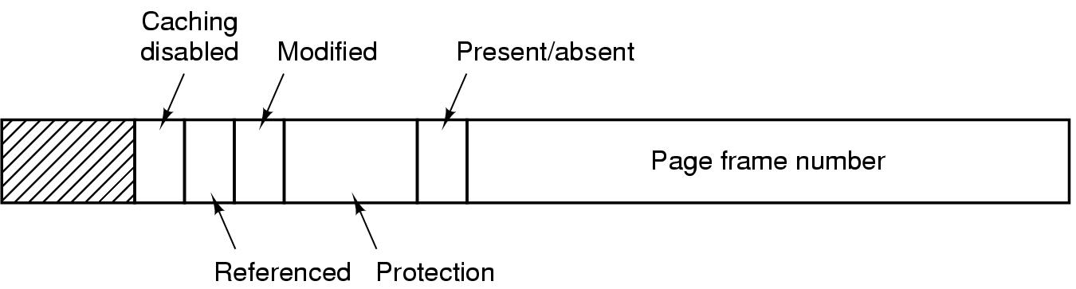
Structure of Page Table Entry
Figure 3-11. A typical page table entry.

Slide 13
Paging implementation issues:
Virtual address to physical address mapping must be fast
Must be done every memory reference
If virtual address space is large, the page table will be large
With 4KB page size, 32-bit address -> how many pages,
With 4KB page size, 64-bit address -> how many pages,
Notes:
With 4KB page size, 32-bit address has 1M (2²⁰) pages, Virtual memory is 4GB
64-bit address has 2⁵² (4K trillion) pages

Slide 14
Outline
Questions?
Virtual Memory
Paging, Page tables
Speeding up paging
Page tables for large memories
Page Replacement Algorithms
Optimal algorithm
NRU, FIFO, Second-chance algorithms
Clock, LRU, Aging algorithms
Working set and WSClock algorithms
Summary

Slide 15
Page Replacement Algorithms
When a page fault occurs, if page frames full, OS needs to choose a page to evict to make room
Similar to cache line replacement
Different in how fast they require
If the evicted page is dirty, it needs to be written back to disk
If clean, no rewrite needed
Naïve random algorithm possible, but we can do a better job!
Notes:
Page Replacement occurs in other areas of computer design: web browsers, catch in CPU.

Slide 16
Optimal Page Replacement Algorithm (OPT)
Best possible algorithm is to pick the page who has the furthest distance to be accessed again
E.g. if pages A, B, C, D in memory, E is referenced and needs to replace a page, with future accesses A, C, D, B, C, …Which one to be picked?
B
Impossible to implement though, need a magic fortune teller!

Slide 17
Not Recently Used (NRU)
Associate two bits for each page
R: reference bit, set when referenced (read/written)
M: modified bit, set when written
OS classifies into 4 classes and NRU picks a random page from the lowest-numbered nonempty class (higher priority to stay with reuse)
Class 0: not referenced, not modified
Class 1: not referenced, modified
Class 2: referenced, not modified
Class 3: referenced, modified
Notes:
Referenced is reset by OS every clock cycle (interrupt): Class 1 can achieved by resetting Referenced on class 3 on clock cycle.

Slide 18
First-In First-Out (FIFO)
FIFO picks the oldest page as the victim page to be replaced
Low-overhead, little book-keeping, easy to implement (FIFO queue)
Issue: ?
heavily-used early arrival page can be replaced

Slide 19
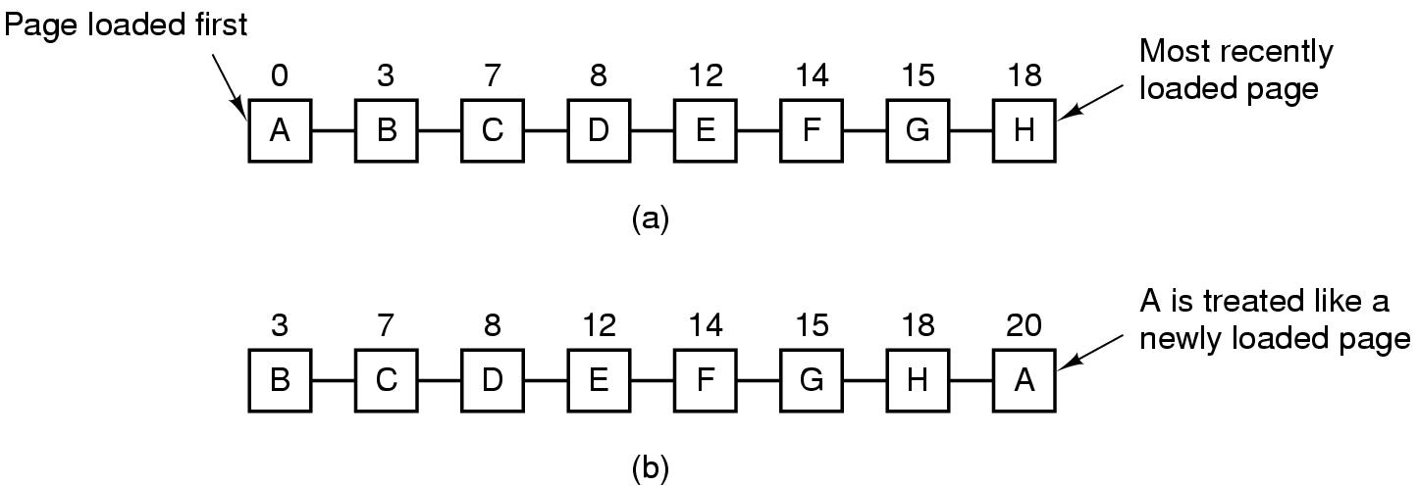
Second Chance Algorithm
Follows FIFO, but check R bit; if 0, replaced; if 1, clear R bit and put into the end of the queue
Figure 3-15. Operation of second chance. (a) Pages sorted in FIFO order. (b) Page list if a page fault occurs at time 20 and A has its R bit set. The numbers above the pages are their load times.

Slide 20
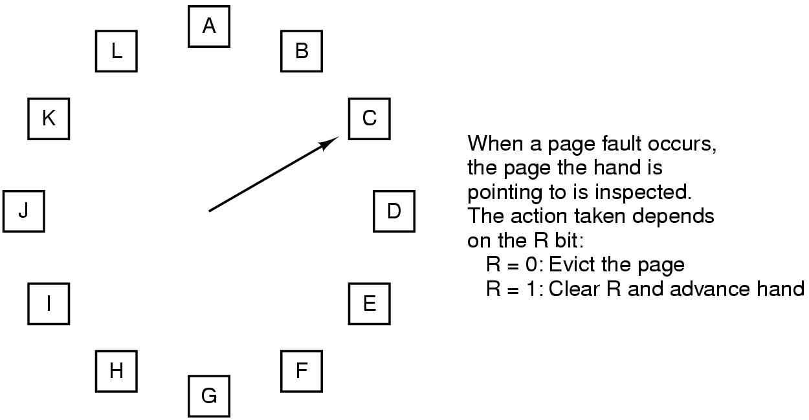
The Clock Page Replacement Algorithm
Figure 3-16. The clock page replacement algorithm.
Notes:
Similar to FIFO with second chance. But this move the pointer instead of move the page to the end of the list

Slide 21
Least Recently Used (LRU) Algorithm (1)
LRU picks the page that has not been used for the longest time
Good approximation of OPT
Not cheap to implement though
Needs a linked list and needs to update this linked list on every memory reference
Hardware implementations
With a counter incrementing after each instruction (“timer”); each page table entry stores a counter value, entry with lowest counter picked
With a matrix of n x n bits, for n page frames

Slide 22
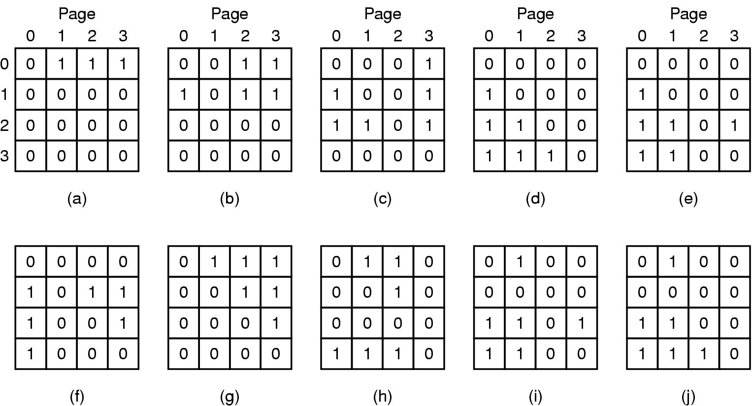
Least Recently Used (LRU) Algorithm (2)
When page frame k referenced, row k sets to 1, col k sets to 0
Row with lowest binary value picked
LRU using a matrix when pages are referenced in the order 0, 1, 2, 3, 2, 1, 0, 3, 2, 3.

Slide 23
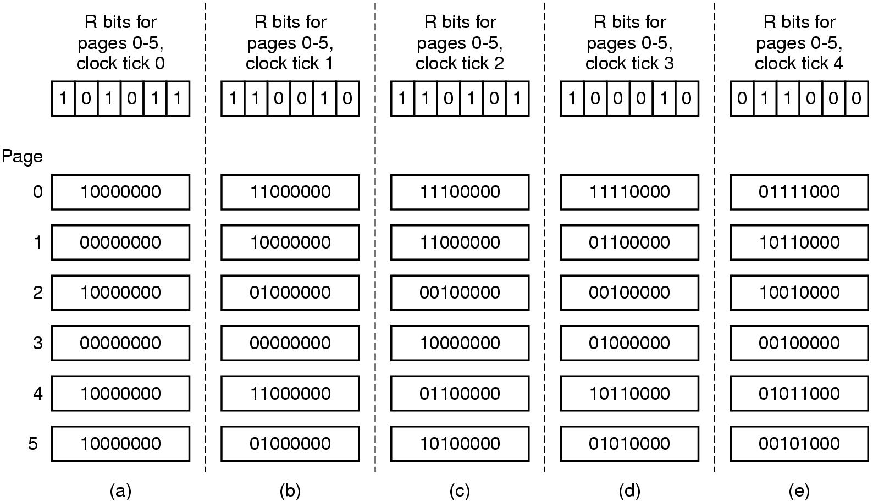
Simulating LRU in Software – Aging Algorithm
Software counter associated with each page
Counter shifted right 1 bit, and R bit added in to the leftmost, at each clock interrupt
Not exact LRU, e.g. pages 3 and 5 after not referenced a while
Figure 3-17. The aging algorithm simulates LRU in software. Shown are six pages for five clock ticks. The five clock ticks are represented by (a) to (e).
Notes:
We are able distinguish within 8 clock cycle but not more than 8 clock cycle

Slide 24
Working Set Page Replacement (1)
The set of pages a process currently using called working set
Principle of locality
Demand paging: pages are loaded only on demand
Thrashing: if a process has frequent page faults e.g. every few instructions
Prepaging (working set model)
Working set page replacement algorithm
Find a page not in the working set and evict it
Notes:
If the entire working set of the process is in the memory, then no page fault for that execution phase.
Principle of locality: process references only a small fraction of its pages during each execution phase.
Thrashing is because available memory is too small
Prepaging is the opposite of demand paging

Slide 25
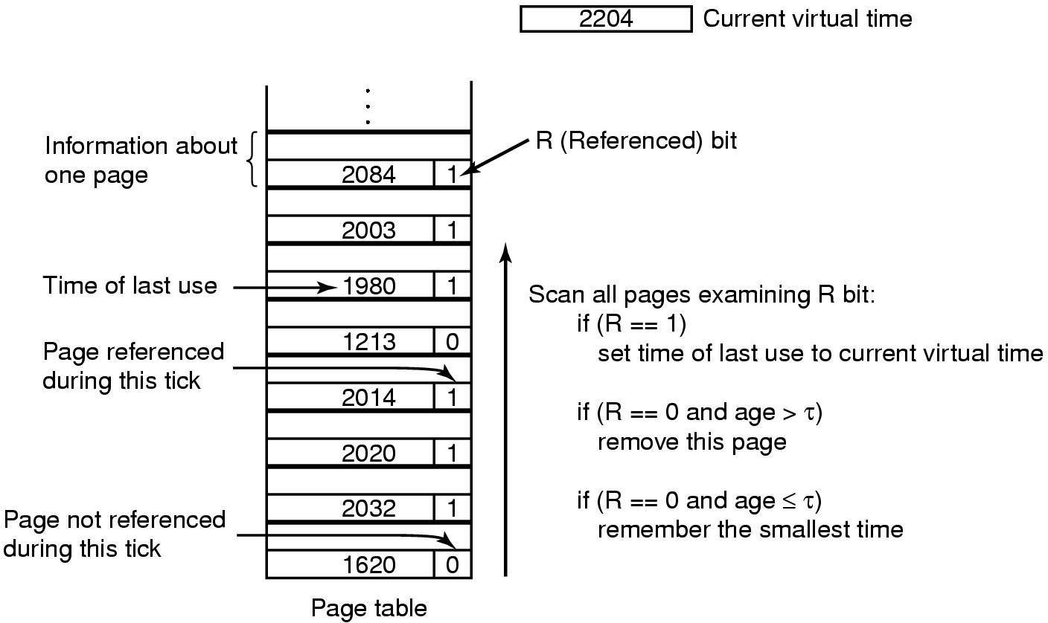
Working Set Page Replacement (2)
Current virtual time: amount of CPU time a process has used since started
On clock interrupt, set all R = 0
τ: a threshold for defining working set
Figure 3-19. The working set algorithm.
Notes:
Not sure why R==1, we have to set the last use = current virtual time?
Maybe because we want to increase its priority in the next page replacement (now his R=0 due to the clock tick). Similar idea of the second chance
In the worst case, all R=1 -> select randomly

Slide 26
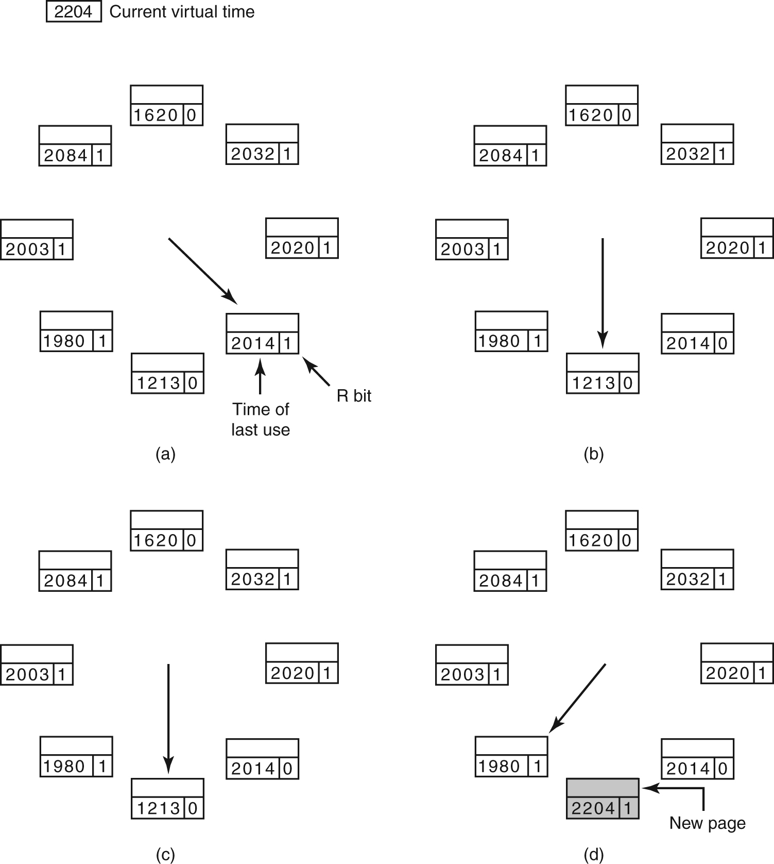
The WSClock Page Replacement Algorithm (1)
Figure 3-20. Operation of the WSClock algorithm. (a) and (b) give an example of what happens when R = 1.

Slide 27
The WSClock Page Replacement Algorithm (2)
Figure 3-20. Operation of the WSClock algorithm.
(c) and (d) give an example of R = 0.

Slide 28
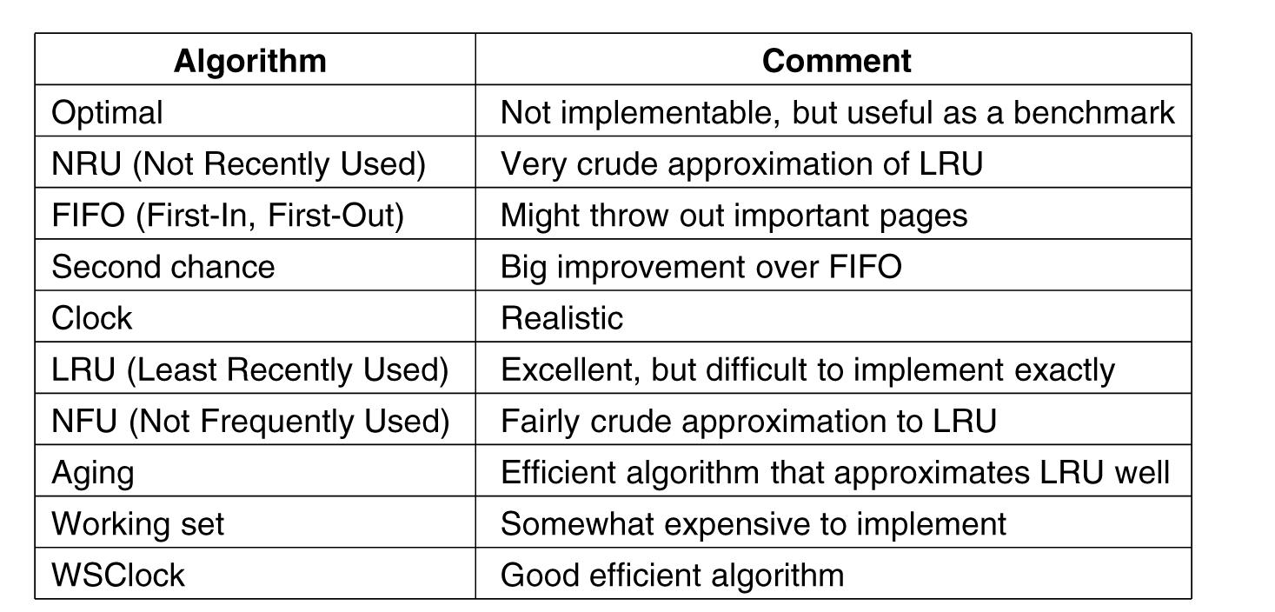
Summary of Page Replacement Algorithms
Figure 3-21. Page replacement algorithms discussed in the text.

Slide 29
Readings
Chapter 3:
Section 3.2
Section 3.3
Section 3.4

