Slide 1



CS4352 Operating Systems
Lecture 11
Instructor: Tommy Dang, Ph.D.
Assistant Professor
Department of Computer Science
Texas Tech University

Slide 2
Outline
Questions?
Page Replacement Algorithms
LRU, Aging algorithms
Working set and WSClock algorithms
Summary
Design Issues for Paging Systems
Local versus global allocation policies
Load control, Page size
Shared pages and shared libraries
Cleaning policy

Slide 3
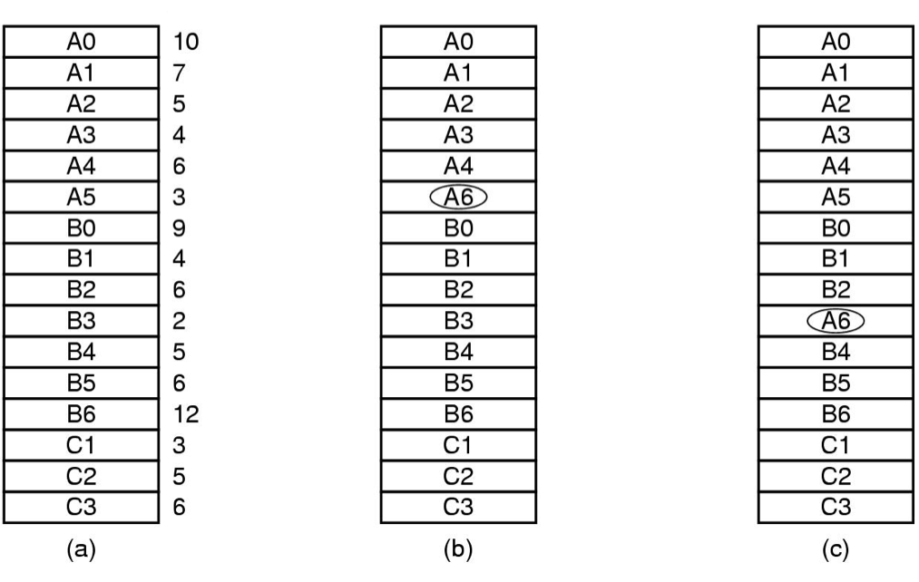
Local versus Global Allocation Policies (1)
Local page replacement v.s. global page replacement
Figure 3-22. Local versus global page replacement. (a) Original configuration.
(b) Local page replacement. (c) Global page replacement.
Notes:
Number are counters

Slide 4
Local versus Global Allocation Policies (2)
Local page replacement
Allocating each process fixed fraction of memory
Can waste memory if working set shrinks
Can cause thrash if working set grows
Global page replacement
Dynamically allocate page frames among runnable processes
A minimum number of pages for each process still desired

Slide 5
Local versus Global Allocation Policies (3)
Two-level page management
Page allocation algorithm + page replacement algorithm
Page allocation algorithm
Equal share of page frames among processes
Proportional to process size
Proportional to Page Fault Frequency (PFF)

Slide 6
Local versus Global Allocation Policies (4)
Not all algorithms applicable to global page replacement
What can you think of?
Working set replacement
WSClock replacement
Applicable to both local and global
OPT
NRU
FIFO, second chance
LRU (and variants), aging

Slide 7
Page Size
It is really a tradeoff and balance among several factors
Small page size
Pros?
Low internal fragmentation
Avoids loading unnecessary program/data and waste of memory
Cons?
Large page table, longer context switch
More times of page transfer
Large page size
The opposite!

Slide 8
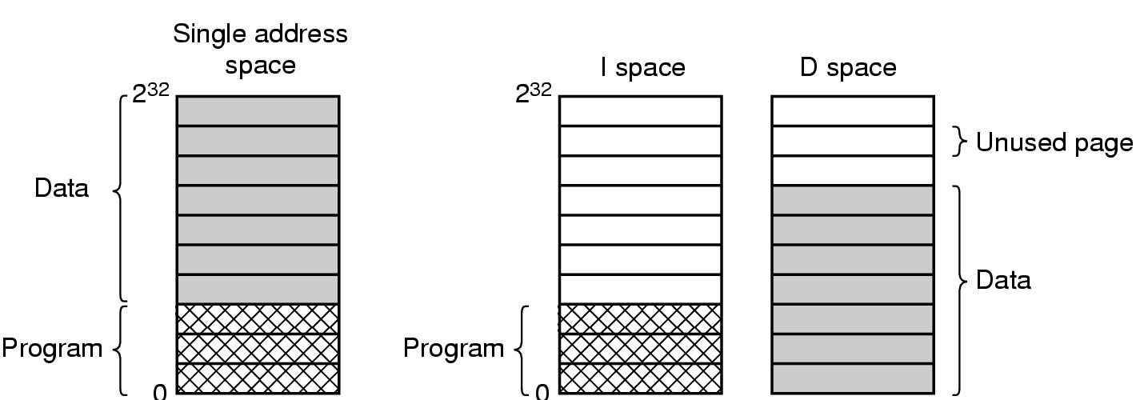
Separate Instruction and Data Spaces
Figure 3-24. (a) One address space. (b) Separate I and D spaces.

Slide 9
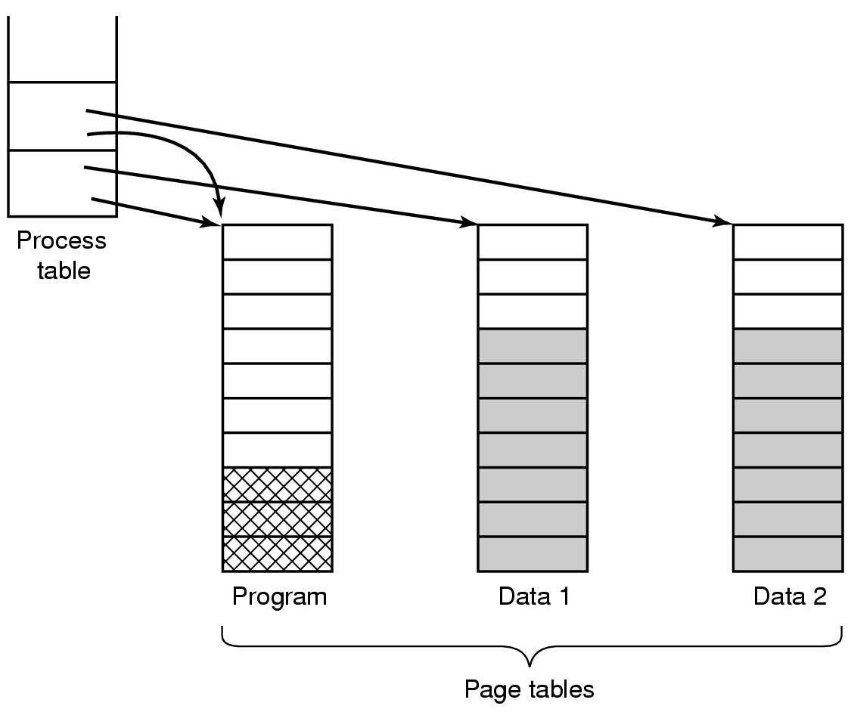
Shared Pages
Sharing program text very common
Sharing data sometimes, what can you think of?
Copy-on-write when forking processes (own page tables, but point to the same set of pages with RDONLY, once write -> new pages, RW
Figure 3-25. Two processes sharing the same program sharing its page table.

Slide 10
Readings
Chapter 3:
Section 3.4
Section 3.5

