Slide 1



CS4352 Operating Systems
Lecture 13
Instructor: Tommy Dang, Ph.D.
Assistant Professor
Department of Computer Science
Texas Tech University
Tommy Dang made minor modifications on the slides

Slide 2
Outline
Questions?
File Systems
Files
File system implementation
Implementing files
Implementing directories

Slide 3
File Systems
Essential requirements for long-term information storage:
It must be possible to store a very large amount of information.
The information must survive the termination of the process using it.
Multiple processes must be able to access the information concurrently.

Slide 4
File Systems
Files
Logical units of information created by processes (abstraction)
File system
An OS component that manages files

Slide 5
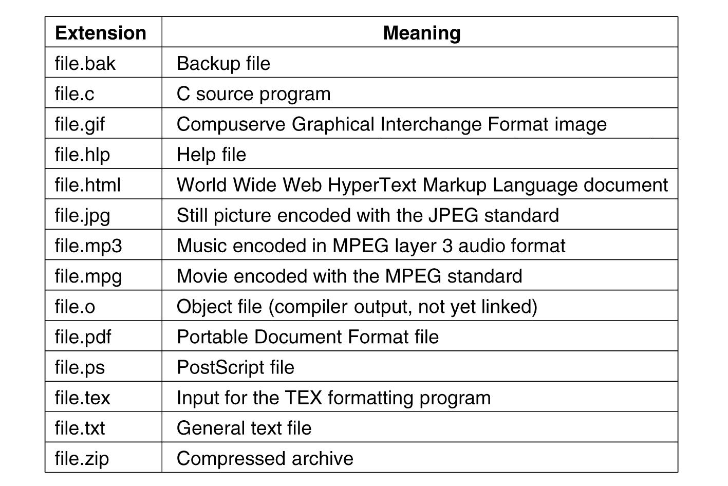
File Naming
Exact file naming rules vary among OSs
E.g. some distinguish between upper/lower case letters whereas others don’t
Usually a two-part file name, separated by a period
The part after the period is called file extension
Figure 4-1. Some typical file extensions.

Slide 6
File Structure
Figure 4-2. Three kinds of files.
(a) Byte sequence. (b) Record sequence. (c) Tree.
Notes:
(a) Byte sequence used in both Unix and Windows
(b) Not currently used
(c) A file is a tree. Records can be located by ‘‘key“, such as Pony. How? -> keys are ordered.

Slide 7
File Types (1)
Regular files
ASCII files
Binary files
Directories
$file foo.c
Determines file type
Notes:
ASCII files contain lines of text and each line ends by a carriage return character. -> can be edited in text editor
Binary files only for specific program. For example executable files.

Slide 8
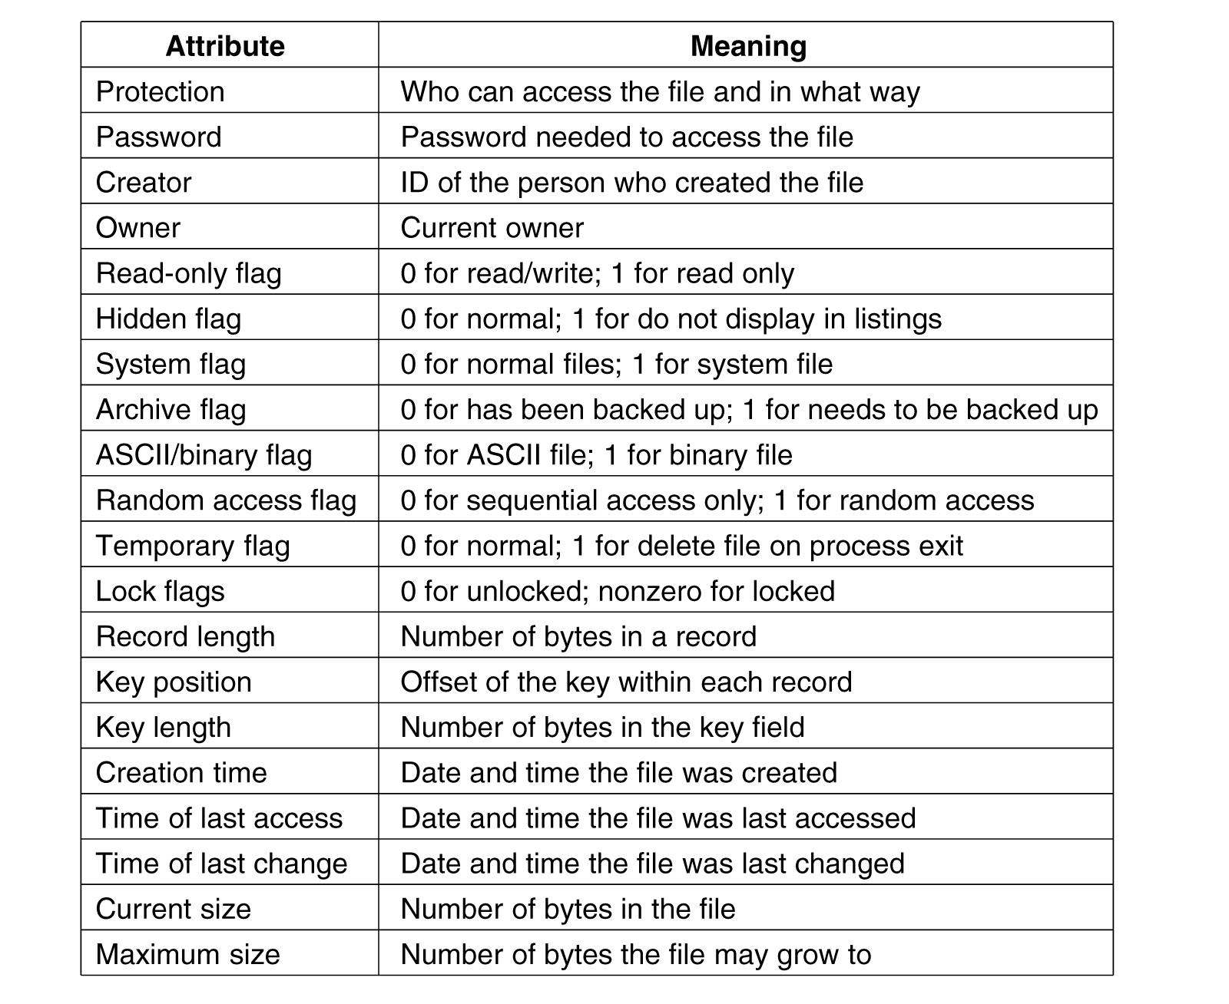
File Attributes (Metadata)
Figure 4-4. Some possible file attributes.
Notes:
How to see those attributes on Mac and on Windows?

Slide 9
File Operations
The most common system calls relating to files:
Create
Delete
Open
Close
Read
Write
Append
Seek
Get Attributes
Set Attributes
Rename

Slide 10
Example Program Using File System Calls (1)
Figure 4-5. A simple program to copy a file.

Slide 11
Example Program Using File System Calls (2)
Figure 4-5. A simple program to copy a file.

Slide 12
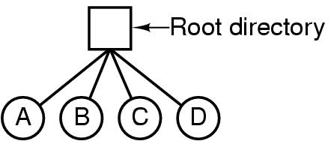
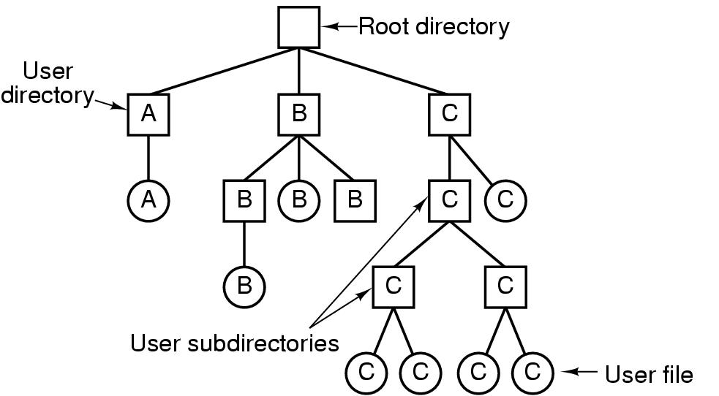
Directories
Directories/folders
Keep track of files (a collection of files/dirs)
Single-level directory systems
Hierarchical directory systems
Figure 4-6. A single-level directory system containing four files.
Figure 4-7. A hierarchical directory system.

Slide 13
Path Names
Absolute path name
Windows: \usr\ast\mailbox
Unix: /usr/ast/mailbox
Multics: >usr>ast>mailbox
Relative path name
Working directory/current directory
E.g. cp mailbox foo v.s. cp /usr/ast/mailbox /usr/ast/foo
“.” and “..”

Slide 14
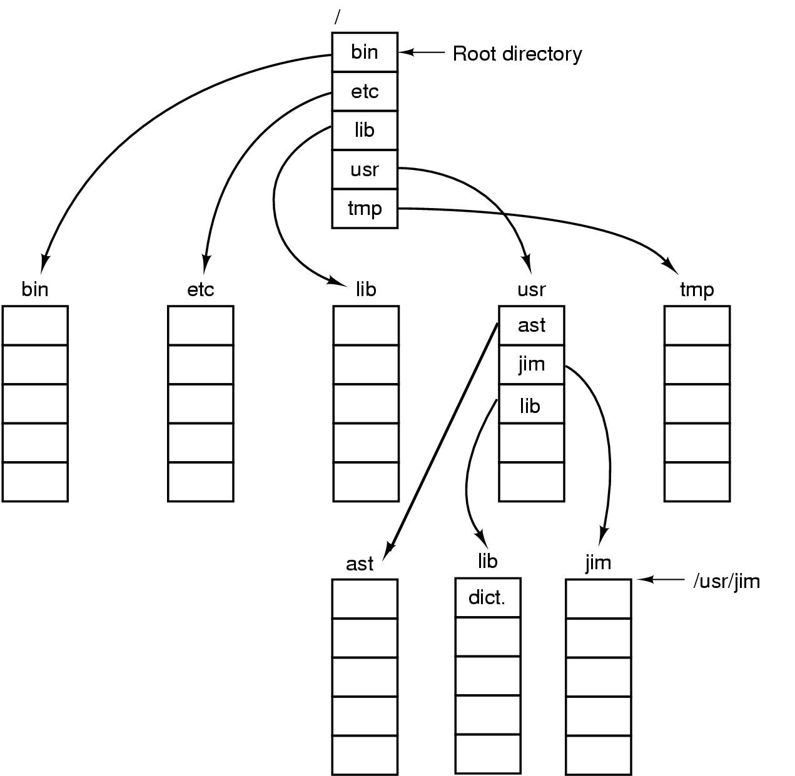
A UNIX directory tree
Figure 4-8. A UNIX directory tree.

Slide 15
Directory Operations
System calls for managing directories:
Create
Delete
Opendir
Closedir
Readdir
Rename

Slide 16
Outline
Questions?
Files
Directories
File system implementation
Implementing files
Implementing directories
Shared files, journaling, virtual file systems

Slide 17
File System Layout
MBR: (Master Boot Record)
Boot block
Superblock
Figure 4-9. A possible file system layout.
Notes:
Master Boot Record is used to boot the computer.
Partition table contain the starting and ending address of each partition.

Slide 18
Implementing Files (2)
OS needs to keep track of which block goes to which file
Contiguous allocation
Linked List Allocation
Linked List Allocation Using a Table in Memory
i-nodes

Slide 19
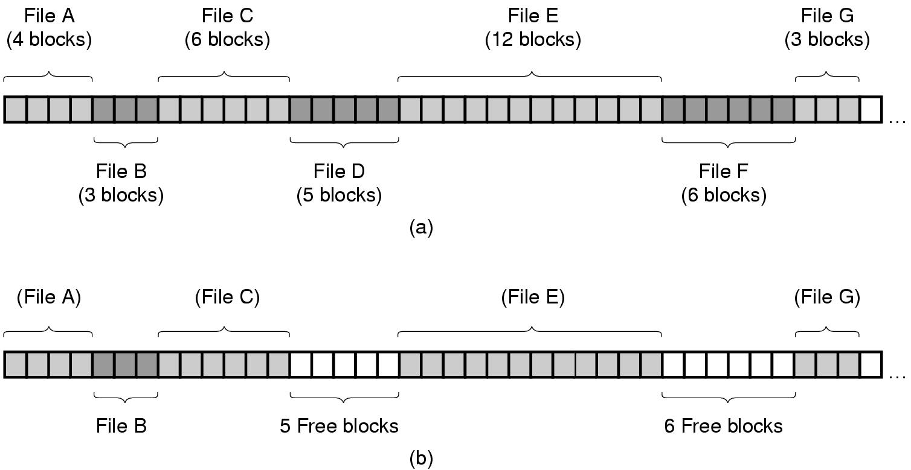
Contiguous Allocation (1)
Figure 4-10. (a) Contiguous allocation of disk space for 7 files.
(b) The state of the disk after files D and F have been removed.

Slide 20
Contiguous Allocation (2)
Pros
Simple to implement (only need to know start addr and num. of blocks)
Sequential access: good performance. Remember the disc structure?
Cons
Need to know file size in advance
Fragmentation (external fragmentation). How to reduce external fragmentation?

Slide 21
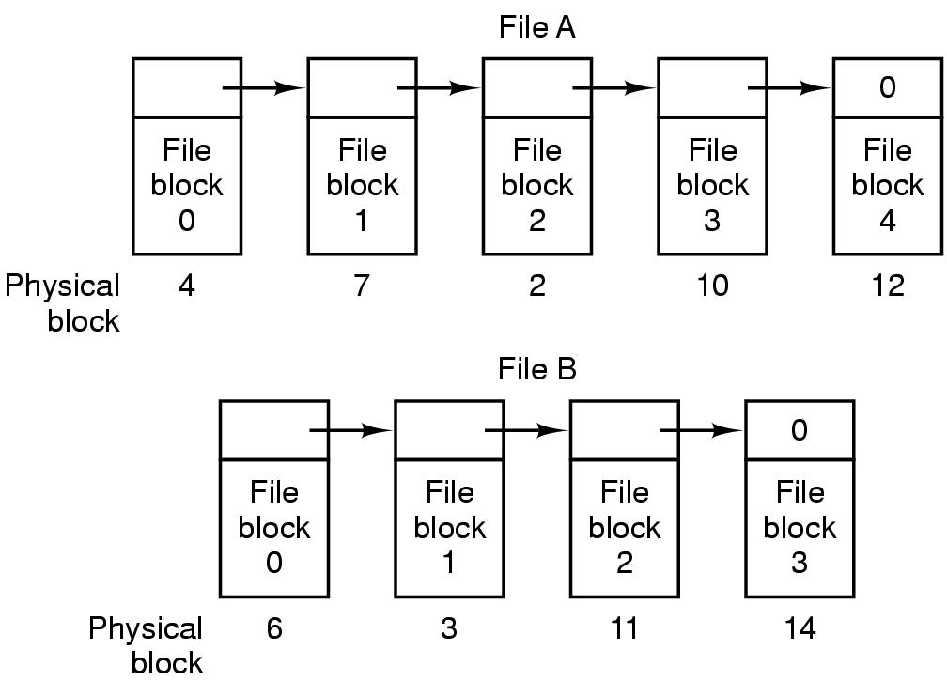
Linked List Allocation (1)
Figure 4-11. Storing a file as a linked list of disk blocks.

Slide 22
Linked List Allocation (2)
Pros
No need to know file size in advance
No external fragmentation, only internal fragmentation
Cons
Random access is slow: need to traverse the next pointer. For example, what is the physical block of the third block of file B?
Irregular storage management: not power of 2 any more. Why?
Notes:
not power of 2 any more due to small size for the next pointer

Slide 23
Linked List Allocation Using a Table in Memory (1)
File Allocation Table (FAT)
Figure 4-12. Linked list allocation using a file allocation table in main memory.

Slide 24
Linked List Allocation Using a Table in Memory (2)
Pros
No need to know file size in advance
No external fragmentation, only internal fragmentation
Easy random access (FAT is entirely in memory -> no disk reference)
Regular storage management (no extra pointer)
Cons
Entire table must be in memory, needing huge memory space
Example on page 286

Slide 25
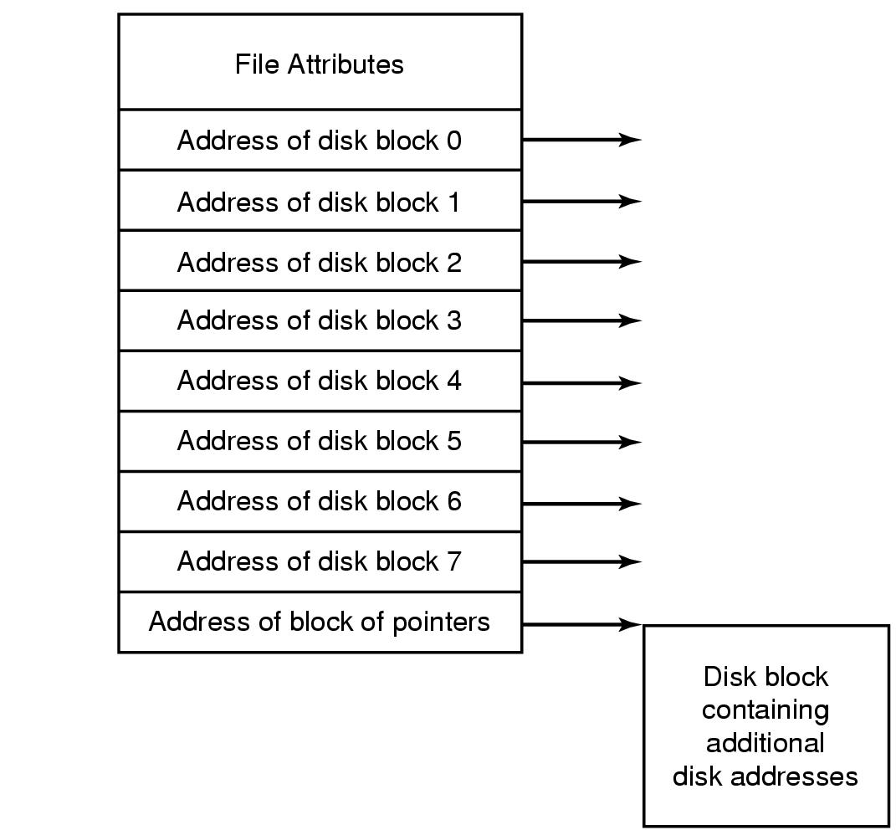
i-nodes
i-nodes: index-nodes
Have all advantages of FAT, plus controlled memory consumption:
i-node only need to be in memory when the file is open
Figure 4-13. An example i-node.

Slide 26
i-nodes
Pros
Only i-nodes of opened files need to be in memory -> not proportional to the disk size
Cons
When a file grows beyond the fixed number of block for each i-nodes?
The solution is to reserve the lost disk address for another i-nodes (see the previous Figure) -> becomes linked list.
Notes:
FAT is proportional to the disk size

Slide 27
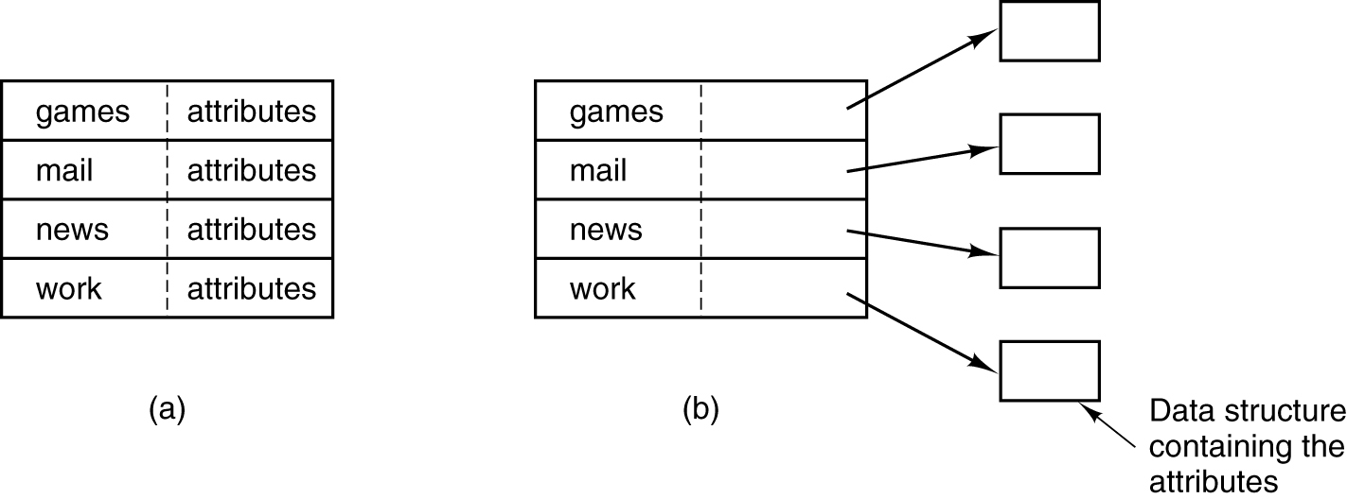
Implementing Directories (1)
Directory maps file names onto info needed to locate data
Figure 4-14. (a) A simple directory containing fixed-size entries with the disk addresses and attributes in the directory entry.
(b) A directory in which each entry just refers to an i-node.

Slide 28
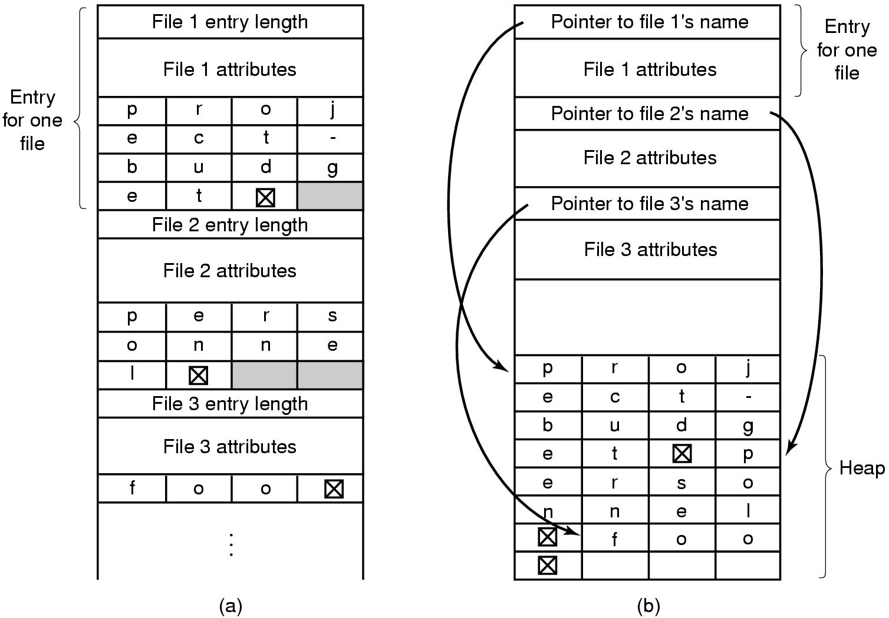
Implementing Directories (2)
How to handle variable-length file names efficiently?
Figure 4-15. Two ways of handling long file names in a directory. (a) In-line. (b) In a heap.

