Slide 1
Water Elevation Presentation
Contributors: Wenhao Ge, Lino, Kevon

Slide 2
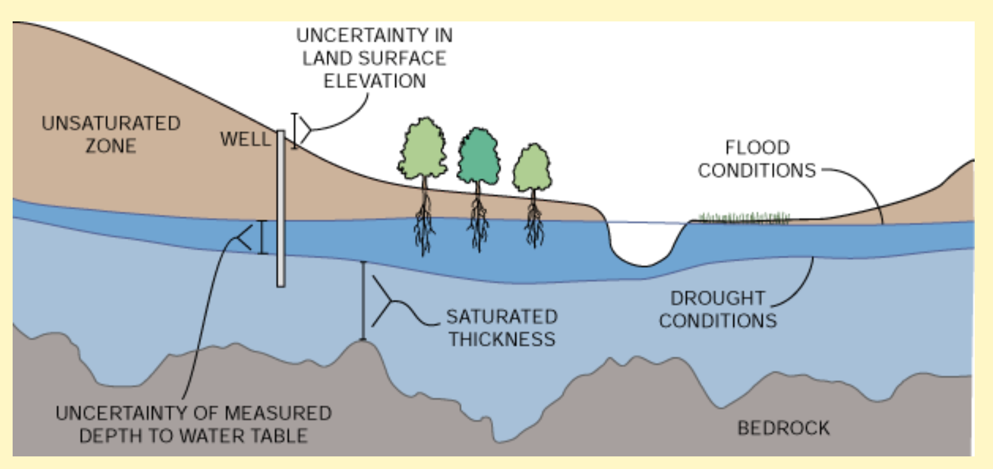

Slide 3
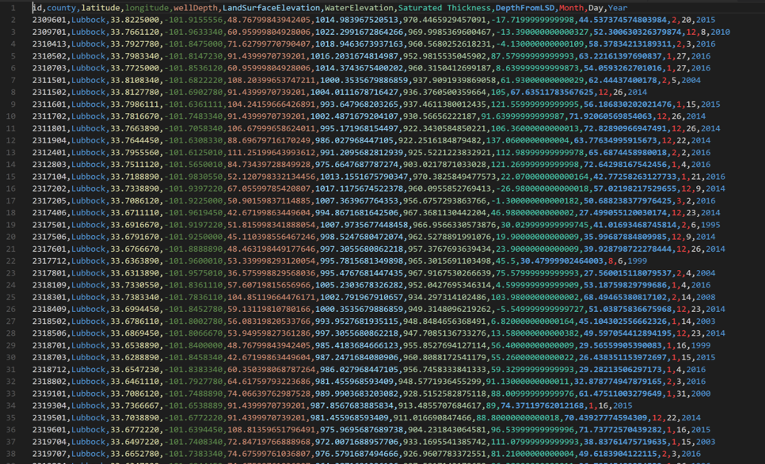
Well Data

Slide 4
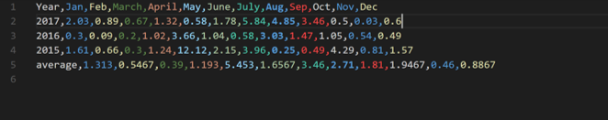
Precipitation

Slide 5
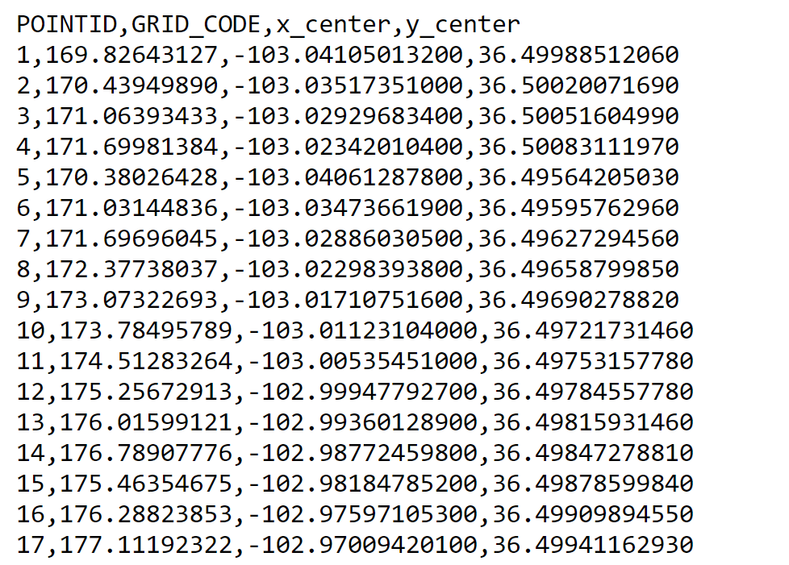
Raster_to_point

Slide 6
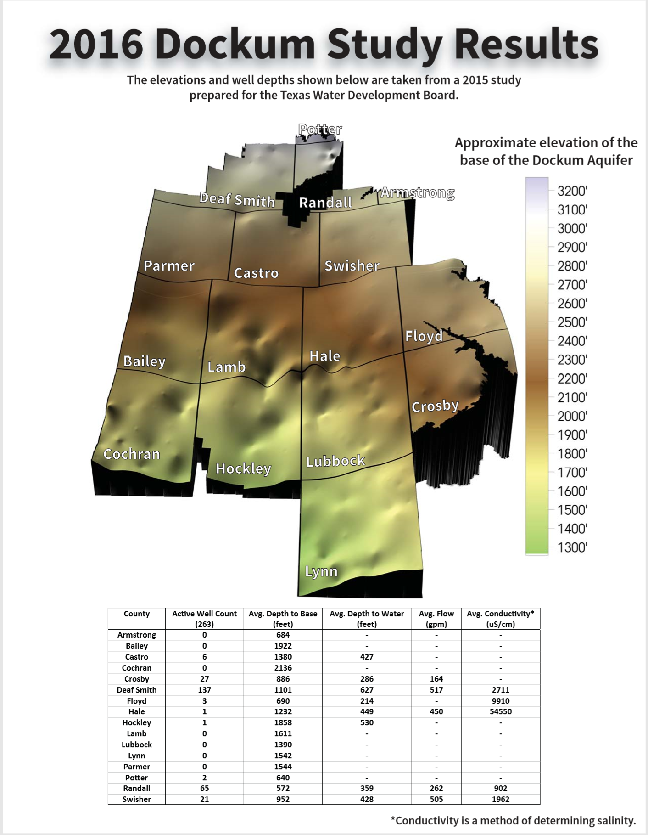
Dockum

Slide 7
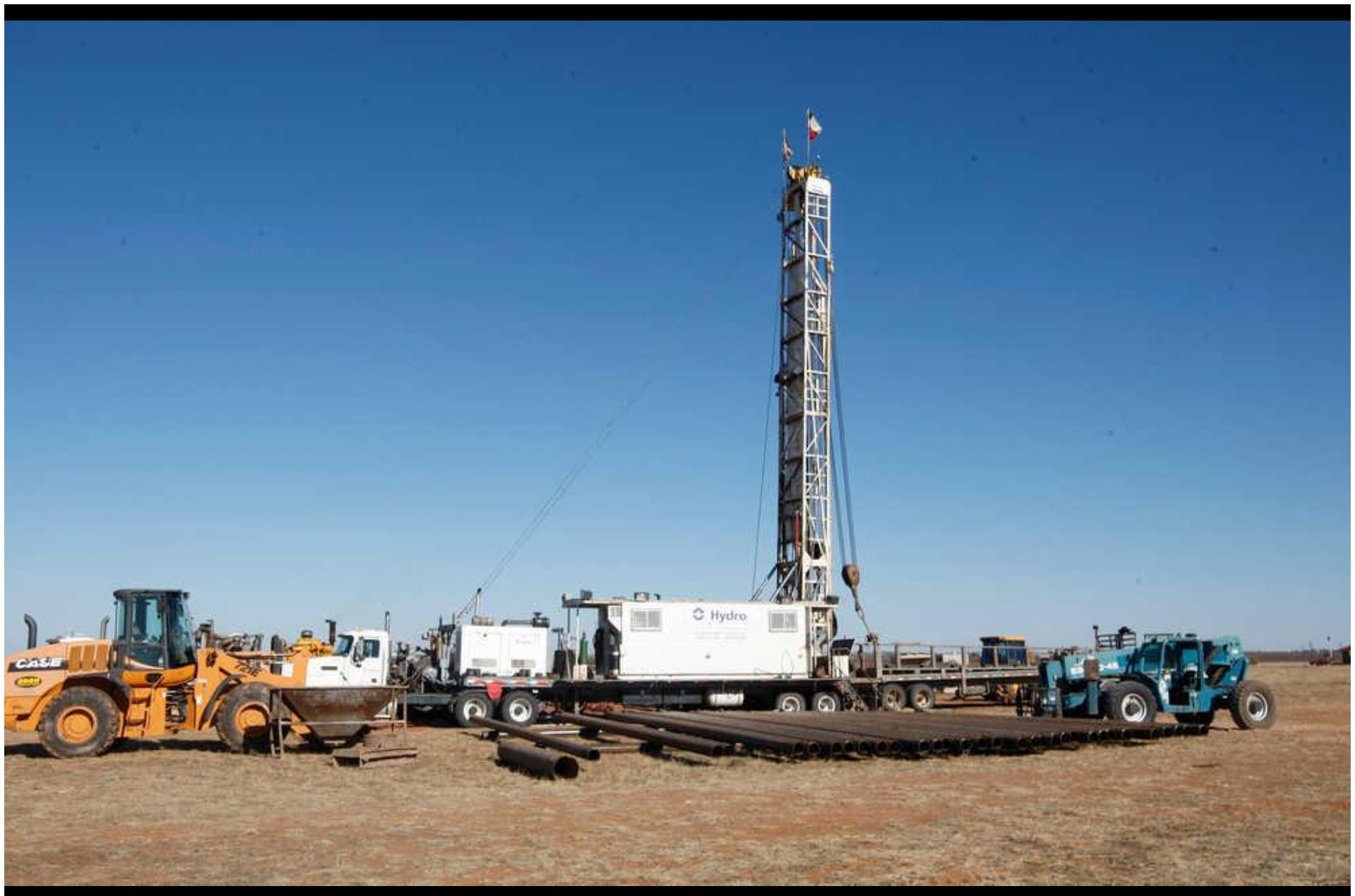
Dockum2

Slide 8
Thank you!
Any questions?

