Slide 1
Webpack: Introduction
2017.07.09

Slide 2
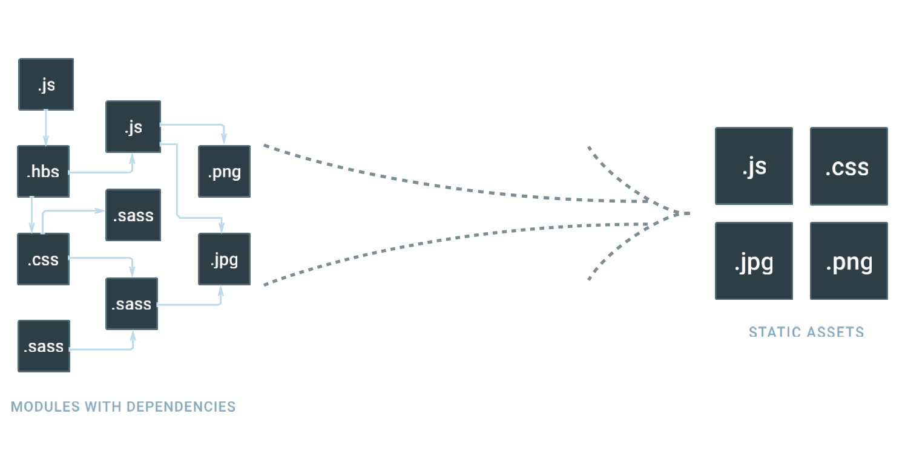

Webpack
Notes:
ITA use only dependency

Slide 3
agenda
1
Introduction
2
Configuration
3
Loaders
4
Plugins
5
Reference

Slide 4
1
Introduction

Slide 5
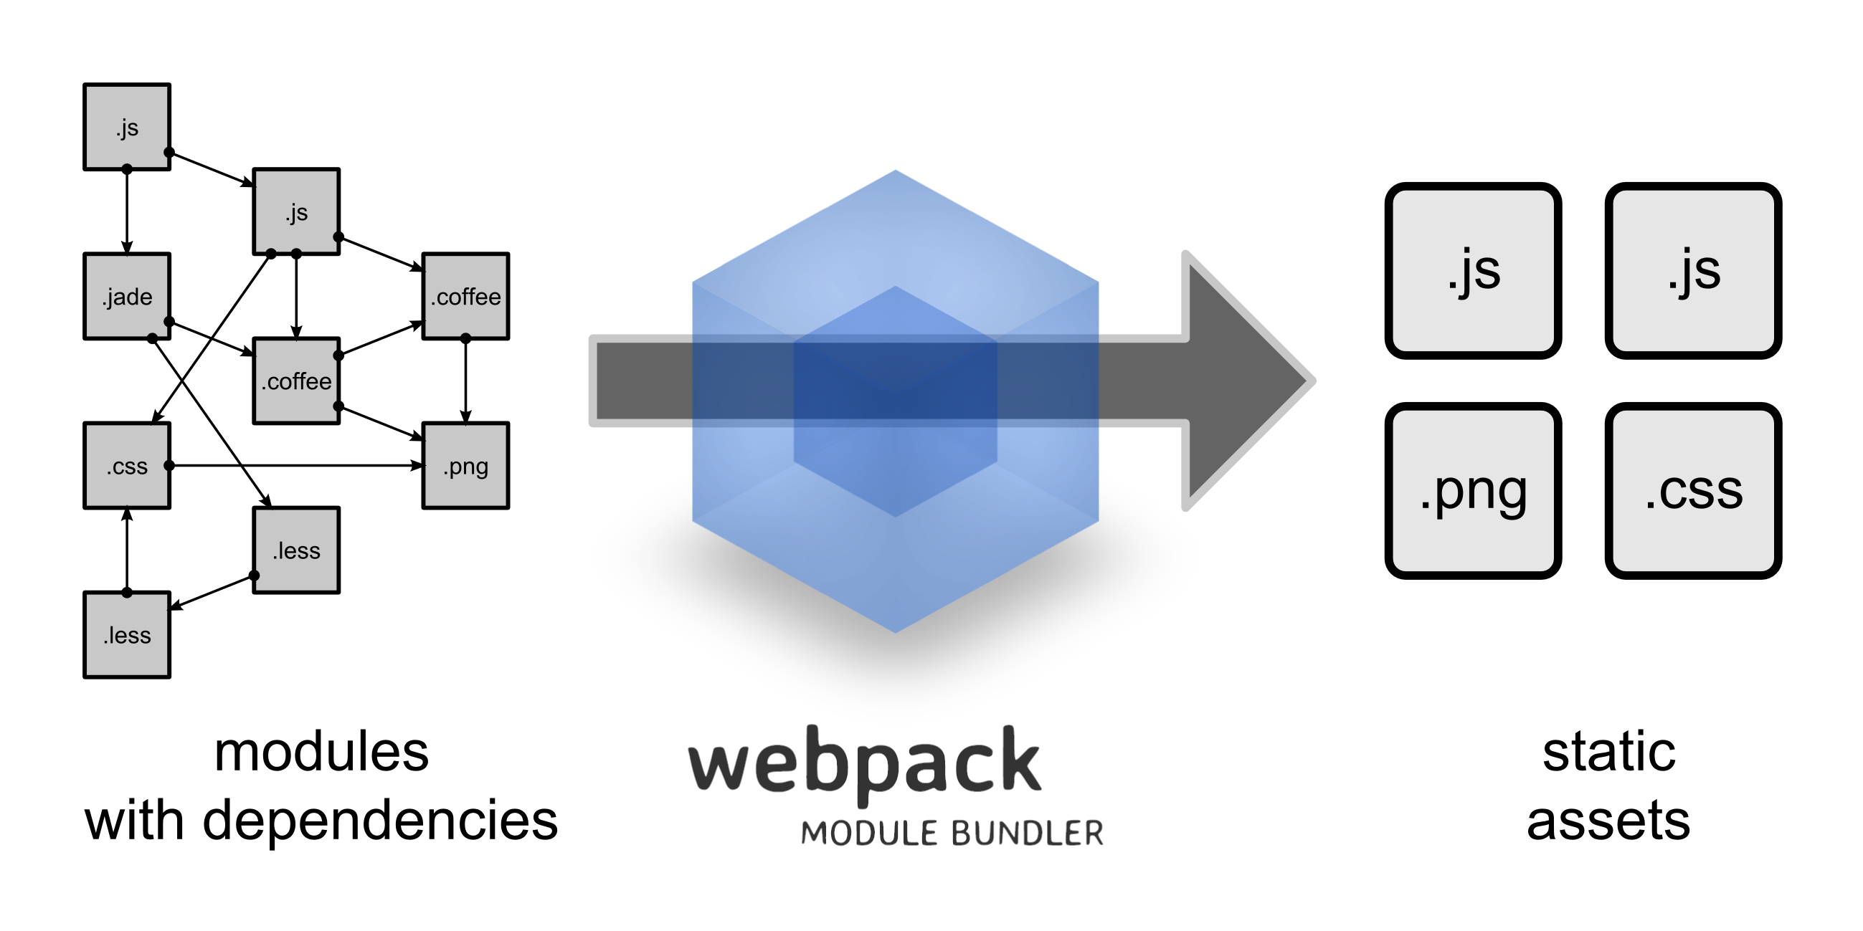
1
Introduction: What is webpack
Notes:
To help cope with this growing complexity, the community came up with different approaches and practices, such as:
The usage of modules in JavaScript, allowing us to divide and organize a program into several files.
JavaScript pre-processors (that allows us to use features today that will be available only in future versions of JavaScript) and compile-to-JavaScript languages (Such as CoffeeScript, for example)

Slide 6
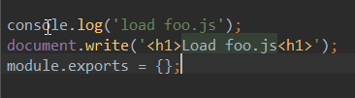

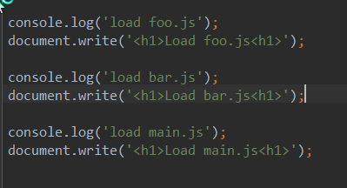
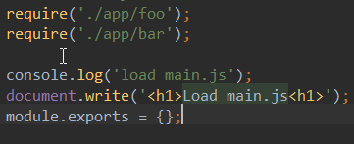
1.1
Introduction: How webpack helps frontend project engineering.
bar.js
foo.js
main.js
webpack
bundle.js
Notes:
Source Code – {webpack compiler} -> Target Code

Slide 7
1.1
Introduction: How webpack helps frontend project engineering.
Parser
Codegen
Abstract Syntax Tree
Source Code
Target Code
Transforms!
Analysis!
Optimizations!
Notes:
Source Code – {webpack compiler} -> Target Code
AST: 抽象语法树

Slide 8
1.2
Introduction: Comparison
Webpack
Requirejs
Browserify
Rollup
Brunch
Prepack
Notes:
插曲:
列出市场上流行的JavaScript 构建工具(无论前端后端)
Webpack
Requirejs
Browserify
Rollup
Brunch
Prepack

Slide 9
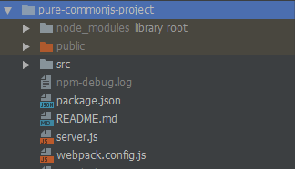
1.3
Get Start with Simple Project
Notes:
Pure-CommonJS-Project
https://github.com/Aquariuslt/Webpack-Revolution/tree/master/pure-commonjs-project
举个例子
1.Copy代码,安装依赖
2.先运行,看看效果
3.逐个文件解释

Slide 10
2
Configuration

Slide 11
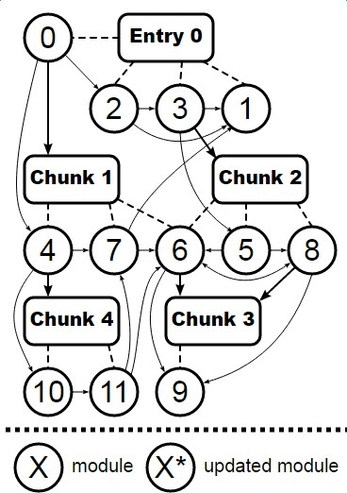
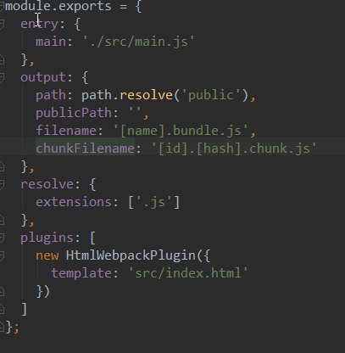
2.1
Sample Configurations
entry
output
resolve
plugins
Notes:
Configuration
此章节主要介绍了 webpack 的配置文件的主要介绍
不要求在该阶段就开始强制知道 配置文件的每个位置,比如context,entry,modules,loaders,plugins 等
只需要知道webpack主要通过配置文件来控制整个构建过程
深化配置文件的重要性
配置文件:
在图中可以看到常见的四个部分
Entry:
官方文档说明:
The point or points to enter the application. At this point the application starts executing. If an array is passed all items will be executed.
一个entry控制了一个构建文件的入口
Output:
官方文档说明:
This option determines the name of on-demand loaded chunk files. See output.filename option for details on the possible values.
Note that these filenames need to be generated at runtime to send the requests for chunks. Because of this, placeholders like [name] and [chunkhash] need to add a mapping from chunk id to placeholder value to the output bundle with the webpack runtime. This increases the size and may invalidate the bundle when placeholder value for any chunk changes.
控制了构建之后输出的文件的目录,路径,等等的控制.
Resolve: (这个不常用到)
Plugins:
官方文档:
The plugins option is used to customize the webpack build process in a variety of ways.
Reference
https://webpack.js.org/configuration/entry-context/

Slide 12
3
Loaders

Slide 13
3.1
Loaders: Introduction
https://webpack.js.org/loaders/
Notes:
webpack enables use of loaders to preprocess files. This allows you to bundle any static resource way beyond JavaScript. You can easily write your own loaders using Node.js.
Loader Lists:
babel-loader
bundle-loader
cache-loader
coffee-loader
coffee-redux-loader
coverjs-loader
css-loader
exports-loader
expose-loader
extract-loader
file-loader
gzip-loader
html-loader
i18n-loader
imports-loader
istanbul-instrumenter-loader
jshint-loader
json-loader
json5-loader
less-loader
mocha-loader
multi-loader
node-loader
null-loader
postcss-loader
raw-loader
react-proxy-loader
restyle-loader
sass-loader
script-loader
source-map-loader
style-loader
svg-inline-loader
thread-loader
transform-loader
url-loader
val-loader
worker-loader
yaml-frontmatter-loader

Slide 14
raw-loader
3.1
Loaders: Popular Loaders under popular Frameworks
babel-loader(babel + babel-preset)
html-loader
file-loader()
url-loader(style-loader)
css-loader
less-loader
vue-loader
ng-template-loader

Slide 15
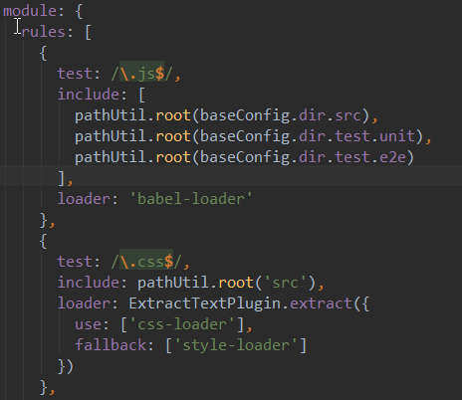
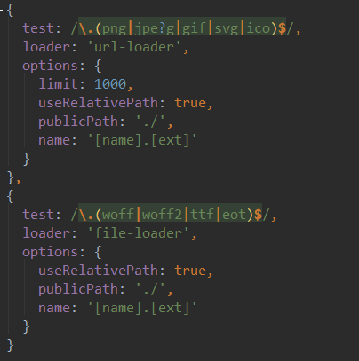
raw-loader
3.1
Loaders: Loader Examples
Notes:
tasks/config/webpack.base.config.babel.js

Slide 16
4
Plugins

Slide 17
4.1
Plugins: Introduction
What can plugins do?
Popular/ High usage plugins?

Slide 18
4.2
Plugins: Introduction
ExtractTextPlugin
HtmlWebpackPlugin
For Development
webpack.HotModuleReplacementPlugin
FriendlyErrorsPlugin
For Production Level
webpack.optimize.CommonsChunkPlugin - avoid load duplicate
webpack.optimize.UglifyJsPlugin - minify JS,CSS

Slide 19
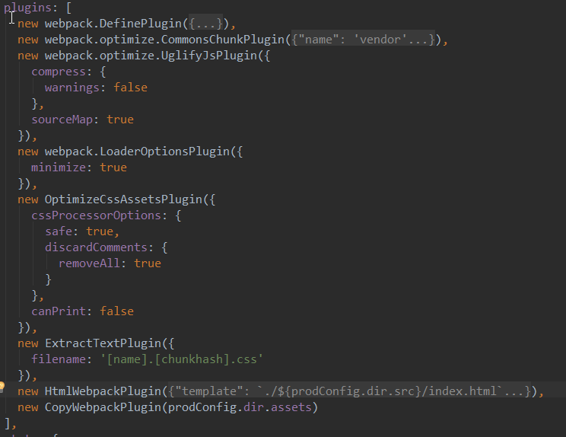
4.2
Plugins: Plugins Example

Slide 20
L
References
Configuration: https://webpack.js.org/configuration/
Loaders: https://webpack.js.org/loaders/
Plugins: https://webpack.js.org/plugins/

