Slide 1
JavaScript Engineering
Background & Road Map
2017.07.06

Slide 2
Toc
1
Engineering Background
2
Road Map of Lessons

Slide 3
1
Engineering Background
Importance of web application develop engineering
Compare with java server side web application
Notes:
1.

Slide 4


1.1
Background: Importance of web application develop engineering
Google found that] the page with 10 results took 0.4 seconds to generate. The page with 30 results took 0.9 seconds. Half a second delay caused a 20% drop in traffic. Half a second delay killed user satisfaction.
Notes:
先做一个引子
1.表明Google证明了网站性能对用户数量的重要性

Slide 5
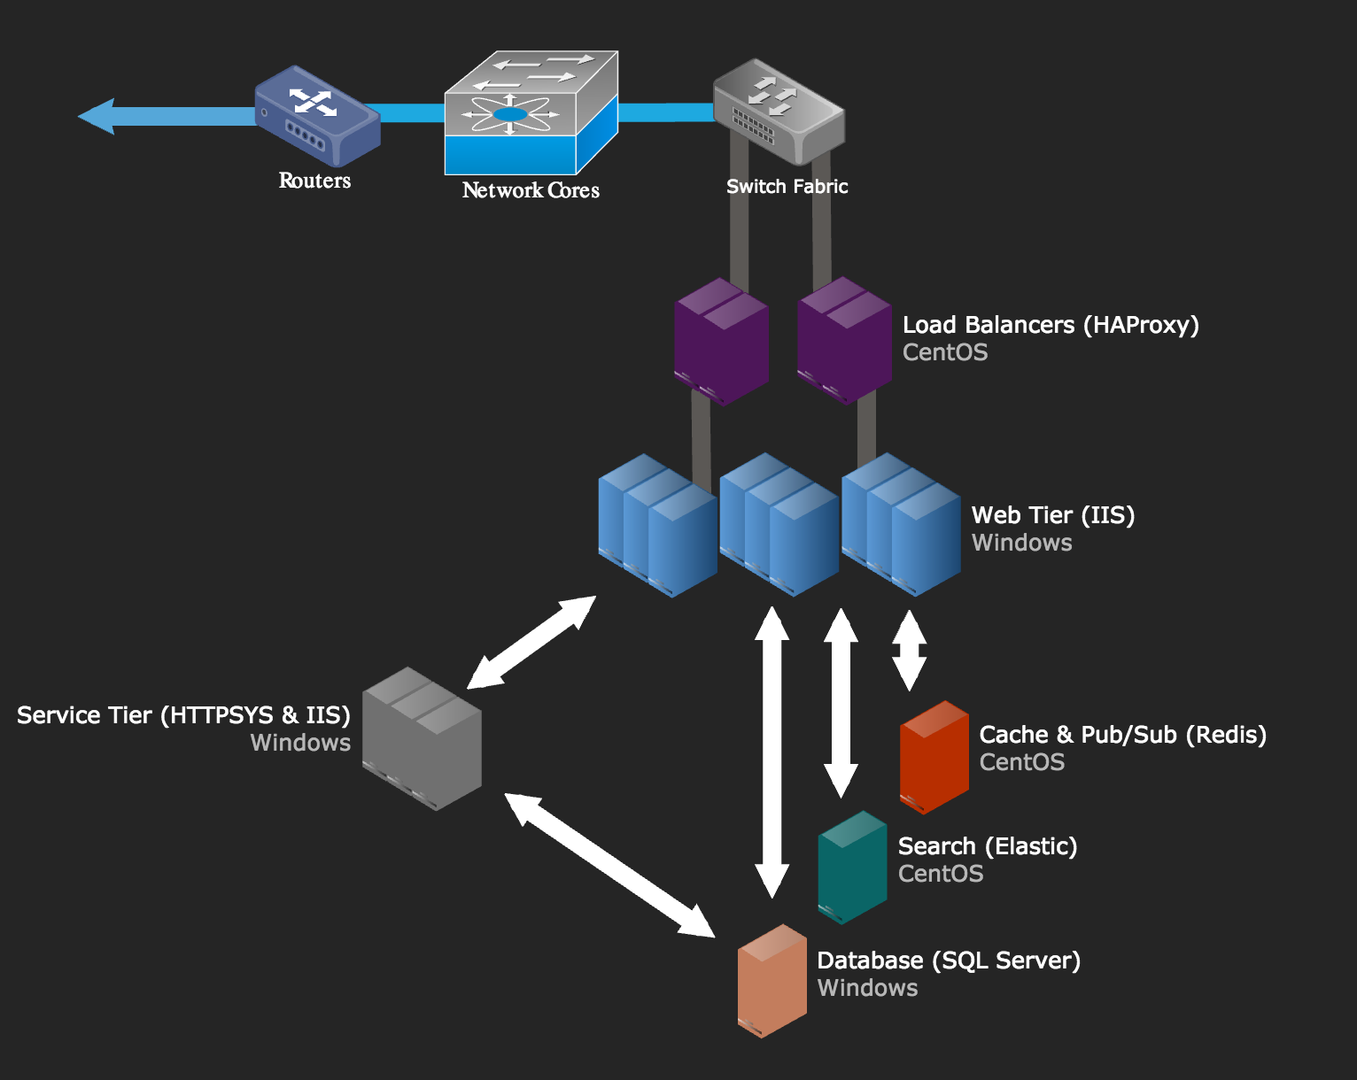
1.1
Background: Importance of web application develop engineering
Stack Overflow: The Architecture - 2016 Edition
Why stackoverflow use 11 servers and 4 load-balance server to serve for over 6M users easily?
Notes:
2.接着上面Google的故事提出一个引子
讲一个故事:
这个故事是从知乎上看到的.
为什么Stack Overflow只需要11台IIS 服务器和4台负载均衡就可以支撑这么大的流量？
至于stackoverflow，我想他们也没有发明什么太多银子弹黑魔法，指数级的提高性能。他们做到的只是：找到了合格的程序员。 这就够了。
https://www.zhihu.com/question/40514188
https://link.zhihu.com/?target=http%3A//nickcraver.com/blog/2016/02/17/stack-overflow-the-architecture-2016-edition/
引出了StackOverflow的Best Practice 经验: 一开始就遵循雅虎的网页性能指导原则

Slide 6

1.1
Background: Importance of web application develop engineering
Put Stylesheets at the Top
Put Scripts at the Bottom
Make JavaScript and CSS External
Minify JavaScript and CSS
Minimize HTTP Requests
Use a Content Delivery Network (server-side)
Reduce DNS Lookups
Add an Expires or a Cache-Control Header (server-side)
Gzip Components (server-side)
…….
Notes:
References:
1.雅虎提出的网站性能优化的14(数不清..)条准则.
https://developer.yahoo.com/performance/rules.html
Yahoo 在2007年提出并总结的网站性能优化准则与实践建议,
虽然是年代有点久远,但是里面提及的经验经久不衰.
先不提及这些建议出现背后的原理.可以先过一下目,了解一下相关名词.
2.前端基础篇: 前端工程与性能优化
https://github.com/fouber/blog/issues/3
3.Google的性能测试工具
https://developers.google.com/speed/pagespeed/

Slide 7
Question:
So, What can engineering help building optimized web application?
Notes:
在提出上面的引子之后:
引出下面一个问题:
既然网站性能很重要.
建设网站的时候,遵循雅虎的网站优化原则很重要.
那么 工程化(JavaScript/前端工程化)要怎么做
才能在建设一个高性能网站应用的过程中发挥作用呢?

Slide 8
1.2
Background: Introduction Engineering in JavaScript
3 Steps in Frontend Engineering.
Main Framework Tech Selection
Build Flow Optimize
JS/CSS Modularize Development
Notes:
这一部分,主要介绍
前端/JavaScript项目工程化在项目中的定位.
中间会分成三个大步骤:
第一阶段：库/框架选型
第二阶段：简单构建优化
第三阶段：JS/CSS模块化开发

Slide 9

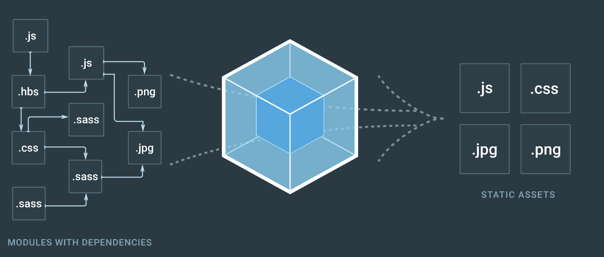
3
Background: Introduction Engineering in JavaScript
Detail in JavaScript engineering build tools.
Put Stylesheets at the Top
Put Scripts at the Bottom
Make JavaScript and CSS External
Minify JavaScript and CSS
Notes:
Gulp
Webpack

Slide 10
2
Road Map of Lessons
JavaScript Modularize Programing
Gulp – Introduction
Webpack – Introduction
Webpack + Gulp + Angular Example (Step by Step)
Notes:
介绍一下Road Map
Ask Dante for help?

Slide 11
2.1
Pre - RequireSuites
Node.js v6 +
Npm / Yarn (if needed, add registry for China network issue)
Git
VSCode
Cmder.
Jetbrains Series IDE

