Slide 1
MongoDB Course
Modeling
Yellow Huang
Ver 2017_06_07

Slide 2
Agenda
1
Data Modeling Concept
2
Date Modeling in MongoDB
3
Samples

Slide 3
1
Data Modeling Concept

Slide 4
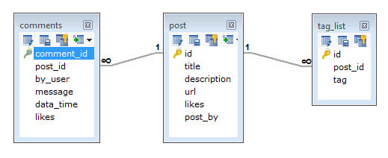
1
Data Modeling Concept
Data Model（RDBMS）
tag
Comment
post

Slide 5
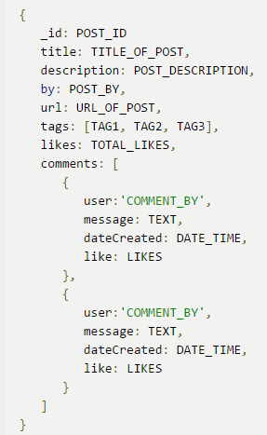
1
Data Modeling Concept
Data Model（MongoDB）
Post
Tag
Comment

Slide 6
1
Data Modeling Concept
RDBMS VS MongoDB
1.Flat Table Structure
2.Cross-record transaction
3.Table Joint
1.Document Structure
2.Single Document transaction
3.No Joint

Slide 7
1
Data Modeling Concept
Advantages of Doc. Model
Data Locality, High Read/Write performance
No Joint, High Scalability
Schemaless, Flexibility, easy to maintain
Easy for human to understand

Slide 8
1
Data Modeling Concept
Consideration
Match Business Requirement?
Data consistency
Performance

Slide 9
2
Date Modeling in MongoDB

Slide 10
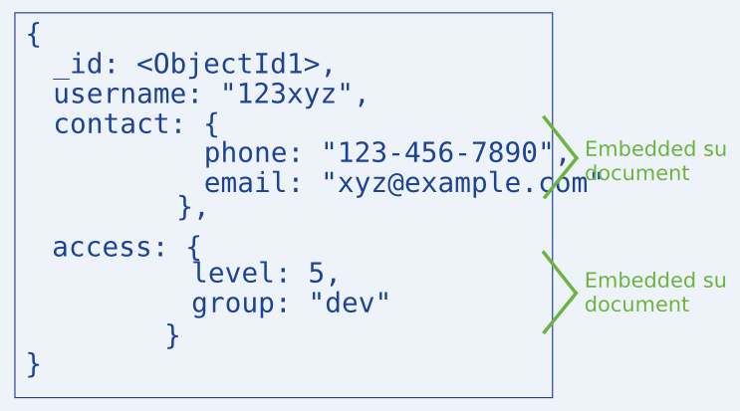
2
Date Modeling in MongoDB
1.Embedded Data
Put related data into one Document

Slide 11
@
https://docs.mongodb.com/manual/indexes/

