Slide 1

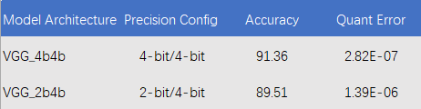
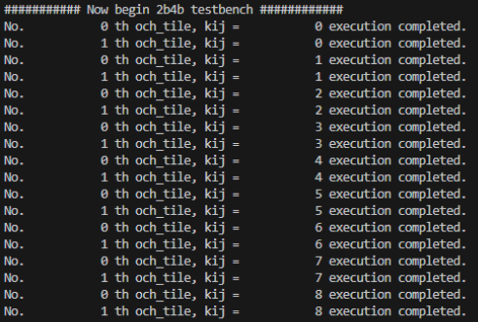
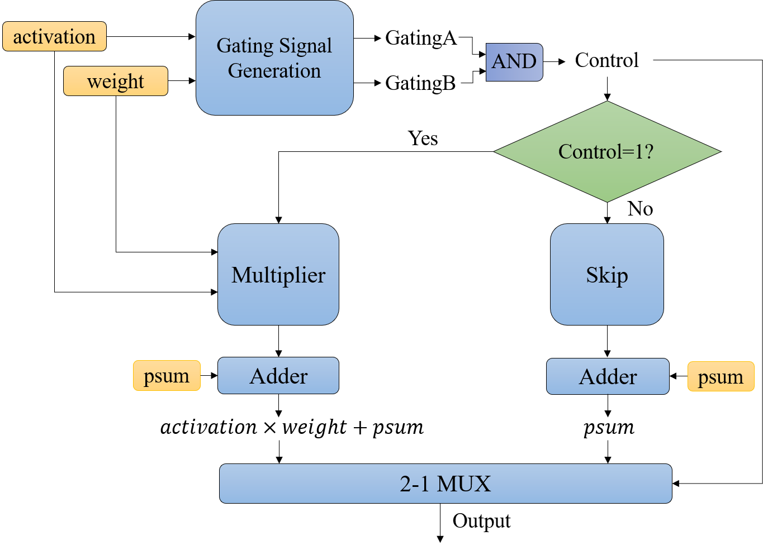
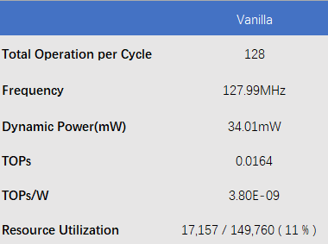
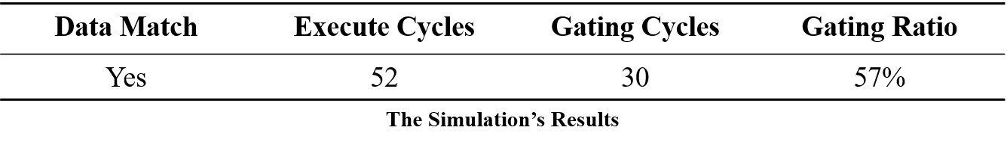
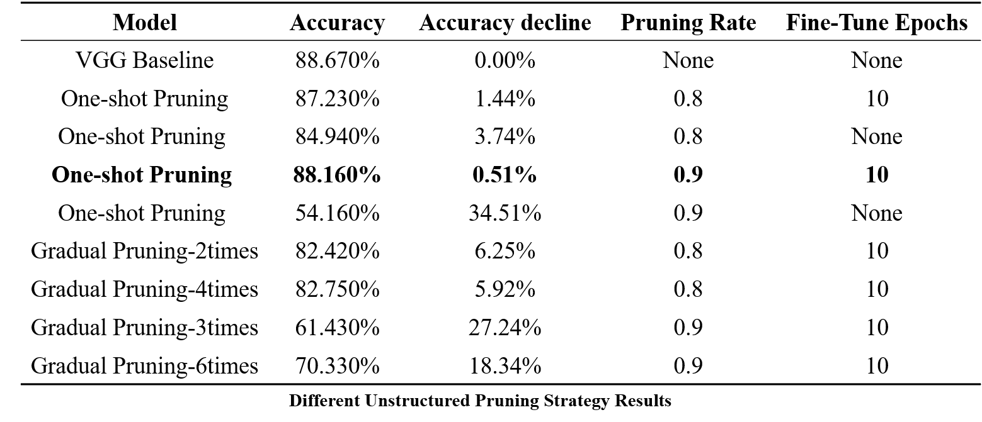
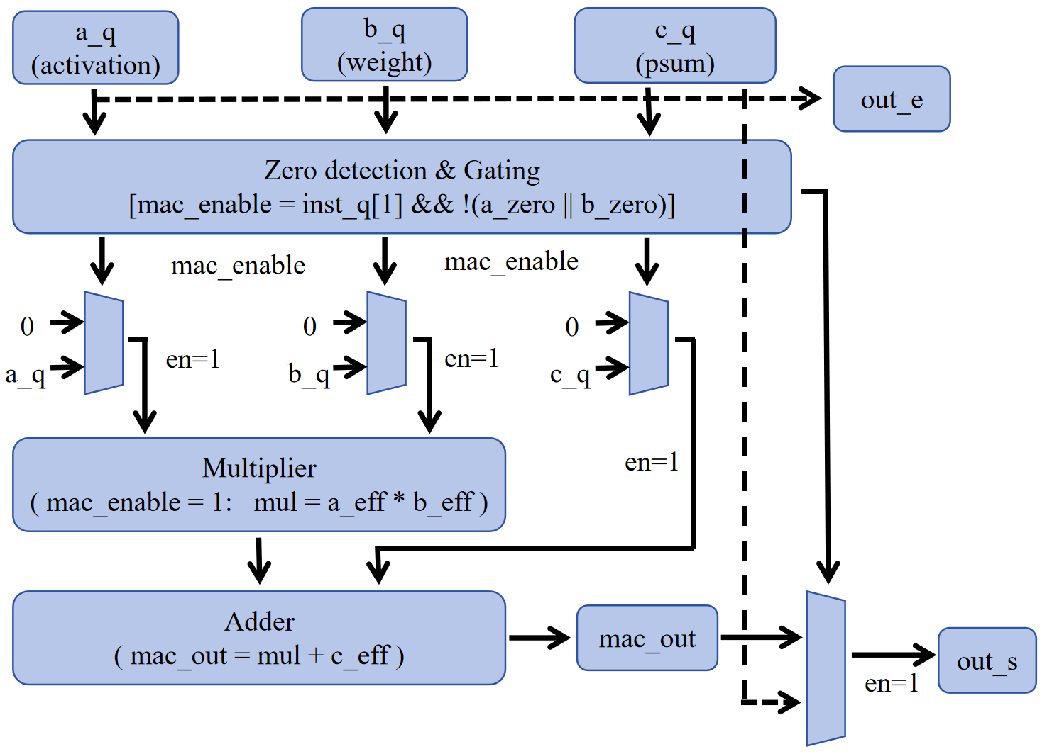
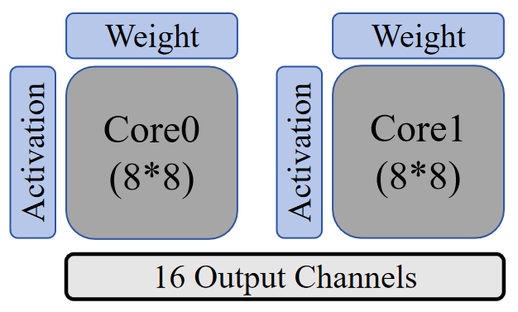

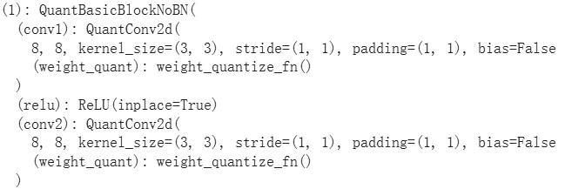
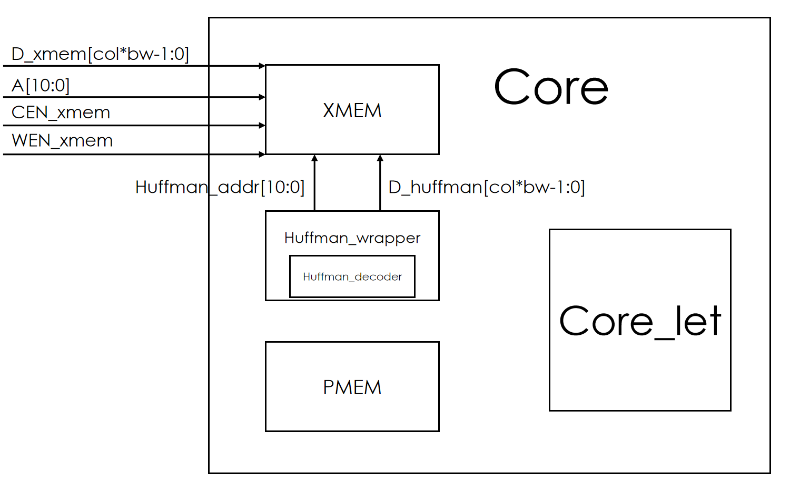
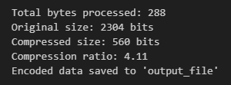
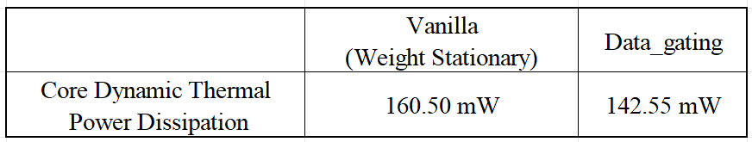
SIMD and Weight-Output reconfigurable 2D systolic array-based AI accelerator and mapping onCyclone IV GX
XYZ Group: Changli Liu, Jiabao Xu, Wenhao Zhao, Xinqi Li, Zijian Li
VGGNet
Alpha2&3: Gating PE
Alpha4: Part2-tiling
We perform 2 types of gating PE
First gates the MAC operation by skipping the multiplier–adder entirely and directly forwarding the partial sum whenever the control signal indicates that the computation should be bypassed.
We perform the tiling for 16*16 and verify all the output channel
FPGA synth
Alpha5: Pruning
We take two strategies based on unstructured pruning: one-shot and gradual pruning.
Second gates the MAC operation by zeroing out the operands through input multiplexers based on the mac_enable signal, so that the multiplier–adder datapath still operates but performs only effective computations.
Alpha6: Testbench dual core
Alpha1: Resnet20-QuantAwareTraining
We reconstructed Layer 2 to include a specialized "Squeeze-Target-Expand" sequence, featuring a central 8-channel convolution without Batch Normalization
Alpha7&8: Huffman encoding&decoder
We evaluate the dynamic power consumption in comparison to the weight-stationary baseline.

