Slide 1
Budget Structure Discontinuity: Unveiling Mechanism and Connecting Logic in China’s Context
Dongmin Yao, Wenhong Yan, and Yongyi Zhu
Center for China Fiscal Development
Central University of Finance and Economics
August 20, 2020

Slide 2
Introduction
Budgeting is one the most powerful tools for leaders to fulfill their responsibilities.
Budget could be either
smooth and gradual: marginal increase or decrease from the base level OR
drastic and disjoint: policy changes are episodic and interrupted
Gradual budget change signals consistent policy, a drastic change implies a shift in the budget maker’s decisional focus. Our focus: structural budget discontinuity.
Change in budget structure reflects the trade-offs in resources allocation
Studies on discontinuous budget generally focus on scales (absolute values or growth)

Slide 3
Introduction
Studies have emphasized that “institutional makeup” (Breunig & Koski, 2006, p. 375) is key to policy discontinuity, explanations include:
political party turnover or party politics (Carter & Jacobs, 2014; Walgrave & Varone, 2008),
shifts in decisional focus among limited issues (Breunig & Koski, 2018), and
different information (Baumgartner & Jones, 2009; Flink, 2015; Jones & Baumgartner, 2005, 2012).

Slide 4
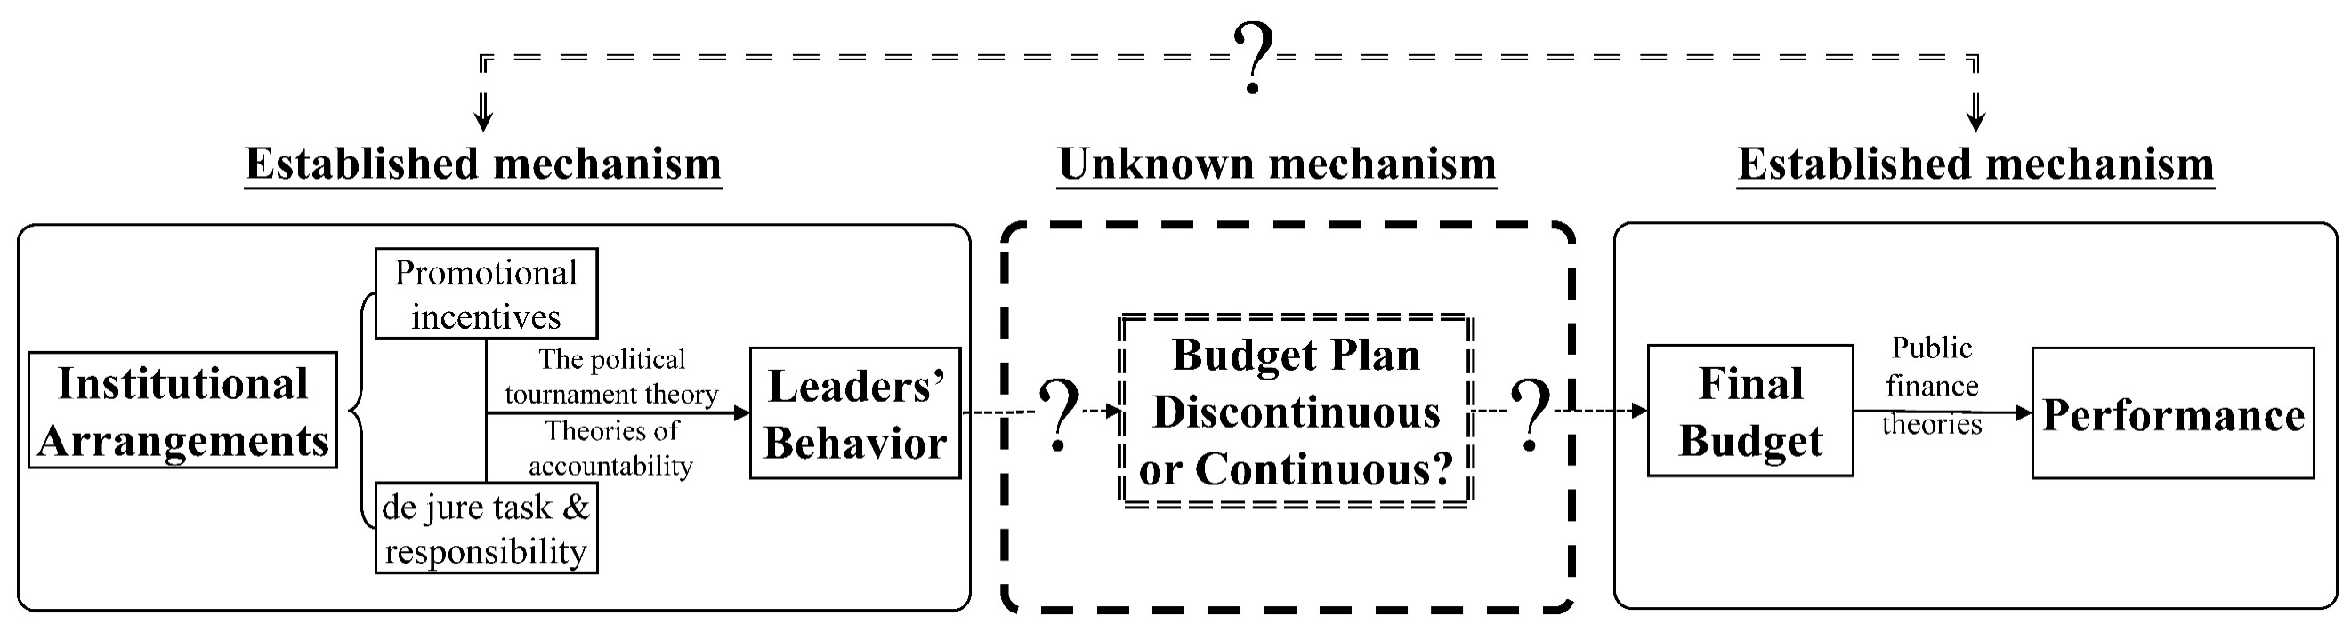
Introduction
However, no studies have addressed structural budget discontinuity in the Chinese context: Top-down centralized unitary political system.
So, we focus on China’s provincial budgeting and seek to explain budget structure discontinuity in the Chinese context.

Slide 5
Literature & institutional background
China’s Budget System & the Sources of Institutional Inertia
Administrative branch: draft budget proposal and execute approved budget
Legislative branch: approve or veto the budget proposal
Budgeting is largely controlled by the administrative branch, specifically,
Provincial Chinese Communist Party Committee Secretary (Party Secretary)
Governor of the provincial government
Define the structure of provincial fiscal expenditure (SPFE) as the proportion of different fiscal expenditures in the total expenditure, and we focus on
(1) economic development;
(2) science, education, culture, and healthcare (SECH); and
(3) public safety

Slide 6
Literature & institutional background
Based on literature, punctuated equilibrium explains large-scale budget changes.
Baumgartner and Jones (1993), Jones and Baumgartner (2005) and Baumgartner et al. (2009) suggest that institutional inertia could cause punctuated equilibrium where “decision-makers under respond to changes”.
Institutional inertia refers to the “stickiness” (Pierson, 2004), which is “some level of resistance” that can be overcome (Jones and Baumgartner, 2005).
As such, the current policy remains static and budget incremental until the push for policy change accumulates to such a high level that outweighs the obstruction created by the institutional inertia.
Two important issues are surrounding institutional inertia in China :
what constitutes institutional inertia?
what goes against the inertia cause changes?

Slide 7
Literature & institutional background
The source of institutional inertia in China:
Wang (2003): cost is the main source of inertia, and the four types of cost are the cost of (1) learning, (2) friction, (3) switching, and (4) structural oscillation.
Sun (2017): path dependency is the cause of China’s institutional inertia.
Xue and Chen (2010): the time value of returns, i.e. switching to new policies will compromise short term return and incur the immediate cost while sticking to old policies means the immediate return and deferred future costs.
We accept these explanation; therefore the more important question is: what goes against the inertia cause changes?

Slide 8
Literature & institutional background
China’s Target-responsibility System and Leaders’ Incentives.

Slide 9
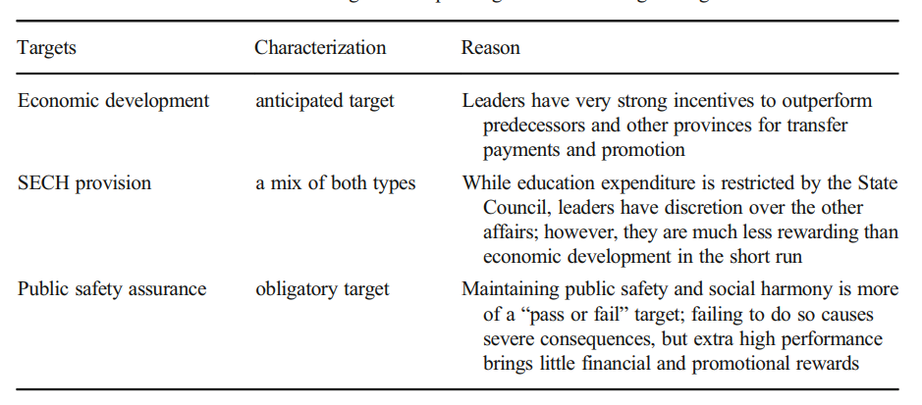
Literature & institutional background

Slide 10
Literature & institutional background
Leaders’ Political Authority and Control over Budgeting
Bureaucratic/positional power: the formal authority, and in the Chinese context it positional power (supervisor-subordinate relationships) is a key source (Zhou et al., 2012). And according to Yang & Pang (2014), we focus on the :
Chinese Communist Party secretary of the provincial Party committee (provincial Party secretary): leads the overall provincial affairs those less involved in budgeting
The governor of the provincial government., and the governor oversees economic affairs and leads the budgeting.
The governor has a greater de jure influence on budgeting than the Party secretary
Informal political authority: Leadership transition and the tenure of newly appointed leaders

Slide 11
Literature & institutional background

Slide 12
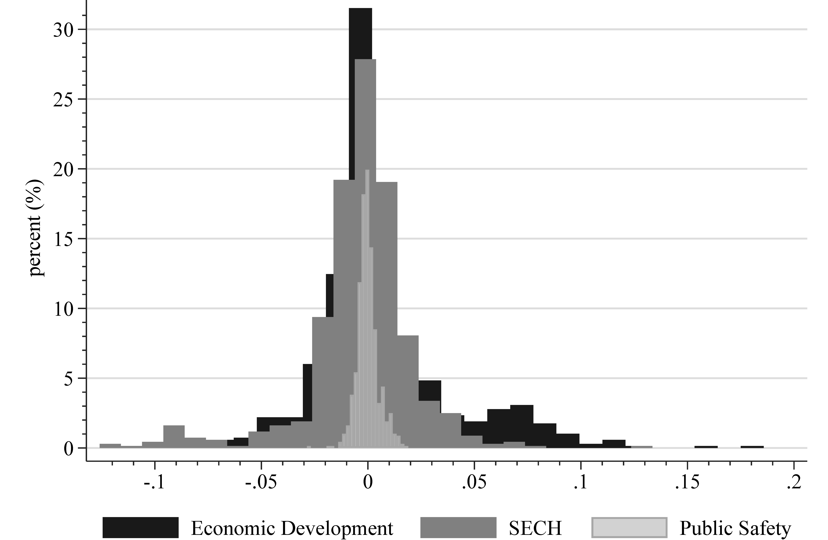
Methodology: identification of discontinuity
We use panel data on 31 Chinese provinces between 1996 and 2018.
 | Economic development | SECH | Public safety
Average SPFE of the current leader | 17.43% | 25.18% | 6.3%
Average SPFE of the predecessor | 13.19% | 25.56% | 6.4%
Average SPFE deviation | 4.24% | -0.38% | -0.1%
No. of occasions the current leaders' SPFE is greater than the predecessors' SPFE | 907 (74.16%) | 606 (49.55%) | 561 (45.87%)
No. of occasions the current leaders' SPFE is greater than the predecessors' SPFE | 1 (0.08%) | 2 (0.16%) | 0 (0%)
No. of occasions the current leaders' SPFE is less than the predecessors' SPFE | 315 (25.76%) | 615 (50.29%) | 662 (54.13%)
total observations | 1223 | 1223 | 1223

Slide 13
Methodology: hypotheses
Hypothesis 1: Leaders’ political missions surrounding the three categories of budget expenditure differ from each other.
fiscal expenditure on economic development: leaders “strive for the upper reaches” and have the incentive to increase the SPFE.
fiscal expenditure on SECH, leaders try to “approaching the average”
fiscal expenditure on public safety, leaders “avoiding big changes”
Hypothesis 2: Leaders use their political authority to overcome institutional inertia, which obstructs them from achieving political missions, causing budget discontinuity found in economic development and SECH.

Slide 14


Variables & data
 | Variables | N | Mean | SD | Min | Max
Governor | BDI (economic development) | 496 | 0.682 | 1.096 | -0.455 | 13.065
 | BDI (SECH) | 496 | 0.015 | 0.169 | -0.434 | 0.837
 | BDI (public safety) | 496 | -0.039 | 0.130 | -0.396 | 0.562
 | Tenure | 496 | 2.960 | 1.847 | 1.000 | 10.000
 | Age | 496 | 58.038 | 3.854 | 45.000 | 65.000
 | Non-local | 496 | 0.435 | 0.496 | 0.000 | 1.000
Party secretary | BDI (economic development) | 490 | 0.674 | 1.033 | -0.424 | 9.543
 | BDI (SECH) | 490 | 0.002 | 0.159 | -0.488 | 0.599
 | BDI (public safety) | 490 | -0.028 | 0.142 | -0.383 | 0.642
 | Tenure | 496 | 3.234 | 2.234 | 1.000 | 14.000
 | Age | 496 | 59.96 | 4.040 | 47.000 | 70.000
 | Non-local | 496 | 0.722 | 0.449 | 0.000 | 1.000
Political mission | DEV (economic development) | 496 | 0.096 | 0.346 | -0.755 | 1.998
 | DEV (SECH) | 496 | 0.209 | 0.189 | 0.001 | 1.145
Provincial- level control variables | Urbanization rate | 496 | 0.514 | 0.149 | 0.201 | 0.896
 | Provincial CPI | 496 | 1.026 | 0.018 | 0.977 | 1.101
 | Provincial GDP (log-transformed) | 496 | 9.134 | 1.163 | 5.221 | 11.49
 | Gross industrial output (log-transformed) | 496 | 8.617 | 1.381 | 4.025 | 11.09
 | The primary industry growth rate (previous year = 1) | 496 | 1.042 | 0.028 | 0.864 | 1.128
 | The secondary industry growth rate (previous year = 1) | 496 | 1.124 | 0.053 | 0.923 | 1.349
 | The tertiary industry growth rate (previous year = 1) | 496 | 1.110 | 0.025 | 1.025 | 1.220
 | Output proportion of the secondary industry | 496 | 0.458 | 0.087 | 0.186 | 0.701
 | Output proportion of the tertiary industry | 496 | 0.438 | 0.090 | 0.283 | 0.811
Budget discontinuity intensity
Deviation from the last year’s national average

Slide 15
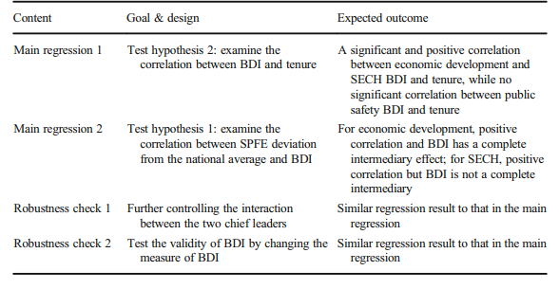
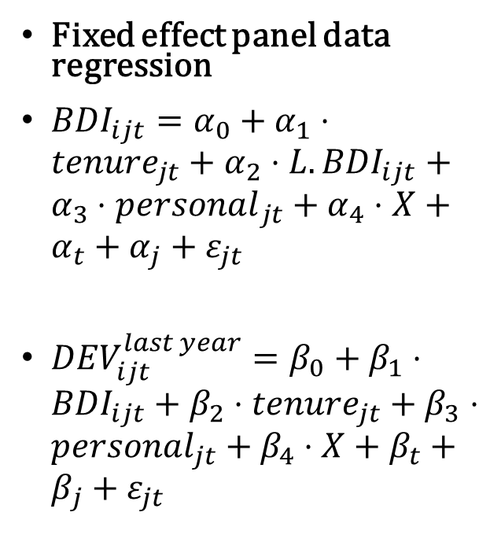
Empirical strategy
Fixed effect panel data regression
${BDI}_{ijt}=α_{0}+α_{1}⋅{tenure}_{jt}+α_{2}⋅{L.BDI}_{ijt}+α_{3}⋅{personal}_{jt}+α_{4}⋅X+α_{t}+α_{j}+ε_{jt}$
${DEV}_{ijt}^{last year}=β_{0}+β_{1}⋅{BDI}_{ijt}+{β_{2}⋅{tenure}_{jt}+β}_{3}⋅personal_{jt}+β_{4}⋅X+β_{t}+β_{j}+ε_{jt}$

Slide 16
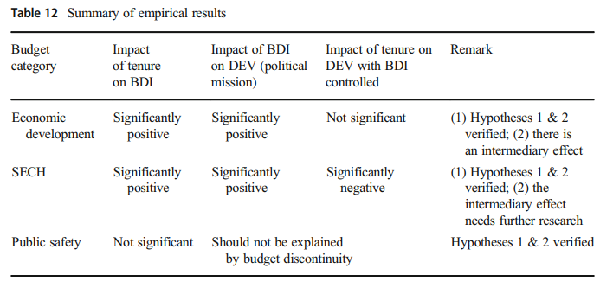
Results

Slide 17
Conclusion
Contributions
Verify that budget discontinuity exists in Chinese provinces, specifically, on economic development and SECH expenditure
We find that the confrontation between leaders’ political motivation and institutional inertia leads to budget discontinuity, and we contextualize it in China
By constructing this mechanism of budget discontinuity, we better connect institutional arrangements, budget planning, and fiscal expenditure performance in the Chinese context
Limitations
Due to data limitations, we could not analyze expenditure in greater detail. Further exploration can be done if data for sub-provincial levels and more detailed and more available
our empirics cannot rule out the possibility of reverse causality that increases to the budget lead to longer tenures. Further exploration needs to tackle this causality issue.

Slide 18
Thank You

