Slide 1


Interactive Governance between and within Governmental Levels and Functions: A Social Network Analysis of China’s Case against COVID-19
Dongmin YAO Jing LI Yijing CHEN Qiunan GAO Wenhong YAN
姚东旻 李 静 陈翊婧 高秋男 严文宏
September 2021

Slide 2
Background
Literature review
China’s institutional background and the validity of selecting China as a case
The construction of the network
Confirmation of dominating interaction patterns
Theoretical development of MLG interaction patterns and practical implications
Conclusion
Content

Slide 3
1. Background
By August 9, 2021, the WHO has announced that worldwide have reported 200,840,180 confirmed COVID-19 cases with 4,265,903 deaths. → Requires the joint effort of pharmaceutical and nonpharmaceutical interventions (NPI)
Most studies have focused on evaluating the effects of NPIs:
survey how NPIs influence people’s behavioral patterns (Cooper et al., 2020; Jiao et al., 2020)
assess how NPIs affect the proliferation and health outcome of COVID-19 (Kraemer et al., 2020; Pan et al., 2020)
comment on some aspects of NPIs (Bonaccorsi et al., 2020; Zaremba et al., 2020).
However, literature has understudied the contextual aspect of NPIs, i.e., how institutional arrangements/governance translate into anti-COVID-19 practice.
The existing literature cannot reveal how government agencies are organized to implement the emergency response.

Slide 4
1. Background
This study introduces the multi-level governance (MLG) as the theoretical foundation, upon which this study constructs an analytical framework that employs social network analysis (SNA) as the primary research method.
The study focuses on China to analyze how an interactive governance system, comprising multiple levels and functions, responds to COVID- 19 during the Wuhan Lockdown.
By doing so, the study aims at identifying intergovernmental interaction patterns and sorting out which pattern should be applied by which governmental levels/functions under what circumstance

Slide 5
2. Literature Review
(1) Multi-level governance (MLG) in emergency/crisis studies
Conventionally, western countries use MLG to deal with emergencies, such as:
Terrorist attacks(Hu, Knox, & Kapucu, 2014).
Natural disasters (Kapucu, 2008; Kapucu, Augustin, & Garayev, 2009).
Climate issues (Bache et al., 2014; İrepoğlu Carreras, 2019).
Public health emergencies (Bache, Bartle, Flinders, & Marsden, 2014; Bache & Flinders, 2015; Benz, 2000; Brattberg & Rhinard, 2011).
MLG theory first appeared in the study of “how the EU was performing as a polity and machinery”(Kohler-Koch & Eising, 1999, p. xii; Marks, 1993):
MLG is defined as a governance system within which power is dispersed across government levels vertically and across sectors horizontally (Bache & Flinders, 2004; Enderlein et al., 2010; Hooghe & Marks, 2003).

Slide 6
2. Literature Review
(1) Multi-level governance in emergency/crisis studies
Type I：A Type I framework is “system-wide, where functions are bundled, and the power-sharing is stable” (Hooghe & Marks, 2003, p. 4); the accountability can be tracked clearly, and governmental levels and entities are multiple but limited.
Type II：Type II MLG is derived from neoclassical political economics and the public choice theory (Blatter J., 2001; Casella & Weingast, 1995; Frey & Eichenberger, 1999), where independent jurisdictions formed by multiple levels and entities interact, collaborate, and perform specific functions respectively.
However, MLG types have failed in response to COVID-19 (Anderson, Mckee, & Mossialos, 2020; Jalali, Peterson, & Galbadage, 2020; Tang & An, 2020; Williams, 2020), WHY?
Type I：Type I MLG mainly exists in a stable vertical system. It is more suitable for dealing with conventional policy problems, so it is unlikely to be efficacious because COVID-19 is so unknown and unbounded. E.g., USA→Each state work independently without much coordination
Type II： Type II MLG is usually in a flexible system; However, the transaction costs for coordinating multiple jurisdictions may exceed the benefits brought by the flexibility. E.g., EU→ flexible and usually solve problems through coordinated policy outputs; However, coordinating NPIs at the EU level is costly, member states adopt "uncoordinated and sometimes competitive" strategies

Slide 7
2. Literature Review
(2) Social network analysis: the tool facilitating the search of alternatives to MLG
Many MLG studies have used social network analysis (SNA) to interpret the intercommunication and collaboration among various government agencies:
SNA : It describes the network structure with nodes and edges connecting them, which reflect the interaction of social relationships.
In a social network, the interaction between actors can be expressed as a relationship or pattern, reflecting the social structure of the network.
We reveals the interactive relationship formed by different government departments by fighting COVID-19 based on policy documents.

Slide 8
3. Why China？
Internal Validity.
Rigorous lockdowns or restrictions bring the massive domestic spread: the Wuhan lockdown “decreased the reproduction number to 0.28 and the total infections in Wuhan by 96.0%” (Hao et al., 2020) and “delayed the arrival of COVID-19 in other cities by 2.91 days” (Tian et al., 2020).
China has also maintained low levels of confirmed and mortality cases relative to its population, ranking the sixth- and seventh-lowest per capita confirmed and mortality cases
One of the first countries to enter a period of full-scale economic recovery
External Validity.
Practical: China’s multi-functional and multi-level characteristics can be extrapolated to many other countries. In this sense, practical suggestions proposed by this study based on China’s levels and functions can be extrapolated to that of other countries.
Methodological: this study uses the MLG and SNA framework to construct and study the intergovernmental interaction network. The method of this study can be replicated in other countries regardless of the country’s anti-pandemic performance or its institutional background.

Slide 9
4. Descriptive analysis of the overall network
(1) Time window :
Our networks are constructed based on 911 government documents released by the central, Hubei provincial, and Wuhan local governments and their 182 subordinate departments, from the beginning (January 23, 2020) to the end (April 8, 2020) of the Wuhan Lockdown.
We divide the 76-day lockdown period into five stages based on the progression of COVID-19.
Stage I (Jan 23-Feb 4) : China's initial response to COVID-19
Stage II (Feb 5-Feb 17) : the pandemic peak
Stage III (Feb 18-Mar 1) : the turning point of pandemic control
Stage IV (Mar 2-Mar 20): China contained the rapid spread of the coronavirus
Stage V (Mar 21-Apr 8): China progress toward normalization

Slide 10
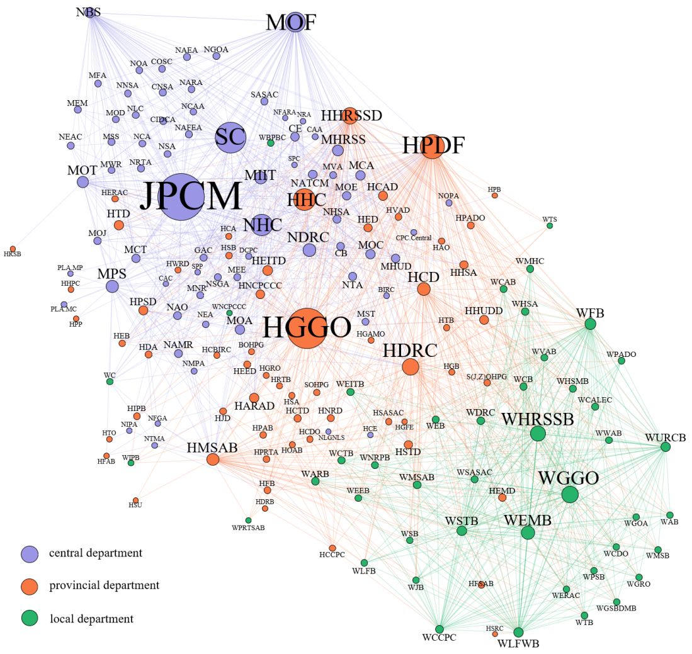
4. Descriptive analysis of the overall network
Figure 1 Community structure in the vertical social network as of April 8
Figure 1 Community structure in the vertical social network as of April 8

Slide 11
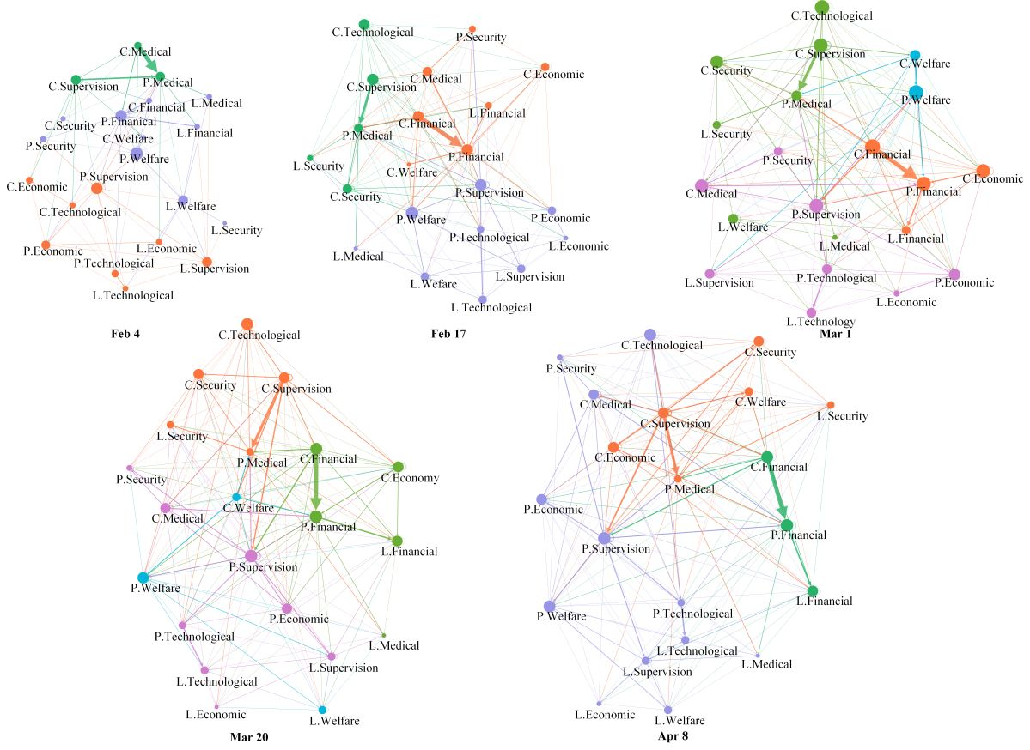

Slide 12
4. Descriptive analysis of the overall network
Figure 1 Community structure in the vertical social network as of April 8

Slide 13
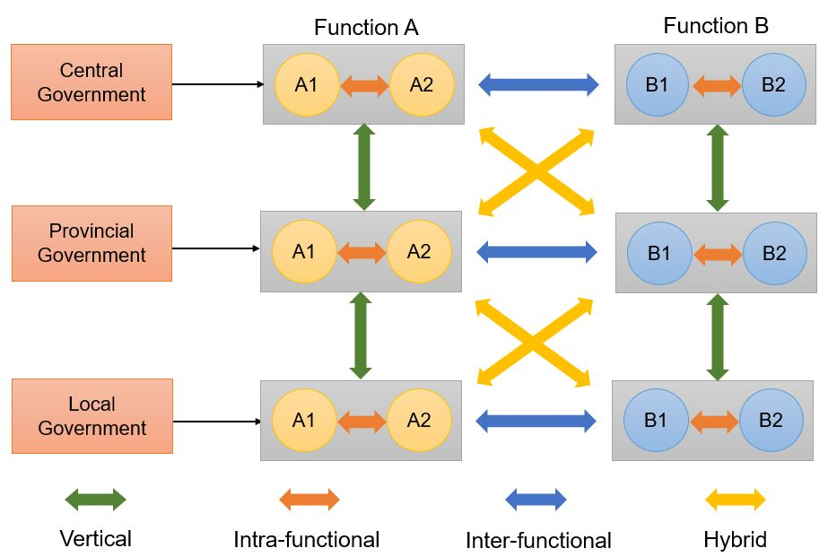
4. Descriptive analysis of the overall network

Slide 14
4. Descriptive analysis of the overall network
Figure 1 Community structure in the vertical social network as of April 8

Slide 15
5. Confirmation of dominating interaction patterns
Table 1 Dominating intergovernmental interaction patterns in the vertical network
Function | Level | Stage I | Stage II | Stage III | Stage IV | Stage V
Finance | central | V (0.500) | V (0.563) | V (0.490) | V (0.449) | V (0.513)
 | provincial | V (0.367) | V (0.489) | V (0.505) | V (0.508) | V (0.526)
 | local | V (0.500) | V (0.435) | V (0.486) | V (0.435) | V (0.431)
Medical | central | V (0.727) | H (0.625) | H (0.491) | H (0.523) | H (0.479)
 | provincial | V (0.587) | H (0.790) | H (0.823) | H (0.824) | H (0.810)
 | local | VH (0.364) | VXH (0.333) | VXH (0.333) | H (0.438) | XH (0.368)
Technical | central | X (0.500) | H (0.429) | X (0.517) | X (0.545) | X (0.511)
 | provincial | V (0.385) | V (0.370) | V (0.382) | V (0.375) | V (0.440)
 | local | VH (0.444) | X (0.409) | V (0.440) | V (0.414) | V (0.441)
Security | central | H (0.500) | H (0.516) | H (0.444) | XH (0.410) | X (0.457)
 | provincial | X (0.625) | H (0.450) | H (0.385) | X (0.393) | X (0.438)
 | local | X (1.000) | H (0.600) | H (0.619) | H (0.667) | H (0.621)
Welfare | central | VH (0.375) | H (0.588) | H (0.425) | H (0.435) | XH (0.467)
 | provincial | XH (0.357) | H (0.455) | H (0.457) | H (0.471) | H (0.438)
 | local | X (0.565) | X (0.538) | X (0.636) | X (0.474) | X (0.480)
Supervision | central | HX (0.424) | H (0.643) | X (0.416) | X (0.426) | X (0.479)
 | provincial | X (0.577) | X (0.550) | X (0.411) | X (0.418) | X (0.438)
 | local | X (0.533) | X (0.409) | X (0.391) | X (0.389) | X (0.519)
Economic | central | XO (0.364) | H (0.684) | H (0.533) | H (0.440) | H (0.446)
 | provincial | X (0.357) | H (0.375) | XH (0.333) | H (0.488) | X (0.477)
 | local | X (0.556) | VXH (0.333) | VH (0.375) | XH (0.455) | X (0.500)

Slide 16
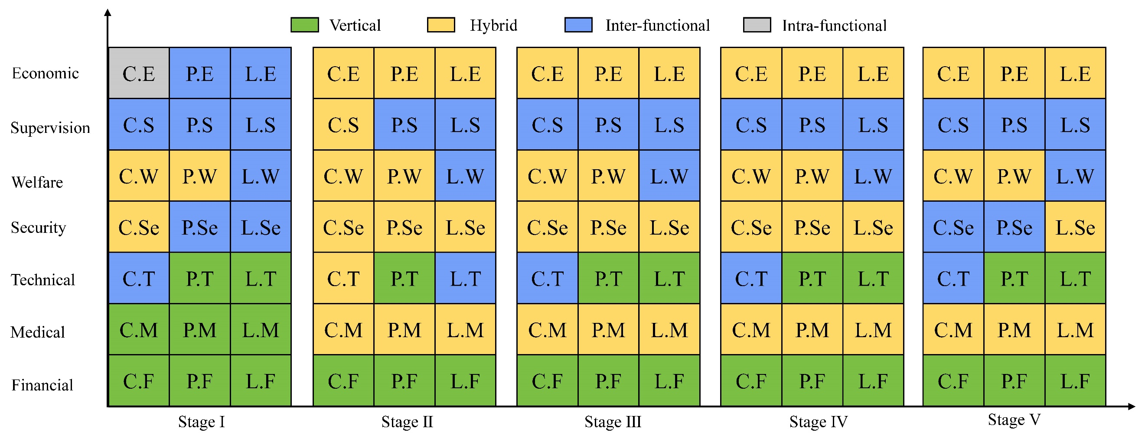
5. Confirmation of dominating interaction patterns
Figure 3 Distribution of intergovernmental interaction patterns in the vertical social network
Note: C, P, L represent central, provincial, and local governments. C.F is the acronym for central financial function.

Slide 17
5. Confirmation of dominating interaction patterns
Vertical interaction is predominant among financial departments at all levels and stages.
Inter-functional interaction is typical among supervision departments almost at all levels and stages.
The hybrid pattern prevails among medical, security, welfare, and economic functions.

Slide 18
5. Confirmation of dominating interaction patterns
Table 2: Network distribution and interaction patterns of functions
Functional departments | Dominating Level | Dominating Stage | Dynamic changes of five stages | Interaction Pattern
Economic | Central & Provincial | Stage Ⅴ | Incremental | Hybrid
Supervision | Central & Provincial | Stage Ⅴ | Incremental | Inter-functional
Welfare | Central & Provincial | Stage Ⅳ | Inverted U-shape | Hybrid
Security | Central & Local | Stage V | Incremental | Hybrid
Technical | Provincial & Local | Stage V | Incremental | Vertical
Medical | Central Provincial | Stage Ⅰ Stage Ⅴ | U-shape | Hybrid
Finance | Central Provincial | Stage Ⅴ Stage Ⅱ | Incremental Fluctuant | Vertical Intra-functional

Slide 19
6. Practical implications for COVID-19 response
Our research attempts to propose a more general response plan for the modern organization, rather than a summary of a practical experience only appliable to a particular country's political system.
First, governments from the central to provincial and local levels are responsible for mobilizing many financial resources vertically for effective pandemic response.
Second, when faced with an unpredictable public health crisis such as COVID-19, only an integrated department has the organizational capabilities to mobilize sufficient resources horizontally to contain it.
Third, the anti-pandemic NPIs require the total mobilization of inter-hierarchical (within & between levels) and inter-functional (within & between functions) resources by multi-level governments.

Slide 20
Thank you for your attention

