Slide 1
CHAPTER 1: INFORMATION AND DATABASE SYSTEM
Chapter Outline:
  1.1 from Information to Data
  1.2 Database System
  1.3 Database Management System (DBMS)
  1.4 History of Data management

Slide 2
1.1 Information and Data
We are living in a “world of INFORMATION”
What is Information?
  Hard to get a perfect definition.
  In a easier but informal way:
  Information can be defined as knowledge or idea that is derived from study, experience, about events or things.

Slide 3
Information media data
Information need to be represented so that it can be process by human being, which may be called media
what human can sense:
  Sound, Text, Graphics, ……
Most traditional media can be transformed into bits or symbols and therefore becomes easier to be manipulate by computer.(data)

Slide 4
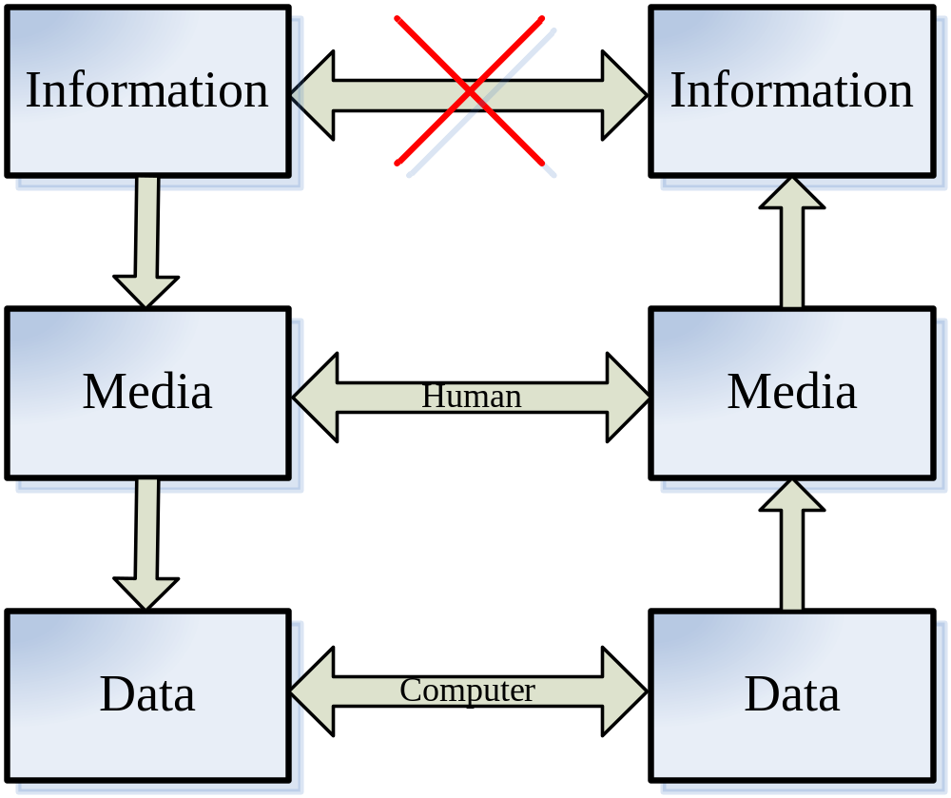
Relationships

Slide 5
The characteristics of Information
Facts: (monotonically Increasing) more and more storage devices are required to store ever growing volume of information:
  Info. is generated from almost everything daily.
Facts: (Infinitely Replicable) copy and paste:
  It can be shared with others without losing anything.
Facts: (Derivation) related information will generate new information
  With more people involved, more information is obtained and new information is generated.
Information is different from “material”, because of the three characteristics. data therefore inherits these characteristics

Slide 6
Database System
Data is increasing and need storage and processing techniques.---database system
A Database System is composed of a database,data model as well as a set of software capable of managing the database called DBMS.

Slide 7
DATABASE
Database is a collection of data with three properties:
  It matches some aspects of the real-world.
  It is created for some specific goal
  the data is related

Slide 8
DATA MODEL
The description of the data in the database system is called data model.
  the structure of the data, which describes the format or organization of data in the database.
  operations on the data. Different data structure will have different data operation mechanism.
  Constraints on the data form the third concern of the data. The constraints are limitations or rules on what the data can do.

Slide 9
DBMS
A database management system (DBMS) is a set of software that are used to define, store, manipulate and control the data in a database.
defines --- define data types, structures and constraints.
stores --- store data to support efficient access.
manipulates --- perform retrieval and update operations using a query language.
controls --- provides control access to data.

Slide 10
Database Languages
Data Definition Language (DDL): used by DBA or database designer to define database schemas.
Data Manipulation Language (DML): used by database users to retrieve, insert, delete and update data in the database.
  Query language: The part of DML that is used to retrieve data.
Data Control Language (DCL): used by database owners and DBA to control the access of data.

Slide 11
Two Types of DML
Procedural DML --- a user is required to specify WHAT data is needed as well as HOW to get it.
Example: DMLs for hierarchical and network database systems.
Non-procedural DML --- a user is required to specify ONLY WHAT data is needed but NOT HOW to get it.
Example: SQL

Slide 12
Procedural DML
Procedural DML is more difficult to use but usually has a better performance
Non-procedural DML is easier to use but usually suffers on performance
A better approach:
Non-procedural DML + query optimization

Slide 13
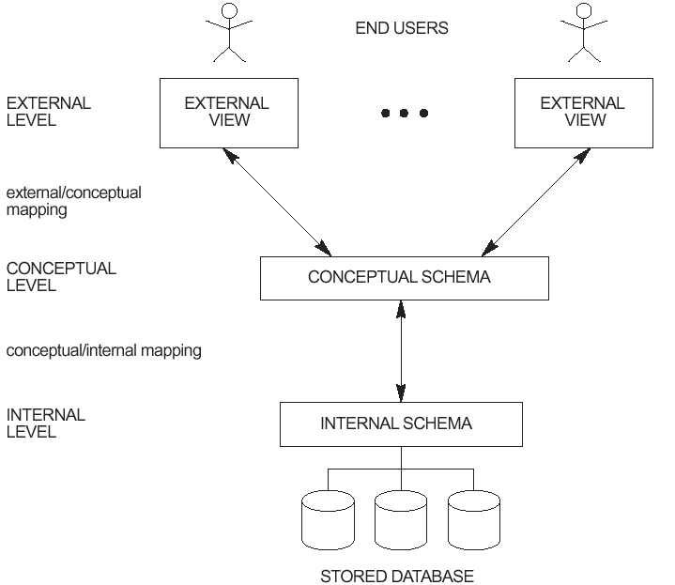
DBMS 3-Tier Architecture

Slide 14
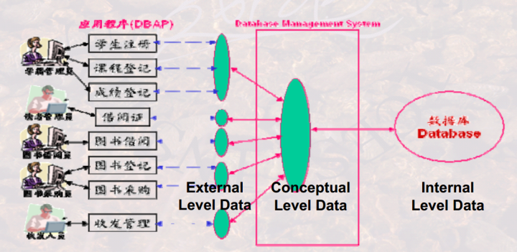

Slide 15
Three-Schema Architecture
Proposed to support DBMS characteristics of:
  Program-data independence.
  Support of multiple views of the data.
DBMS schemas at three levels :
  Internal schema at the internal level to describe data storage structures and access paths. Typically uses a physical data model.
  Conceptual schema at the conceptual level to describe the structure and constraints for the whole database. Uses a conceptual or an implementation data model.
  External schemas at the external level to describe the various user views. Usually uses the same data model as the conceptual level.
Mappings among schema levels are also needed. Programs refer to an external schema, and are mapped by the DBMS to the internal schema for execution.

Slide 16
Database Schema (1)
Definition: Database schema is the description of the user data in the database.
In relational model, a database schema consists of a set of tables.
Conceptual schema: logically describes all data in the database

Slide 17
Database Schema (2)
Internal schema (Physical schema): describes how data in the database are actually stored
External schema (User view): Each external schema provides a description of a portion of the data in the database which are interested or can be accessed by a special group of users.

Slide 18
Advantages of the Three-Tier Architecture
Easier for users to understand and use the database.
Provides a mechanism for access control.

Slide 19
An Example
Conceptual schema: students: student_ID char(6)
Department_number char(4)
GRADE numeric(5)
Internal schema: Stored_std: length = 20
Header Type = byte(6), offset = 0
std# Type = byte(6), offset = 6, Index = STDX
Dept# Type = byte(4), offset = 12
GRD Type = byte(4), offset = 16
External schema 1: STD_GRD: STDNo char(6)
GRD integer
External schema 2: STD_Dept: STDNo char(6)
DeptNo char(4)

Slide 20
Mappings
Two mappings are needed to process a user query:
From external schema to conceptual schema
Ex: StdNo to Student_ID
From conceptual schema to internal schema
Ex: Student_number to STD#

Slide 21


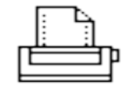
End Users
External
External
External
External Level
View A
View B
View N
external/conceptual mapping
Conceptual Level
Conceptual Schema
conceptual/internal mapping
Internal Level
Internal schema
Stored Database

Slide 22
Data Independence
Data Independence: the ability to modify the lower level descriptions of a database without causing application programs to be rewritten.
Logical Data Independence: the ability to modify the conceptual schema without causing application programs to be rewritten.
Physical Data Independence: the ability to modify the internal schema without causing conceptual schema to be rewritten.
Data independence is achieved through proper manipulation of the above two mappings.

Slide 23
DBMS related roles
DBMS Developers: Those who design and implement DBMS software: buffer manager, query processor, transaction manager, interface, ...
Database designers: Those who are responsible for determining
  what data should be stored in the database;
  how data in the database should be organized;
  the design of customized views;
  the design of special data structures to improve the performance of the system.

Slide 24
DBMS Professionals(2)
Database administrator (DBA): Those who manage and monitor the daily operation of a database system.
  authorization for database access, e.g., who can access what data in what mode.
  routine maintenance: backup, install new tools, ...
  modification to existing database design.

Slide 25
DBMS Professionals(3)
End-user:
  Casual users: those who access the database using SQL directly.
  Naive users: those who access the database using pre-prepared packages.
Application programmers: Those who write menu applications for naive users, typically, through database calls embedded in a program.

Slide 26
1.2 History of Data Management
In 50's -- 60's, File based system emerged to meet the need of managing data.
File based system consists of Application Programs as well as some independent files.
Example:
A bank with several branches

Slide 27
An Example File System
A banking system may have files for customers, saving accounts and checking accounts;
Application Programs to deposit and withdraw money, to find balance, etc.

Slide 28
Problems of File Systems (1)
No guarantee that data is not lost if not backed up
No support to query languages
No efficient access to data items unless the location is known
Application depends on the data definitions (structures)
Change to data definition will affect the application programs
Single view of the data
Separate files for each application
Limited control to multiple accesses
Data viewed as physically stored
It is difficult to support new applications.

Slide 29
Problems of File Systems (2)
  No centralized control of data.
  Files are often created for a particular application.
  Files are created and managed independently.

Slide 30
Problems of File Systems (3)
There often exists severe data redundancy and inconsistency.
Checking-Account: Acct#, Owner-name, Owner-SSN, Owner-Addr, Balance, ...
Saving-Account: Acct#, Owner-name, Owner-SSN, Owner-Addr, Balance, Interest, …

Slide 31
Problems of File Systems (4)
It lacks concurrency control.
Concurrency control: prevent mutual interference of concurrent requests.
Example (Train ticket reservation):
Consider the situation when two customers are trying to book the only ticket left for a train through two agents at about the same time.

Slide 32
Hierarchical database systems
Hierarchical database systems (HDBS), late 60's -- early 70's
Best known HDBS: IMS (Information Management System of IBM).
One-to-many relationships between parent records and child records.
Records are connected pointers.

Slide 33
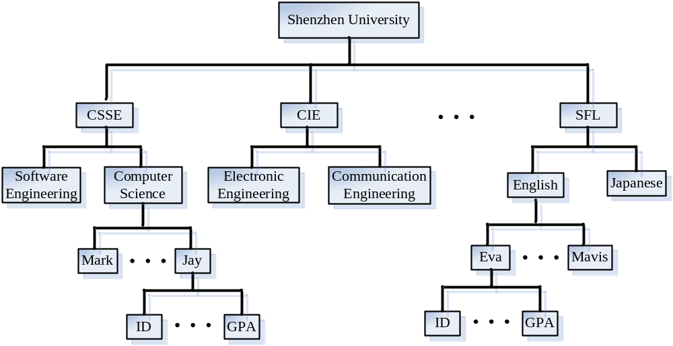
Example of Hierarchical Database

Slide 34
An IMS Query
Query: find all shenzhen University students whose major is computer science and whose GPA is higher than 3.5.
GU University (Name = `Shenzhen University')
College (Name = `CSSE')
Department (Name = `Computer Science')
Student (GPA > 3.5)
L1: GNP Student (GPA > 3.5)
Goto L1

Slide 35
History of Database (Continued)
Network database systems (NDBS), late 60's -- early 70's
In NDBS, record types are organized into an acyclic graph.
Some commercial NDBSs: IDS II (Honeywell), DMS II (UNISYS).
Main problem with HDBS and NDBS: difficult to use.

Slide 36
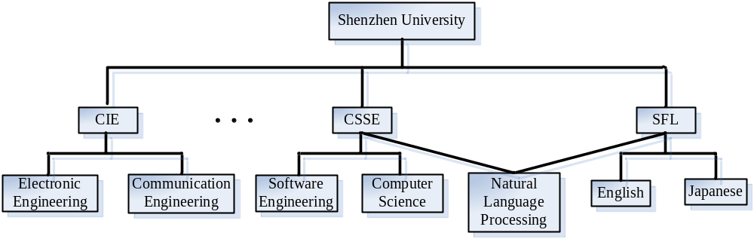
Example of Network database

Slide 37
History of Database (Continued)
Relational database systems (RDBMS), early 70's -- now
Example relational DBSs: DB2, Oracle 10g, Microsoft SQL server ...
In RDBMS, data are organized into tables (relations).

Slide 38
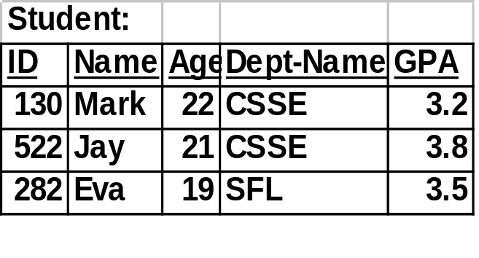
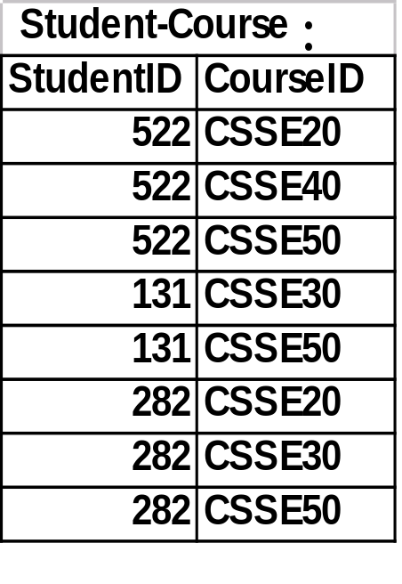
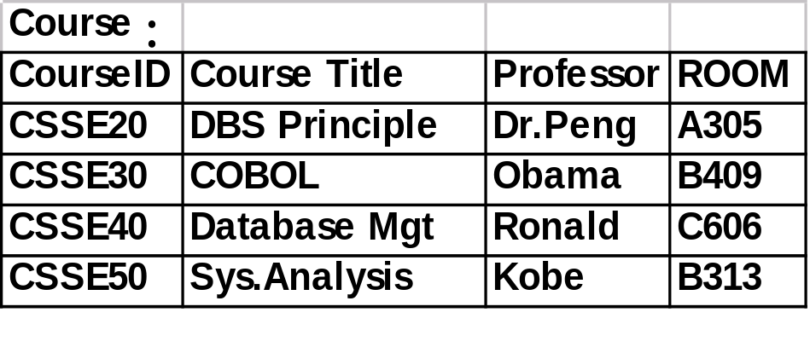
Relational database

Slide 39
History of Database (Continued)
Object-oriented and Object-Relational database systems (OODBS), 80's -- now
Example OODBSs: O2, Objectivity, ObjectStore, Versant, …
Example ORDBSs: Oracle 9, Informix, UniSQL/X.

Slide 40
Additional Benefits of Database Technology
- Controlling redundancy (不必要的重复) in data storage and in development and maintenance efforts.
- Sharing of data among multiple users.
- Restricting unauthorized (未经批准的)access to data.
- Providing multiple interfaces to different classes of users.
- Representing complex relationships among data.
- Enforcing integrity constraints (数据完整性) on the database.
- Providing backup and recovery services.
- Potential for enforcing standards.
- Flexibility (适应性) to change data structures.
- Reduced application development time.
Availability of up-to-date information.
Economies of scale (因经营规模扩大而得到的经济节约)

Slide 41
When not to use a DBMS
Main inhibitors is costs of using a DBMS:
  High initial investment and possible need for additional hardware.
  Overhead for providing generality, security, recovery, integrity, and concurrency control is very high.
When a DBMS may be unnecessary:
  If the database and applications are simple, well defined, and not expected to change.
  If there are stringent real-time requirements that may not be met because of DBMS overhead.
  If access to data by multiple users is not required.
When no DBMS may suffice :
  If the database system is not able to handle the complexity of data because of modeling limitations
  If the database users need special operations not supported by the DBMS.

Slide 42
Rank:Calculating the scores
Number of mentions of the system on websites, measured as number of results in search engines queries. At the moment, we use Google, Bing and Yandex for this measurement. In order to count only relevant results, we are searching for <system name> together with the term database, e.g. "Oracle" and "database".
General interest in the system. For this measurement, we use the frequency of searches in Google Trends.
Frequency of technical discussions about the system. We use the number of related questions and the number of interested users on the well-known IT-related Q&A sites Stack Overflow and DBA Stack Exchange.
Number of job offers, in which the system is mentioned. We use the number of offers on the leading job search engines Indeed and Simply Hired.
Number of profiles in professional networks, in which the system is mentioned.We use the internationally most popular professional networks LinkedIn and Upwork.
Relevance in social networks. We count the number of Twitter tweets, in which the system is mentioned.

Slide 43

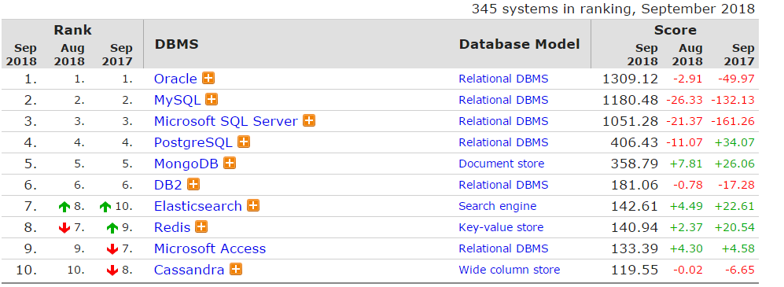

Slide 44
Questions
?

