Slide 1
Software Development Project
Multilingual: Text to Speech
Presentation 5
Albert Millert
Shalini Priya
Wenjun Sun
Soklay Heng

Slide 2
Agenda
1. Primary Goal
2. Model Used
3. Architecture
4. Planning
a.Preprocessing
b.Language Classifier
c.WebApp
d.Containerization
5.Timeline
6.Summary

Slide 3
Primary goal
Develop a web application that uses Grad-TTS Model for Text to Speech conversion. Languages supported by the TTS converter app are:
English
French

Slide 4
Model Used: Grad-TTS
A novel text-to-speech model with score-based decoder producing Mel spectrograms by gradually transforming noise predicted by encoder and aligned with text input by means of Monotonic Alignment Search.
Encoder + Duration Predictor + Decoder = Mel Spectrograms

Slide 5
Planning
In Progress Completed
1
2
3
4
5
Grid5000 Account
Testbed for experiment
Preprocessing
Generating phoneme from input text
RNN LSTM Classifier
For Identifying language
Training
To train a model
Deployment
Combine all modules and deploy working model on WebApp

Slide 6
Completed
Language classifier + prediction
Server + modules connection
Web app - server connection
English TTS
Notes:
server connects various modules: classifier, synthesis module, etc.
web app (is the ui) / frontend app
both server and and frontend work
but the network connection is not entirely well established between the two
ok i understand well
thanks
good for you

Slide 7
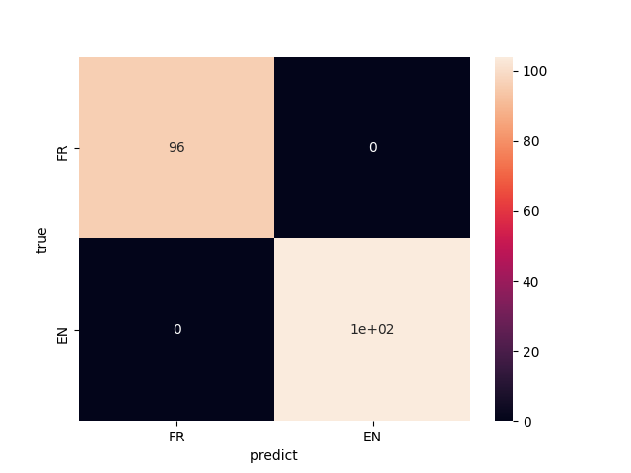
Test with unseen data

Slide 8
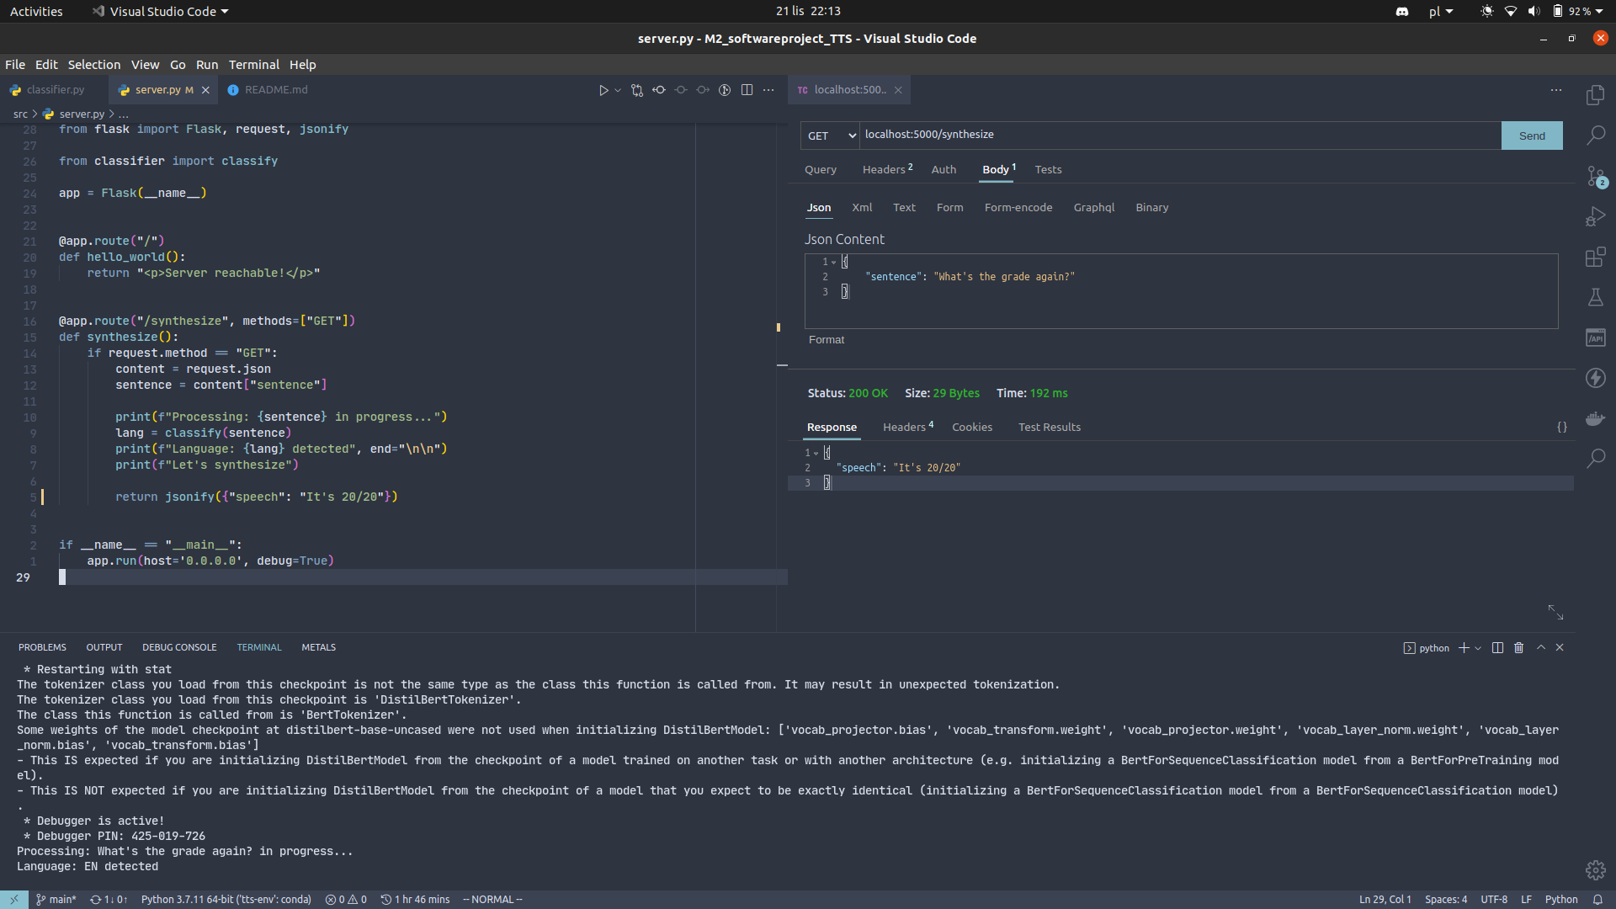

Slide 12
Available server-side functionality
language classification (done)
English speech synthesis (in progress)
works but not plugged in
French speech preprocessing (in progress)
works but still waiting for next step
French speech synthesis (next step)

Slide 13
Providing the app as a service
frontend app container
server container
when deployed - should come with the pretrained models
can be heavy
should be accessible by the other container
react app is actually running on the client side in the browser

Slide 14
Next steps on the server-side
Incoming sentence request
if French
request to external API to obtain base phonemes
convert based on conversion dictionaries
pass these to French TTS model
if English
pass to the English TTS model
In both cases send back a response in a format supported by the frontend

Slide 15
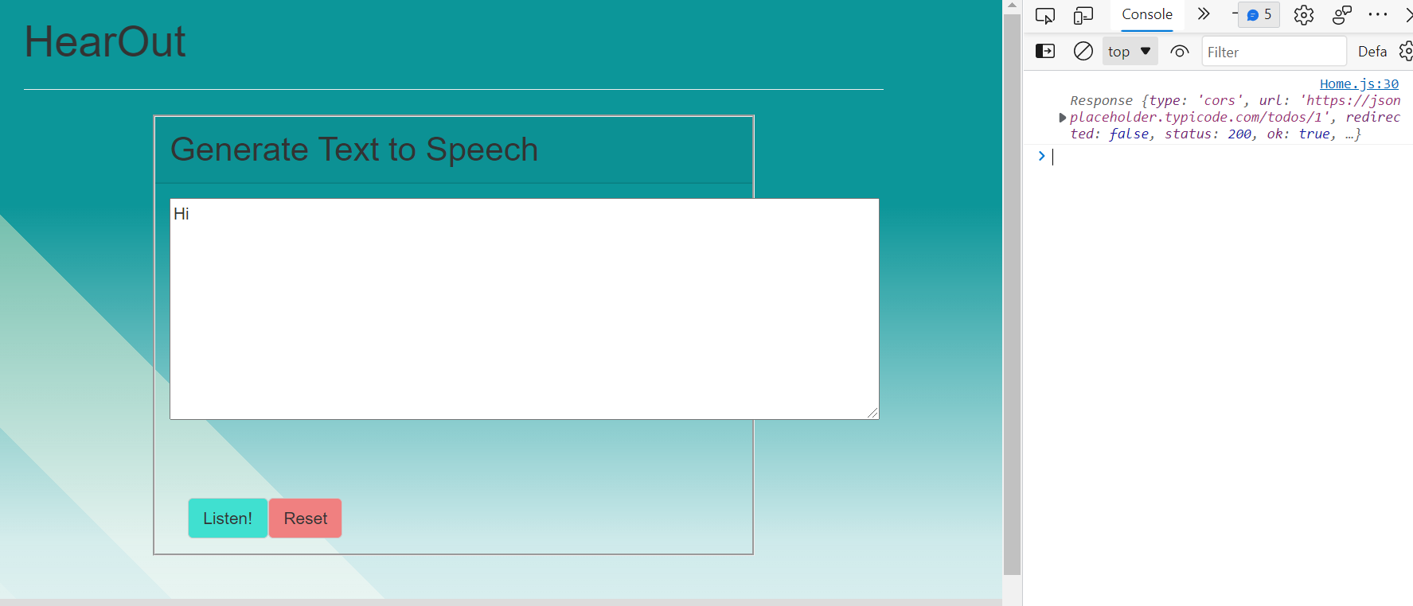

Slide 16
Demo
works in English
still need to be connected with other modules

Slide 17
Timeline
4th Nov 2021
10th Dec 2021
14th Feb 2022
Module Combining
Document writing and Defense
PreProcessing , Classifier
Deploying modules on WebApp
Model Training
11th Nov 2021
14th Jan, 2022

Slide 18
Thank you

