Slide 1


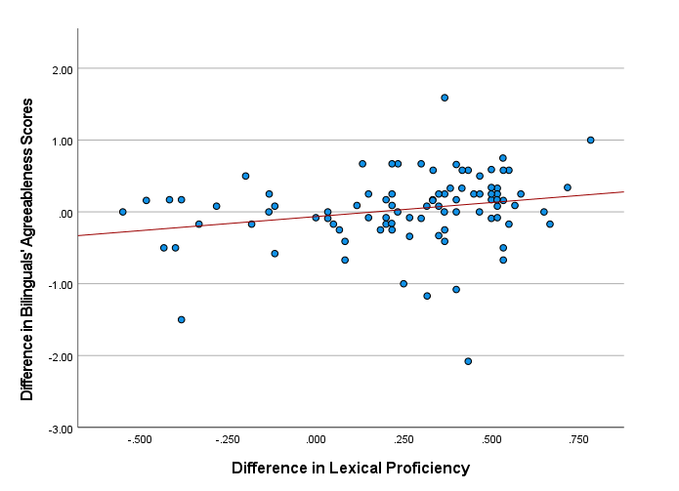
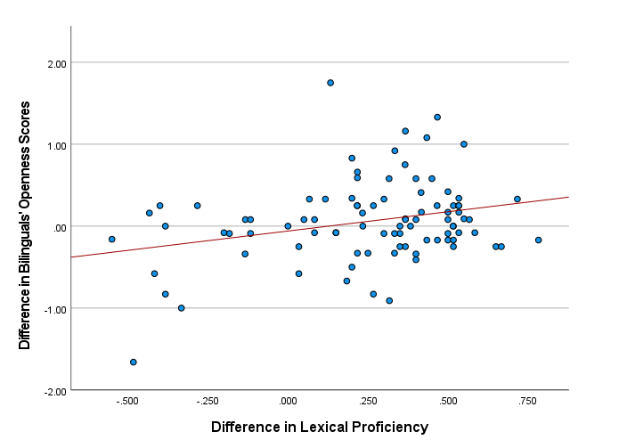
The Effects of Lexical Proficiency in Bilinguals' Personality Test Results
Wenlan Pan¹ & Jonah Cox²
¹Johns Hopkins University, ²University of California, Davis
Introduction
Method
Discussion
The question of whether language can influence personality traits has been a subject of extensive scientific debate for decades. Prior research has shown that bilinguals may exhibit different personality dimensions depending on the language they use [Chen & Bond, 2010]. Studies have also identified a significant relationship between personality traits and general language proficiency (e.g., IELTS scores) [Shiva & Hoda, 2017]. However, the impact of lexical proficiency on performance in personality assessments has yet to be explored.
With 21.7% of the U.S. population speaking a language other than English in 2022 [U.S. Census Bureau, 2022], it is crucial to understand how multilingual backgrounds might influence performance on personality assessments, which are often designed with only one language in mind.
We surveyed 91 bilingual (Chinese & English) college students to assess their lexical proficiency and Big Five personality traits in both languages.
Independent Variables:
Lexical Proficiency
English version: LexTALE [Lemhöfer & Broersma, 2012]
e.g., Determine whether this is an existing English word: abergy
Chinese version: LexCHI [Wen et al., 2024]
e.g., 请判断该组合是否为汉语词汇：颁昧
Difference in Lexical Proficiency
Subtract the score of LexTALE (EN) from the score of LexCHI (CN).
Dependent Variables:
Big Five Personality Scores
English version: Big Five Inventory-2 (BFI-2) [Soto & John, 2016]
e.g, I am someone who is outgoing, sociable.
Chinese version: Chinese BFI-2 [Zhang et al., 2022]
e.g., 我是一个性格外向，喜欢交际的人。
Difference in Big Five Personality Scores
Subtract the score of BFI-2(EN) from the score of Chinese BFI-2 (CN).
This result suggests that Openness and Agreeableness may be the traits most influenced by lexical proficiency within individuals, but not between them, and further indicates that bilinguals' varying levels of proficiency in their two languages can impact their personality scores, depending on the language in which the test is taken. Therefore, researchers should consider participants' lexical proficiency when measuring their trait levels, especially when working with bilingual or multilingual individuals, as it may be a significant factor influencing the Big Five test outcomes, particularly for Agreeableness and Openness.
Limitations:
We observed a ceiling effect in the Chinese proficiency scores, which may have limited the variability and affected the accuracy of the analysis.
With our smaller sample size, we may have only been able to detect the traits most strongly affected by language proficiency differences.
We only investigated bilinguals who speak English and Chinese, so the effect may not be generalizable to speakers of other languages.
Future Directions:
Examine whether other language-related proficiencies (e.g., verbal thought ability) predict trait levels.
Examine whether bilinguals' perceptions of typical native speakers' trait levels predict their own trait levels.
Research Question
What is the relationship between lexical proficiency and bilinguals' personality trait scores when the test is taken in different languages (Chinese & English) ?
Result
No significant relationship was found between lexical proficiency and the Big Five personality scores across all five traits in both languages. However, there was a significant correlation between the difference in lexical proficiency and variation in bilinguals' scores on two traits: Agreeableness (r(89) = .23, p = .03) and Openness (r(89) = .28, p = .01).
Hypothesis
An exploratory analysis was conducted on lexical proficiency between two languages and individuals' personality trait scores in those languages. Given the limited research in this area, specific predictions for the relationship for each trait were not made.

Slide 2
References
Chen, S. X., & Bond, M. H. (2010). Two languages, two personalities? Examining language effects on the expression of personality in a bilingual context. Personality and Social Psychology Bulletin, 36(11), 1514–1528. https://doi.org/10.1177/0146167210385360
Lemhöfer, K., & Broersma, M. (2012). Introducing LexTALE: A quick and valid lexical test for advanced learners of English. Behavior Research Methods, 44(2), 325–343. https://doi.org/10.3758/s13428-011-0146-0
Shiva, S., & Hoda, M. (2017). The relationship between Big-Five personality traits, English language proficiency scores on IELTS, and academic success of Iranian foreign students. Theory and Practice in Language Studies, 7(11), 1046–1052. https://doi.org/10.17507/tpls.0711.13
Soto, C. J., & John, O. P. (2016). The next Big Five Inventory (BFI-2): Developing and assessing a hierarchical model with 15 facets to enhance bandwidth, fidelity, and predictive power. Journal of Personality and Social Psychology, 113(1), 117–143. https://doi.org/10.1037/pspp0000096
U.S. Census Bureau. (2022). 2022 ACS 5-year estimates data profiles. American Community Survey. https://data.census.gov/table/ACSDP5Y2022.DP02?=&hidePreview=true
Wen, Y., Qiu, Y., Leong, C. X. R., Lu, X., & Chua, T. (2024). LexCHI: A quick lexical test for estimating language proficiency in Chinese. Behavior Research Methods, 56, 2333–2352. https://doi.org/10.3758/s13428-023-02151-z
Zhang, B., Li, Y. M., Li, J., Luo, J., Ye, Y., Yin, L., ... & John, O. P. (2022). The Big Five Inventory–2 in China: A comprehensive psychometric evaluation in four diverse samples. Assessment, 29(6), 1262–1284. https://doi.org/10.1177/10731911211050864

