Slide 1

MANUAL testing for different devices
Aliaksandr kazlouski
September 21, 2017

Slide 2
Agenda
OS, browsers, devices
Different breakpoints
The most common issues
Best practice examples
Questions

Slide 3
1. OS, Browsers, devices
Manual testing for different devices

Slide 4
What we are using for testing purposes
 | OS | Used browsers
Desktop browsers | Win7, Win8 | Chrome (latest version), Mozilla (latest version), IE11.
 | Win10 | Chrome (latest version), Mozilla (latest version), Edge (latest version*), IE11.
 | MAC OS | Safari (latest version).
Tablets | Android*** | Chrome, Native.
 | iOS10, iOS11** | Safari, Chrome.
Mobiles | Android*** | Chrome, Native.
 | iOS10, iOS11** | Safari, Chrome.
* - different versions can be set up under different installation packages;
** - we use two latest versions and the newest interim version for each of them;
*** - latest available version for particular device.

Slide 5


Mobile devices used for testing*
Tablets | iPad mini 4 iPad Air iPad 5th Gen. iPad 4 iPad Pro
Mobiles | iPhone 4s** iPhone 5c iPhone SE iPhone 6 iPhone 6+ iPhone 6s+ iPhone 7
Tablets | Tesco Hudl 2**
Mobiles | Samsung Galaxy S6
* - available in Minsk;
** - used only for exploratory testing purposes.
https://moneysupermarket.atlassian.net/wiki/spaces/CT/pages/6062426/Mobile+devices+-+Registry

Slide 6
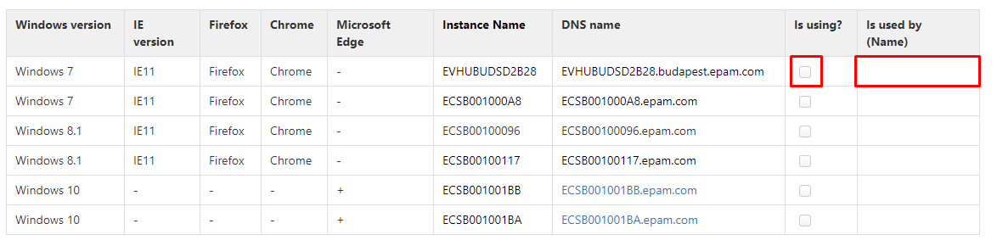
Virtual machines for cross-browser testing
https://moneysupermarket.atlassian.net/wiki/spaces/CT/pages/32407614/Virtual+machines+for+cross-browser+testing
Edit the “Confluence” page selecting needed virtual machine and leave your name and surname in the appropriate field.
Note: you can find MAC on the place 410-18.

Slide 7
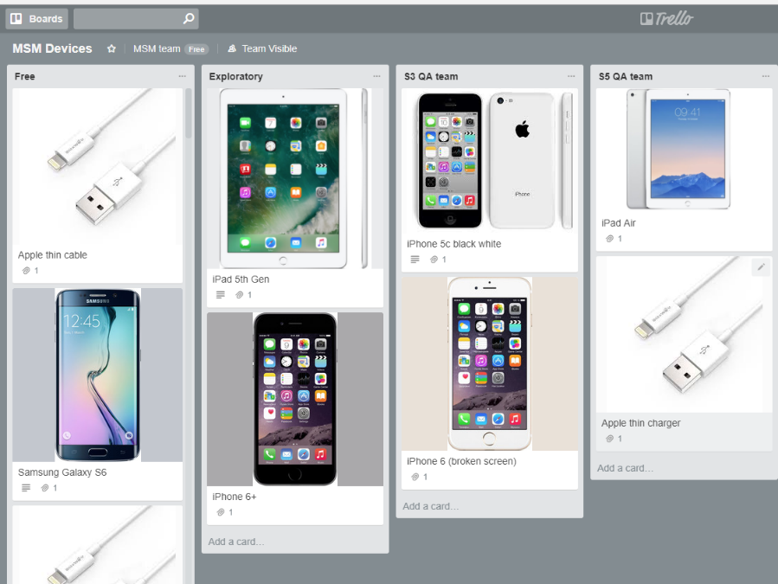
Trello - online tool for tracking devices and battery chargers using
How to join Trello:
- Open https://trello.com/ and create an account
Important note: Full name = [Name Surname] (as it is specified in the UPSA/Telescope)
- Proceed to the https://trello.com/invite/msmteam/bbe3467422cb7460e796b9acd03c8bc1
Click on the “MSM Devices” board and click on the “Join Board” on the right menu panel.
After those actions you can just drag devices/chargers from the "Free" column to "Your column" and move back after using

Slide 8
2. DIFFERENT BREAKPOINTS
Manual testing for different devices

Slide 9
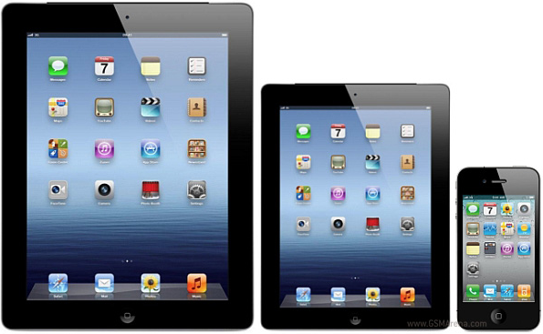
Different breakpoints (developed channels)
Developed channels (Car-insurance, Home-insurance, Mortgage, Savings, Current-Accounts):
L (large): 1200px and more
MD (medium): 992px – 1199px
SM (small): 768px – 991px
XS (extra small): 320px – 767px

Slide 10
Different breakpoints (developed channels)
Breakpoint | Desktop browsers | Tablets | Mobile phones
L | Chrome, Mozilla, Edge, IE11, Safari | iPad Pro (landscape)
MD |  | iPad Pro (portrait) iPad mini 4, iPad Air, iPad 5th Gen., iPad 4 (landscape)
SM |  | iPad mini 4, iPad Air, iPad 5th Gen., iPad 4 (portrait) Tesco Hudl 2 (landscape)
XS |  |  | iPhone 4s, iPhone 5c, iPhone SE, iPhone 6, iPhone 6+, iPhone 6s+, iPhone 7, Samsung Galaxy S6 (both orientations) Tesco Hudl 2 (portrait)

Slide 11

Different breakpoints (channels under development)
Channels under development (Credit-Cards, Energy, Loans):
L (large) + MD (medium): 992px and more
SM (small): 768px – 991px
XS (extra small): 320px – 767px
Credit-Cards question set:
Breakpoint | Pixels range
BP1 | 320px – 339px
BP2 | 340px – 419px
BP3 | 420px – 619px
BP4 | 620px – 819px
BP5 | 820px and more

Slide 12
3. The Most common issues
Manual testing for different devices

Slide 13
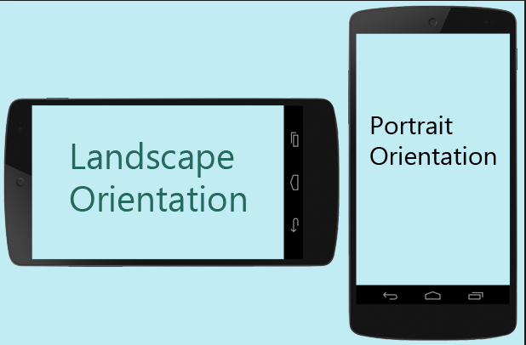
Changing the device orientation
When we can face with that behavior: Another breakpoint is rendered after changing device orientation; Particular cases (iPhone 6+ and iPhone 6s+); Possible consequence: Data and elements losing (values previously entered/selected into the fields, drop-downs, etc.); Some elements can be appeared in the wrong place; Some elements (buttons, icons, etc.) aren’t clickable; Pagination is broken; Styles are broken.

Slide 14

F5 (page refreshing)
When we can face with that behavior: Just refresh the page . Possible consequence: Data and elements missing (for example, when a form wasn’t fully filled out); Unexpectedly data appearance in the wrong place (data can appears in the empty fields or overwrites another data); Selected element becomes unselected; Validation messages are appeared/disappeared.

Slide 15
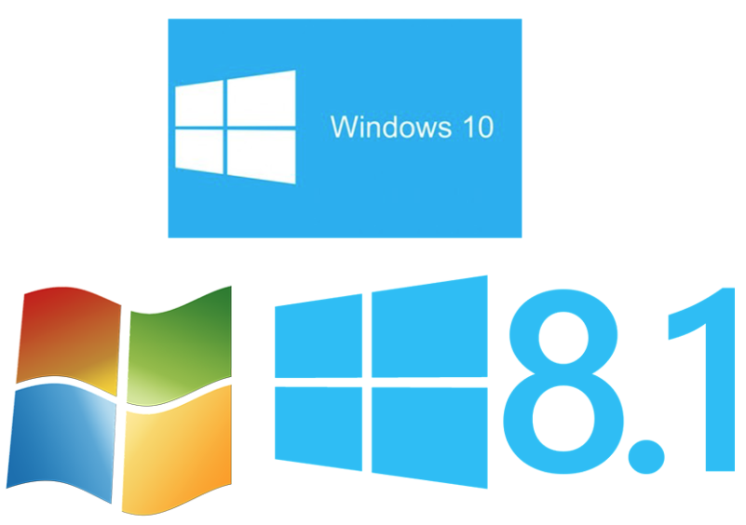
Different OS and browsers versions
When we can face with that behavior: Some defects can be born by new browser version (however, opposite cases also occur); Particular cases (IE under Win7/Win8, old/new IOS versions); Possible consequence: Missing elements; Possibility to re-enter default values in the drop-downs; Incorrect displaying of the text font; Users aren’t able to enter more than 1 symbol in the currency field (Chrome case); Some elements aren’t clickable (Android case). Delay in the interaction.

Slide 16
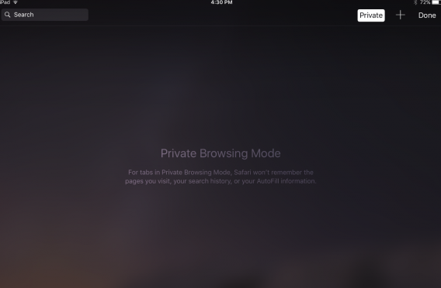
Safari private browsing
When we can face with that behavior: Since recent time, checking of the Safari private mode is “must have” case for developers and testers; Checking session storage (it doesn’t work in the private mode). Possible consequence: Missing elements (lots of cases); Some elements have incorrect height and width; Some elements aren’t clickable; Incorrect redirecting.

Slide 17
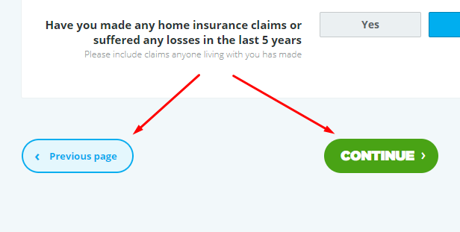
Back-forward journey
When we can face with that behavior: Just going back/forward through the pages using appropriate CTA buttons or “back”/“forward” browser buttons. Possible consequence: Previously entered data is disappeared or displayed incorrectly (for example, Nan); Data selected for previous item (address/policy holder/vehicle) remains the same for the new one; Incorrect redirecting (mostly cases related to the sliders on the results).

Slide 18
4. Best practice examples
Manual testing for different devices

Slide 19

We have a common final goal

Slide 20
Some tips from the own experience on the project
Be ready for internal showcase for the BA and QA (depends on story T-shirt); Sometimes it is reasonable to share you workstation with a tester after making a large number of edits. Tester can have a look new version to not waste a time on the devvm deployment; Ask BA, QA, Squad lead about unclear/disputed points (designs mismatching, gaps in the acceptance criteria, blockers, etc.) to save time in the future. Moreover, customer approve is mandatory in most of the cases; Check your story/defect not only in Chrome (sometimes have a quick look using another browsers); Specify clear affected area in the pull requests; Have a look on the related areas; Share your suspicions about the weak areas in code with a tester; Use parallel development if it is needed (tester can tell you how they are going to check a story/defect);

Slide 21
5. Questions
Manual testing for different devices
June 7, 2016

Slide 22
Thanks for your attention

