Slide 1

Telco Churn Customer Prediction
Wenny Chandra Sari

Slide 2
Outline
Objective
Datasets
Exploratory Data Analysis
Feature Selection
Model and Evaluation
Demo
Prediction Evaluation
Conclusion

Slide 3
Objective
Make a Telco-Churn-Customer-Prediction Model that Telco can provide promotions to retain the suspected-churn-customer.

Slide 4
Dataset
Dataset contains information about 19 features that support the Telco-Churn-Customer-Prediction Model.
https://www.kaggle.com/datasets/tejashvi14/medical-insurance-premium-prediction

Slide 5
Exploratory Data Analysis

Slide 6
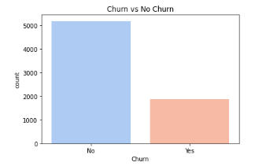
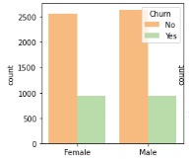
Target: Churn that Moderately Imbalance
Feature: Gender
No Churn: 5174 or 26.5%
Churn: 1869 or 73.5%
There are no significant differences between churn and non-churn female and male customers.

Slide 7
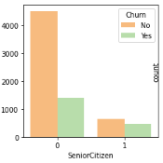
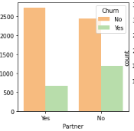
Feature: Senior Citizen or Not
Feature: Have a Partner or Not
The graph shows more young customers than senior customers.
Churn customers are more young customers.
The graph shows more non-partnered than partnered customers.
Churn customers are more on non partnered customers.
On contrary non-churn customer are more on partnered customers.

Slide 8
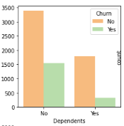
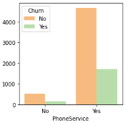
Feature: Have Dependents or Not
Feature: Subscribe Phone Service or Not
The graph shows more customers have dependents.
The graph shows that more customers subscribe Phone Service.

Slide 9
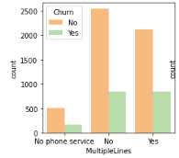
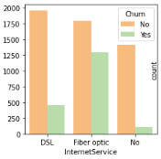
Feature: Subscribe Multiple Line PhoneService or Not
Feature: Subscribe for Internet Service or Not
The graph shows more customers who do not use Multiple Line Service.
Churn customers mostly use phone services (both singleline and multiple lines).
Most non churn customers only use singleline.
The graph shows that more customers are using Fiber Optic Internet Service.
Churn customer mostly use Fiber Optic Internet Service and non churn customers mostly use DSL.

Slide 10
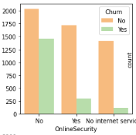
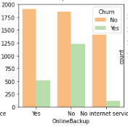
Feature: Subscribe for Online Security or Not
Feature: Subscribe for Online Back Up or Not
Data shows more customers who are not registered with Online Security.
Customers churned the most from those who do not use Online Security.
Data shows more customers who are not registered online backup.
Most of the churn customers do not use Online Backup.

Slide 11
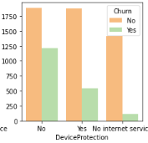
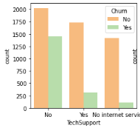
Feature: Subscribe for Device Protection or Not
Feature: Subscribe for Tech Support or Not
The data shows that more customers do not use Device Protection.
Most of the churn customers do not use Device Protection.
The data shows more customers who are not registered with Tech Support.
Customers churn the most from those who don't use Tech Support.

Slide 12
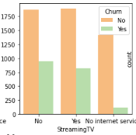
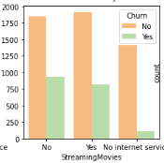
Feature: Subscribe for Streaming TV or Not
Feature: Subscribe for Streaming Movie or Not
The data shows that the comparison between customers who use Streaming TV and do not use it is relatively small and there are more who do not use it.
The data shows a comparison between customers who use Streaming Movie and those who don't.

Slide 13
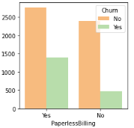
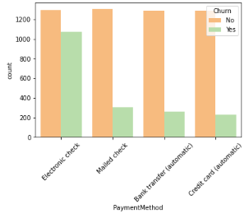
Feature: Prefer Paperless Billing or Not
Feature: Preferred Payment Method
Data shows more customers prefer Paperless Billing.
The data shows that more customers are using electronic checks.
Most churn customer is for those who use electronic checks.

Slide 14
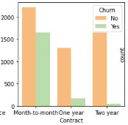
Feature: Bind by a Contract or Not
The data shows more customers are bound by monthly contracts.
The most customer churn is on the monthly contract.

Slide 15
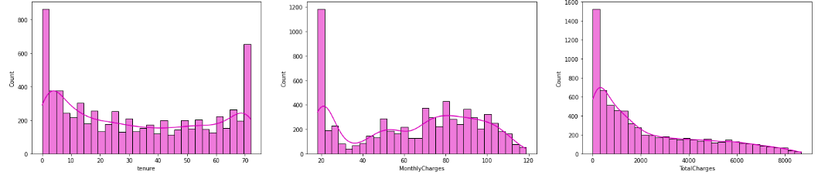
Feature: Tenure, Monthly Charges, Total Charges
Range of Tenures are between 0 month to 72 months (6 years ). The median is 29.
The Range of Monthly Charges are between 18.25 to 118.75 dollars. The median is 89.85.
The range of Total Charges are between 18.80 to 8684.80 dollars. The median is 1397.475 dollars.

Slide 16
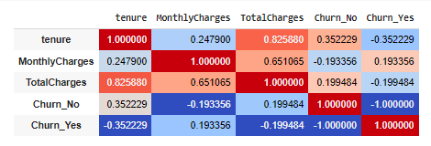
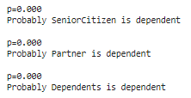
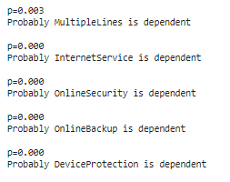
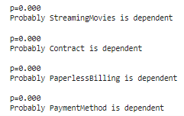

Based on Collinearity all numeric features have considerate collinearities with our target (Churn)
Based on Chi Contigency: SeniorCitizen, Partner, Multiplelines, InternetService, OnlineSecurity, OnlineBackup, DeviceProctection, TechSupport, StreamingTV, StreamingMovies, Contract, PaperlessBilling, and PaymentMethod are dependent with our target.

Slide 17
Feature Selection:
We select all the feature and the model will drop irrelevant feature by itself using dropout technique.

Slide 18
Model

Slide 19
Model-1: Sequential Model
Model-3: Functional Model
We had created 4 models which are:
Model-2: Tunned Sequential Model
Datasize: 5379 rows
Input layer: 45 neuron
Hidden layer 1: 4 neuron
Output: 1 neuron
Batch: 64
Epoch: 10
Optimizer: -
Loss = binary_crossentropy
metrics = accuracy
Input layer: 45 neuron
Hidden layer 1: 4 neuron, batch_normalization, af= relu
Hidden layer 2: 2 neuron, batch_normalization, af= relu
Output: 1 neuron, batch_normalization, af= sigmoid
Batch: 64
Epoch: 10
Optimizer: adam
Loss = binary_crossentropy
metrics = accuracy
Model-4: Tunned Functional Model
Input layer: 45 neuron
Hidden layer 1: 4 neuron
Output: 1 neuron
Batch: 64
Epoch: 10
Optimizer: -
Loss = binary_crossentropy
metrics = accuracy
Input layer: 45 neuron
Hidden layer 1: 4 neuron, af= relu
Hidden layer 2: 2 neuron, af= relu
Output: 1 neuron, af= sigmoid
Batch: 64
Epoch: 10
Optimizer: adam
Loss = binary_crossentropy
metrics = accuracy

Slide 20
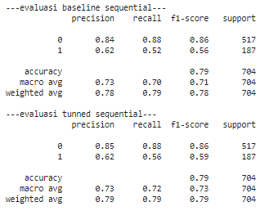
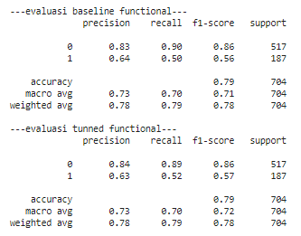
Evaluation
“Based on evaluation we see that baseline functional model and tuned functional model have the most great class 1 precision.
We focus on the class 1 precision or the ability to correctly a predict churn customer.”

Slide 21
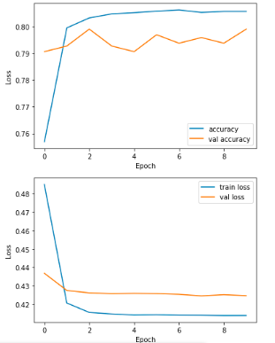
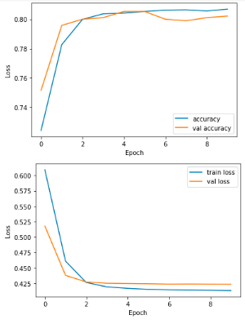
Evaluation
Functional Model
Tunned Functional Model
Based on the accuracy and loss from the model, we see that the accuracy and loss of Tunned Functional Model are smoother. Because of that we will use The Tunned Functional Model.

Slide 22
Model Conclusion:
We will use the Tuned Functional Model

Slide 23
Demo
https://huggingface.co/spaces/Wenny/Telco-Customer-Churn

Slide 24
Prediction Evaluation

Slide 25
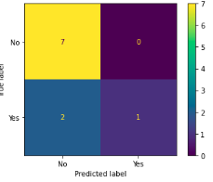
I had done some Inferencing with 10 new data
The classification results were quite good, of the 7 people who originally did not churn, we managed to classify 7 as not churn. Of the 3 people who originally churn, we managed to classify 1 person as churn. This is related to the model recall which is higher than the precision.

Slide 26
Conclusion

Slide 27
Thank You

