Slide 1
Health Insurance Price Prediction for Magma HDI General Insurance Ltd. (in INR)
Wenny Chandra Sari, Cartesian Consulting, Mumbai

Slide 2
Outline
Objective
Datasets
Exploratory Data Analysis
Prediction Demo
Conclusion

Slide 3
Objective
Make a sample model to predict Magma HDI Health Insurance Price.

Slide 4
Dataset
Dataset contains information about 10 features that affect the health insurance price.
https://www.kaggle.com/datasets/tejashvi14/medical-insurance-premium-prediction

Slide 5
Exploratory Data Analysis

Slide 6
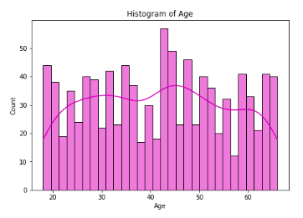
Ages between 18-66 years old
Mean: 42 years old
Mode: 43 years old

Slide 7
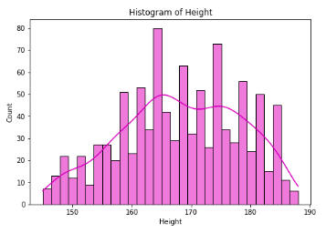
Heights between 145-188 cm
Mean: 168 cm
Mode: 164 cm

Slide 8
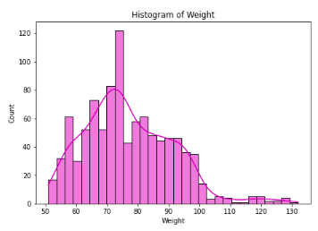
Weights between 51-132 kg
Mean: 77 kg
Mode: 73 kg

Slide 9
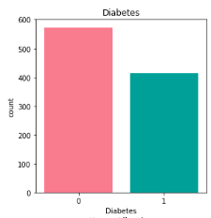
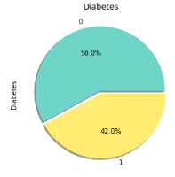
Mode: No Diabetic Problem

Slide 10
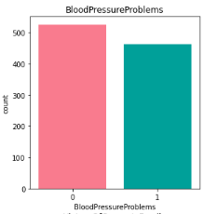
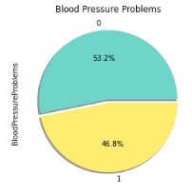
Mode: No Blood Pressure Problems

Slide 11
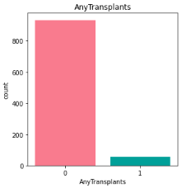
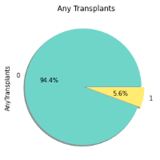
Mode: No Transplantation Record

Slide 12
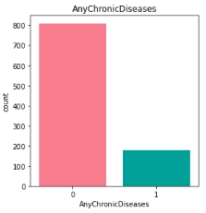
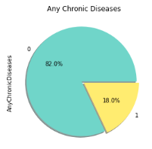
Mode: No Chronic Disease Record

Slide 13
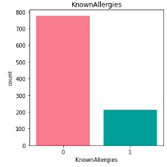
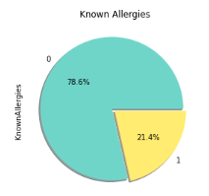
Mode: No Allergies Problems

Slide 14
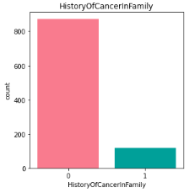
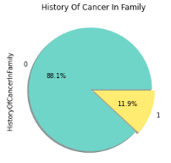
Mode: No History of Cancer in Family

Slide 15
Demo

Slide 16
Conclusion

Slide 17
Thank You

