Slide 1
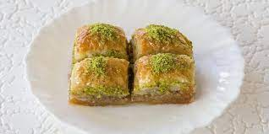
Baklava
Baklava

Slide 2
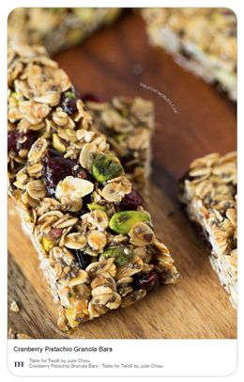
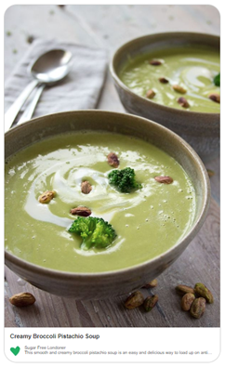
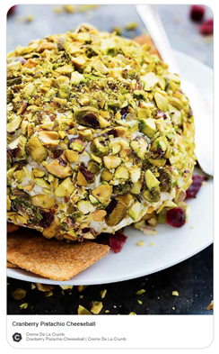
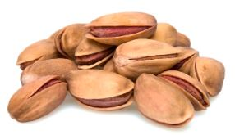

Slide 3

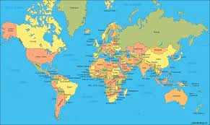



Slide 4
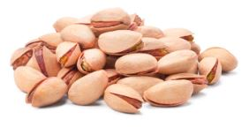
Kirmizi Pistachio:
The small and slim pistachios in brown shells. They are consumed as a snack and are major component in baklava and other sweets.
Siirt:
are round, fatter nuts with pale beige shells.

Slide 5
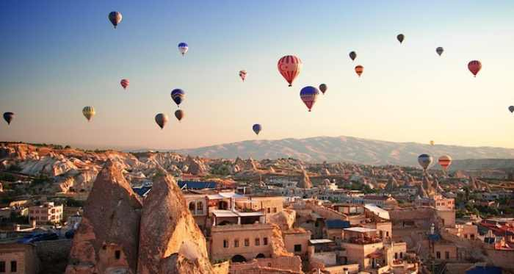
Turkish Pistachio Competition

Slide 6
PISTACHIO Model for Turkish Pistachio Competition
by Wenny Chandra Sari, FTDS-16, Hacktiv8

Slide 7
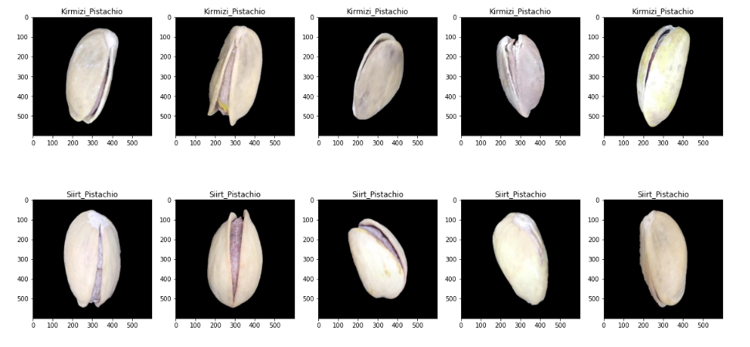
Dataset from kaggle.com

Slide 8
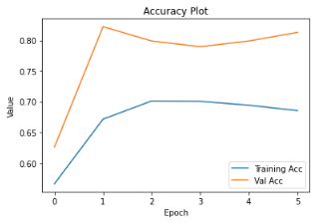
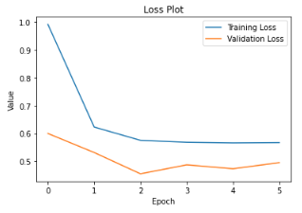
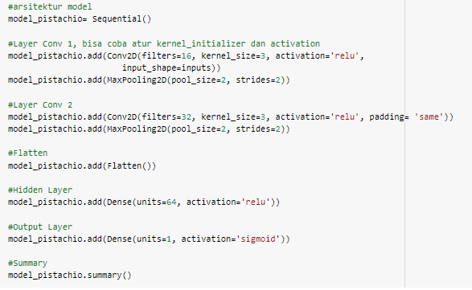
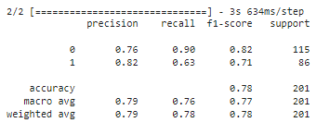
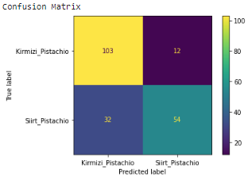
Pistachio Model
Architecture
Graph
Evaluation

Slide 9
DEMO
Deploy at:
https://huggingface.co/spaces/Wenny/Pistachio-Prediction2-2022

Slide 10
CONCLUSION

Slide 11
Thank You!

