Slide 1
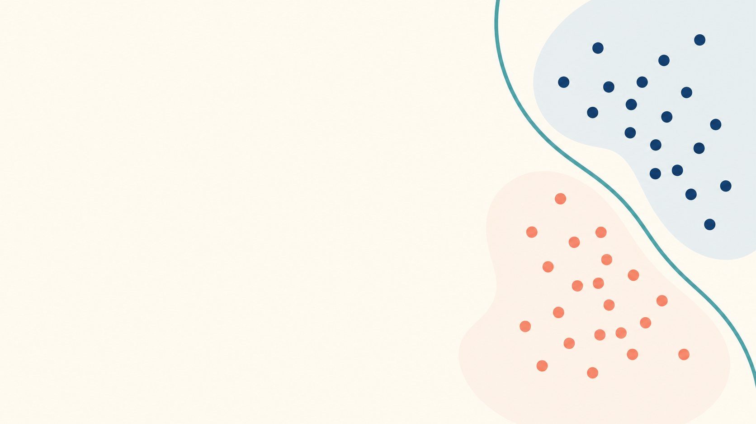
Learning goal and success check
Choose a label and explain the threshold rule.
Synthetic public demo · 1/3
Notes:
Synthetic public demo material. Licensed CC BY 4.0. Narration: This is the second synthetic round. By the end, learners should choose a binary label and explain how the threshold supports the choice. The explanation is part of the success check.

Slide 2
Think, compare, explain
Scores: 0.72 and 0.31
Think silently, compare, then explain.
Synthetic public demo · 2/3
Notes:
Synthetic public demo material. Licensed CC BY 4.0. Narration: Consider two model scores: zero point seven two and zero point three one. First think silently. Then compare your labels with a partner. Explain why each score falls on one side of the zero point five threshold. I will pause before sharing the answer.

Slide 3
Reasoning check
0.72 gives label 1
0.31 gives label 0
What changes at threshold 0.80?
Synthetic public demo · 3/3
Notes:
Synthetic public demo material. Licensed CC BY 4.0. Narration: Now check the reasoning. Zero point seven two gives label one, and zero point three one gives label zero. If the threshold changed to zero point eight, the first prediction would also become label zero. Write one sentence explaining why.

