Slide 1
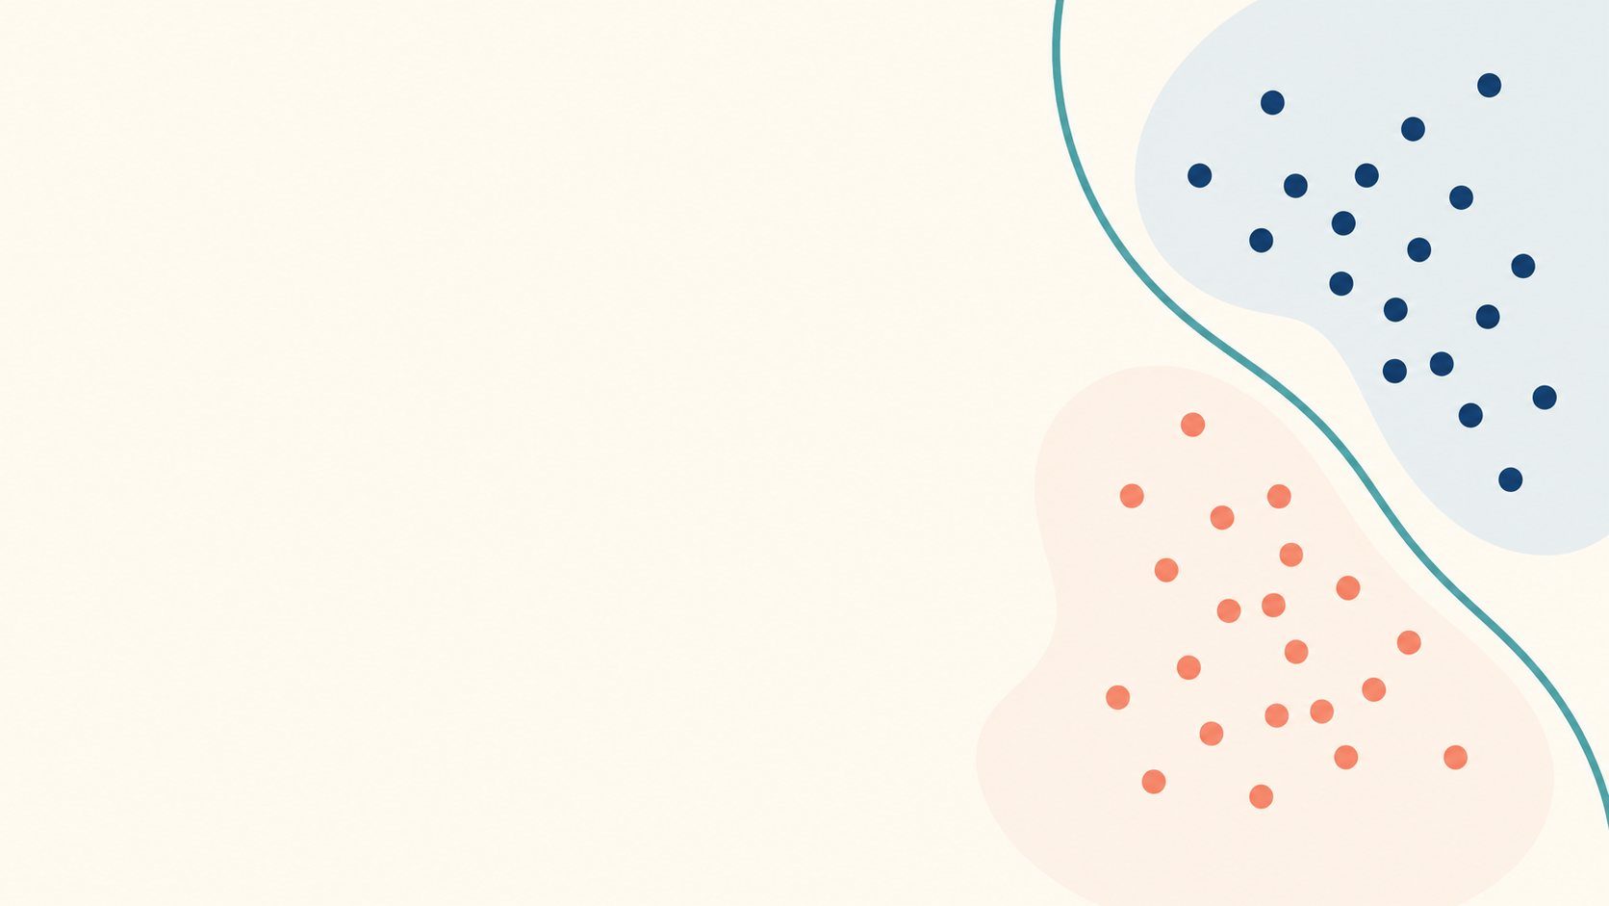
Learning goal
Predict label 0 or 1 from input features.
Synthetic public demo · 1/3
Notes:
Synthetic public demo material. Licensed CC BY 4.0. Narration: This is a synthetic classroom recording created for the Classroom Review Agent public demo. In binary classification, our learning goal is to predict label zero or one from input features. We fit the model on labeled training examples.

Slide 2
Decision threshold
Probability ≥ 0.50 gives label 1
Probability < 0.50 gives label 0
Synthetic public demo · 2/3
Notes:
Synthetic public demo material. Licensed CC BY 4.0. Narration: The model returns a probability. We use a decision threshold of zero point five. A probability at or above zero point five becomes label one. A lower probability becomes label zero.

Slide 3
Quick check
The model score is 0.72. Which label?
Answer: label 1
Synthetic public demo · 3/3
Notes:
Synthetic public demo material. Licensed CC BY 4.0. Narration: Here is a quick check. The model score is zero point seven two. Which label should we predict? The answer is label one because the score is above the threshold. We will move on immediately.

