Slide 1
Part 2: Exploratory Data Analysis

Slide 2
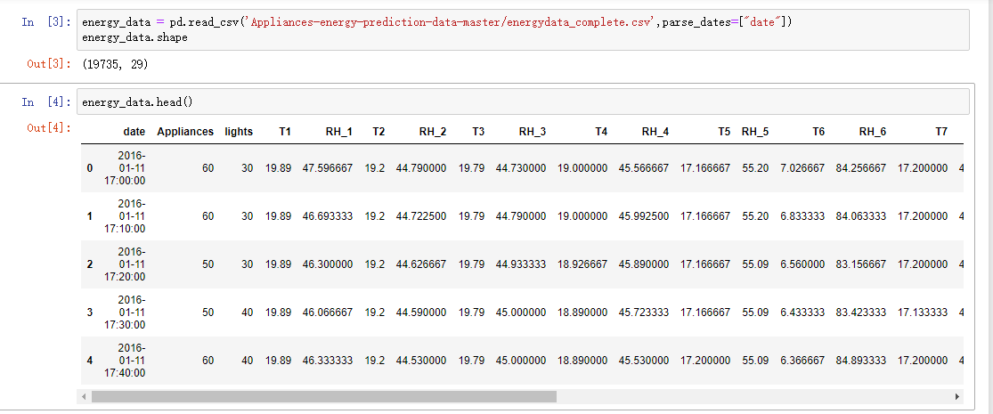
Date ingestion and describetion

Slide 3
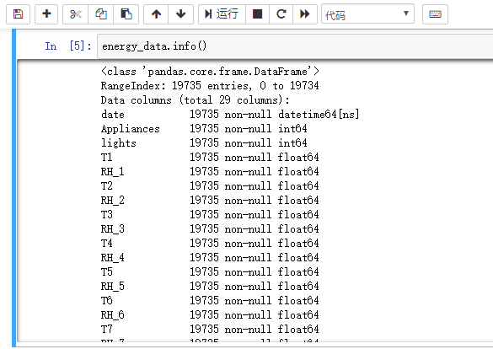
Dataset information
Notes:
We can see there is a datetime64 formate and we need to transform or generate new columns for that column.

Slide 4
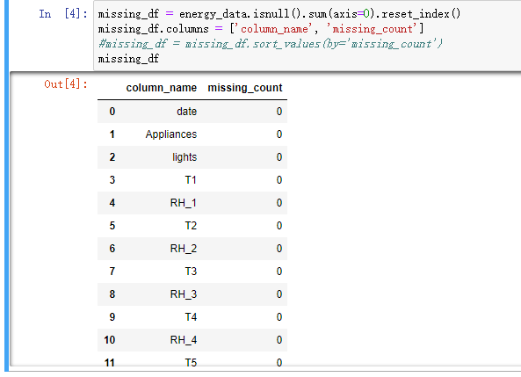
Missing Data
Notes:
From this step, we can see there is no missing data in this dataset so we do need to fill missing data.

Slide 5
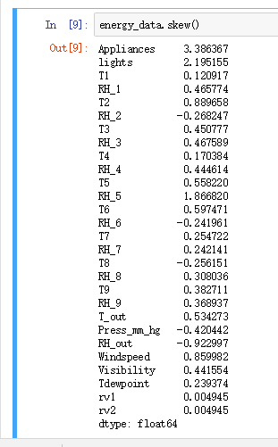
Skewness of dataset
Notes:
Skewness is a measure of the symmetry in a distribution. A symmetrical dataset will have a skewness equal to 0. Skewness essentially measures the relative size of the two tails. If a skewness bigger than 0, that means dataset has long tail above average and verse visa.

Slide 6
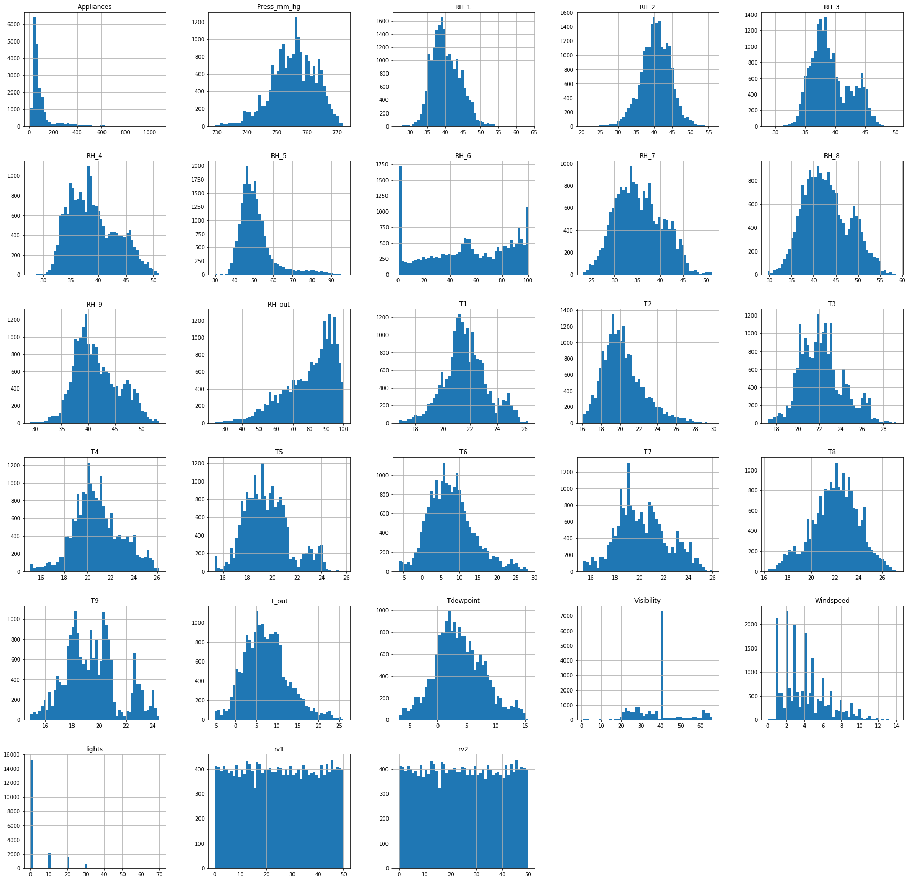
Histgrams

Slide 7
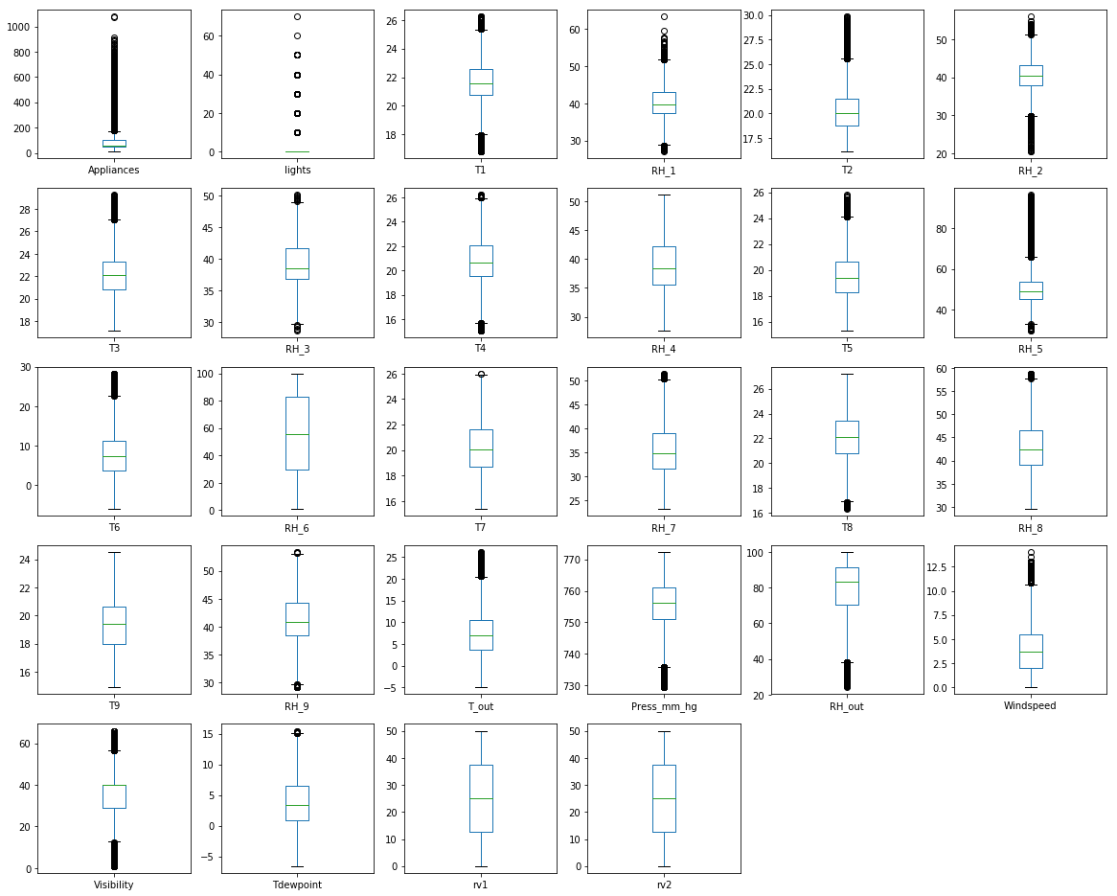
Box plots

Slide 8
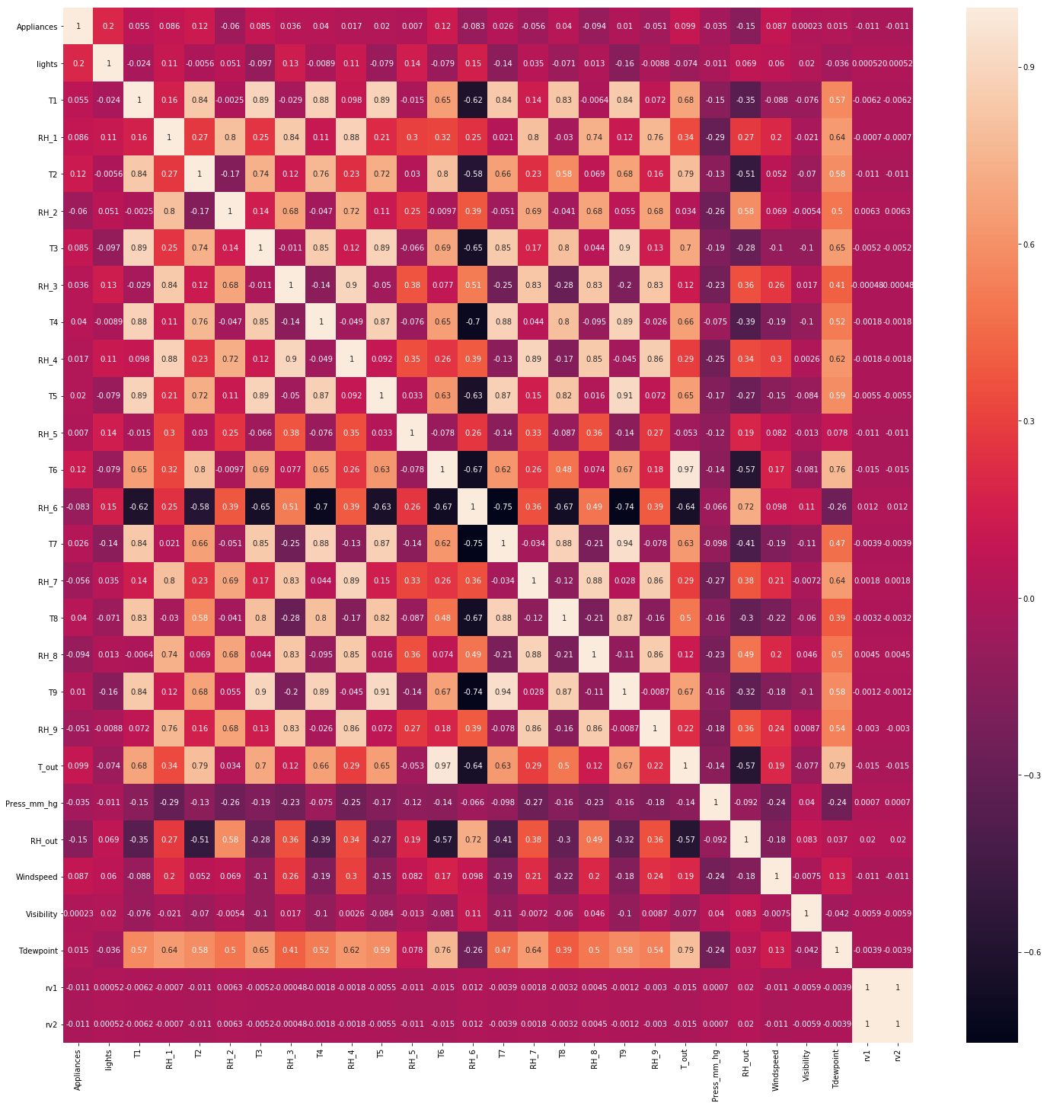
Heat map

Slide 9
Pairplots

