Slide 1
Midterm Case
Team1: Byron Kiriibwa
Wenqi Cui
Yuchen Qiao

Slide 2
Catalog
Part1. Data wrangling
Data Download and pre-processing
Exploratory Data analysis
Part2. Building and evaluating models
Prediction
Classification

Slide 3
Part 1. Data wrangling

Slide 4
Data Download and pre-processing
Download data
Load data
Process data
Generate summary

Slide 5
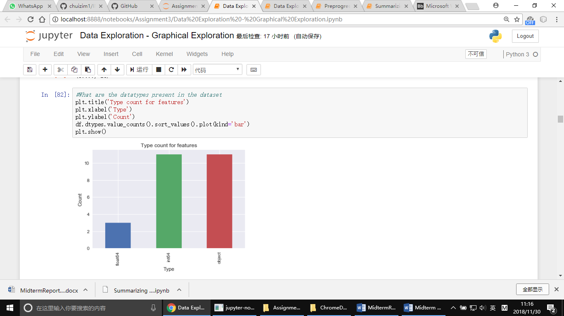
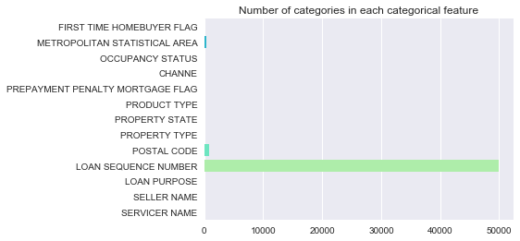

Slide 6
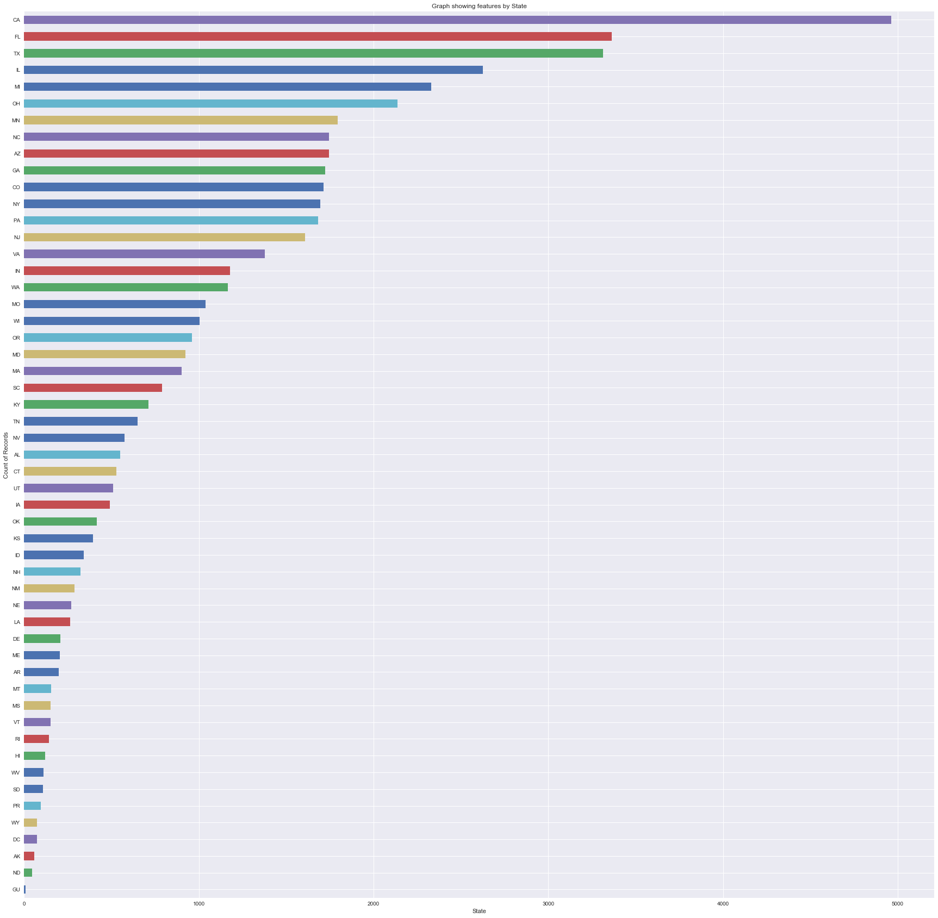

Slide 7
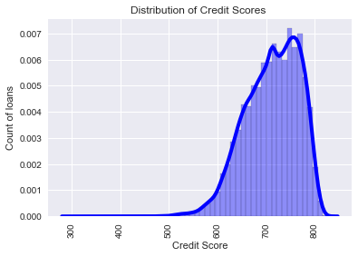
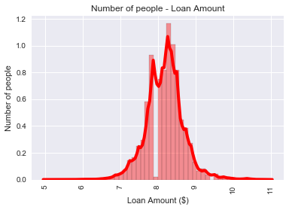

Slide 8
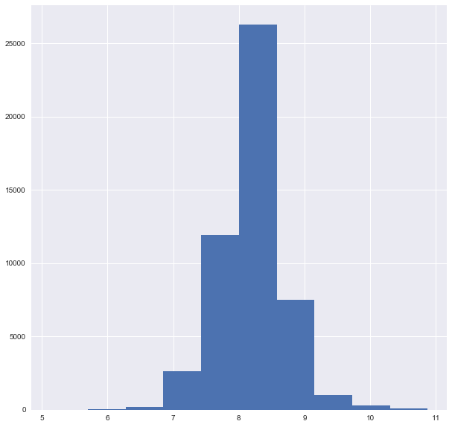
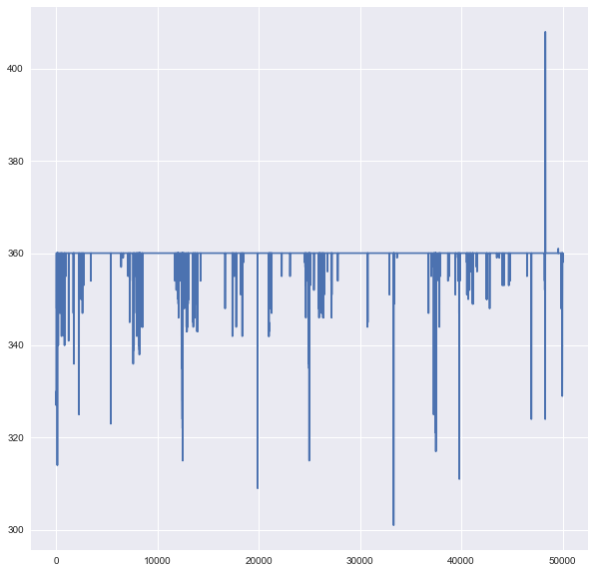

Slide 9
Part2. Building and evaluating models

Slide 10
Prediction
Download data
Load data
Process data
Build regression models
Select best model
Linear regression
Decision tree
Random Forest
Neural Network
TPOT
H20

Slide 11
Classification
Download data
Load data
Preprocessing data
Build regression models
Select best model
Logistic regression
Decision tree
Random Forest
Neural Network
TPOT
H20

Slide 12
Output
 | Actual Delinquents | Predicted Delinquents | Records in the dataset | Delinquents properly classified | nondelinquents improperly classified as delinquents | Validation Quarter
1 | 37190 | 178 | 100000 | 51 | 127 | Q21999
2 | 4062 | 4861 | 100000 | 122 | 4739 | Q31999
3 | 4927 | 141 | 100000 | 53 | 88 | Q41999
4 | 5450 | 55 | 100000 | 55 | 0 | Q12000
5 | 4655 | 125 | 100000 | 117 | 8 | Q22000
6 | 6405 | 394 | 100000 | 163 | 231 | Q32000
7 | 4593 | 106 | 100000 | 62 | 44 | Q42000
8 | 5469 | 151 | 100000 | 87 | 64 | Q12001

Slide 13
Thank you

