Slide 1
Group 6---WeDnesday Presentation2
Yelp Data Analysis

Slide 2
structure
❶ Word to Vector
❷ Dictionary Creating and LDA
❸ Model fitting and Prediction
❹ Strengths and Weaknesses

Slide 3
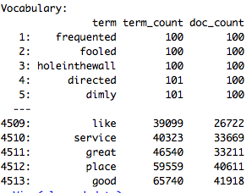
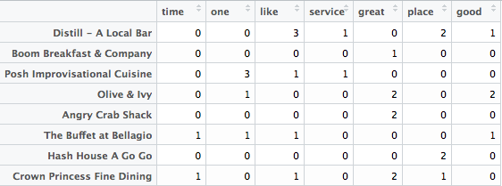
❶ Word to Vector
Vocabulary
Sparse Matrix

Slide 4
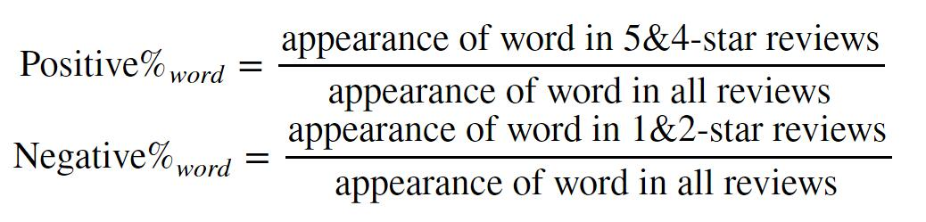
❷ Dictionary Creating --- Base

Slide 5
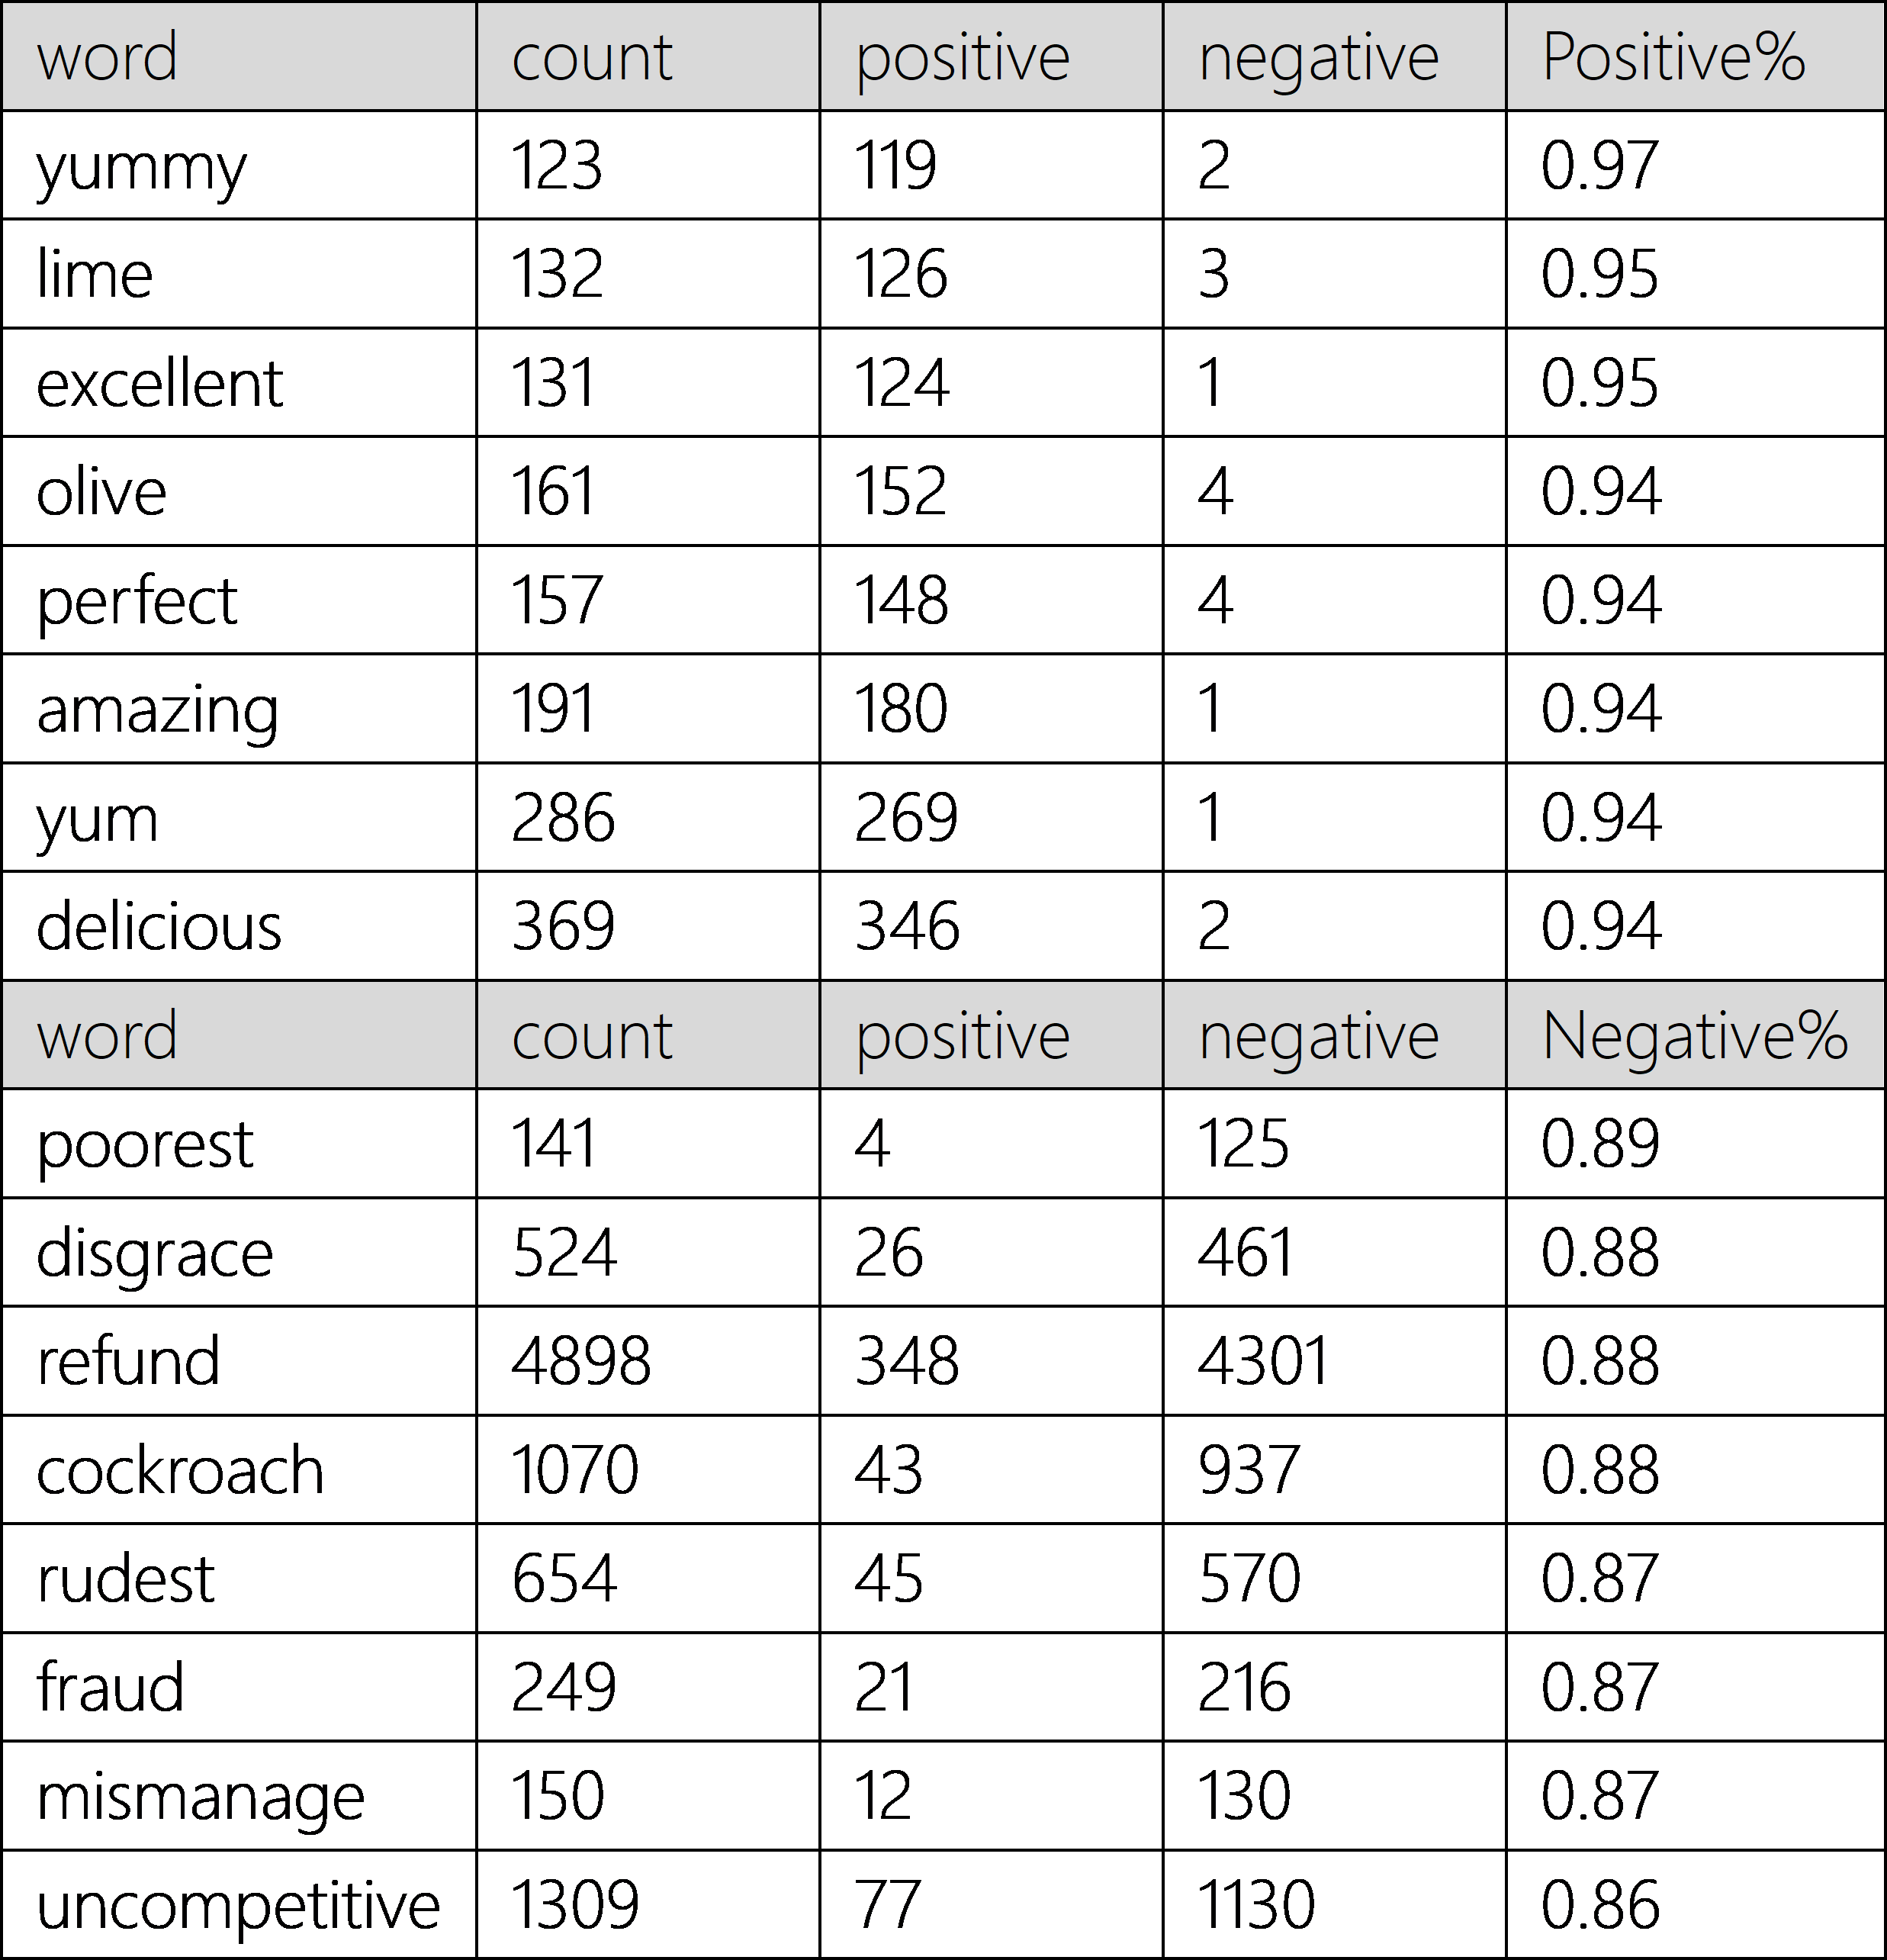
❷ Dictionary Creating --- Base

Slide 6
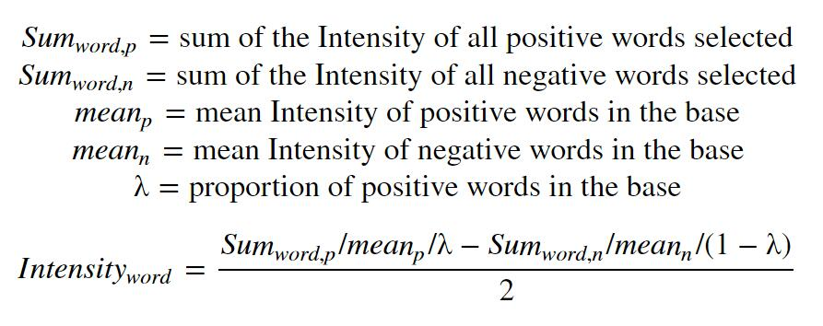
❷ Dictionary Creating --- Adding
(1) Find nearest words in the base dictionary
(2) Calculate sentiment points using weighted average

Slide 7
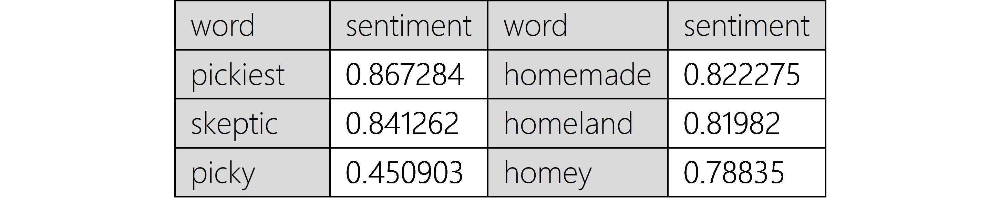
❷ Dictionary Created
Interesting positive words :

Slide 8
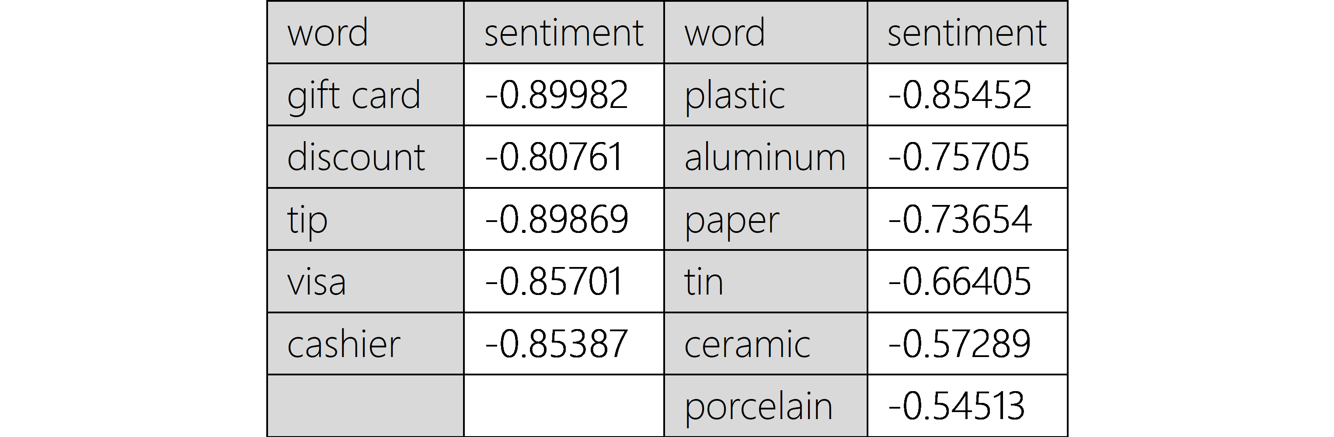
❷ Dictionary Created
Interesting negative words :

Slide 9
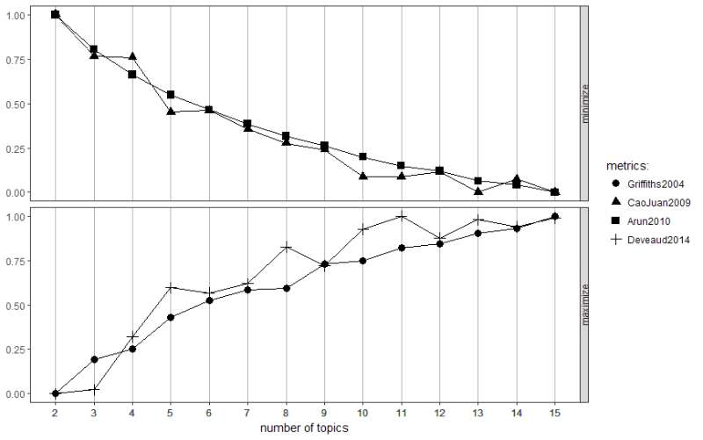
LDA

Slide 10
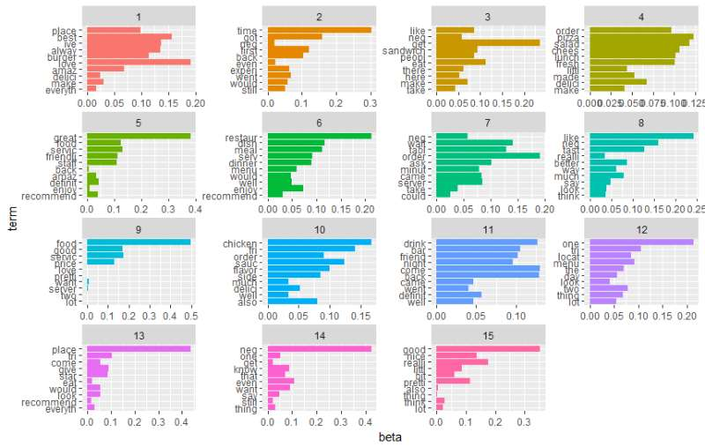
LDA

Slide 11
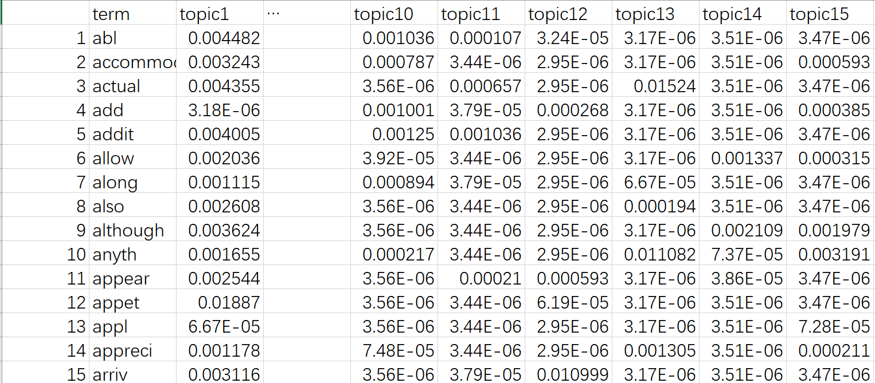
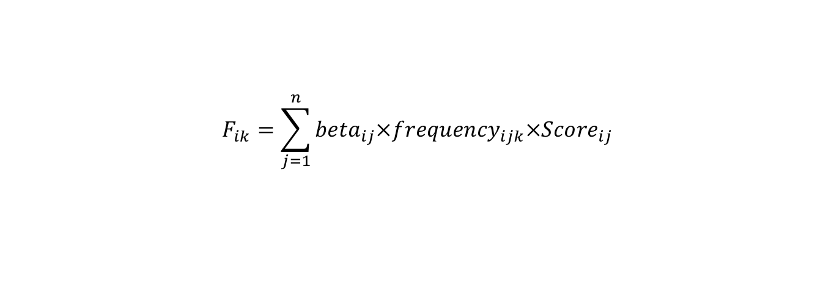
Feature Value from LDA
$$F_{ik}=\sum_{j=1}^{n}{{beta}_{ij}×{frequency}_{ijk}×{Score}_{ij}}$$

Slide 12
❸ Machine Learning Models
Tried Machine Learning Models
Xgboost
Random Forest
Ranger

Slide 13
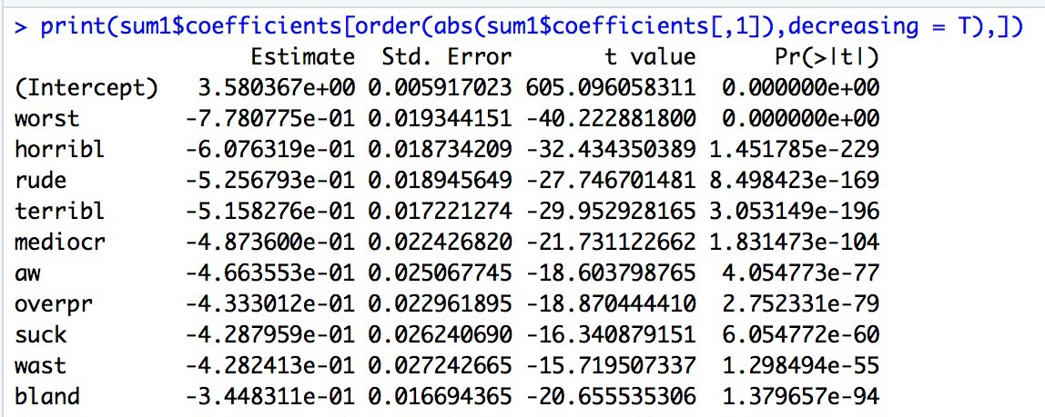
❸ Model --- Linear Regression
Select word variables by p values and coefficients
NV
AZ

Slide 14
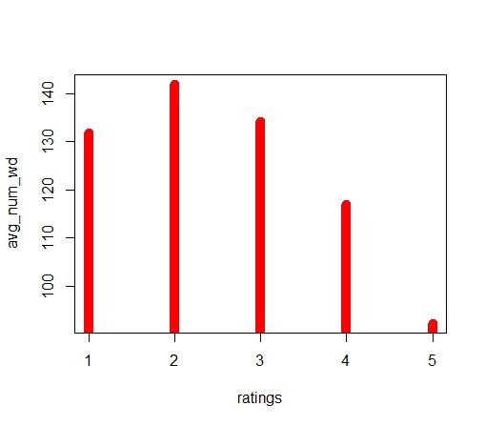
❸ Model --- Linear Regression
Feature of length by ratings
Length of reviews
Statistical Significant !

Slide 15
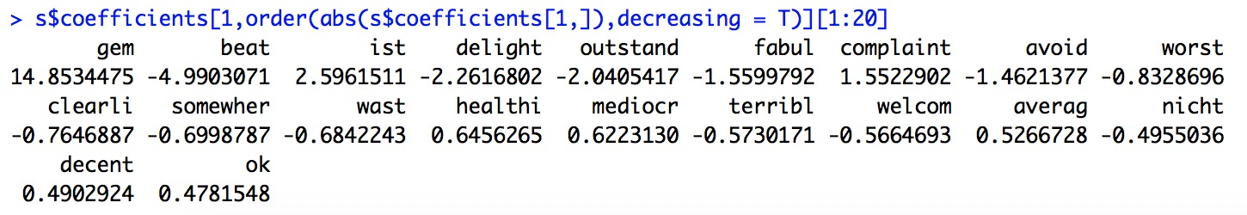
❸ Model --- Multinomial Logistic Regression
Model = multinom ( Stars ~ Word variables + Length)

Slide 16
❸ Model --- Multinomial Logistic Regression
Type of Predictions
Class : 1 2 3 4 5
Probs : probabilities --- weighted average

Slide 17
Model | Variables | RMSE based on cleaned train data
Multinomial Logistic | Words Sparse Matrix + Length | 0.678
 | LDA features | 0.742
Xgboost | Words Sparse Matrix + Length | 0.725
 | LDA features | 0.766
Random Forest | Words Sparse Matrix + Length | 0.831
 | LDA features | 0.890
Ranger | Words Sparse Matrix + Length | 0.793
 | LDA features | 0.943
Linear Regression | Words Sparse Matrix + Length | 0.846
 | LDA features | 0.965
Model Comparison
Model Comparision

Slide 18
Strengths : Dictionary; Easy to interpret; Accuracy
Weaknesses : Information wasted; MSE not low enough
❹ Strengths and Weaknesses

Slide 19
Q&A
THANK YOU!

