Slide 1

Machine Learning
for
Enabling Active Measurements
in
IoT Environments
Introduction
Name: Wenqing Yan
Program: NSS
ML in Wireless Sensor Networks
Notes:
Hello every one, my name is Wenqing Yan. My thesis topic is:

Slide 2
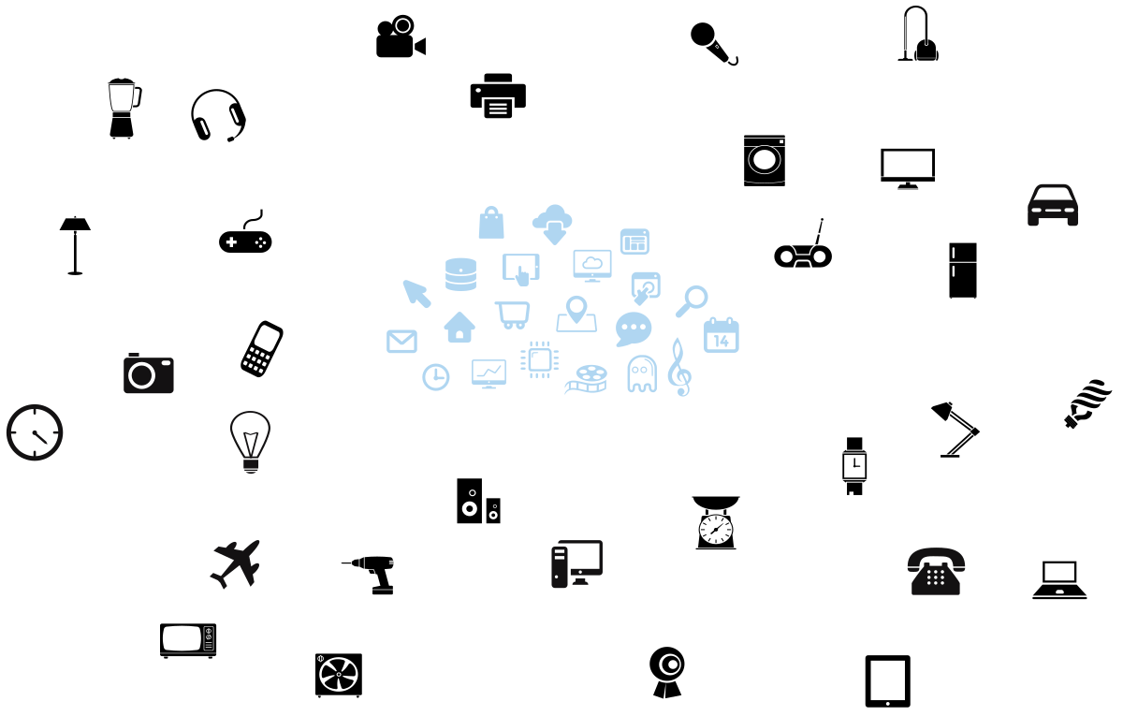
IoT
“Internet of Things (IoT) is New generation of globally accessible Internet system that interconnects trillions of everyday objects.”
Networked Society
Ericsson
IoT

Slide 3
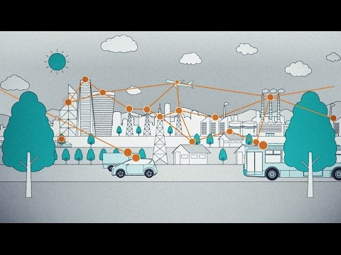
WSNs
Notes:
One typical technology for IoT is Wireless sensor networks, (WSNs).
It is a network connects intelligent sensors to sense and monitor the surrounding information.

Slide 4
WSNs
City
Light
Smart
Agriculture
Temperature
Factory
Humidity
Parking, Traffic
Traffic

Slide 5
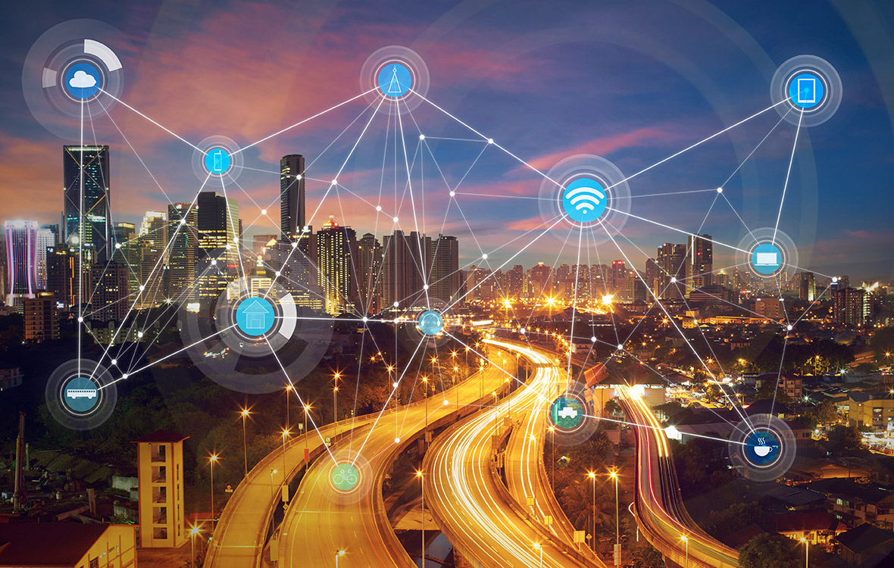
WSNs
Wireless Technology

Slide 6
WSNs
Wireless Technology
Service Requirement
Dynamic
Unstable
Reliable
Stable

Slide 7
Network Management
Monitor QoS
Detect malfunctions + repair
Metrics

Slide 8
Network Management
Available Metrics
2. Coveted Metrics
Raw sensing data
Probe packets

Slide 9
Observability Expander
WSNs
Probe
Load
processing capability
memory
power
Limited processing capability
memory
power
Reducing overhead
+
energy consumption

Slide 10
Observability Expander
ML Prediction model
Available Metrics
Coveted Metrics

