Slide 1

shield+
A Improved Data Verification Framework with Reputation System
Wenqing Yan

Slide 2
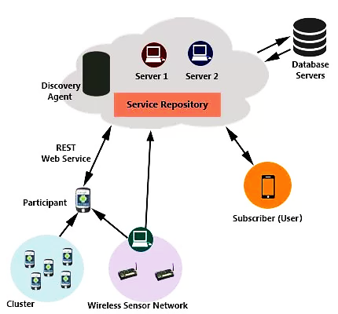

shield
Light
Accelerometer
Temperature
Orientation
Gravity
…
A Data Verification Framework for Participatory Sensing Systems
Pressure
Wenqing Yan

Slide 3
Research Reasons
Machine Learning
#1. SHIELD → Statistical anomaly detection. DBSCAN
#2. Some hints in the original SHIELD paper.
DATA
User
Wenqing Yan

Slide 4
1
DATA
User
History
2
SHIELD
Time Stamp
Report Stream
3
iNCENtivizing
Wenqing Yan

Slide 5
+reputation system
1
DATA
User
2
+Reputation System
Time Stamp
Report Stream
3
iNCENtivizing
Wenqing Yan

Slide 6
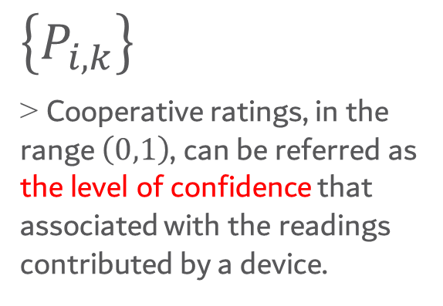
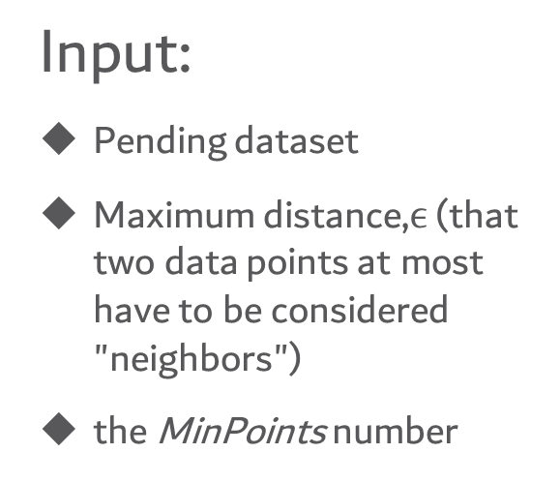
Can we add REPUTATION?
Feasibility
dbscan
Reputation
system in [1]
Input:
Pending dataset
Maximum distance,$ϵ$ (that two data points at most have to be considered "neighbors")
the MinPoints number
$\left\{P_{i,k}\right\}$
> Cooperative ratings, in the range $\left(0,1\right)$, can be referred as the level of confidence that associated with the readings contributed by a device.
Density >The number of points in the neighbor area.
The degree of confidence that one data has the contribution to the sensing task
[1]. “Are you contributing trustworthy data?: the case for a reputation system in participatory sensing.”
Huang, Kuan Lun, Salil S. Kanhere, Wen Hu
Wenqing Yan

Slide 7
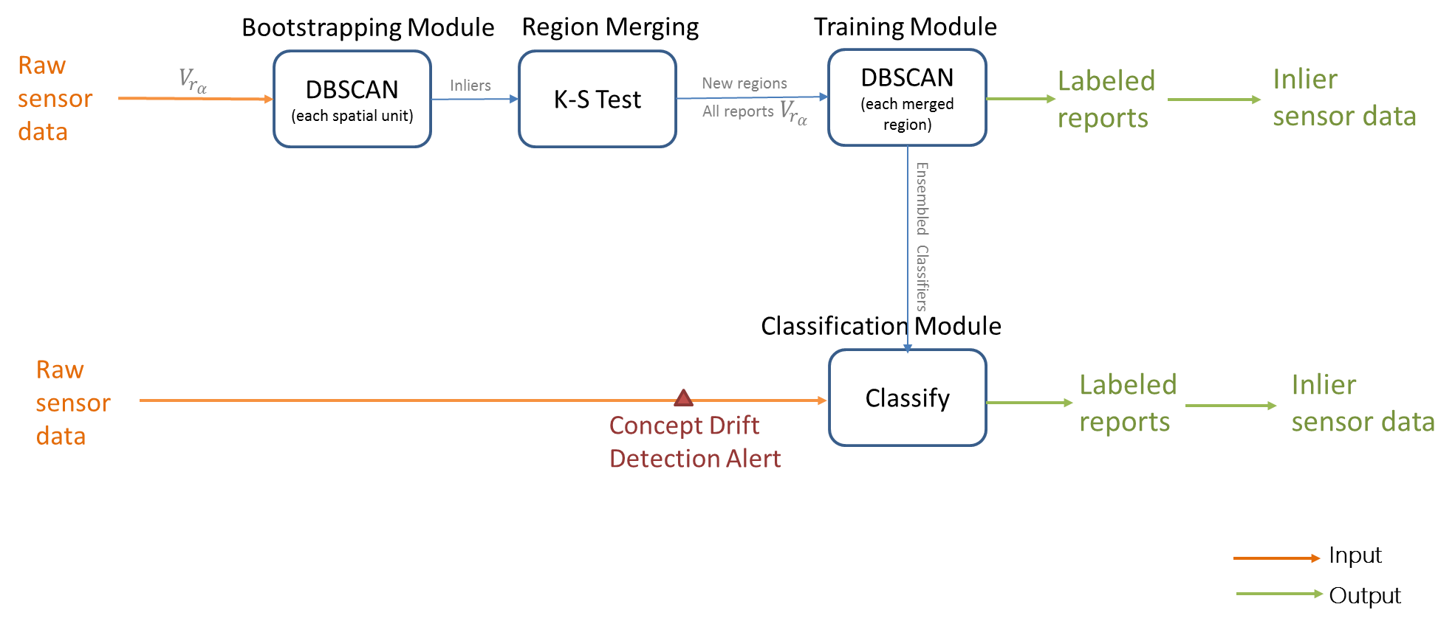
DIFFERENCE
Information Flow
shield
Wenqing Yan

Slide 8
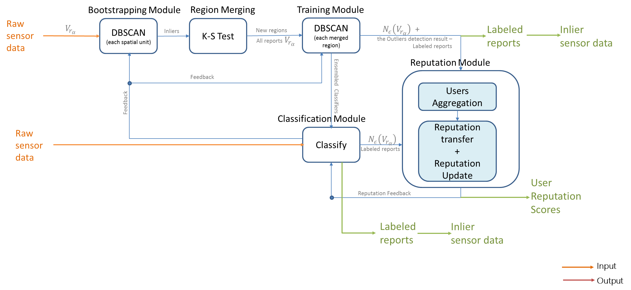
DIFFERENCE
Information Flow
Shield+
Wenqing Yan

Slide 9






DIFFERENCE
Timeline
Shield+
Report Timeline
$${Rep}_{i,0}$$
$${Rep}_{i,2}$$
$${Rep}_{i,3}$$
$${Rep}_{i,4}$$
…
$${Rep}_{i,1}$$
$${Rep}_{i,k}$$
T
t
T
t
Reputation Timeline
Reputation Bootstrapping Point
Reputation Updating Point
Rebootstrapping Point
Retraining Point
Wenqing Yan

Slide 10
Other components
Total Revocation
Pseudonym Revocation[1]
Partial Revocation
Incentivizing Support
[1]. SPPEAR: Security & Privacy-Preserving Architecture for Participatory-Sensing Applications. S. Gisdakis, T. Giannetsos, and P. Papadimitratos
Wenqing Yan

Slide 11
Performance evaluation
Extra Functionalities
Cluster Algorithm Complexity
Computing Time
Different adversary models
Participation rate
Participation Rate
Accuracy
Load
CPU Load
Wenqing Yan

Slide 12
FUTURE
Shield+
Framework
Joint Point
Theoretical Analysis
Feasibility
Advantages
Testbed setup
&
Testing in different scenarios
Wenqing Yan

Slide 13


