Slide 1
Unsupervised Domain Adaptation In Medical Images
6th Sep 2022
Wenqing Zong Supervisor: Dr. Matthew Williams
Supervisor: Elsa Angelini
I will quit and rejoin this meeting in case of annoying network errors

Slide 2
Presentation Overview
Motivation
Project Goal
Classification (Data, Method, Result, Conclusion)
Segmentation (Data, Method, Result, Conclusion)
Final Conclusion and Future Work
References
Appendix
Questions

Slide 3
Motivation
Deep learning has already achieved remarkable progress in medical image analysis.
However, most methods require a huge amount of annotated data to train their model.
Also, domain shift makes it difficult for a trained model to perform well on another data domain.
Unsupervised Domain Adaptation can help!

Slide 4
Project Goal
Use UDA methods to solve two common tasks in medical image analysis: classification and segmentation with the following two restrictions:
Data comes from two domains, and only one of them contains ground truth labels. We call this domain as ‘Source Domain’ and the other ‘Target Domain’.
There is an obvious domain shift so a model trained on source domain cannot be directly applied on target domain.

Slide 5
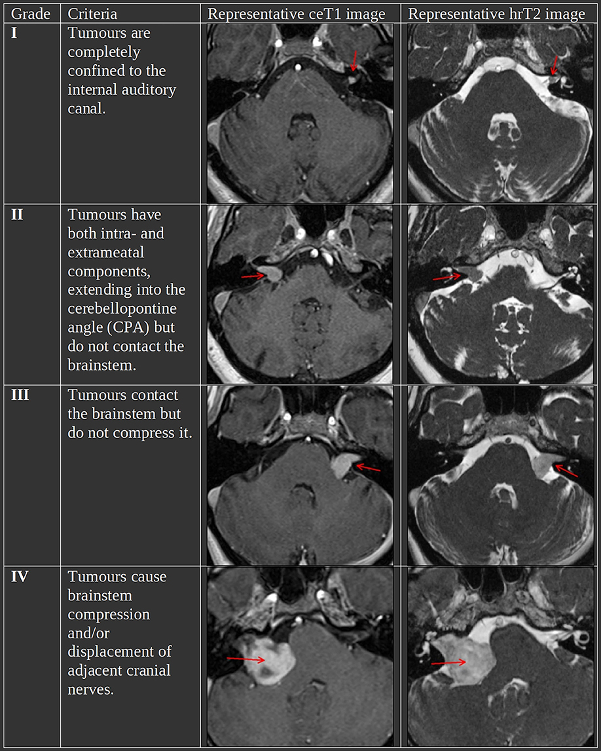
Classification - Data
Dataset: CrossModa 2022^{[1]}, it uses T1ce modality as source domain, and T2 modality as target domain.
210 samples in source domain training set, 210 samples target domain training set, 64 samples in validation set.
Task: Classify Vestibular Schwannoma according to Koos grading system^{[2]}.
Fig 1. Illustration of CrossModa 2022 Dataset^{[1]}

Slide 6
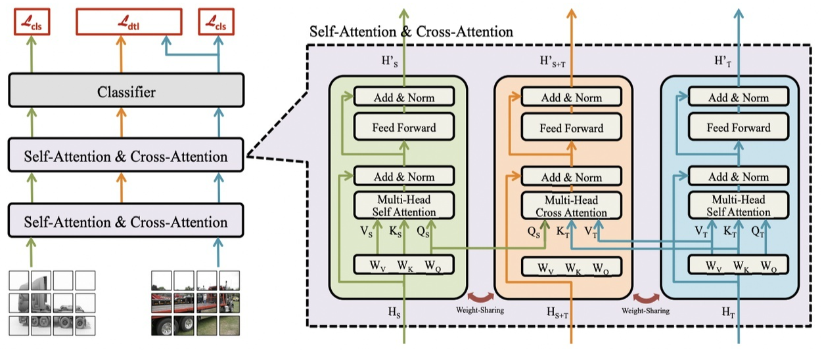
Classification - Method - Overview
Cross Domain Transformer (CDTrans) architecture^{[3]}.
The first few works that use transformer ideas to solve UDA problem.
Data are fed into network in pairs. (more details at next slides)
Fig 2. CDTrans Architecture^{[3]}

Slide 7
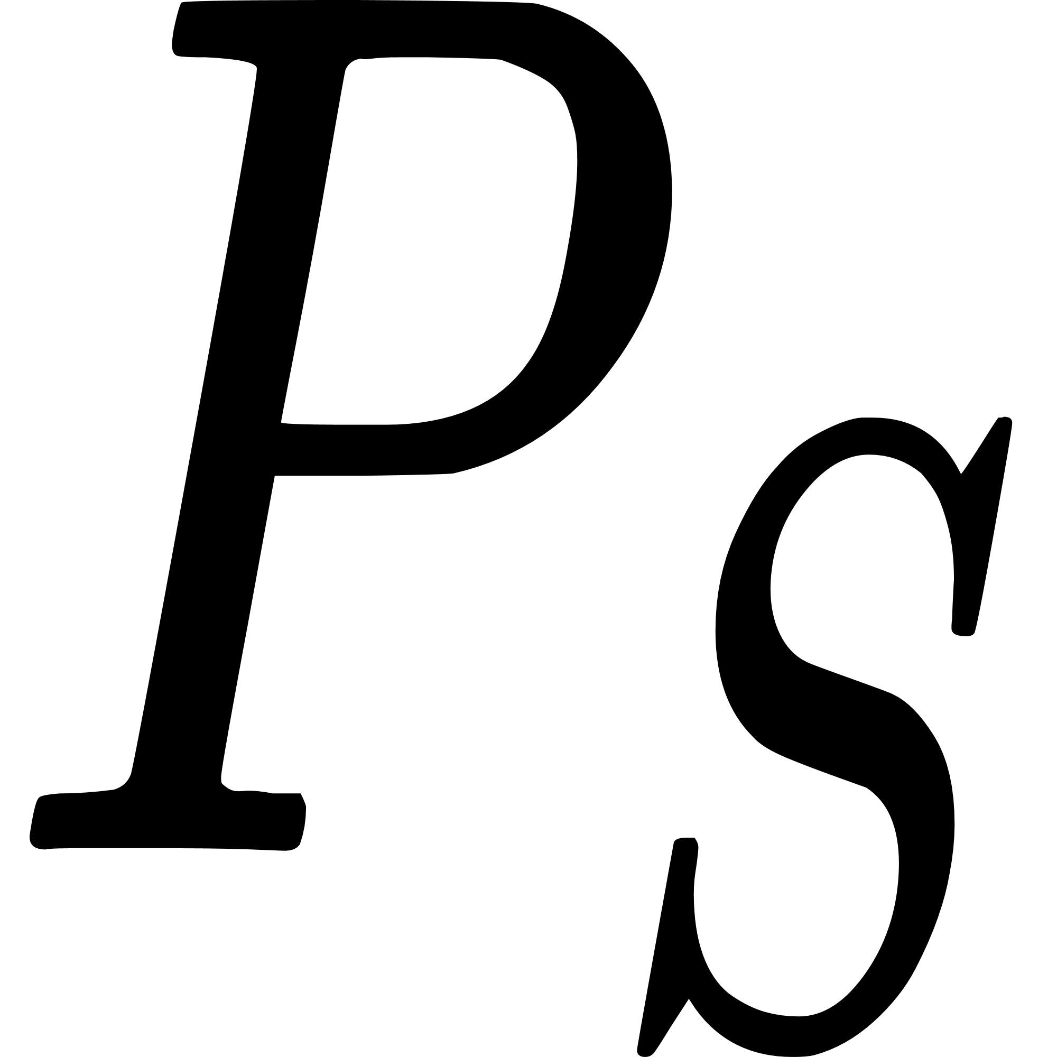
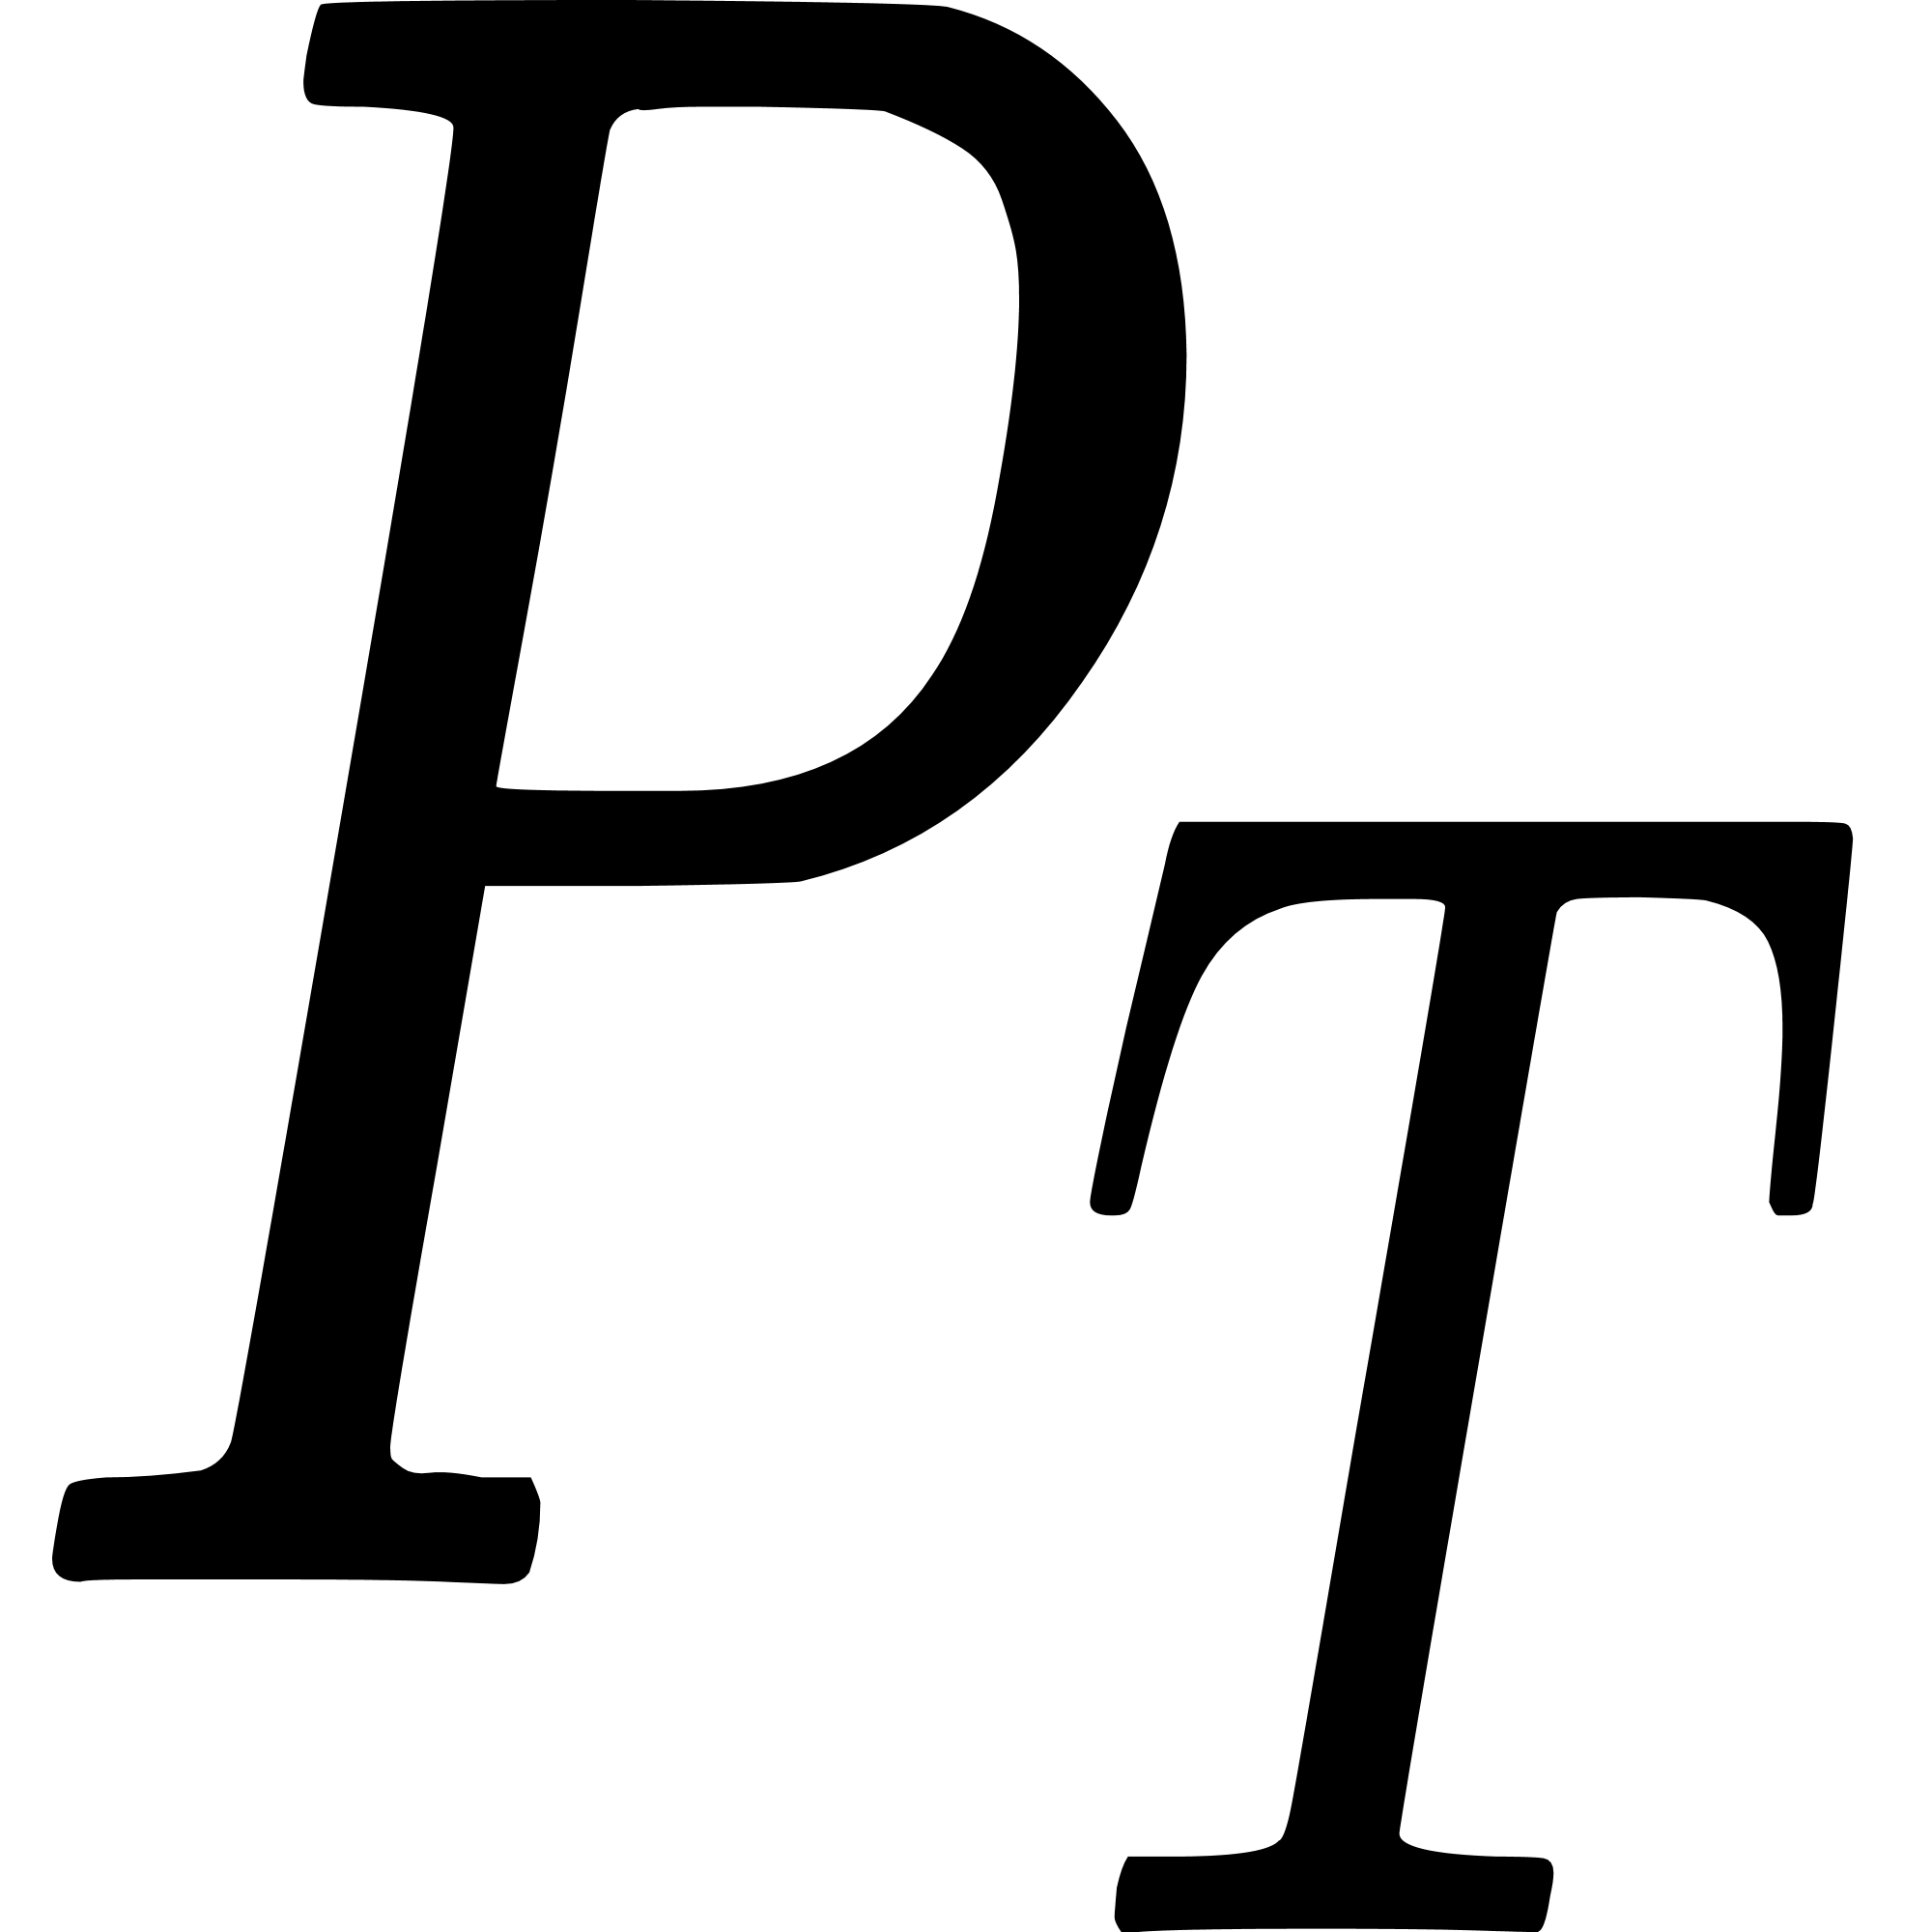
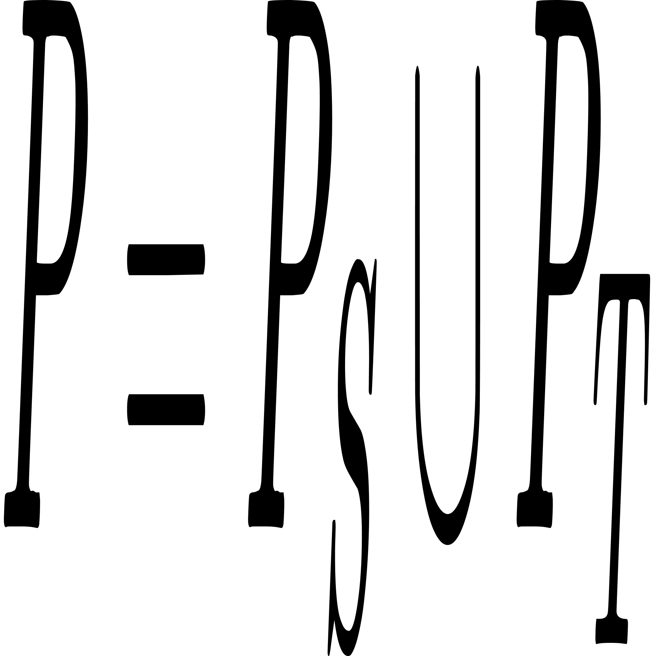
Classification - Method - Building Pairs
For each data in source domain, find its most similar data in target domain, thus we get . For each data in target domain, find its most similar data in source domain, thus . The final input pairs are: . For each pair, we assume the pseudo label for target data is the same as source data label.

Slide 8

Classification - Method - Pseudo Label Denoising
is expected to contain a lot of noisy pseudo labels.
Train a source model using only source data and corresponding labels.
Directly apply this model to target domain data. For each target domain data, get their probability distribution.
Use K-means algorithm to find class centres, and use KNN algorithm to re-assign pseudo labels.
A pair in is discarded if the re-assigned pseudo label is inconsistent with its old pseudo label.

Slide 9
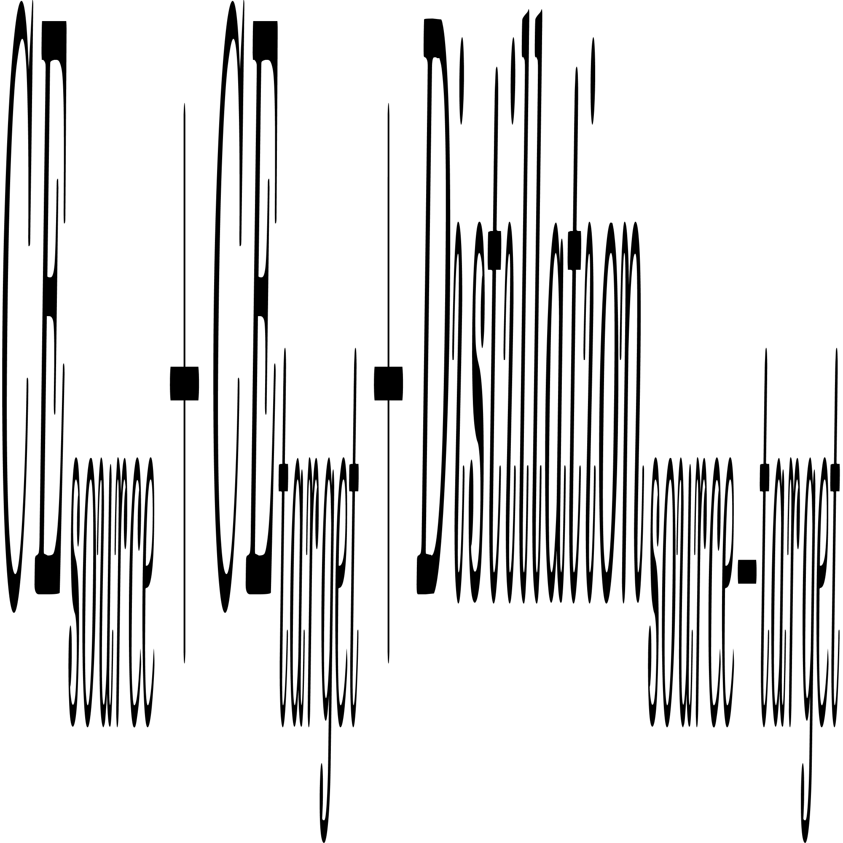
Classification - Method - Training
Source data and ground truth labels are fed into source branch.
Target data and pseudo labels are fed into target branch.
Source-Target branch uses cross attention to align feature distribution of two domains.
Triplet loss:
Fig 2. CDTrans Architecture^{[3]}

Slide 10
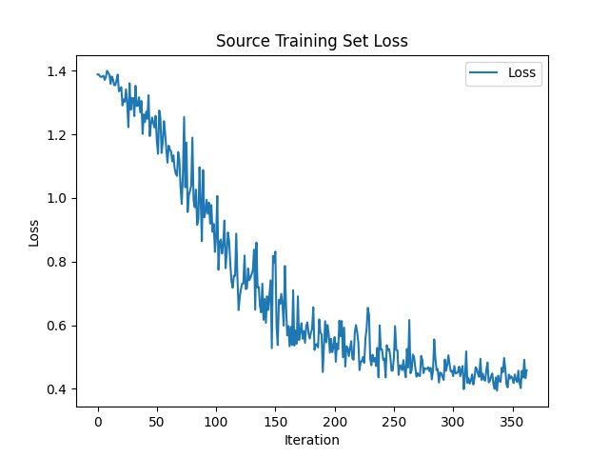
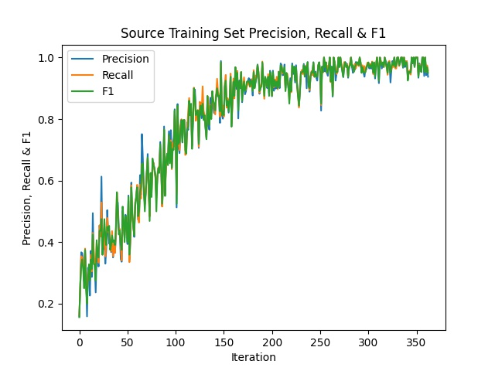
Classification - Result - Source Domain Pretrain
Ideal performance on CrossModa 2022 source domain training set.
Fig 3. CDTrans Performance on CrossModa 2022 Source Training Set

Slide 11
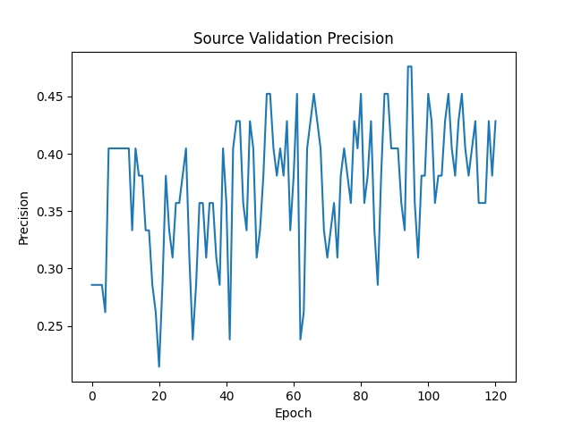
Classification - Result - Source Domain Pretrain
Bad performance on CrossModa 2022 source domain validation set.
Fig 4. CDTrans Performance on CrossModa 2022 Source Validation Set

Slide 12
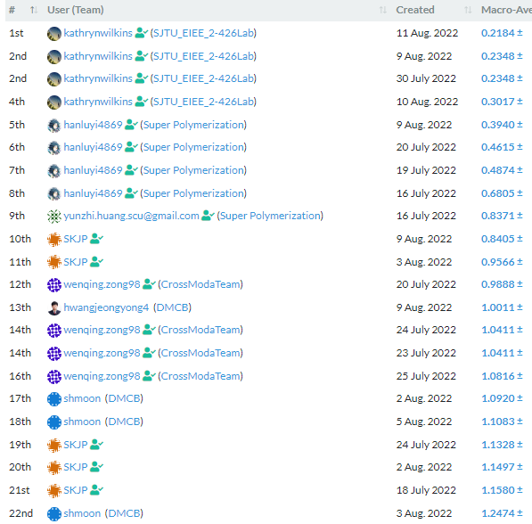
Classification - Result - Target Domain
Ranked 12th out of 22 submissions on the official leaderboard.
But sadly, this result is obtained by source model, intended to use it as a baseline.
Best Target modal ranked 14th out of 22 submissions.
Fig 5. The Official Leaderboard^{[4]}

Slide 13
Classification - Conclusion
CDTrans has a great ability in memorising training samples.
CDTrans is not suitable for CrossModa 2022 dataset. Compared to the whole brain, only a tiny portion determines VS grade. CDTrans cannot learn in this extreme situation.

Slide 14
Segmentation - Data
Dataset: BraTS 2021^{[5]}, 1251 subjects in total.
Source Domain: T1ce, Target Domain T2.
Dataset split: source training : target training : validation : test = 500 : 500 : 125 : 126.
Each subject is converted to 155 2D axial images.

Slide 15
Segmentation - Method - Overview
Inspired by Chen et al.^{[6]}, We proposed a novel Momentum Prototype UDA (MP-UDA) method, which has the following two advantages:
Source-Free.
Support various network backbones.

Slide 16
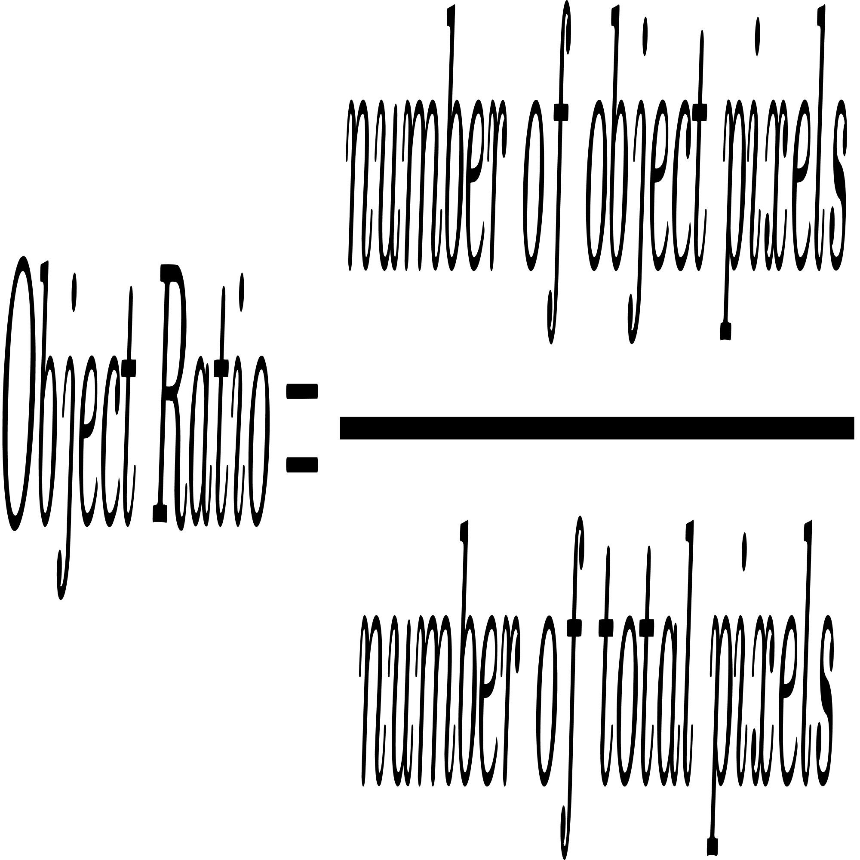
Segmentation - Method
Define 3 things:
probability: output of the last convolutional layer with softmax activation applied.
feature: input of the last convolutional layer.
Object Ratio:

Slide 17
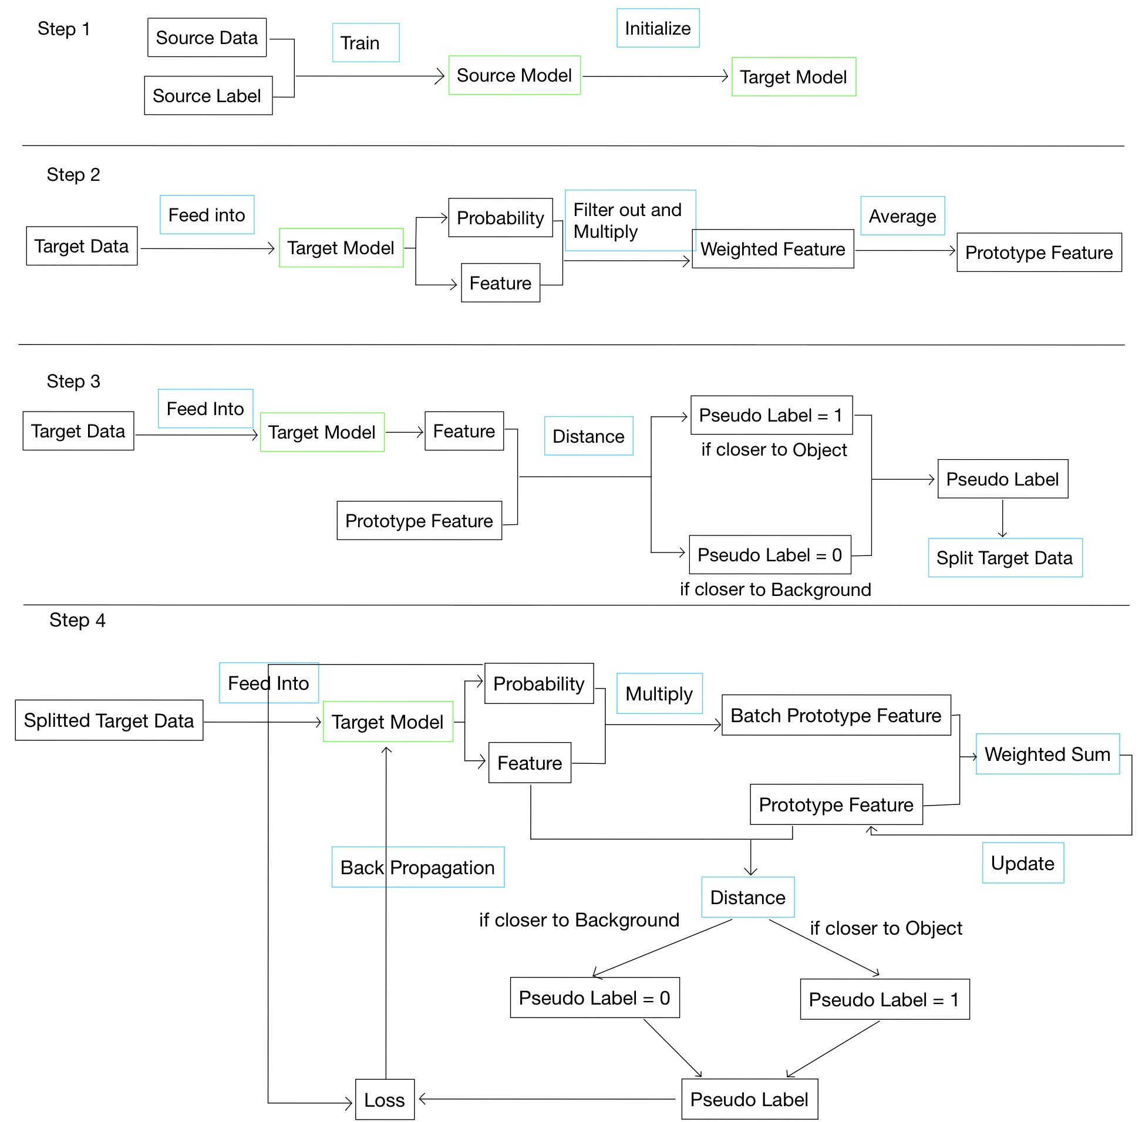
Segmentation - Method - Step 1
Use source domain data and labels to train a source model.
Use the source model to initialise target model.
Fig 6 MP-UDA Step 1

Slide 18
Segmentation - Method - Step 2
Directly feed target data into untrained target model.
Filter out pixels with low probability, then multiply probablity and feature to get weighted feature.
Repeat for all target data and take their average to get prototype feature.
Fig 7. MP-UDA Step 2

Slide 19
Segmentation - Method - Step 3
Use distance measure and prototype feature to decide pseudo labels for each pixel.
Use pseudo label to calculate object ratio and resplit target data into two parts: one part with a higher object ratio, and the other with a low object ratio.
Fig 8. MP-UDA Step 3

Slide 20
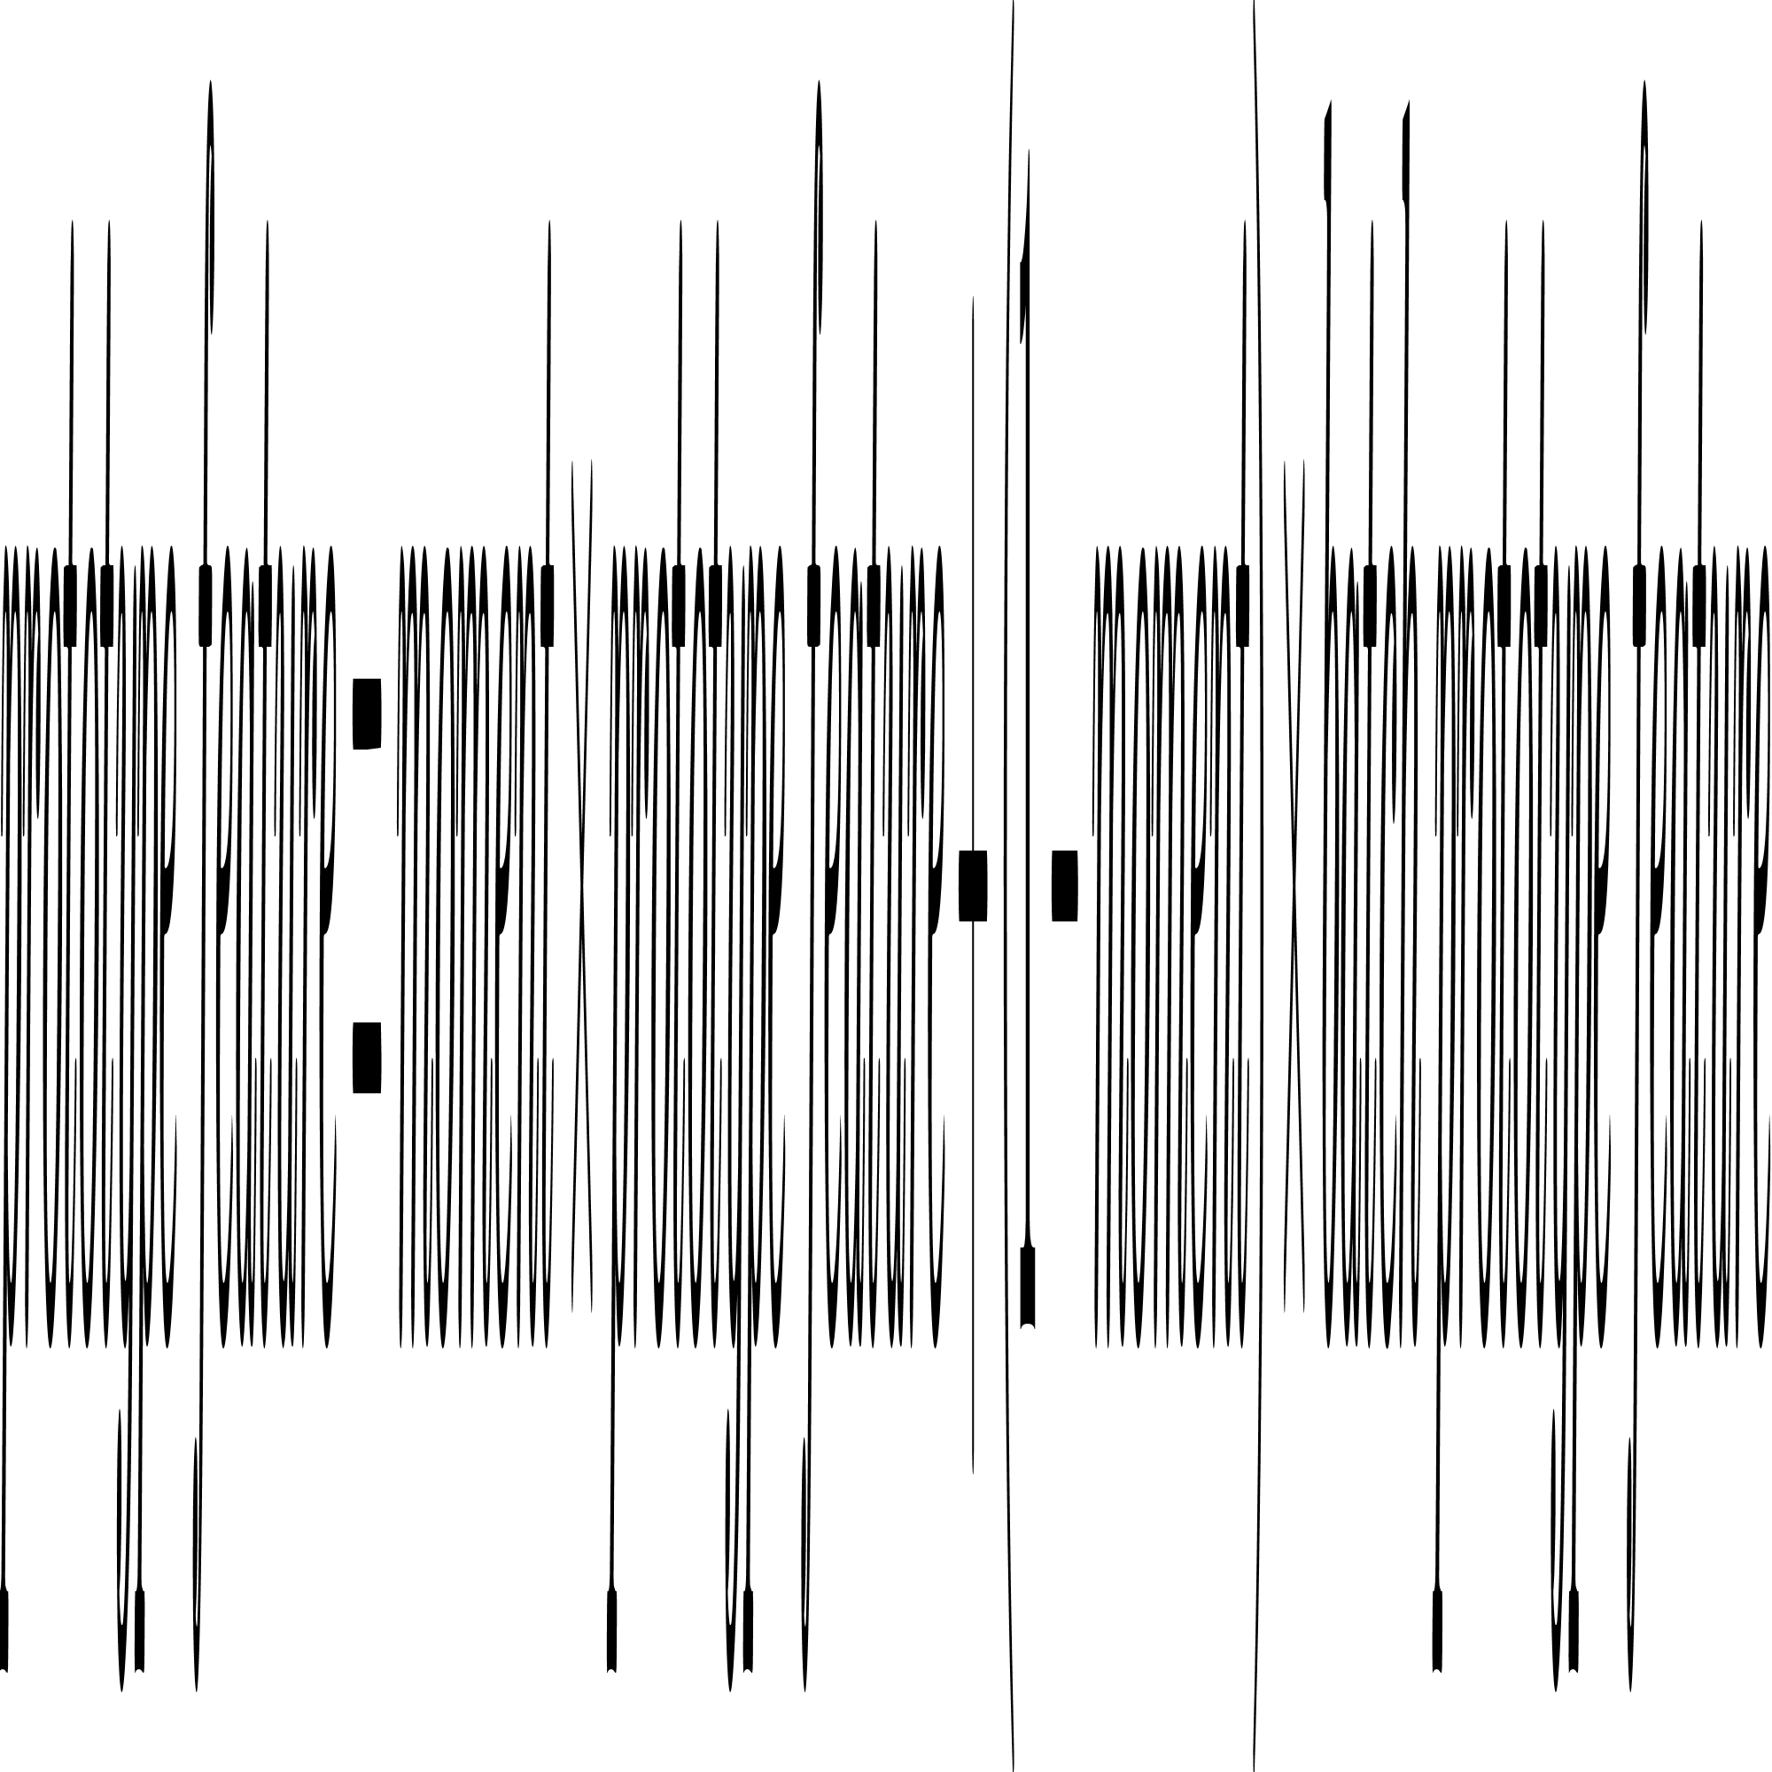
Segmentation - Method - Step 4
Momentum update prototype feature as:
Use updated prototype feature to calculate pseudo labels.
Loss is a combination of dice loss and entropy loss as suggested by Liang et al. ^{[7]}
Fig 9. MP-UDA Step 4

Slide 21
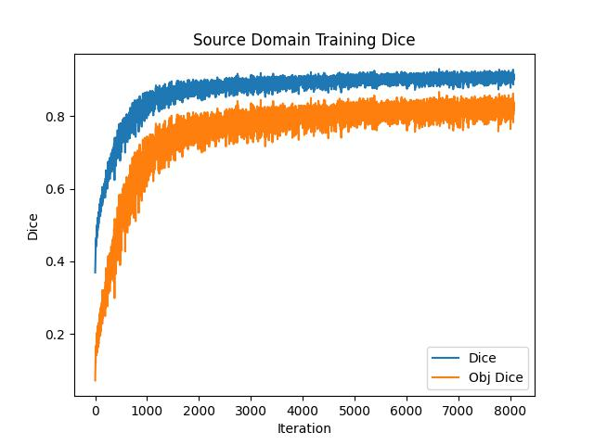
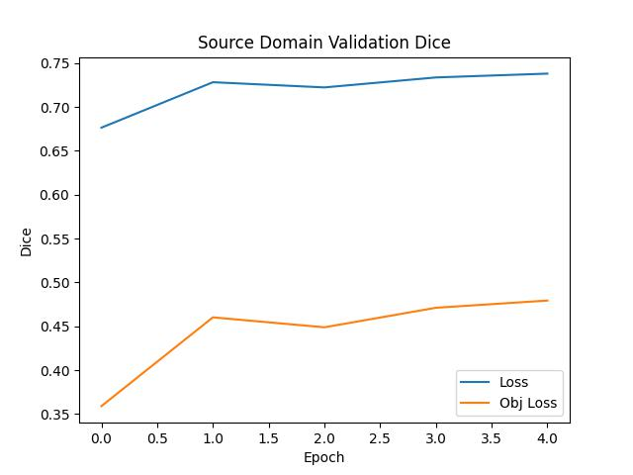
Segmentation - Result
Good performance on source domain training set, and generalise well to unseen source domain data.
Fig 10. MP-UDA Performance on BraTS 2021 Source Training Set

Slide 22
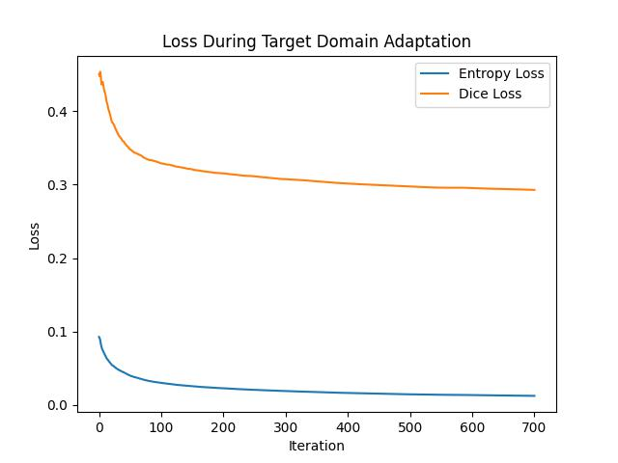
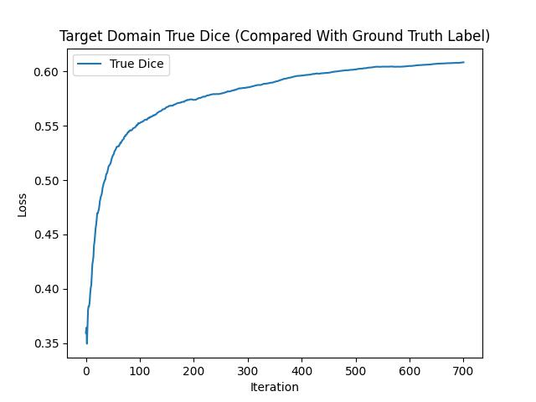
Segmentation - Result
Good adaptation to target domain.
Fig 11. MP-UDA Performance on BraTS 2021 Target Training Set

Slide 23
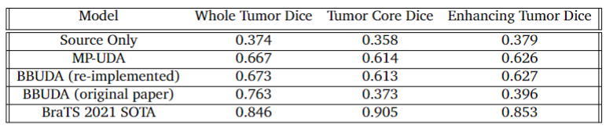
Segmentation - Result
For comparision with source only, MP-UDA solved the domain shift problem and achieved good dice score.
In comparision with BBUDA (The latest model publish this June), it also achieves a similar performance.
Tabel 1. MP-UDA Performance and Comparision on BraTS 2021 Test Set

Slide 24
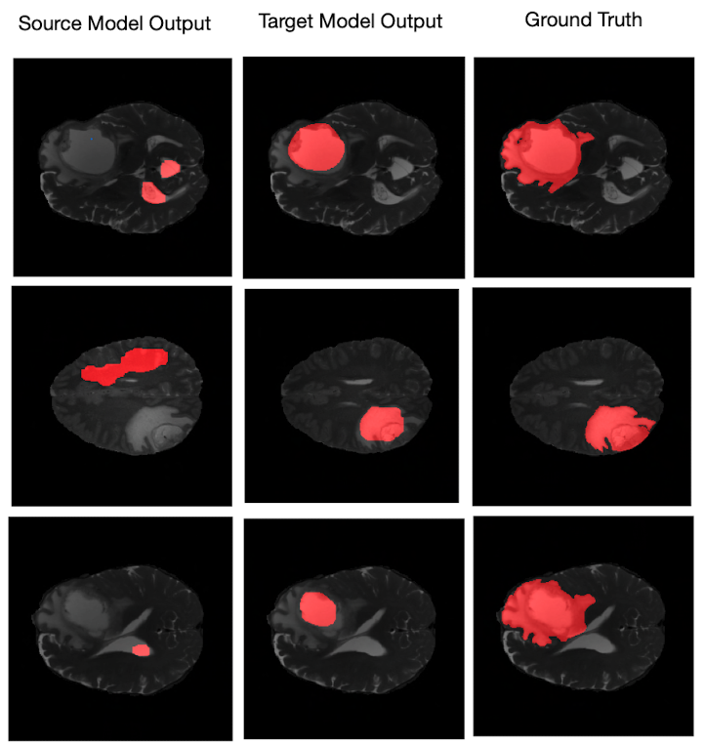
Segmentation - Result
Fig 12. MP-UDA Performance Visualisation on BraTS 2021 Test Set

Slide 25
Segmentation - Conclusion
MP-UDA uses prototype feature to calculate pseudo labels, and momentum update it during training.
It overcomes domain shift, fulfils project goal.

Slide 26
Final Conclusion
We used CDTrans to solve classification problem, but the result is not ideal.
We proposed a noval MP-UDA to solve segmentation problem, it overcomes domain shift, achieves similar result when compared to the latest BBUDA model.

Slide 27
Future Work
Using transformer achitecture to detect small objects in medical images.
MP-UDA is a source-free method, it is not designed to be black box as an attacker could get 100% accurate target domain data if it launches a Man In The Middle attack, but an attacker can get some source domain data if it launches a Model Inversion (MI) attack (although not 100% accurate). Consider adding MI prevention measures in the future.

Slide 28
Reference
^{[1]}CrossModa 2022 Availabel from https://crossmoda-challenge.ml/ [Accessed 30 Aug] 2022
^{[2]}Koos WT, Day JD, Matula C, Levy DI. Neurotopographic considerations in the
microsurgical treatment of small acoustic neurinomas. American Association of
Neurological Surgeons. 1998;88:506-12
^{[3]}Xu T, Chen W, Wang P, Wang F, Li H, Jin R. CDTrans: Cross-domain Transformer for Unsupervised Domain Adaptation. 2021 9. Available from: https://arxiv.org/abs/2109.06165v4 [Accessed on 30 Aug 2022]
^{[4]}Leaderboard - Grand Challenge;. Available from: https://crossmoda2022.grand-challenge.org/evaluation/task-2-koos-classification-validation-phase/leaderboard/ [Accessed on 30th Aug 2022]

Slide 29
Reference
^{[5]}RSNA-ASNR-MICCAI BraTS Challenge 2021 Available from http://braintumorsegmentation.org/ [Accessed 30 Aug 2022]
^{[6]}Chen C, Liu Q, Jin Y, Dou Q, Heng PA. Source-Free Domain Adaptive Fundus
Image Segmentation with Denoised Pseudo-Labeling. Lecture Notes in Computer
Science (including subseries Lecture Notes in Artificial Intelligence and Lecture
Notes in Bioinformatics). 2021 9;12905 LNCS:225-35. Available from: https://arxiv.org/abs/2109.09735v1 [Accessed 30 Aug 2022]
^{[7]}Liang J, Hu D, Feng J. Do We Really Need to Access the Source Data? Source
Hypothesis Transfer for Unsupervised Domain Adaptation. 37th International
Conference on Machine Learning, ICML 2020. 2020 2;PartF168147-8:5984-
95. Available from https://arxiv.org/abs/2002.08546v6 [Accessed 30 Aug 2022]

Slide 30
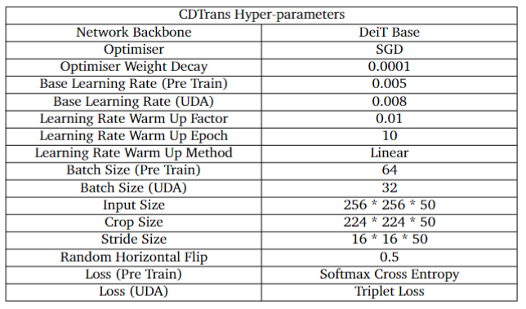
Appendix - CDTrans Hyper-parameters
Table 2. CDTrans Hyper-parameters

Slide 31
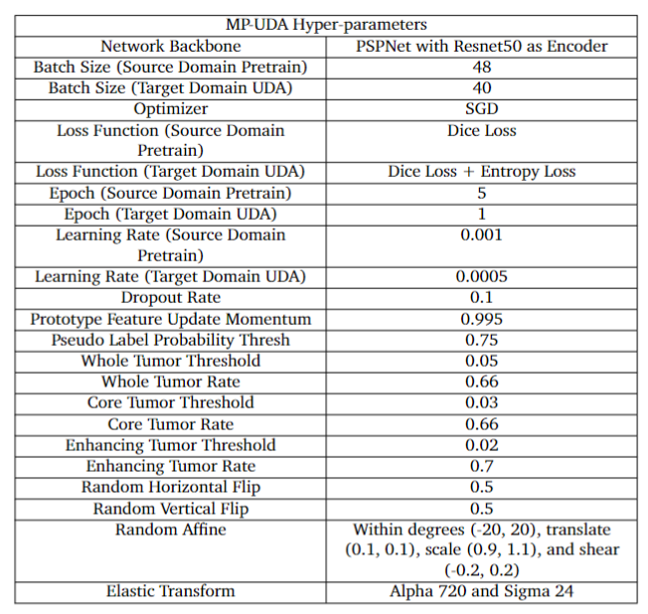
Appendix - MP-UDA Hyper-parameters
Table 3. MP-UDA Hyper-parameters

Slide 32
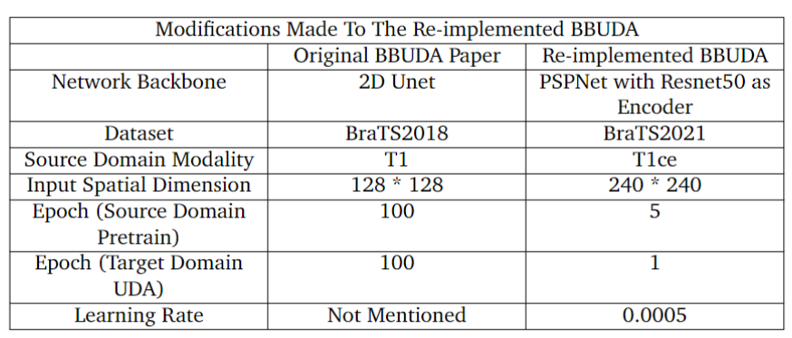
Appendix - Modifications to Reimplemented BBUDA
Table 4. Modifications to Reimplemented BBUDA

Slide 33
Questions?

Slide 34
Thank you for listening!

