Slide 1
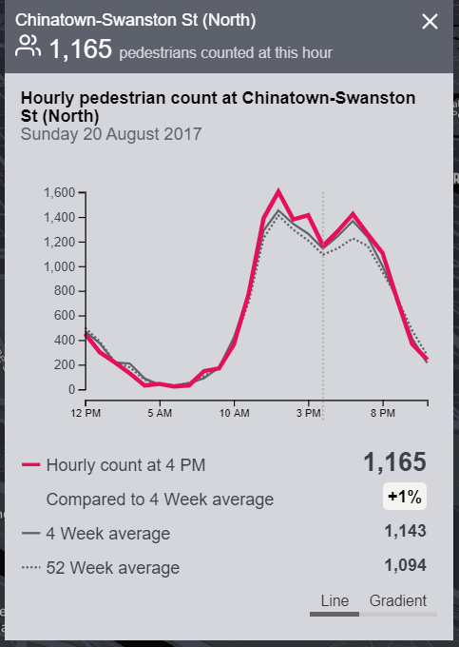
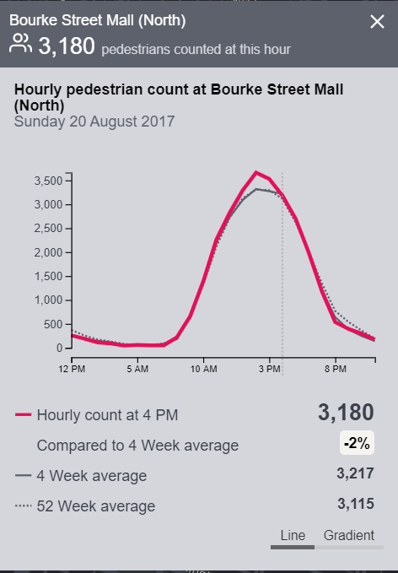
Based on the data source from Melbourne Chinatown, we find that:
all four recording points around Chinatown, their 52 week average data have a “V” curve between 2pm to 5pm. Those points including: Lonsdale St (South), Chinatown-Lt Bourke St (South),Bourke St-Russell St (West), Chinatown-Swanston St (North).
While other places where are a little far from Chinatown does not have this “V” curve. The pedestrian number for those points like “n”. Those points including: Bourke Street Mall (North)/(South), Melbourne Central, Little Collins St-Swanston St (East).
Image on the right is what “V” curve and “n” curve look like
V cuve
n cuve

