Slide 1
Midterm Case Studies
Group 7

Slide 2
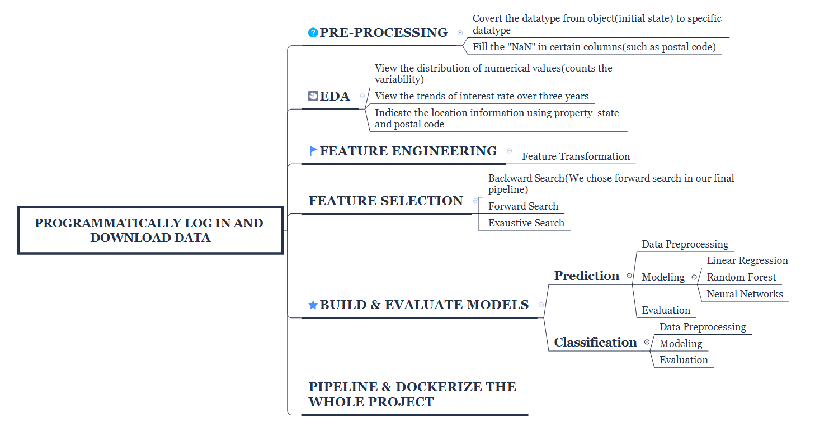
Workflow for the midterm case studies

Slide 3
Programmatically log in and download data
For data wrangling, there are several ways to accomplish the task, different modules such as requests or requests-html are both good approach, here we used both of them, but the basic thoughts are the same.
1) Build a session to store all user sessions and our script will be kept login until we terminate it.
2) Pack up the username and password as post data, send the POST request to ~/auth.php instead of ~/login.php, and in the meanwhile, disable the redirect parameter of auth.php.
3) Pack up another post data and send another post request to the download page, because the website ask the user to review and accept their terms and conditions.
4) After we get two status_code with 200, that means the login is successful
5) We simply used regex to grab all the urls and do a match up, after we get the link according to year and quarter, we can retrieve the file and download it into local system (but actually we download the file to ubunt@aws).

Slide 4
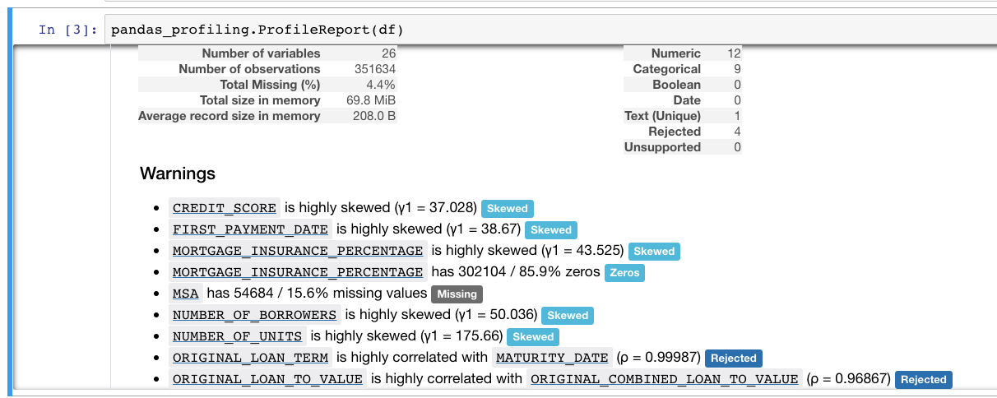
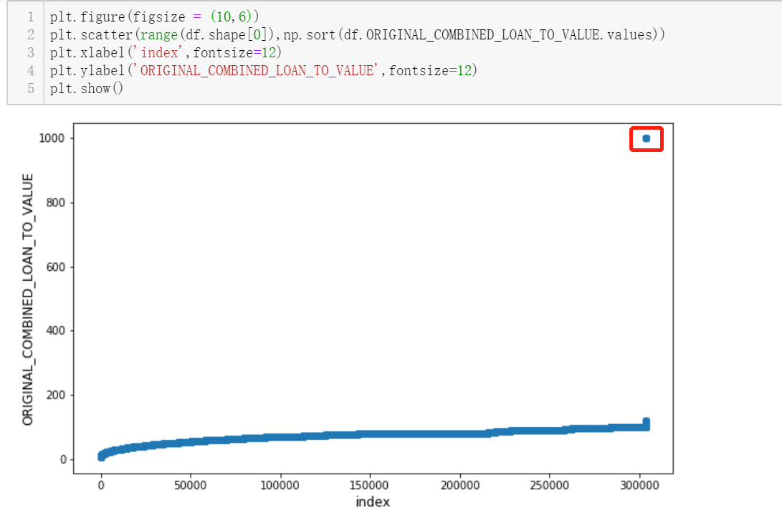
Exploratory Data Analysis
At the very beginning, we use profiling in Pandas to give us a basic view on our dataset.

Slide 5
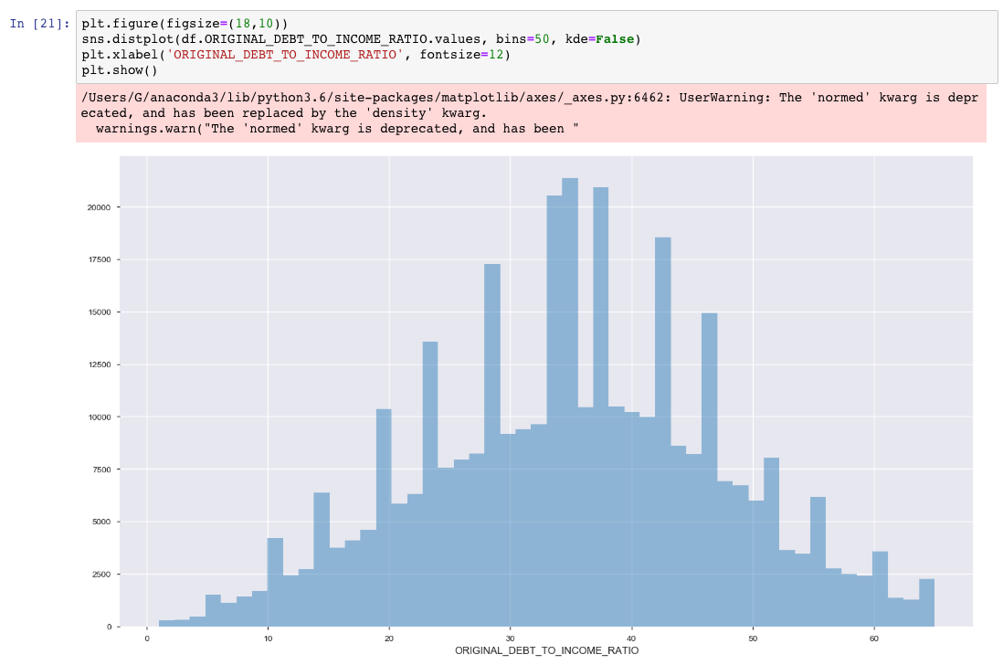
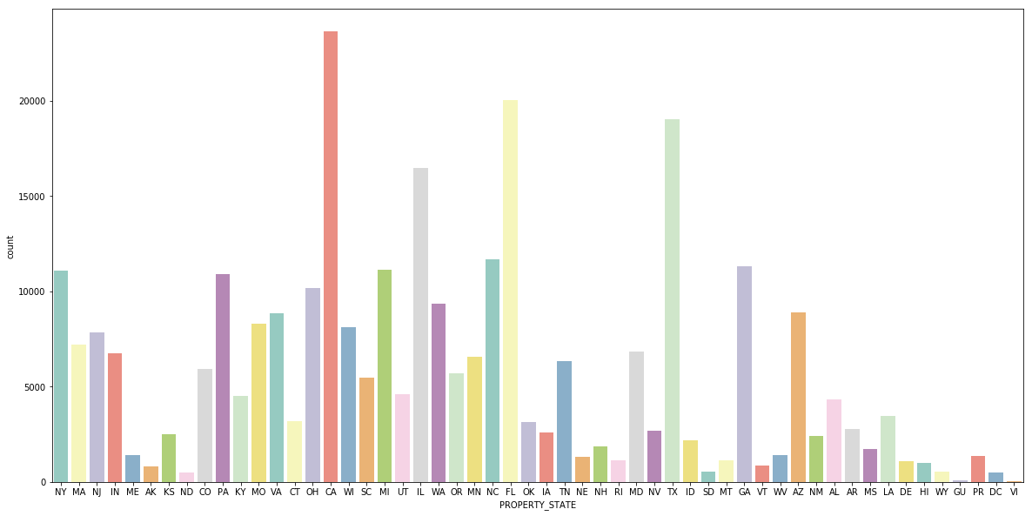
Exploratory Data Analysis

Slide 6
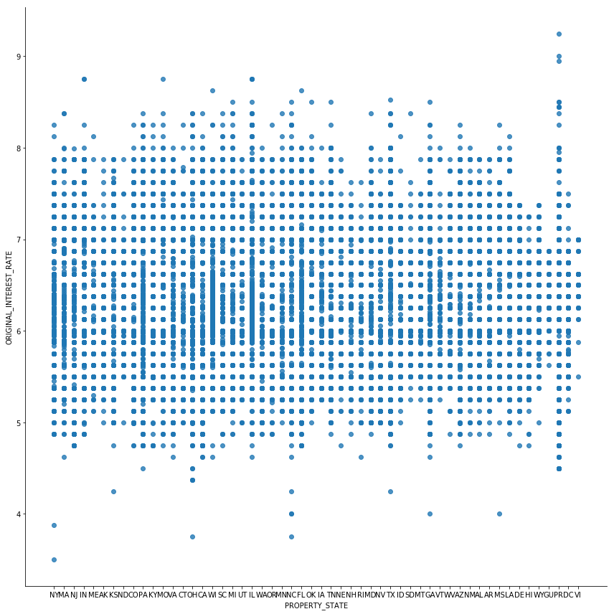
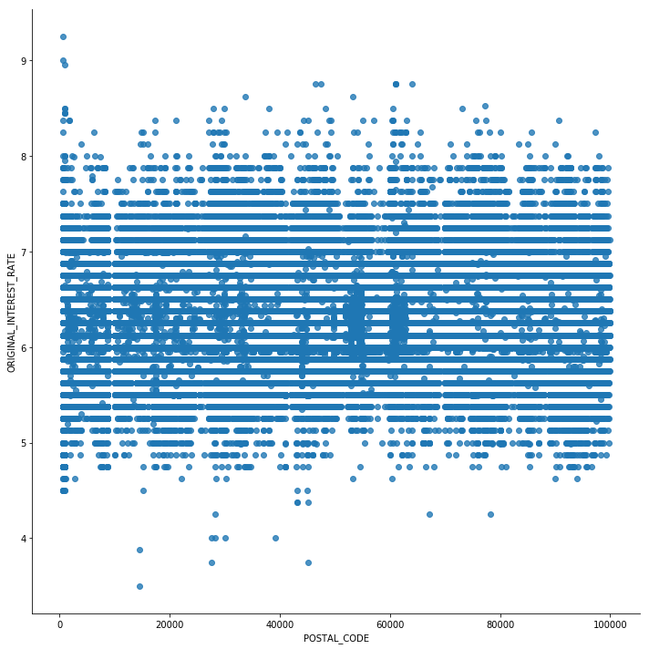
Exploratory Data Analysis

Slide 7
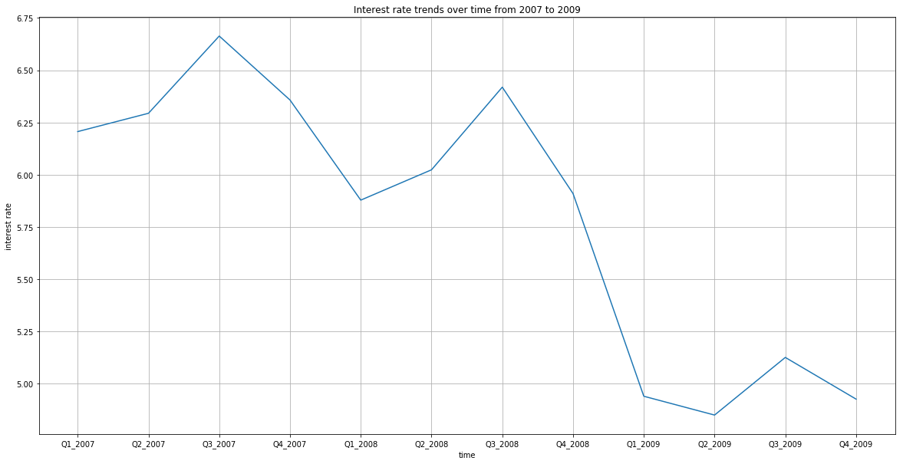
Exploratory Data Analysis

Slide 8
Contributions

