Slide 1
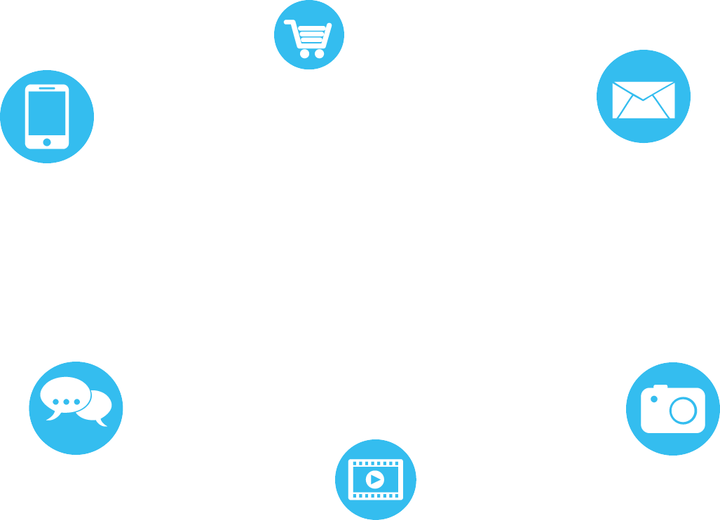
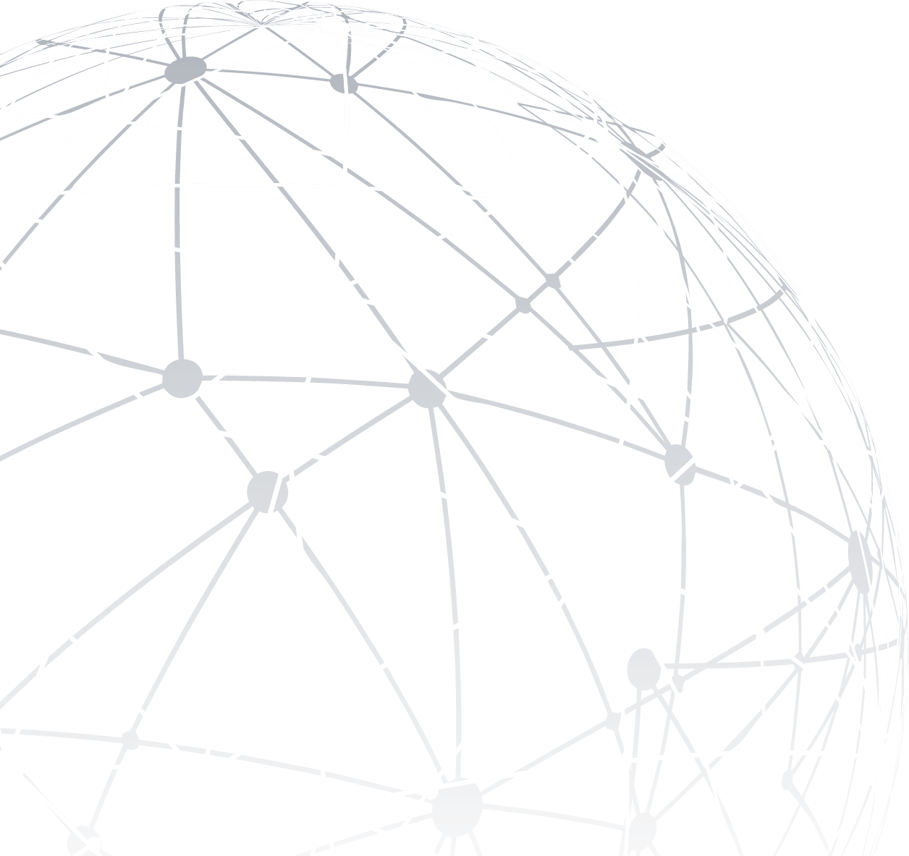
Computer Networking
Project: IoT
Wentao Bi
Dr.Abdul-Hak, Dr. Aidibi

Slide 2
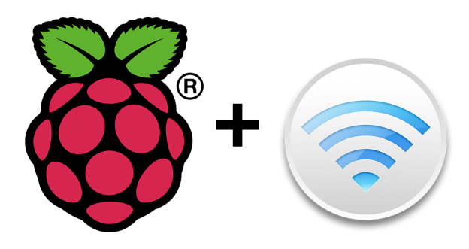
Overview
Using Raspberry Pi Board connected with Sensor/ Actuator (LED), Writing HTML code display in webpage and Controlling LED in LAN. Then, get LED states and display it in another webpage using different port number, Last, request weather API and decode weather information and display it in web.

Slide 3
Contents
01
Web to LED
02
LED to Web
03
Weather to Web
04
Network Structure

Slide 4
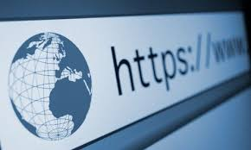

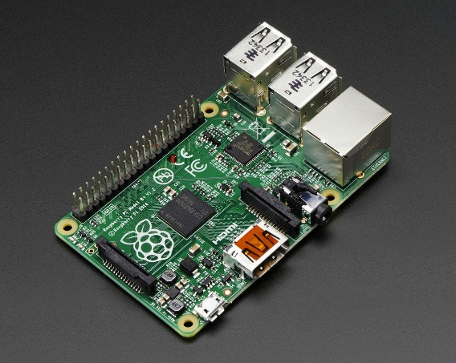
01
Web to LED
Used Python Flask package as web framework. Create basic HTML webpage and HTTP Server configuration. Then, return the button information by using Flask and process button data and send it to Raspberry Pi GPIO

Slide 5
02
LED to Web
Read GPIO states and send it to another webpage.

Slide 6
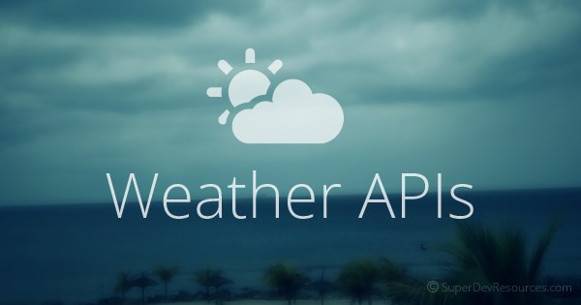
03
Weather to Web
Using UDP get weather information then send it to the HTML and display it in the webpage, then, set web reload frequency.

Slide 7
Network Structure
04
Protocol:
HTTP, TCP, UDP, ARP, 802.11

Slide 8
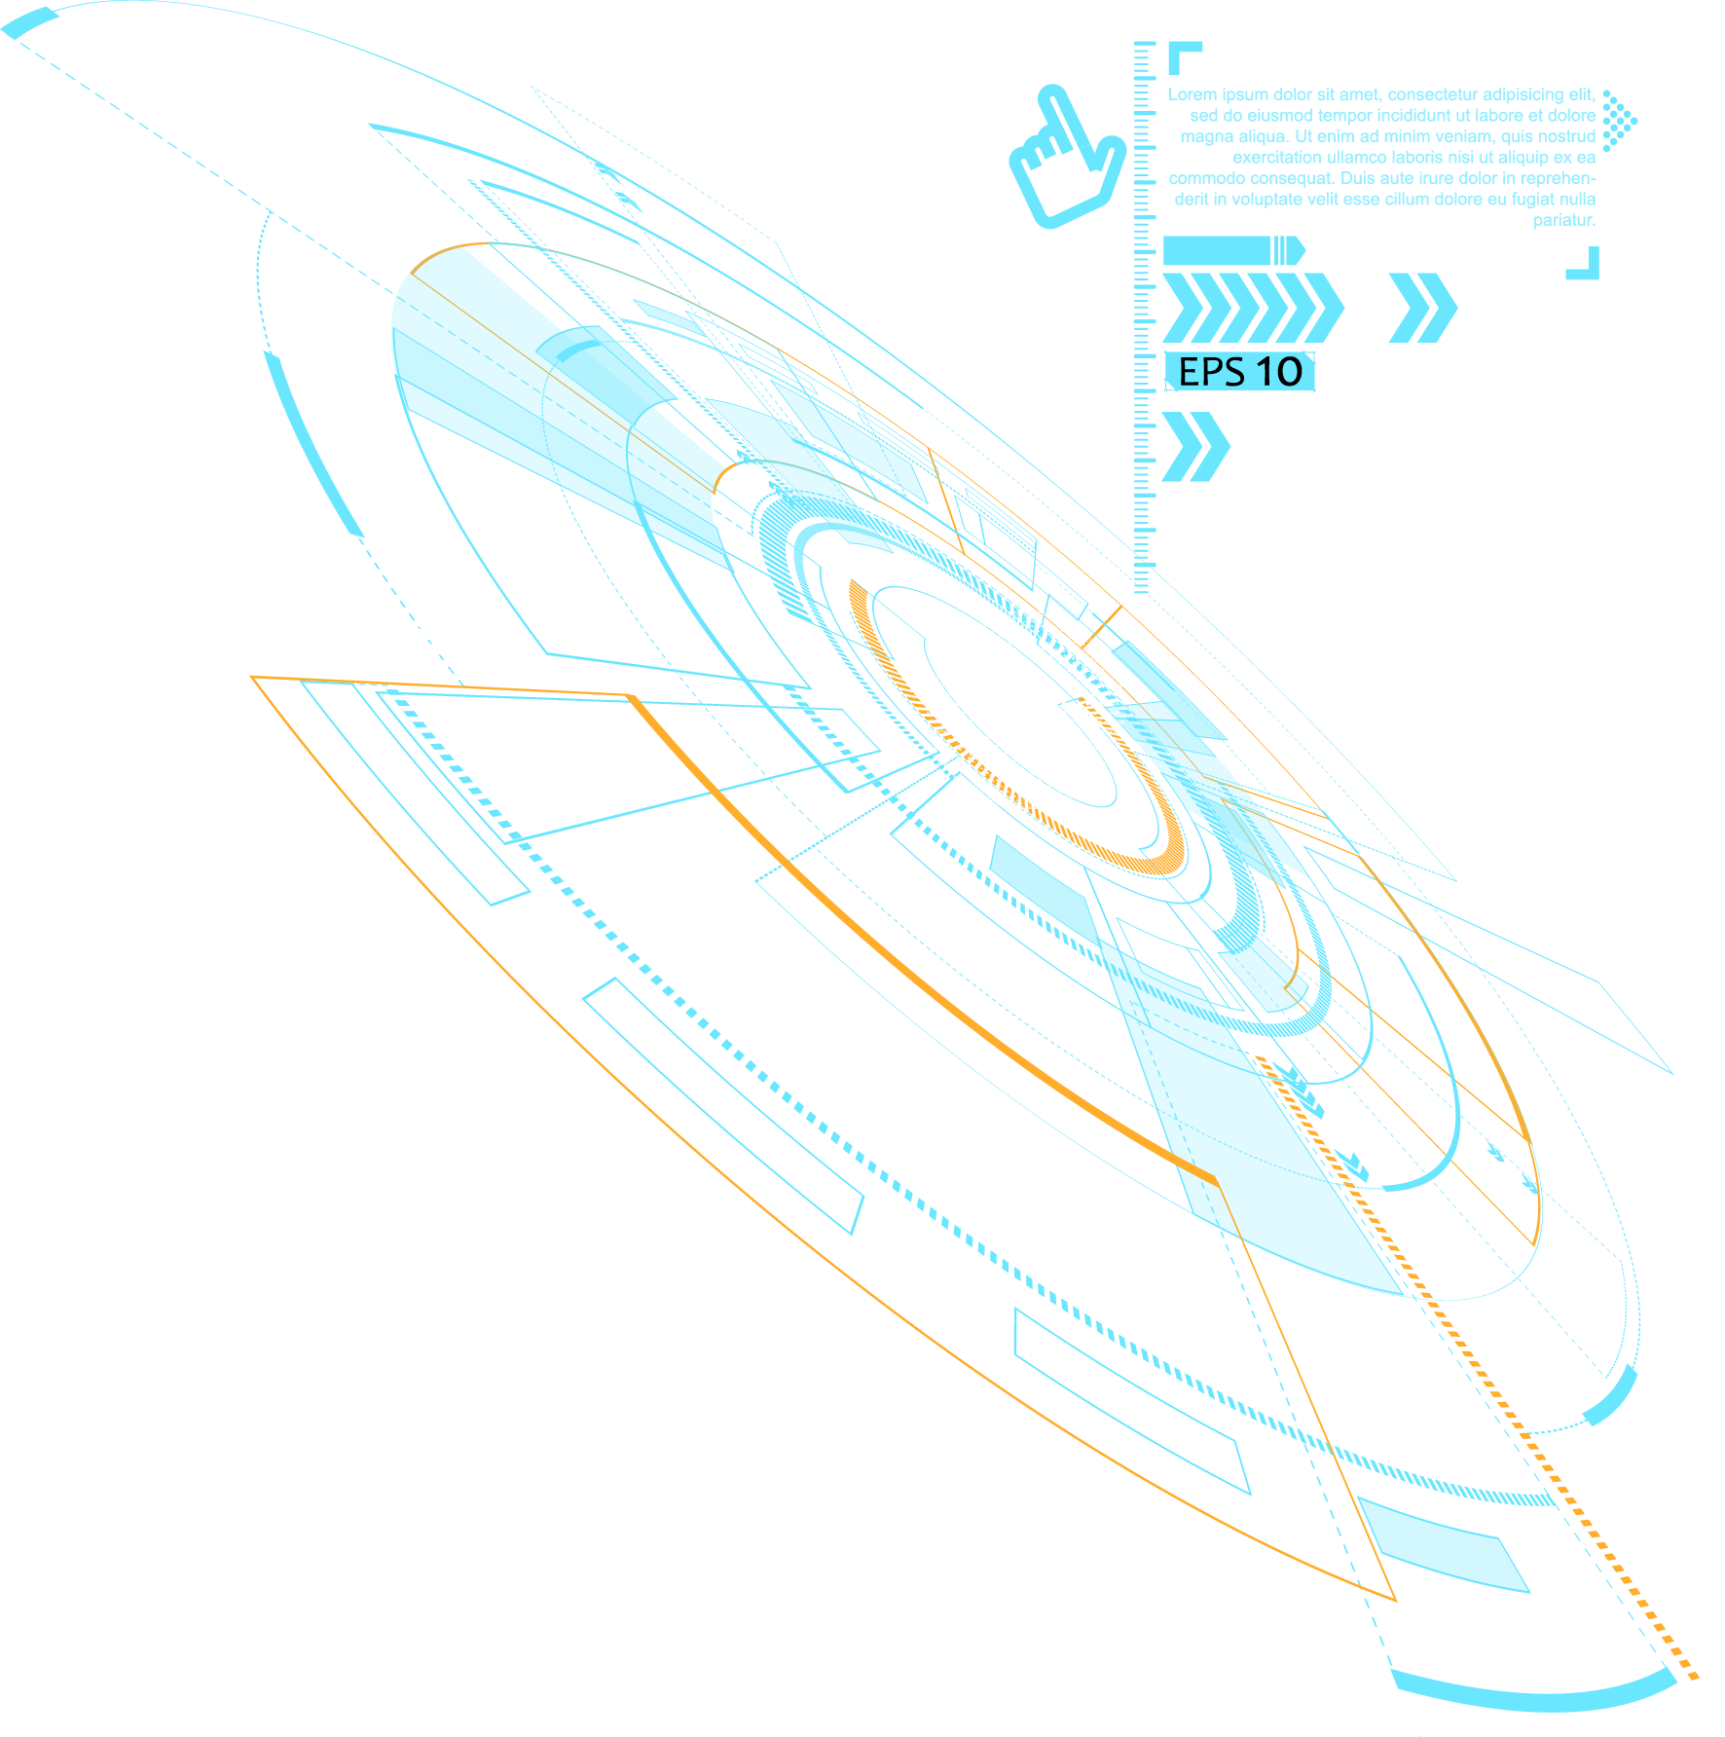
THANK YOU
.

