Slide 1

🌍
A BOARD GAME OF CITIES, CRISES & ECOLOGY
ECOPOLIS
🌿
🌿
Build a thriving city, balance your resources, and protect the fragile ecosystem
2–4 PLAYERS · STRATEGY · ECOLOGY · CRISIS MANAGEMENT

Slide 2
Welcome to Ecopolis
Game Objective
You are a city planner.
Your goal is to build a thriving city while managing your resources and protecting the global environment.
Core Idea
Every decision you make has benefits and consequences.
Players must balance growth, capital, and environment.

Slide 3
THE FOUR PERSONAL POINTS
💰
😊
🏭
🏆
Capital
VICTORY
Well-being
Pollution
Money & Investment
essential for winning
Public Happiness
Affects Environmental Health
Spend to build assets and trigger positive choice events. Earn from markets and economic booms.
The happiness of your citizens. Built through culture, safety, and recreation facilities.
Detrimental to your city's ecological footprint. Handle it effectively to attract investors and unlock green bonds.
Need to collect this in order to win
If your capital or well-being points reaches zero ,you lose
If your pollution points reach 100 , you lose

Slide 4
SETUP
Place the board in the middle.
Set the Global Eco track to 100.
Shuffle the Outer Loop and Inner Path event decks separately. Place them face down.
Shuffle the Building Cards and place them face down.
Place the Global Events Wheel within reach.
Each player chooses a color and takes:
1 dashboard
1 token (placed on Space 1 of the outer loop)
100 Capital, 100 Well-being, 0 Pollution
100 Land pieces
0 Victory Points
An empty Echo Inventory

Slide 5
COMPONENTS
Game board with outer loop (80 spaces) and inner paths (diagonals, vertical, horizontal) leading to a center circle
4 player tokens
2 six-sided dice (identical)
Global Events Wheel with spinner
140 Building Cards
4 player dashboards
Resource tokens: Capital, Well-being, Pollution, Global Eco
Land pieces (100 per player)
Echo Inventory track on each dashboard
Victory Point tokens

Slide 6
Victory Points are earned from
Victory
Points
Building cards (each card shows its Victory Point value, usually 1 to 2)
Completing a set of three cards in the same category on your dashboard
The first player to reach 30 Victory Points wins immediately.
Reaching the center circle every second time
Reaching the center circle every second time

Slide 7
Turn Structure
Phase 1: Roll the Dice
At the beginning of your turn, roll both dice.
Add them together to get the Total Roll.
Phase 2: Echo Release
Before moving, resolve the Echo Release first:
The Total Roll from both dice is your Release Amount.
Move that many Pollution tokens from your Echo Inventory to your Personal Pollution track.
If your Echo Inventory has fewer tokens than the Total Roll, move all of them.
Special Rule: Clean Roll
If you roll a double (both dice show the same number), it is a Clean Roll.

Slide 8
Turn Structure
Phase 3: Movement
Now use the same Total Roll to move:
Move your token forward along the outer loop by the Total Roll.
If you pass or land on Space 1 (Start), collect 2 Capital.
If you land on an intersection, you may either stay on the outer loop or turn onto the inner path.
On inner paths, you move along that line in either direction. At another intersection, you may switch to a different inner path.
To reach the center, you must land exactly on it. If you overshoot, you stop at the last space before it and cannot enter that turn.

Slide 9
Turn Structure
Phase 4: Apply Set Bonuses
After moving, immediately apply any set bonuses you have earned from completed sets on your dashboard:
Eco set bonus: Remove 1 Pollution from your Echo Inventory.
Well-being set bonus: Gain 1 Well-being.
Transportation set bonus: Gain 1 Capital.
Industry set bonus: Gain 1 Capital.
These bonuses apply every turn, regardless of what else happens.

Slide 10
Turn Structure
Phase 5: Resolve Space
Draw and resolve the event card for the space you landed on.
Follow its instructions immediately.
Event cards may:
Give or take Capital or Well-being
Add pollution to your Echo Inventory
Affect Global Eco
Grant Victory Points
Have other effects
Discard the card after use unless it says to keep it.

Slide 11
Turn Structure
Phase 6: Optional Building
After resolving the event, you may build one building if you have enough Capital and Land:
Choose a Building Card from the draw pile or from cards you have collected.
Pay the Capital cost shown on the card.
Remove the required number of Land pieces from your supply.
Add the card's Echo value to your Echo Inventory immediately.
Place the card face up in the corresponding section of your dashboard.
If this gives you three cards in that section, you immediately gain the set bonus and 1 Victory Point.

Slide 12
Phase 7: Production
Collect ongoing benefits from all your buildings as shown on each card.
This may include additional Capital, Well-being, or other effects.
Turn Structure
Phase 8: Check Thresholds
Check your personal resources:
If your Personal Pollution reaches 100, you lose.
If Capital reaches zero, you lose.
If Well-being reaches zero, you lose.

Slide 13
Turn Structure
Phase 9: Global Events Wheel
After checking thresholds, spin the Global Events Wheel.
The segment it lands on affects all players simultaneously.
Resolve the effect, then check for any eliminations or Victory Point changes.
Phase 10: End of Turn
Pass the dice clockwise to the next player.

Slide 14
End of Round
After the last player finishes their turn, calculate the average personal pollution of all players before the next player begins their turn:
Add together each player's current Personal Pollution score.
Divide the total by the number of players.
Round up to the nearest whole number. This is the Decay Amount.
Subtract the Decay Amount from the Global Eco track.
This is the only time Global Eco decreases.
Global Eco Penalty
If Global Eco reaches zero during this calculation, apply the penalty immediately:
Every player loses 1 Victory Point.
Then Global Eco resets to 50.
If any player's Victory Points would go below zero, they stay at zero instead.
Then check again for any players who may have lost due to resources hitting zero from the penalty.
After resetting, continue the game.

Slide 15
Reaching the center
When you land exactly on the center, you immediately gain:
2 Capital
2 Well-being
Reduce your personal Pollution by 1
Increase Global Eco by 1
Draw one Building Card for free and may build it immediately (no land cost)
Additionally, every second time you reach the center, you gain 1 Victory Point.

Slide 16
The Echo System (Pollution)
Your Echo Inventory holds pollution that has not yet affected you or the environment.
It has no maximum.
When you build a polluting building or certain events add pollution, put that many Pollution tokens into your Echo Inventory.
The pollution stays in your Echo Inventory until your next turn, when it will be released based on your dice roll.
Released pollution adds to your Personal Pollution but does not directly reduce Global Eco.

Slide 17
The Echo System (Pollution)
Example of Echo Release
Player A builds a Coal Plant on their turn, adding 5 Pollution to their Echo Inventory.
Turn passes to Player B, then C, then D.
When Player A's next turn begins, they roll the dice and get a total of 8.
They have 5 Pollution in their Echo Inventory, so they release all 5.
They move 5 Pollution to Personal Pollution.
Global Eco is not reduced during this phase.
Their Echo Inventory is now empty.
They then move 8 spaces and continue their turn.

Slide 18
The Echo System (Pollution)
Clean Roll Example
Player A has 7 Pollution in their Echo Inventory.
On their next turn, they roll a double (3 and 3).
Instead of releasing pollution, they remove 2 Pollution from their Echo Inventory permanently.
No pollution is added to Personal Pollution.
They then move 6 spaces and continue their turn.

Slide 19
Additional Rules
Land
You start with 100 Land pieces.
When you build a card:
Remove that many Land pieces from your supply.
You cannot build if you do not have enough Land.
Land is never regained except through extremely rare events.
Winning the Game
The game ends immediately when:
A player reaches 30 Victory Points.
Only one player remains.
Global Eco hits zero and all players are eliminated.

Slide 20
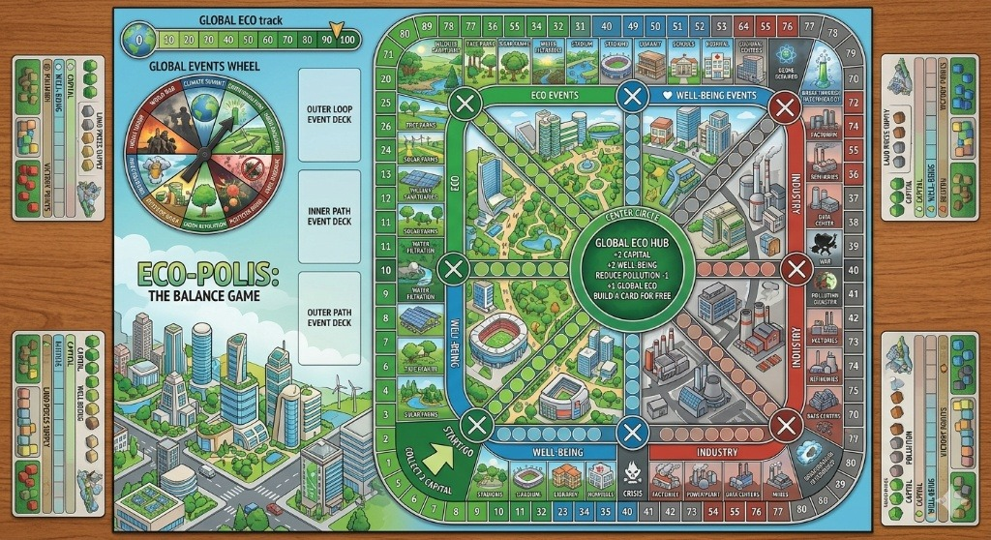
Tentative Board

Slide 21
CITY ASSETS — BUILD YOUR EMPIRE
🌱 GROUP A — Environmental Health
🚇 GROUP B — Transport & Mobility
Sewage/Water Filtration
💰 -4
🏭 -5
😊 +4
Subways
💰 -6
🏭 -4
😊 +6
Solar Energy Farm
💰 -5
🏭 -6
😊 +2
Bus Facility
💰 -3
🏭 -3
😊 +4
Waste-to-Energy Plant
💰 -3
🏭 -4
😊 +2
EV Hubs
💰 -4
🏭 -2
😊 +4
Air Quality Monitoring
💰 -2
🏭 -3
😊 +4
Bike Lanes
💰 -1
🏭 -2
😊 +3
Air Filtration Towers
💰 -3
🏭 -4
😊 +5
Pedestrian Bridges
💰 -2
🏭 -2
😊 +4
Permeable Pavements
💰 -2
🏭 -4
😊 +1
Traffic Management
💰 -2
🏭 -1
😊 +4
Hazardous Waste Sites
💰 -2
🏭 -5
😊 +3

Slide 22
CITY ASSETS — COMMUNITY, HEALTH & SAFETY
📚 GROUP C — Community & Culture
🏃 GROUP D — Health & Recreation
🚨 GROUP E — Safety & Essential
Public Libraries
Public Health Clinics
Police
😊 +5 🏭 0 💰 -3
😊 +7 🏭 +1 💰 -5
😊 +6 🏭 +1 💰 -4
😊 +5 🏭 1 💰 -4
Museums
Sports Complex
😊 +5 🏭 +1 💰 -4
Fire Brigade
😊 +8 🏭+ 1 💰 -5
Theatre/Cinema
Gyms
😊 +4 🏭 +1 💰 -3
Crisis Shelters
😊 +5 🏭 +1 💰 -2
😊 +6 🏭 +1 💰 -2
Amphitheatres
Pools
Homeless Shelters
😊 +4 🏭 0 💰 -2
😊 +3 🏭 0 💰 -4
😊 +4 🏭 0 💰 -3
Public Schools
Dog Parks
Emergency Sirens
😊 +6 🏭 +1 💰 -4
😊 +5 🏭 0 💰 -3
😊 +3 🏭 0 💰 -1
Job Training Schools
Skating Rink
Street Lights
😊 +7 🏭 +1 💰 -5
😊 +5 🌿 0 💰 -2
😊 +2 🏭 +1 💰 -1
Farmers Market
Fountains
😊 +4 🏭 +1 💰 +3
😊 +3 🏭 0 💰 -2

Slide 23
Industries and resources
Group A: Heavy Industry & Manufacturing
Group A: Heavy Industry & Manufacturing
Petrochemical Refineries
💰 +8
🏭+8
😊 +4
Textile
💰 +5
🏭+2
😊 +6
Metal Refineries
💰 +7
🏭+7
😊 +2
Consumer Goods
💰 +4
🏭+2
😊 +4
Foundries
💰 +6
🏭+6
😊 +2
Rare Earth Processing
💰 +9
🏭+6
😊 +4
Cemet
💰 +6
🏭+4
😊 +3
Sheet Metal Forming
💰 +4
🏭+2
😊 +4
Glass
💰 +7
🏭+5
😊 +4
Ceramics Factory
💰 +3
🏭+2
😊 +4
Automobile
💰 +8
🏭+6
😊 +6
Machine Tools Industry
💰 +4
🏭+2
😊 +2
Heavy Machinery
💰 +6
🏭+4
😊 +3
Electronic Industries
💰 +5
🏭+3
😊 +3

Slide 24
Industries and resources
Group B: Tech, Finance & Innovation
Group B: Tech, Finance & Innovation
Stock Exchange
💰 +9
🏭+2
😊 +4
Cyber Centers
💰 +6
🏭+3
😊 +4
IT Company
💰 +8
🏭+2
😊 +6
Special Economic Zones (SEZ)
💰 +6
🏭+5
😊 +5
Data Centers
💰 +6
🏭+5
😊 +2
Industrial Testing Labs
💰 +4
🏭+2
😊 +4
Quantum Hubs
💰 +6
🏭+3
😊 +3
Telecom Infrastructure
💰 +6
🏭+3
😊 +5
Semiconductor Fabrication
💰 +9
🏭+5
😊 +6
Pharmaceuticals
💰 +4
🏭+2
😊 +4
Tech Incubators
💰 +7
🏭+3
😊 +6
Vocational Training
💰 +2
🏭+3
😊 +5

Slide 25
Industries and resources
Group C: Green Industry & Circular Economy
Group D: Energy & Power Infrastructure
Bio-Gas Bottling Plants
💰 +3
🏭-3
😊 +3
Standard Power Plants
💰 +6
🏭+6
😊 +3
Carbon Credit Trading
💰 +5
🏭-3
😊 +1
Nuclear Power Plants
💰 +10
🏭+5
😊 +5
Sustainable Forestry
💰 +3
🏭+2
😊 +2
Agrochemical Hubs (Eco-pesticide)
💰 +4
🏭+2
😊 +3
Cold Chain Logistics
💰 +4
🏭+1
😊 +2

Slide 26
Industries and resources
Group E: Food Industry
Group F: Resource Extraction & Heavy Support
Dairy Processing Plants
💰 +5
🏭+1
😊 +3
Quarrying
💰 +6
🏭+6
😊 +3
Food & Bev Processing
💰 +6
🏭+1
😊 +2
Heavy Equipment Rental
💰 +7
🏭+3
😊 +5
Inland Container Depots
💰 +3
🏭+1
😊 +2
Construction Sector
💰 +6
🏭+6
😊 +3
Agricultural Machinery
💰 +4
🏭+2
😊 +3
Logging (Standard)
💰 +3
🏭+4
😊 +5
Paper Mills
💰 ++2
🏭+3
😊 +3

Slide 27
⚠ THE CRISIS DECK
📉
🏛️
⚔️
💣
🦠
🌡️
🌲
Financial Crisis
Gov. Collapse
War
Terrorism
Pandemic
Climate Change
Deforestation
🏭
🌾
☢️
🌊
💻
⚡
☢️
Pollution Disaster
Famine
Nuclear Accident
Refugee Crisis
Cyber Attacks
Grid Attack
Nuclear Strike
⚖️
💧
🛢️
🐟
🦋
🤖
📊
Social Inequality
Water Scarcity
Oil Spill
Overfishing
Biodiversity Loss
AI Disruption
Inflation
🧑‍🔬
💾
🎭
😔
🍞
🧴
🏜️
Innovation Crisis
Chip Shortage
Trust Crisis
Loneliness Crisis
Food Security
Plastic Pollution
Desertification
Any of these can be drawn at any moment. Preparation is your only shield.

Slide 28
✨ POSITIVE EVENT CARDS
Spend Capital or Resources to unlock these ⭐ positive upgrades
#01
Green Manufacturing Grant
🏭 -3
#09
Vertical Farm Pilot
💰+1
#10
Renewable Energy Transition
🏭 -2 💰+1
#02
Factory Retrofit
🏭 -2 🌍 +1 Global
#11
Smart Grid Integration
💰+1
#03
Sports Complex Construction
😊 +3
#12
Public Library Expansion
😊+2 ⚙️ +1
#04
Student Club Initiative
🏭 -2
#13
Waste-to-Energy Plant
💰+1 🏭 -1
#05
Bicycle Lane Network
🏭 -2 😊+1
#14
Heritage Restoration
😊+2
#15
University Tech Park
💰+1
#06
Electric Vehicale Subsidy
🏭 -2
#07
Bullet Train Proposal
💰 +1 😊+2
#08
Odd-Even Rule (Delhi Style)
🏭 -2 😊+1

Slide 29
✨ POSITIVE EVENT CARDS
These are rewards, breakthroughs, or global triumphs that trigger on their own.
#01
Ozone Layer Repaired
🏭 -1 💰+1
#09
Green Bond Issuance
💰+3
#10
Philanthropic Donation
💰+3
#02
Engineering Convention
💰+2😊+1
#11
Smart Grid Integration
💰+1
#03
Community Garden
🏭 -1💰+1
#12
Sustainable City Award
😊+1💰+2
#04
Youth Leadership Program
😊+1
#13
Coral Reef Restoration
🏭 -2
#05
Reforestation Success
🏭 -3
#14
Plastic-Eating Bacteria
🏭 -2💰+1
#15
Blue Whales Return
🏭 -2
#06
Endangered Species Sighted
🏭 -1
#07
Renewable Breakthrough
😊+2
#08
Economic Boom
🏭 -3

Slide 30
✨ POSITIVE EVENT CARDS
These are rewards, breakthroughs, or global triumphs that trigger on their own.
#16
Beehive Fence Success
🏭 -1 💰+1
#17
Carbon Capture Breakthrough
🏭 -2
#18
Record Harvest
💰+3
#19
Car-Free Sunday
😊+1 🏭 -1
#20
Freshwater Aquifer Discovered
💰+3
#21
Zero-Emission Fleet
😊+1🏭 -1

Slide 31
🌿 ECOLOGICAL DILEMMAS
🌲
Forest Decision
🌊
River Dam
A large forest is discovered
A major river flows through your city
▸ Cut for Timber: 💰+4, 🏭−6
▸ Hydroelectric Dam: ⚡+5, 🏭−4
▸ Protect: 🏭-6 + Biodiversity bonus
▸ Protect River: 🏭+5, 🤗+2
▸ Eco Tourism: 💰+2, 🏭+4
▸ Small Eco Dam: ⚡+3, 🏭−1
⛰️
Rare Minerals
⚡
Energy Demand Spike
Minerals found in nearby mountains
Energy demand suddenly surges
▸ Open Mine: 💰+6, 🏭−6
▸ Coal Plant: ⚡+6, 🏭−7
▸ Regulated Mining: 💰+3, 🏭−2
▸ Import Energy: ⚡+3, 💰−3
▸ Ban Mining: 🏭+5, 💰−3
▸ Solar Farms: ⚡+4, 🏭+4
🐢
Sea Turtle Beach
🌏
Climate Summit
Turtle nesting beach discovered
Invited to international summit
▸ Build Resort: 💰+5, 🏭−7
▸ Aggressive Pact: 🏭-6, 💰−3
▸ Protect Nesting: 🏭+6, 🤗+2
▸ Moderate Agreement: 🏭-3
▸ Seasonal Tourism: 💰+3, 🏭+3
▸ Reject: 💰+2, 🤗−4

Slide 32
🌿 ECOLOGICAL DILEMMAS
🌲
Population
🌊
Wind Energy
🌆
City population is growing rapidly
Windy Hill near City , Wind Energy Proposal
▸ Expand into Green Land: 💰+4, 🏭 +5 , 🤗 +5
▸ Build Large Wind Farm: Money +5, 🏭 -6
▸ High-Density Smart Housing : 🏭 -2,💰+4,Housing +4
▸ Small Turbines: 🏭 -3, 💰 -2
▸ Limit Expansion: Housing -3, 🏭 -4
▸Ignore Wind Energy: 🏭 -2, 💰−3
🌳
⛰️
Old Trees
🌊
Ocean Plastic Cleanup
A 500 year old tree is discovered
Plastic waste harming marine life
▸ Declare Heritage Tree: 🏭 -5
▸Major Cleanup Campaign: 💰 -3, 🏭 -5
▸ Create Learning Site: Education +3, 🏭 -3
▸ Limited Cleanup: 🏭 -2 , 💰−1
▸ Seed Propagation project: 🏭 -5, Forest Frowth +2
▸ Ignore: 💰+2,🏭 +4
🔥
Forest Fire Prevention
🌏
Carbon Capture Project
Authorities propose prevention program
Scientists propose capturing CO2 from factories
▸ Build fire prevention system:💰-3, 🏭 -4
▸ Install carbon capture technology 🏭 -6, 💰-4
▸ LImited momitoring: 🏭 -2, 💰 -1
▸ Limit Factory emissions: 🏭 -3, 💰 -1 Factory income -2
▸ Ignore risk: 💰+2, 🏭 +3
▸Ignore Emissions : 💰+3, 🏭 +5

Slide 33
🌿 ECOLOGICAL DILEMMAS
🚦
Traffic
🍄
Mycelium Network
Traffic congestion is increasing.
Scientists discover a massive underground mycelium network.
▸Build Metro System💰-4, , Mobility +6,Mobility +6
▸ Protect fungal ecosystem:🏭 -6
▸ Expand roads: Money -2 Mobility+3 🏭 -3
▸ Community gardening workshops:🏭 -3, Education +4
▸Promote Cyling Insfrastructure : 💰-1, 🏭 -5, Health +4
▸Native plant distribution: 🏭 -5
⛰️
Green Spaces
⚡
Wildlife Conservation
Citizens request more green spaces
Wildlife habitat threatened
▸ Large tree planting campaign: 💰-3, 🏭 -5,public Happiness +3
▸Build Wildlife Sanctuary: 💰-−2, 🏭 -6 Tourism +2
▸ Small park development:💰-1, 🏭 -2
Ignore and build houses: 💰+3,🏭 +5
▸ Ignore request: :💰 +1. Public happiness −3
🌱
Seeds
🌏
Water Resource Decision
Botanists organize a festival celebrating native plant seeds.
Water shortage.
▸ Rare seeds exchange:🏭 -4 Biodiversity +3
▸Build Dam:Resources +3,🏭 +3
▸Community gardening workshops 🏭 -6, Public awareness +4
▸ Rainwater harvesting: 💰- −2, 🏭 -3
Native plant distribution: 🏭 -5

Slide 34
🌿 ECOLOGICAL DILEMMAS
🌲
Organic Farming
🌊
Climate Refugee Settlement
Farmers propose switching to organic farming
People displaced by climate disasters.
▸Subsidize organic farming: 💰-3 🏭 −6
▸ Build eco housing: 🏭 -2, 💰-3, b 😊+3
▸ Protect: 🏭 -4, 💰+3
▸ Temporary shelters:💰-1,😊+1
▸ Eco Tourism: 💰+2, 🏭 +4
▸ Reject settlement:💰+2,😊-3
⛰️
Maintain Forests
⚡
River Fish Collapse
Local communities volunteer to maintain forests
Fish population in the river is declining
▸ Training programs: 🏭 -3
▸ Ban fishing temporarily: 🏭 -5, 💰-2
▸ Tree guardians : 🏭 -4
▸ Limit fishing: 🏭 -2, 💰+1
▸ Youth forest camps : 🏭 -3, awareness bonus
▸ Continue fishing: 🏭 +4, 💰+3
🐢
A Rare Plankton discovered
🌏
Desert Expansion
It causes the shoreline to glow blue at night.
nearby land becomes desert
▸ Protect the shoreline habitat: 🏭 -5, Biodiversity +2
▸ Plant drought-resistant plants: 🏭 -5, 💰−3
▸ Create night observation areas: 🏭 -3, 😊+3
▸ Use land for solar energy: 🏭 -3, 💰+2
▸Ignore desertification: 🏭 +2, 💰+1

Slide 35
🌱Ecological Chain Reaction Events
Bird Population Growth
Predator Protection
Excess Fertilizer Damage
Bird population increases.
➡ Birds eat crop pests
➡ Farmers use fewer pesticides
➡ Crops grow better
Wolves or big predators are protected.
➡ Predator population increases
➡ Herbivore animals decrease
➡ Forest vegetation grows healthier
Excess fertilizers damage soil.
➡ Soil fertility decreases
➡ Crop yields drop
➡ Desertification begins
Game effect:Protect bird habitat
💰 −1,🌿+3
Next round:Agriculture +2
Game effect:Protect predators
💰 −2,🌿 +5
Next round:Forest health +2
Game effect: Intensive farming
+3 Resources,🌿−4
Next round:Agriculture −2
Forest Destruction Chain Reaction
Bee Population Decline
Nature systems are connected.
Example:
If a player destroys forest →
➡ river health decreases
➡ fish population decreases
➡ food production decreases
So one bad action causes multiple consequences.
Pollinators help plants reproduce.
If pesticides increase:
➡ Bees die
➡ Crops produce less
➡ Flower plants disappear
Game effect: Heavy pesticide farming
💰 +2 , 🌿−4
Next round:agriculture output −3
Cut forest:🌿−6
Next round: agriculture output -2

Slide 36
🦋 RARE WORLD WONDERS
🦋
🐦
🌳
🌸
Butterfly Storm
Symphony of Birds
Great Forest Awakening
Golden Pollination Season
Millions of butterflies fill the sky in a breathtaking display.
Hundreds of species begin nesting in a chorus of life.
The ecosystem becomes fully interconnected.
A record pollination season transforms the entire region.
Forest Decision + Seeds + Green Spaces
Old Trees + Wildlife Conservation
Maintaining Forests + Forest Decisions + Forest Fire Prevention
Seeds + Organic Farming
✨
🏆
🌍
Firefly Night
Biodiversity Jackpot
Planet Regeneration
Millions of fireflies emerge and light up the city at night.
-20 Pollution Points instantly — but lose one habitat and the jackpot vanishes.
Nature heals itself: -5 Pollution globally. Cooperation rewarded.
Carbone Capture Project + Climate summit + population
Rare Minerals + Sea turtle Beach +Mycelium network + Maintain Forest
All Players: No Pollution Damage for 1 Round

Slide 37
THE SACRED LAWS — RULES OF THE WORLD
I
II
III
Four Personal Resources
The Global Eco Pool
Build, Then Maintain
Each player manages Capital, Resources, Well-being, and Eco Tokens. If any one drops to zero — that player is eliminated.
Exactly 100 Global Eco Points are shared by all. If this pool reaches zero, everyone loses points simultaneously.
Assets cost Capital to build but pay dividends in Ecology, Well-being, or Resources over time. Invest with vision.
IV
V
Cooperation Wins
Cascading Consequences
Crisis Cards Are Binding
VI
Destroy a forest → river health drops → fish die → food supply falls. One action triggers multiple consequences.
When a Crisis card is drawn, its effects are immediate and unavoidable. Only pre-built infrastructure can soften the blow.
Planet Regeneration rewards collective restraint. The highest victories come from a thriving shared world.

Slide 38
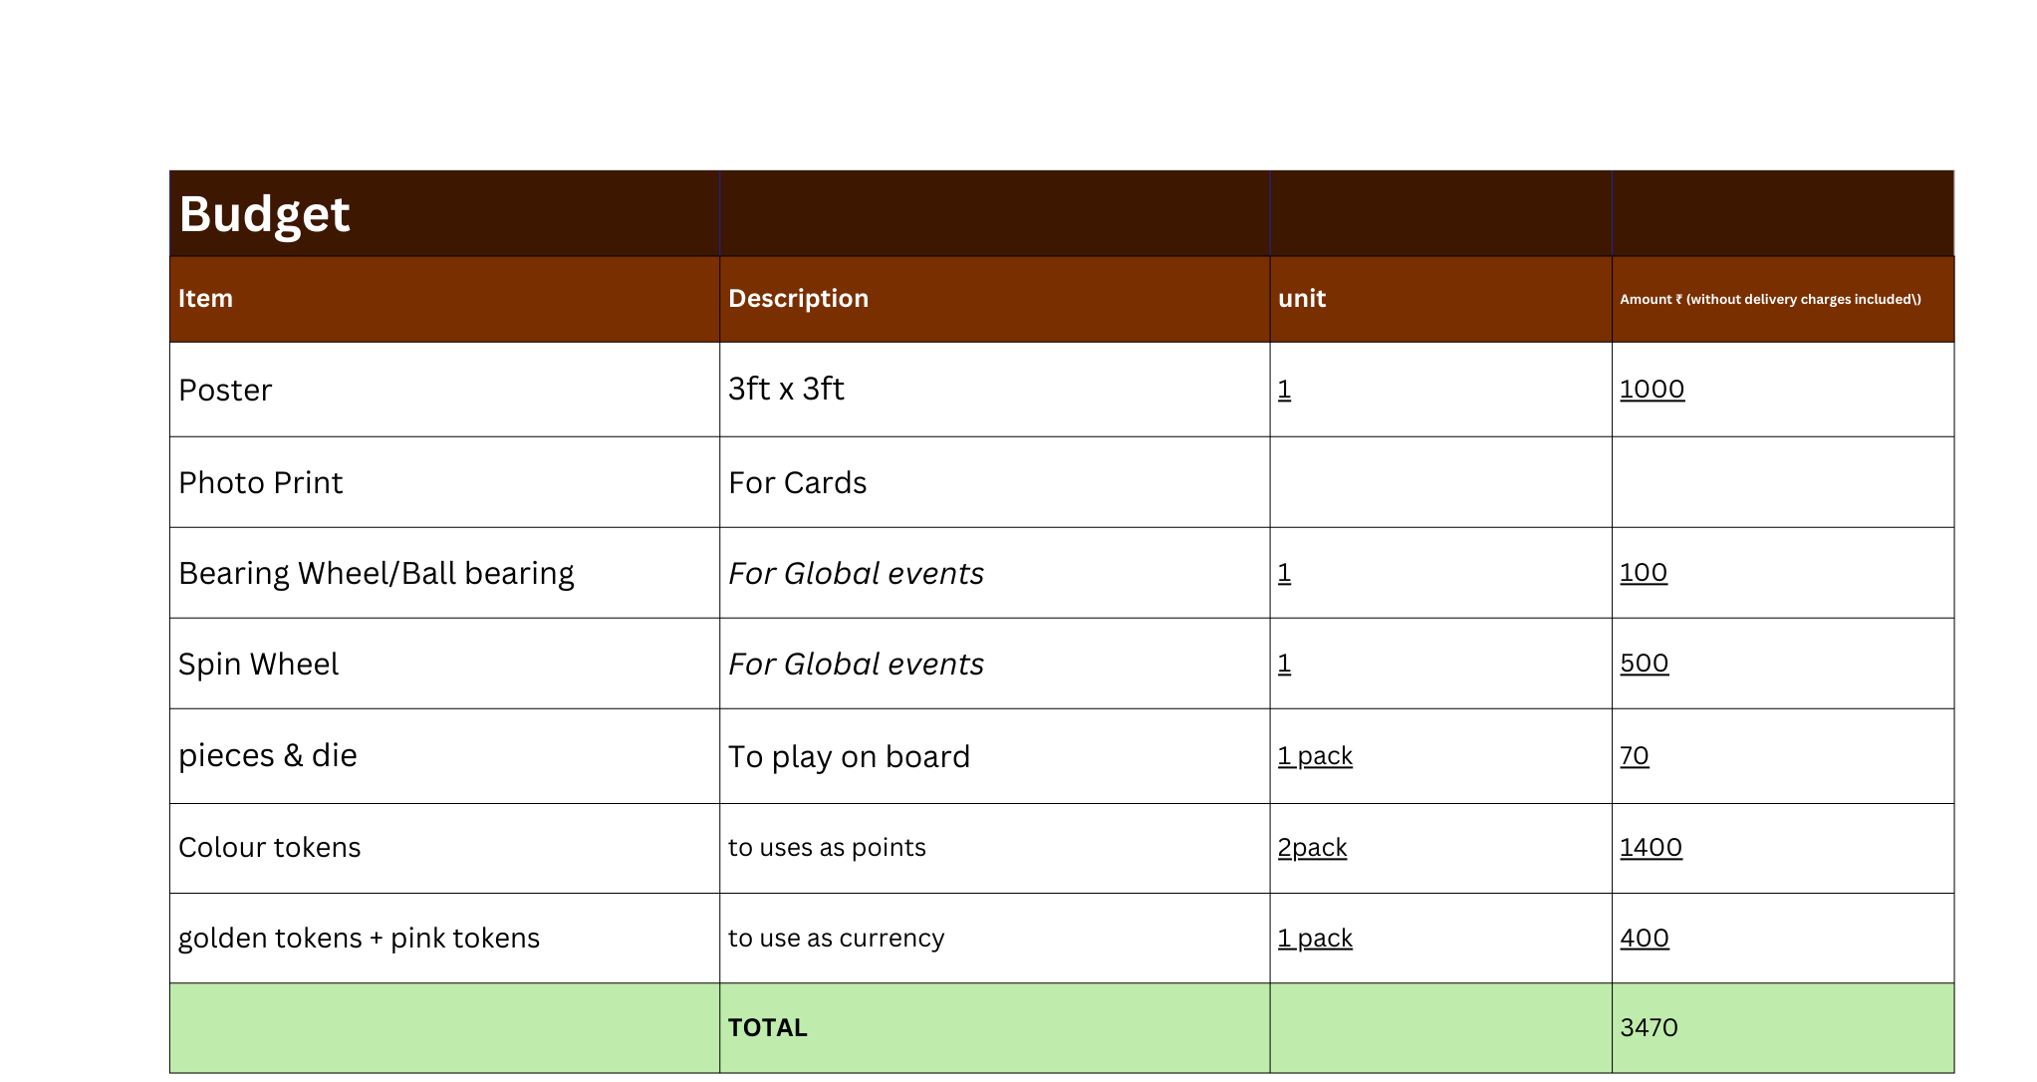

Slide 39
🌍
The Earth Has Only
100 Points Left.
Every resource matters. Every choice matters.
Play wisely. The world is watching.
💰 Capital · ⚙️ Resources · 😊 Well-being · 🏭 Pollution

