Slide 1

Fama-French Three-Factor Analysis

Slide 2
Learning Objectives
Upon completing this assignment, students will be able to:
Describe the Fama-French three-factor model
Build a regression model in Excel
Analyze how well an asset’s returns are explained by the Fama-French three-factor model

Slide 3
From a Single to Multi-Factor Model
R_{i} = asset return
R_{f} = risk-free rate of return
𝛼_{i} = difference between the asset’s return and the expected return
β_{i} = measure of the asset’s systematic risk in relation to the market
R_{MKT} = the market return
e_{i} = random error/non-systematic risk
The traditional regression model for analyzing excess returns is the Capital Asset Pricing Model (CAPM), a single-factor model:
(𝑅_{𝑖}−𝑅_{𝑓}) = 𝛼_{𝑖} + 𝛽_{𝑖} (𝑅_{𝑀𝐾𝑇}−𝑅_{𝑓}) + e_{i}
The model stipulates there is only one risk factor: the return on the market portfolio.

Slide 4
From a Single to Multi-Factor Model (cont.)
According to the CAPM theory, in the previous slide’s equation, 𝛼 (alpha) should equal 0. However, that is not always the case.
Researchers began investigating models where additional factors (e.g. interest rates) could be added to the market factor in order to better explain excess returns.
Analyzing historical data, Eugene Fama and Kenneth French noticed that small-cap stocks and value stocks tended to outperform large-cap stocks and growth stocks.

Slide 5
Fama-French Three-Factor Model
Fama and French added a size factor and a value factor to the market factor:
(𝑅_{𝑖}−𝑅_{𝑓}) = 𝛼_{𝑖} + 𝛽_{𝑖} (𝑅_{𝑀𝐾𝑇}−𝑅_{𝑓})+ s_{i}(SMB) + h_{i}(HML) + e_{i}
Empirically, their three-factor model explained historical returns better than the single-factor market model, explaining over 90% of excess returns as opposed to approximately 70%.

Slide 6
Size: (SMB) Small Minus Big
(𝑅_{𝑖}−𝑅_{𝑓}) = 𝛼_{𝑖} + 𝛽_{𝑖} (𝑅_{𝑀𝐾𝑇}−𝑅_{𝑓})+ s_{i}(SMB) + h_{i}(HML) + e_{i}
The size premium (SMB) is the average monthly return on the smallest 30% of stocks (in terms of market capitalization) minus the average monthly return on the largest 30%.
When small stocks do well relative to large stocks, this will be positive; when they do worse than large stocks, this will be negative.

Slide 7
Value: (HML) High Minus Low
(𝑅_{𝑖}−𝑅_{𝑓}) = 𝛼_{𝑖} + 𝛽_{𝑖} (𝑅_{𝑀𝐾𝑇}−𝑅_{𝑓})+ s_{i}(SMB) + h_{i}(HML) + e_{i}
The value premium (HML) is the average monthly return for the 50% of stocks with the highest book-to-market ratio minus the average return for the 50% of stocks with the lowest book-to-market ratio.
When high value stocks do well relative to low value stocks, this will be positive; when they do worse than low value stocks, this will be negative.
High book-to-market stocks are considered “value” stocks; low book-to-market stocks are considered “growth” stocks.

Slide 8
Factor Betas
Extending the single factor CAPM model, the Fama-French model uses three factor betas:
A factor beta (sometimes called a “factor loading”) is the sensitivity of security’s returns to a particular systematic factor.
With this model, market returns can roughly be explained by three factors: (1) exposure to the overall market (R_{MKT} - R_{f}); (2) exposure to small cap stocks (SMB); and (3) exposure to value stocks (HML).
(𝑅_{𝑖}−𝑅_{𝑓}) = 𝛼_{𝑖} + 𝛽_{𝑖} (𝑅_{𝑀𝐾𝑇}−𝑅_{𝑓})+ s_{i}(SMB) + h_{i}(HML) + e_{i}

Slide 9
The Fama-French Factors
Ken French publishes datasets of the Fama-French factors for distribution from his web site at Dartmouth University.
For more detailed information on how these factors were calculated, visit his web site at:
http://mba.tuck.dartmouth.edu/pages/faculty/ken.french/data_library.html
As research continues, additional factors continue to be added to the original three-factor model.

Slide 10
Assignment
Use a WRDS query to select and download historical monthly returns for two exchange-traded funds (ETFs).
The Fama-French three-factor data will be provided in this query’s output.
After downloading the data, use the regression function in Excel to perform a multiple linear regression for each fund’s excess returns using the Fama-French three-factor data as the three independent variables.
Compare the results for the two funds.

Slide 11
About Excel
The following instructions were created using Excel 2013 (Microsoft Office Professional Plus 2013) using a PC.
Depending on your version of Excel, screens may look slightly different, and the corresponding steps may need to be adjusted.
If you are using a different version of Excel and need additional help, access the Microsoft Excel Help Center at: https://support.office.com/en-us/excel

Slide 12
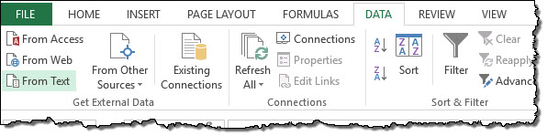
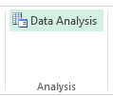
Checking Data Analysis in Excel
Begin by checking to make sure your Excel application has the Data Analysis functionality loaded.
To check, select the Data tab on the ribbon.
You should see the Data Analysis button in the Analysis group at the top right corner of the screen.

Slide 13
Installing Data Analysis in Excel
If your Excel does not have Data Analysis, use these installation steps from Microsoft Office support:
Click the File tab.
Click Options.
Click Add-Ins.
In the Add-Ins box, select the Analysis ToolPak, and then click OK.

Slide 14
ETF Returns in WRDS
Exchange-traded funds (ETFs) are traded on stock exchanges. To download ETF returns, use the WRDs Stock Return query at the following link:
https://wrds-www.wharton.upenn.edu/classroom/stock-and-factor-returns/

Slide 15
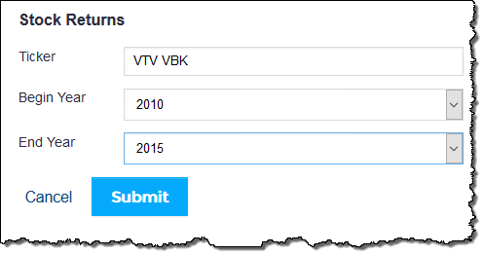
ETF Returns Query
Enter the following ETF tickers: VTV VBK
Enter the date range for this assignment: 2010 – 2015.
Click Submit to run the query.

Slide 16
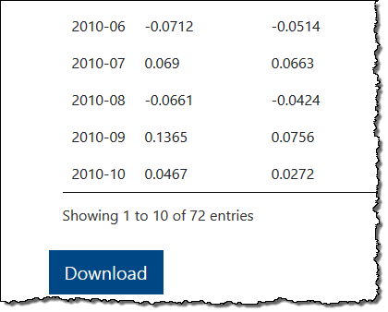

ETF Returns Query (cont.)
Scroll to the bottom of the screen and click Download.
After opening the file in Excel, you may need to click Enable Editing to allow you to continue the assignment.

Slide 17
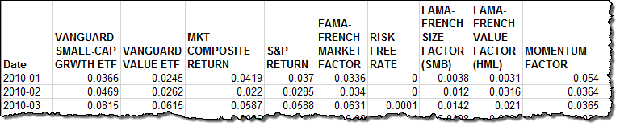
Removing Extra Data
The WRDS query was designed to provide data to build several types of models.
For this Fama-French three-factor analysis, only some of this data is relevant.

Slide 18
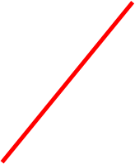

Removing Extra Data (cont.)
Delete the following three columns of data that will not be used in this model: MKT COMPOSITE RETURN, S&P RETURN, and MOMENTUM FACTOR.

Slide 19
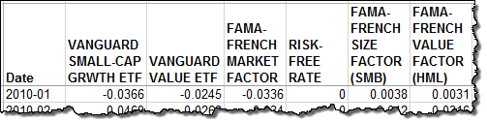
Arranging the Worksheet
Move the RISK-FREE RATE column to a new location between the INDEX FUNDS: VANGUARD SMALL-CAP GRWTH ETF and the VANGUARD VALUE ETF columns.
This new arrangement, which keeps the three Fama-French factors in a row, will help simplify the regression process.

Slide 20
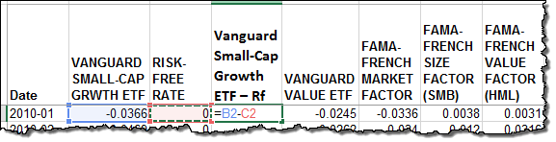
Subtract the Risk-Free Rate
Add a new column after the Risk-Free Rate and label it Vanguard Small-Cap Growth ETF – Rf.
In this column’s first cell, create a formula to subtract the risk-free rate from Vanguard’s Small-Cap Growth ETF returns. The syntax for the formula can be found in the screenshot below.

Slide 21
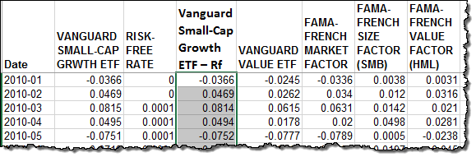
Subtract the Risk-Free Rate (cont.)
Click Enter. The value of the fund’s returns, less the risk-free rate, appears.
Populate the rest of the column with the formula by double-clicking the cell’s bottom right corner.

Slide 22
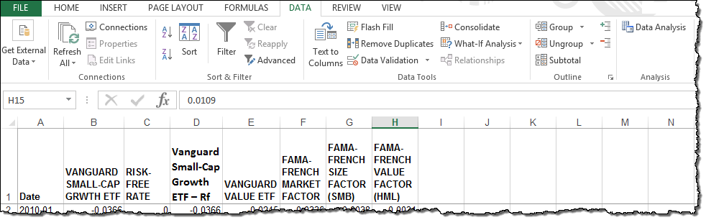
Access the Regression Function
Select the Data tab.
Click Data Analysis.

Slide 23
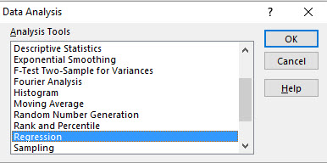
Access the Regression Function (cont.)
Select Regression in the Analysis Tools window and click OK.

Slide 24
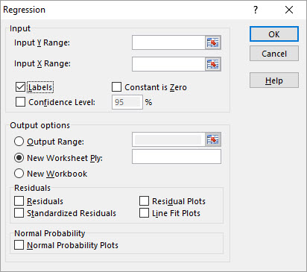
The Dependent Variable
The Regression Input window appears. Select the Labels checkbox to retain the column’s labels in your results.
The Y-axis is the dependent variable. This is the ETF’s excess returns: (Fund Return - Risk Free Rate)

Slide 25

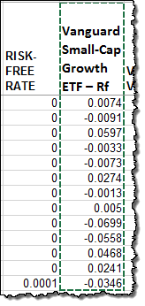
The Dependent Variable (cont.)
In the Regression window, place your cursor in the Input Y Range field.
In the spreadsheet, click first cell of the Vanguard Small-Cap Growth Fund – Rf column.
Drag downward until you reach the last month of data. This is the Input Y Range.

Slide 26
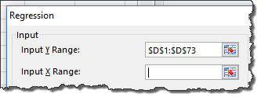
The Independent Variables
In the Regression window, place your cursor in the Input X Range field.
The X-axis is the independent variable. Remember, in the Fama-French 3-Factor model, there are three independent variables:
Market: (R_{MKT} - R_{f}) = (Market Return - Risk Free Rate)
Size: SMB = Small Minus Big
Value: HML = High Minus Low

Slide 27
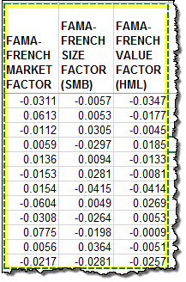
The Independent Variables (cont.)
In the spreadsheet, use your cursor to select all three labeled cells of the Fama-French Factors.
Drag downward until you reach the last month of data. These three columns represent the Input X Range.

Slide 28
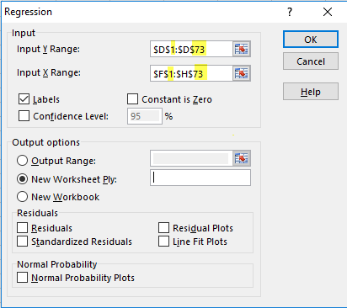
Calculate the Regression
Check the Input Ranges to make sure you captured the full range of data, from rows 1 to 73.
Click OK to calculate the regression.

Slide 29
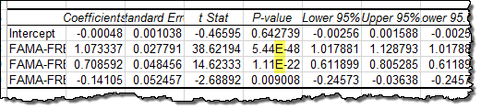
Optional: Turn off Scientific Notation in Excel Results
A new worksheet appears, with the regression results.
Note the letter “E” in some of the value fields. For values with more than 15 digits, Excel displays them, by default, using scientific notation.

Slide 30
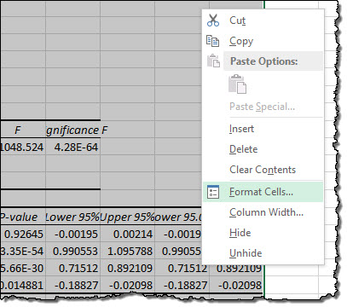
Optional: Turn off Scientific Notation in Excel Results (cont.)
To simplify your results for analysis, you may wish to turn off scientific notation. Use your cursor to select all the columns with numerical data.
Right click to open the options and select Format Cells.

Slide 31
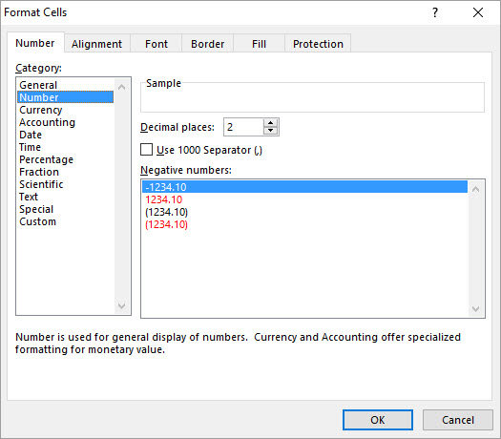
Optional: Turn off Scientific Notation in Excel Results (cont.)
Select Number in the Number tab.
Leave the default number of decimal places at 2 and click OK.
Your results will now be rounded to the nearest 2 decimal places. Keep in mind some precision is now lost.

Slide 32
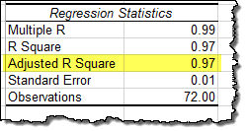
Summary Output: Interpreting R²
R Square provides information on the explanatory power of the linear regression model; it indicates how well the data “fits” the model.
The Adjusted R Square is modified to adjust for the number of independent variables in the model, and is therefore considered the more conservative estimate.

Slide 33
Interpreting R² (cont.)
Here, the Adjusted R Square measures the degree to which this ETF’s excess returns can be attributed to the independent variables.
During this time period, 97% of this ETF’s excess returns can be attributed to the three Fama-French factors.

Slide 34
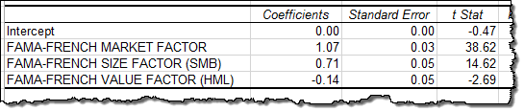
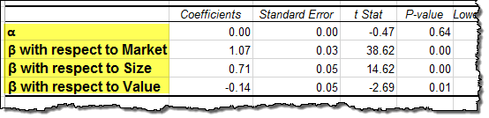
Interpreting the Regression Data
The intercept is the alpha, and the three subsequent coefficients are the beta factor values.
The results can be rewritten as:

Slide 35
Interpreting the Regression Data (cont.)
As you interpret the fund’s sensitivity to the three factors, keep in mind that this Vanguard ETF is designed to “tilt” toward small cap growth stocks.

Slide 36
Comparing ETF Regression Data
Repeat the process to perform a regression analysis on the second ETF, ticker VTV.
Remember to subtract the risk-free rate to get the excess returns.
As you interpret this fund’s sensitivity to the factors, keep in mind that Vanguard has designed it to skew toward large-cap value stocks.

Slide 37
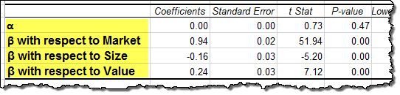
Compare the ETFs in Terms of the Fama-French Factors
Vanguard Small-Cap Growth ETF
Vanguard Large-Cap Value ETF

Slide 38
Conclusion
In the Capital Asset Pricing Model, the market portfolio return is the sole source of risk.
The Fama-French three-factor model suggests that portfolio returns can roughly be explained by three factors:
(1) exposure to the broad market (R_{MKT} - R_{f})
(2) exposure to small stocks (SMB)
(3) exposure to value stocks (HML)
A factor beta represents the sensitivity of a portfolio’s returns to changes in a systematic factor.

Slide 39
Notes (cont.)
For Fama-French data:
Monthly returns on the market portfolio are value-weighted returns for all firms listed on the NYSE, AMEX, and NASDAQ.
The risk-free rate is the return on 1-month T-bills.
Additional information is available on Ken French’s web site: http://mba.tuck.dartmouth.edu/pages/faculty/ken.french/index.html

