Slide 1

git basics
Maxime Charlebois
CCQ, Flatiron Institute

Slide 2
git

Slide 3
git
test1
master
feature1

Slide 4
git
test1
master
feature1

Slide 5
Navigation

Slide 6
git
test1
HEAD
master
feature1

Slide 7
git checkout
HEAD
test1
master
feature1
$ git checkout test1

Slide 8
git checkout
test1
master
feature1
HEAD
$ git checkout feature1

Slide 9
git checkout
test1
HEAD
master
c25a15d...
feature1
$ git checkout c25a15d

Slide 10
git checkout
test1
HEAD
master
feature1
$ git checkout master

Slide 11
Editing

Slide 12
test1
HEAD
master
feature1

Slide 13
$ tree
.
├── makefile
├── README
├── src
│ ├── main.c
│ └── basicMatrix.h
└── a.out

Slide 14
git status
work directory
staging area
Specific commit
$ tree
.
├── makefile
├── README
├── src
│ ├── main.c
│ └── basicMatrix.h
└── a.out
$ git status
On branch master
nothing to commit,
working directory clean
.
├── makefile
├── README
├── src
│ ├── main.c
│ └── basicMatrix.h
└── a.out

Slide 15
git status
work directory
staging area
Specific commit
$ tree
.
├── LICENSE
├── makefile
├── README
├── src
│ ├── main.c
│ └── basicMatrix.h
└── a.out
$ git status
On branch master
Untracked files:
LICENSE
.
├── makefile
├── README
├── src
│ ├── main.c
│ └── basicMatrix.h
└── a.out

Slide 16
git add
$ git add LICENSE
work directory
staging area
Specific commit
$ tree
.
├── LICENSE
├── makefile
├── README
├── src
│ ├── main.c
│ └── basicMatrix.h
└── a.out
$ git status
On branch master
Changes to be committed:
new file: LICENSE
.
├── makefile
├── README
├── src
│ ├── main.c
│ └── basicMatrix.h
└── a.out

Slide 17
git rm
$ git rm a.out
work directory
staging area
Specific commit
$ tree
.
├── LICENSE
├── makefile
├── README
└── src
├── main.c
└── basicMatrix.h
$ git status
On branch master
Changes to be committed:
deleted: a.out
new file: LICENSE
.
├── makefile
├── README
├── src
│ ├── main.c
│ └── basicMatrix.h
└── a.out

Slide 18
git commit
$ git commit
work directory
staging area
Specific commit
$ tree
.
├── LICENSE
├── makefile
├── README
└── src
├── main.c
└── basicMatrix.h
$ git status
On branch master
Changes to be committed:
deleted: a.out
new file: LICENSE
.
├── LICENSE
├── makefile
├── README
└── src
├── main.c
└── basicMatrix.h

Slide 19
git commit
work directory
staging area
Specific commit
$ tree
.
├── LICENSE
├── makefile
├── README
└── src
├── main.c
└── basicMatrix.h
$ git status
On branch master
nothing to commit,
working directory clean
.
├── LICENSE
├── makefile
├── README
└── src
├── main.c
└── basicMatrix.h

Slide 20
.gitignore
work directory
staging area
Specific commit
$ tree
.
├── LICENSE
├── makefile
├── README
├── src
│ ├── main.c
│ └── basicMatrix.h
└── a.out
$ git status
On branch master
Untracked files:
a.out
.
├── LICENSE
├── makefile
├── README
└── src
├── main.c
└── basicMatrix.h

Slide 21
.gitignore
work directory
$ ls -a
.
..
.git
LICENSE
makefile
README
src
a.out
staging area
Specific commit
$ tree
.
├── LICENSE
├── makefile
├── README
├── src
│ ├── main.c
│ └── basicMatrix.h
└── a.out
$ git status
On branch master
Untracked files:
a.out
.
├── LICENSE
├── makefile
├── README
└── src
├── main.c
└── basicMatrix.h

Slide 22
.gitignore
work directory
$ ls -a
.
..
.git
.gitignore
LICENSE
makefile
README
src
a.out
a.out
$ git add .gitignore
staging area
Specific commit
$ tree
.
├── LICENSE
├── makefile
├── README
├── src
│ ├── main.c
│ └── basicMatrix.h
└── a.out
$ git status
On branch master
Untracked files:
.gitignore
.
├── LICENSE
├── makefile
├── README
└── src
├── main.c
└── basicMatrix.h

Slide 23
.gitignore
work directory
$ ls -a
.
..
.git
.gitignore
LICENSE
makefile
README
src
a.out
a.out
$ git commit
staging area
Specific commit
$ tree
.
├── LICENSE
├── makefile
├── README
├── src
│ ├── main.c
│ └── basicMatrix.h
└── a.out
$ git status
On branch master
nothing to commit,
working directory clean
.
├── LICENSE
├── makefile
├── README
└── src
├── main.c
└── basicMatrix.h

Slide 24
git merge
test1
HEAD
master
feature1
$

Slide 25
git merge
test1
HEAD
master
feature1
$ git merge feature1

Slide 26
Hands on

Slide 27
Hands-on
https://bit.ly/343MXTt
$ git status
fatal: Not a git repository (or any of the parent directories): .git

Slide 28
Hands-on
[user]
email = mcharlebois@flatironinstitute.org
name = Maxime Charlebois
$ git config --global --edit

Slide 29
Hands-on
$ git init
$ git status

Slide 30
Hands-on
$ date >> file1
$ git status
$ git add file1
$ git status

Slide 31
Hands-on
HEAD
master
$ git commit -m "first commit"
$ git status

Slide 32
Hands-on
HEAD
master
$ date >> file1
$ cat file1
$ git status
$ git diff
$ git add file1
$ git status
$ git diff

Slide 33
Hands-on
HEAD
master
$ git commit -m “second commit”

Slide 34
Hands-on
HEAD
master
$ date >> file2
$ git status
$ git diff
$ git add .
$ git status
$ git diff
$ git commit -m "third commit"
$ date >> file1
$ git commit -am "4th commit"

Slide 35
Hands-on
HEAD
master
76b75ae
!! BEWARE, commit number will be different in your case !!
$ git log
$ git chekcout 76b75ae

Slide 36
Hands-on
HEAD
test1
master
$ git checkout -b test1
$ ls -a >> tmpList
$ git add tmpList
$ git commit -m "test branch"
$ git log

Slide 37
Hands-on
test1
master
d7421b2
$ git log
$ git checkout d7421b2
$ git status
$ git checkout -b feature1
$ date >> file1
$ git add file1
$ git commit -m "creating conflict"
feature1
HEAD
!! BEWARE, commit number will be different in your case !!

Slide 38
git merge
!!! CONFLICT in file1 !!!
please solve
test1
HEAD
master
$ git checkout master
$ git merge feature1
feature1
file1 content:
Fri Oct 25 17:12:30 EDT 2019
Fri Oct 25 17:12:30 EDT 2019
<<<<<<< HEAD
Fri Oct 25 17:12:30 EDT 2019
=======
Fri Oct 25 17:13:15 EDT 2019
>>>>>>> feature1

Slide 39
Remote

Slide 40
git remote
test1
HEAD
master
feature1

Slide 41
git remote
local

Slide 42
git remote
GitHub
local

Slide 43
git push
GitHub
$ git push
local

Slide 44
git push
GitHub
local

Slide 45
git push
GitHub
$ git push
local

Slide 46
git clone
GitHub
local
co-worker computer

Slide 47
git clone
GitHub
$ git clone
local
co-worker computer

Slide 48
GitHub
local
co-worker computer

Slide 49
one day later
GitHub
local
co-worker computer

Slide 50
git pull/push
GitHub
$ git pull
local
co-worker computer

Slide 51
git pull/push
GitHub
$ git push
local
co-worker computer

Slide 52
git pull/push
GitHub
$ git pull
local
co-worker computer

Slide 53
git pull/push
GitHub
$ git push
local
co-worker computer

Slide 54
git pull/push
GitHub
$ git fetch
local
co-worker computer

Slide 55
git pull/push
GitHub
$ git pull
local
co-worker computer

Slide 56
etc

Slide 57
git commit -m “...”
Explicit messages
$ git commit -m “[mpi] Added parrallelization to Monte Carlo sampling”
$ git commit -m “[mkl] BUG, not working yet, do not use.”
Bad messages
$ git commit -m “error 2”
$ git commit -m “.”

Slide 58
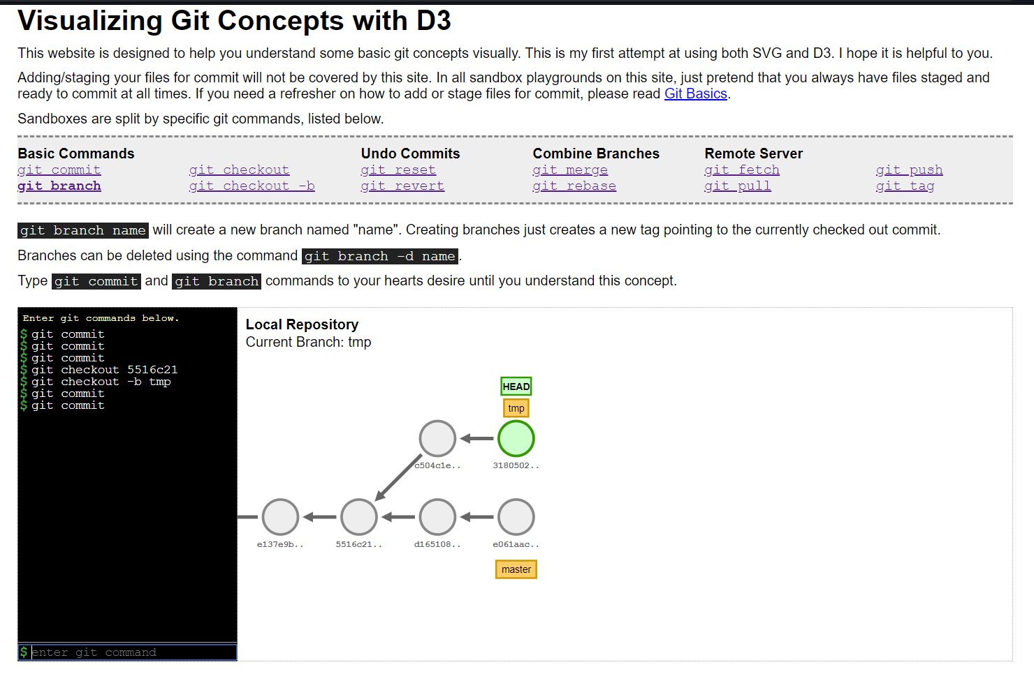
Reference
onlywei.github.io/explain-git-with-d3/#checkout-b

