Slide 1



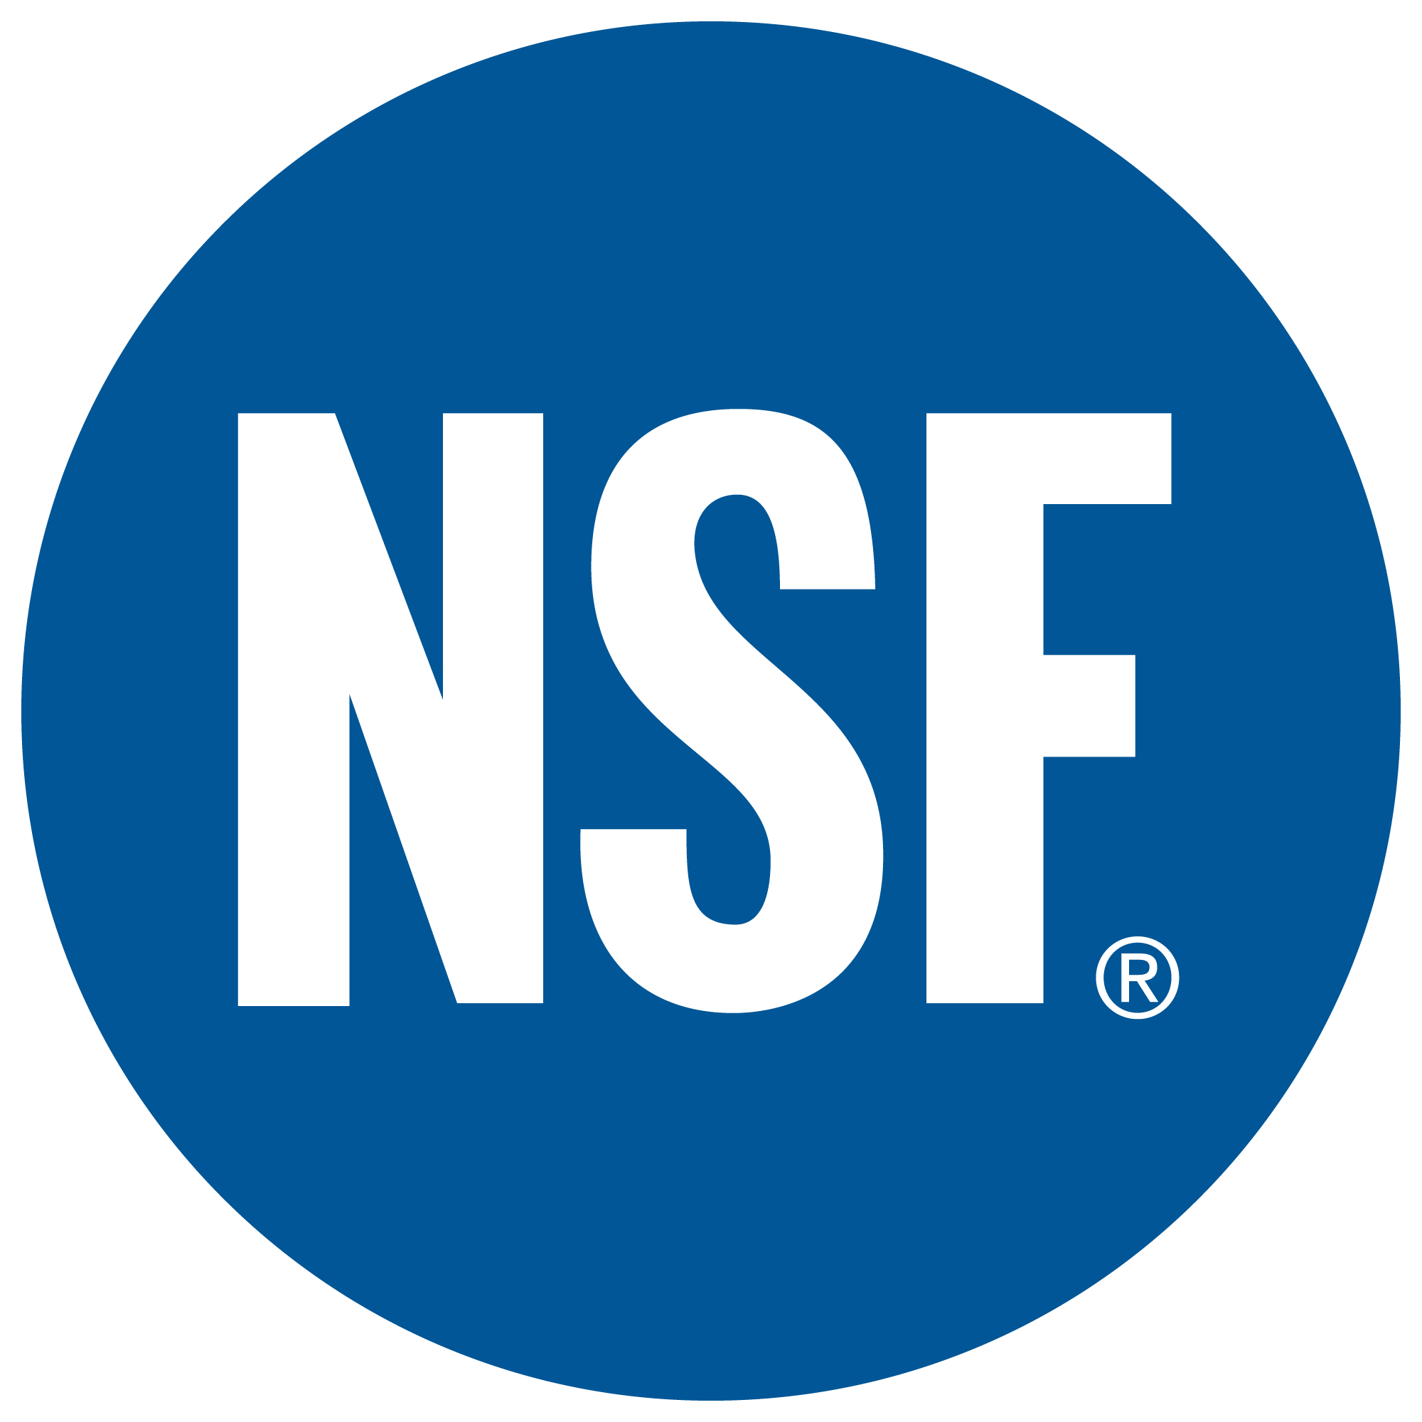

Discrepancies among Pre-trained Deep Neural Networks: A New Threat to Model Zoo Reliability
Diego Montes, Pongpatapee Peerapatanapokin,
Jeff Schultz, Chengjun Guo, Wenxin Jiang, James C. Davis
Supported by Gifts from

Slide 2
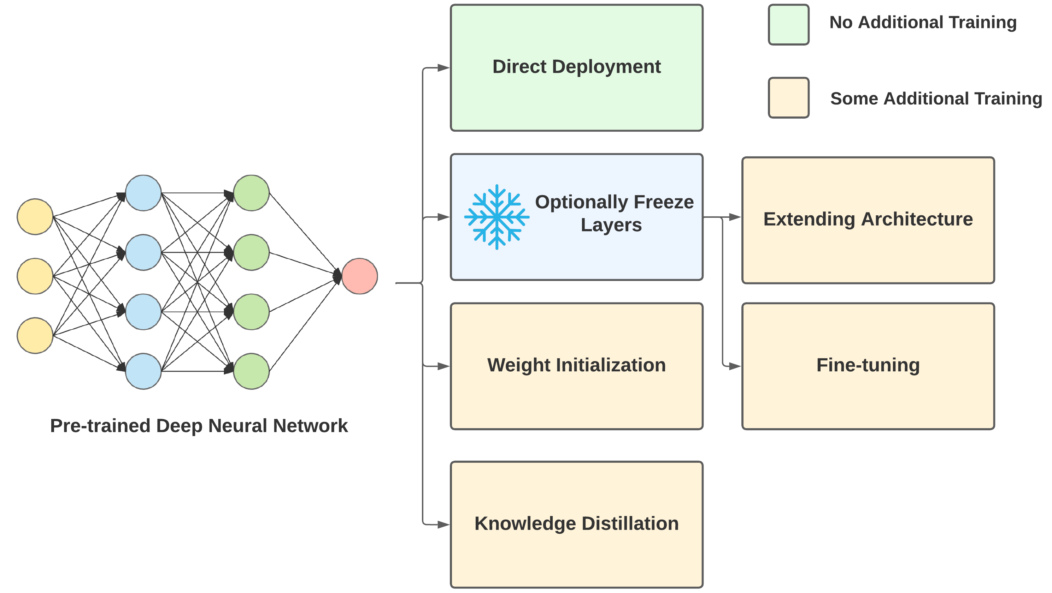
Pre-trained Deep Neural Networks (PTNNs)
What is a PTNN
How do we use PTNNs
Re-using PTNNs can accelerate model development.
Transfer learning can reduce training times and increase accuracies.
Deep neural network previously trained on a large dataset to solve a particular task, such as image classification.
2

Slide 3




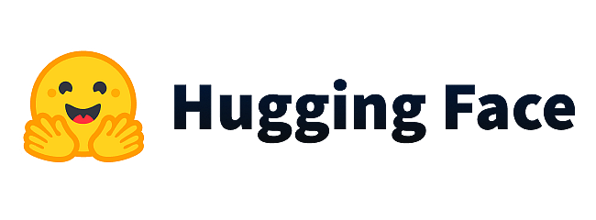
Model Zoos – What They Are
What is a Model Zoo
Collection of PTNNs, generally for a diverse set of tasks. A model zoo might contain PTNNs for image classification AND object detection.
Where Can I Find Them
Machine learning frameworks have created model zoos developed with their framework.
Not limited to machine learning frameworks, like Hugging Face.
3

Slide 4
Model Zoos – PTNNs
Past research has emphasized difficulties in reproducing machine learning research papers. These difficulties may affect the PTNNs in model zoos too!
Model Zoos take well-known deep neural network architectures, often from research papers, and implement them.
Deep Residual Learning for Image Recognition proposed the ResNet architecture
PTNN named "ResNet v1" implemented with the TensorFlow API
PTNN named "ResNet v1" implemented with the Keras API
PTNN named "ResNet v1" implemented with the PyTorch API
4

Slide 5
Research Question
Do discrepancies exist between the accuracy, latency, and architecture of PTNNs across different model zoos?
5

Slide 6
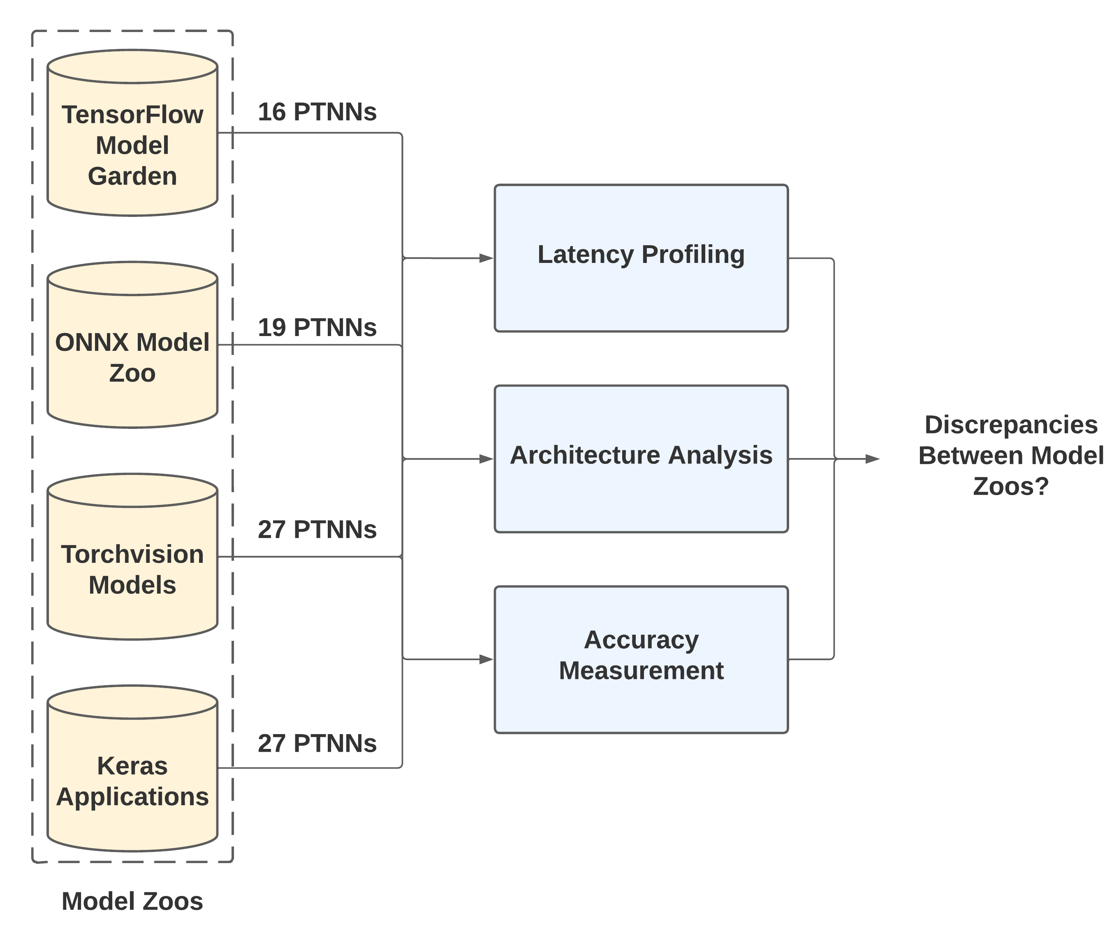
Model Zoo Selection
Keywords in GitHub Search
Selection criteria:
Developed alongside machine learning framework
GitHub repository with at least 3000 stars
Measurements highlighting important qualities of a DNN
4 model zoos after PTNN availability analysis
36 PTNN image classification architectures
6

Slide 7
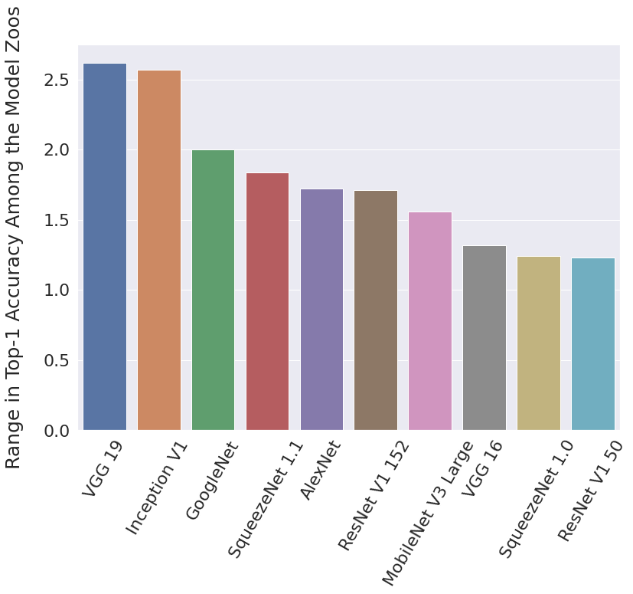
Accuracy Latency Architecture
10 of 35 PTNN architectures with top-1 accuracies differences greater than 1%
5 of 32 PTNN architectures with top-5 accuracy differences greater than 1%
ResNet V1 152 from Keras, 76.6% top-1, less accurate than ResNet V1 101 from Torchvision, 77.3% top-1
ResNet V1 101 was originally reported to be 0.32% less accurate than ResNet V1 152
7

Slide 8
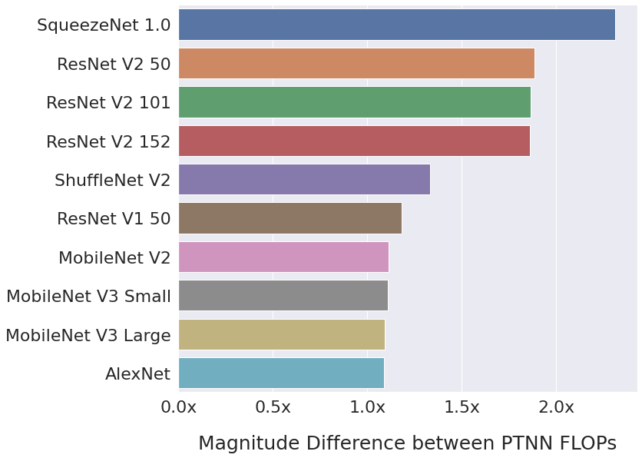
Accuracy Latency Architecture
8

Slide 9
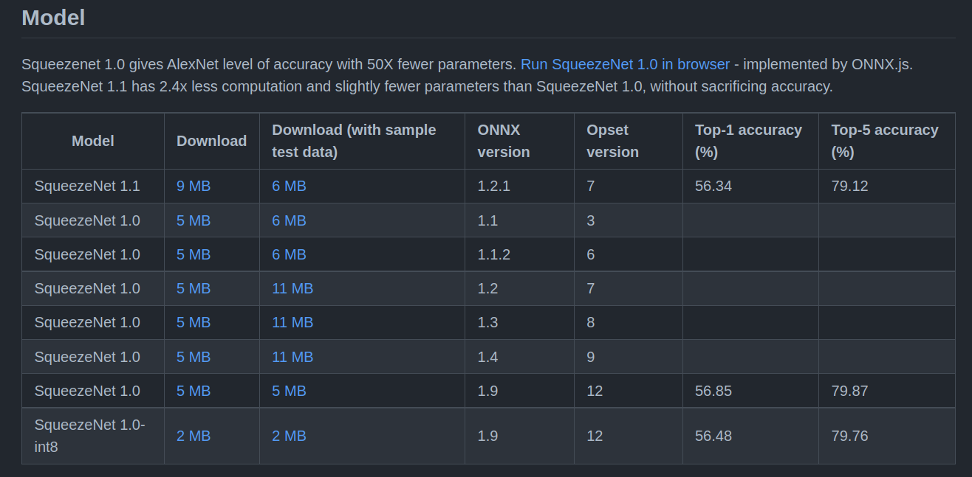
Accuracy Latency Architecture
All these models are Squeezenet 1.1!
Misadvertising SqueezeNet 1.1 as SqueezeNet 1.0 by ONNX Model Zoo
9

Slide 10
Accuracy Latency Architecture
TensorFlow Model Garden changing input size from 224x224 to 299x299
10

Slide 11
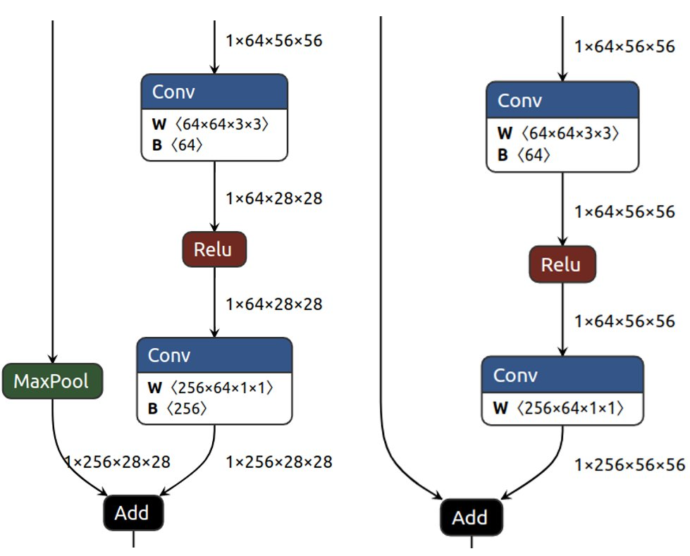


Accuracy Latency Architecture
ResNet V2 50:
Keras PTNNs contains Max Pool skip connections not present in research paper
AlexNet:
Torchvision implements different paper by the same author but calls PTNN "AlexNet".
11

Slide 12
Future Directions
Naming Conventions
Security vulnerabilities
What do engineers prefer: exact reproductions or more accurate and lower latency variants?
How should we name PTNNs?
Empirical Validation
Verifying accuracy claims of model zoos
New Metrics and Automated Tools
Metrics to further measure reliability
Automated measuring of PTNN characteristics
12

Slide 13
Conclusions
We Want To Make Model Zoos Reliable!
Contact: montes10@purdue.edu

Slide 14
Implications
Model Zoo:
Architecture:
Top-1: 75.81%
Top-5: 92.82%
Top 1: 76.0%
Top 5: 93.0%
Accuracy:
Latency:
4.12 Billion FLOPs
3.49 Billion FLOPs
14

