Slide 1
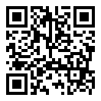
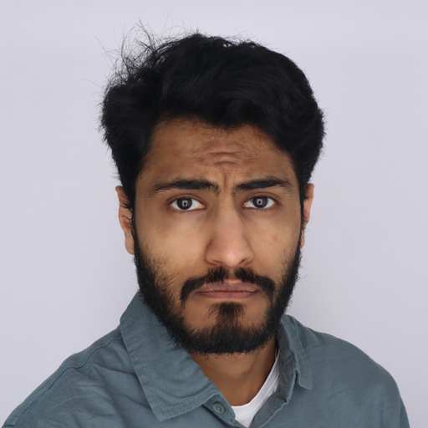
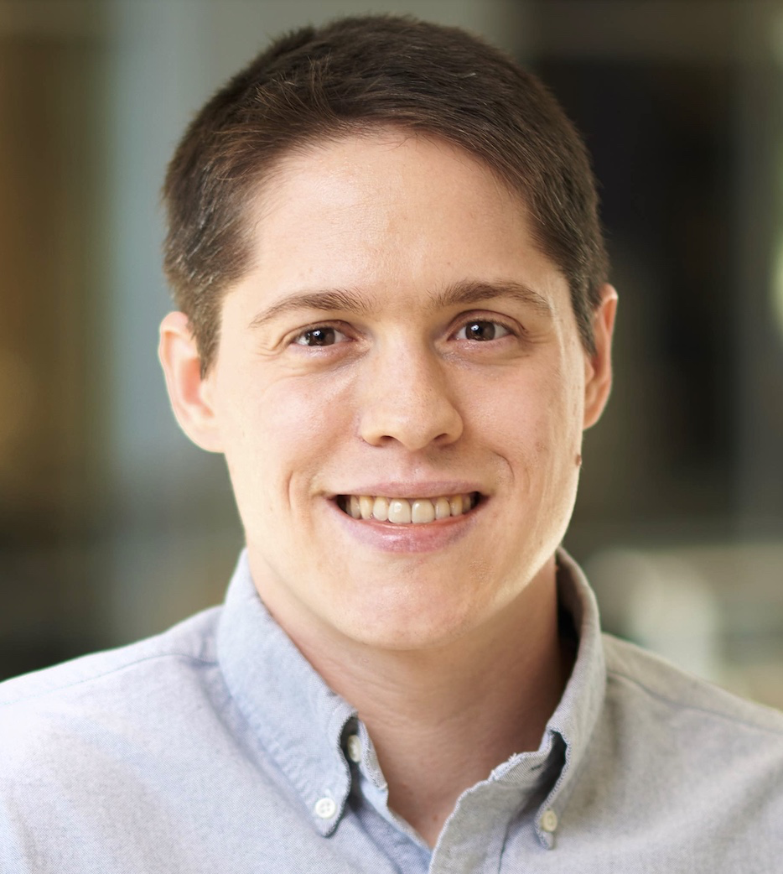

Analysis of Failures and Risks in Deep Learning Model Converters
A Case Study in the ONNX Ecosystem
Paper and slides: https://davisjam.github.io/publications/
Purvish Jajal James C. Davis
(Joining remotely)
Notes:
Hello Purvish Jajal, I am PhD student

Slide 2

Talk outline
Overview of research literature: ONNX/etc.
Our study on ONNX failures
Method
Results
Implications for you
Ways you can get involved
Notes:
A brief outline of our talk:
I will talk briefly about existing research on ONNX
Then I will talk about our study: methods, results, implications
Finally we will talk about ways you can get involved

Slide 3
A quick literature review
(for your reading lists)

Slide 4
Academic Work on ONNX
Empirical Work:
An Empirical Study of Challenges in Converting Deep Learning Models [1]
Tooling Work:
Sionnx: Automatic Unit Test Generator for ONNX Conformance [2]
Selected Application Works:
Pre-Quantized Deep Learning Models Codified in ONNX to Enable Hardware/Software Co-Design [3]
ESPnet-ONNX: Bridging a Gap Between Research and Production [4]
Notes:
So in terms of research on ONNX:
There has been empirical work on ONNX, they study how models perform before and after conversion.
There has been work to create tools for unit test generation.
There has been work where:
ONNX is used to separate quantization from compilation allowing for hardware/software co-design
and where conversion to ONNX has been used to provide speed ups for speech processing.

Slide 5
Our study on ONNX failures
Notes:
So what are we studying?
We are studying how ONNX model converters have failed.

Slide 6
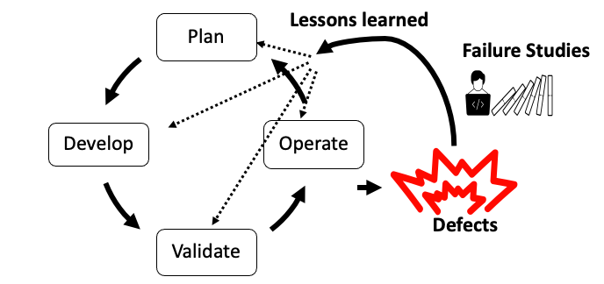
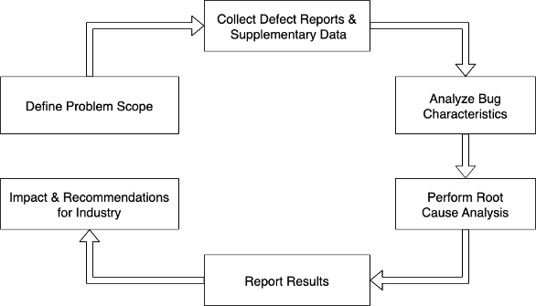
Background: Failure Analysis
Notes:
In the software development life cycle, we plan a software project, build and validate it and everything seems to work well. But once deployed and during operation, things break, bugs happen. These bugs are undesirable. To better understand these bugs, academic researchers or industry investigators conduct failure studies. The goal is to learn lessons from these failures. There are two audiences for such work: (1) the product engineers, who want to reduce occurrence of these bugs; and (2) the product users, who want to understand their risks when they use the product.

Slide 7
Goal: Understanding failures of ONNX model converters.
Audience:
Product Users: To understand risks in the use of ONNX model converters
Product Engineers: To reduce the occurrence of bugs in ONNX model converters
Notes:
So what is our goal: we want to understand how ONNX model converters fail.
And our audience is the same as any failure analysis: product engineers, who want reduce the occurrence of bugs in model converters; and product users who want to understand the risks of using converters.

Slide 8
Research Questions
RQ1: What are the characteristics (symptoms, causes) of failures?
RQ2: To what extent do changes in the ONNX specification correlate with model converter failures?
RQ3: How often do current ONNX converters fail on real and systematically generated models?
Notes:
To achieve our goal we ask the following questions:
RQ1: What are the characteristics of failures? By characteristics I mean symptoms and causes. Symptoms are the effects of the failure, whereas the causes are the underlying reason for the failure.
RQ2: To what extent do changes in the ONNX specification correlate with model converter failures?
RQ3: How often does interoperability software fail on real and systematically generated models?

Slide 9
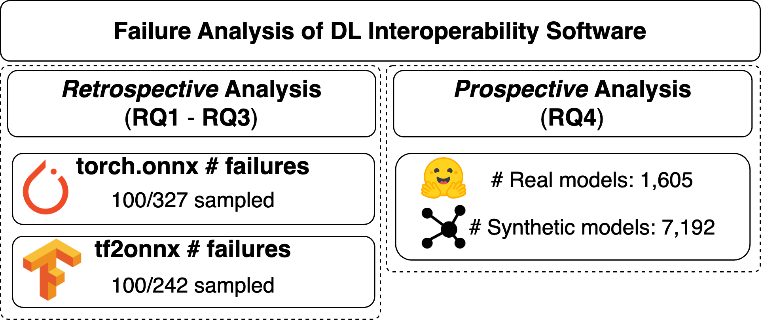
Method Overview
Notes:
Our work studies two model converters: pytorch converter (torch.onnx) and tf2onnx (the tensorflow converter).
And we study these converters in two ways:
- Retrospectively: we study 100 Closed GitHub issues reported for each converter. This provides a historical perspective on how thing have failed in the past.
- Prospectively, current users care about how they currently behave. So we test these converters with many different DL models, both real (i.e., pretrained) and synthetic (i.e., randomly generated).

Slide 10
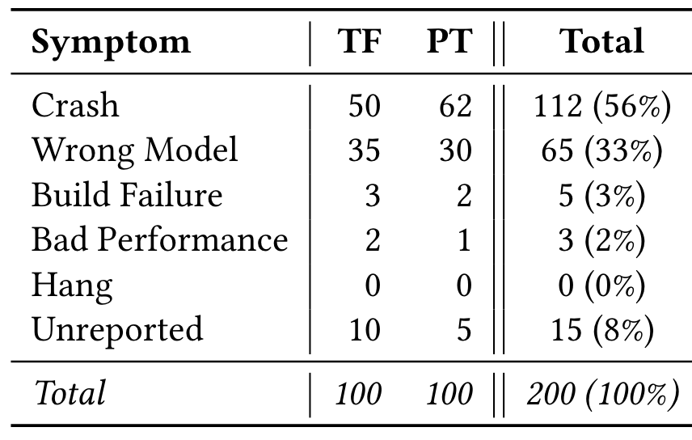
RQ1: Failure Symptoms
Common Failure Symptoms:
Crashes
Wrong Models
Notes:
When we ask what the failure symptoms are, what we are asking is what are the effects of the failure that users have seen?
We measure that: converter crashes and incorrectly converted models (wrong models) are the most common failure symptoms.
Crashes occurred in 56% of the studied failures.
Wrong Models occurred in 33% of the studied failures.

Slide 11
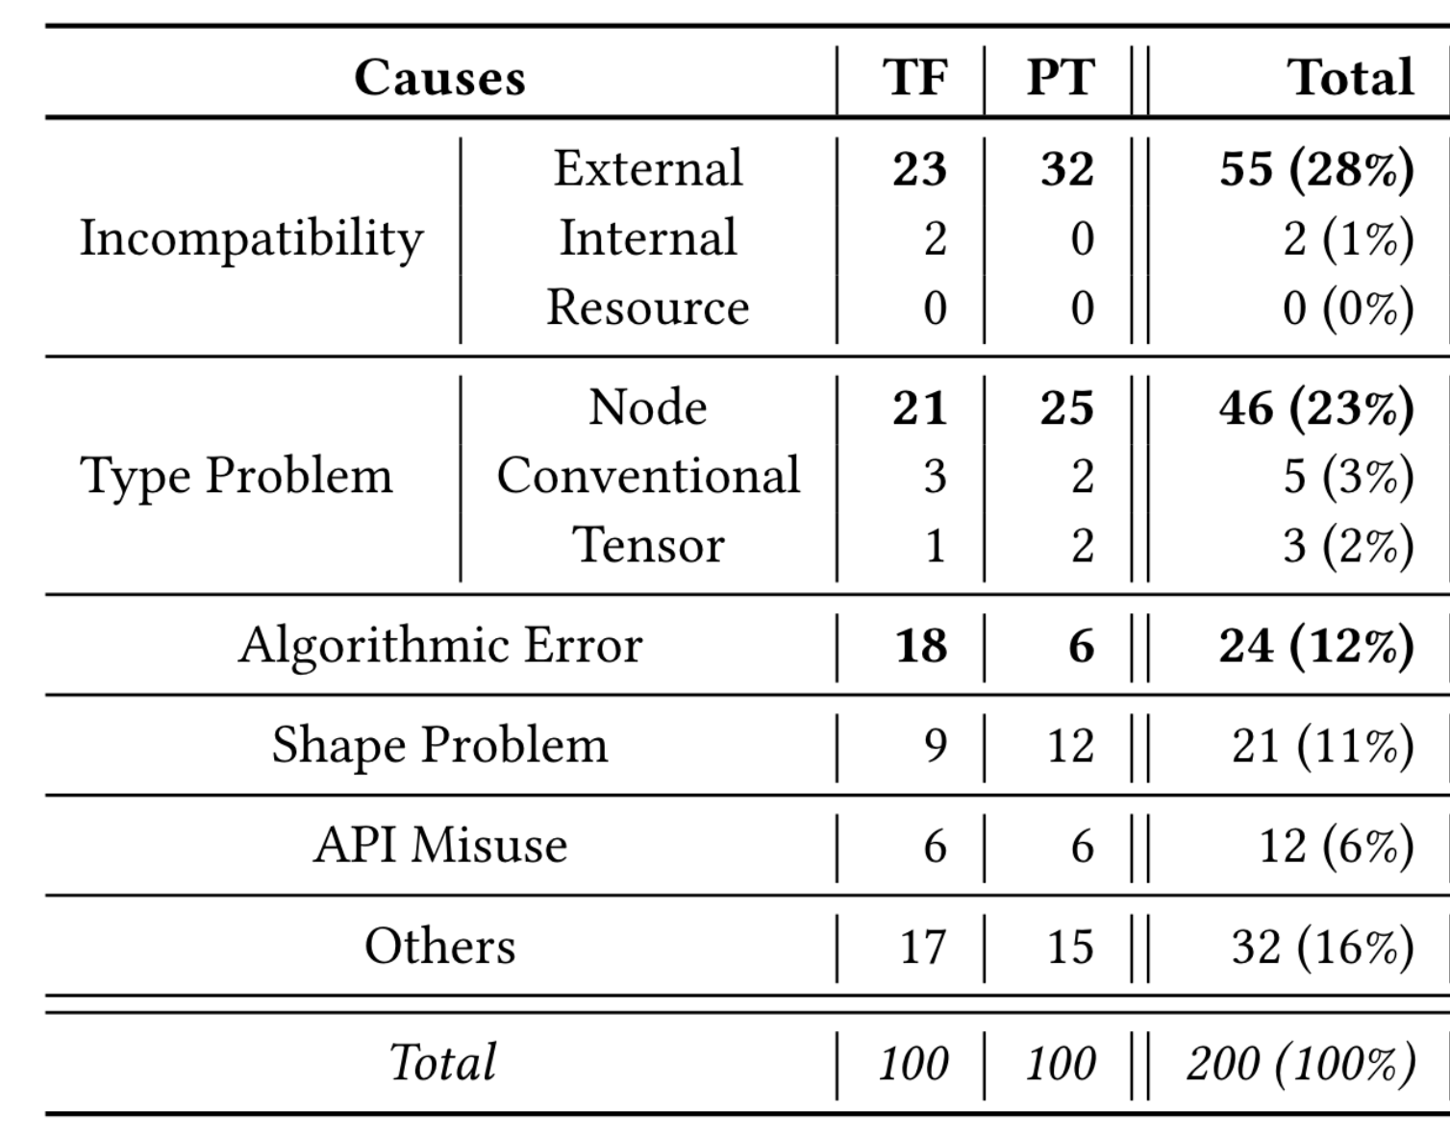
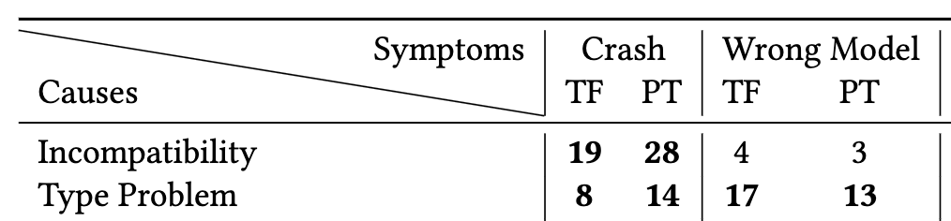
RQ1: Failure Causes
Common Causes:
Incompatibilities – External
Type Problems – Node
Notes:
In addition to failure symptoms we also look at the causes of these failures. There are two common causes of failures:
External Incompatibilities which make up 28% of failures, which essentially means that many of the failure that were found were people trying to convert to ONNX but being unable to due to an operation not be supported.
Node Type Problems which make up 23% of failures. These are issues pertaining to the conversion of nodes.

Slide 12
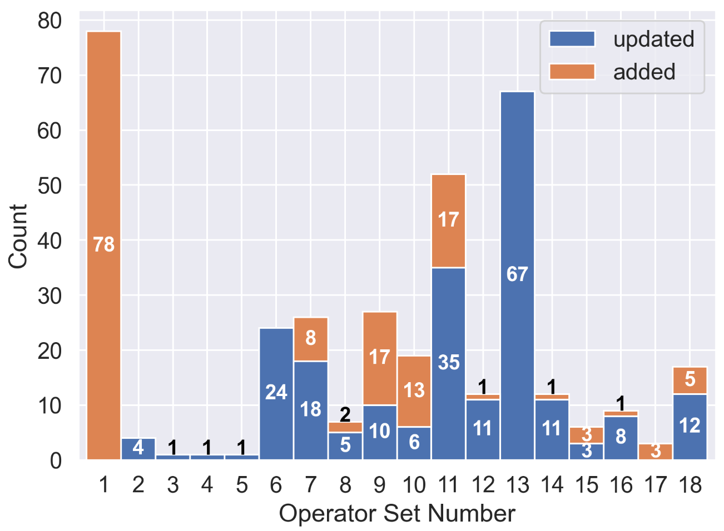
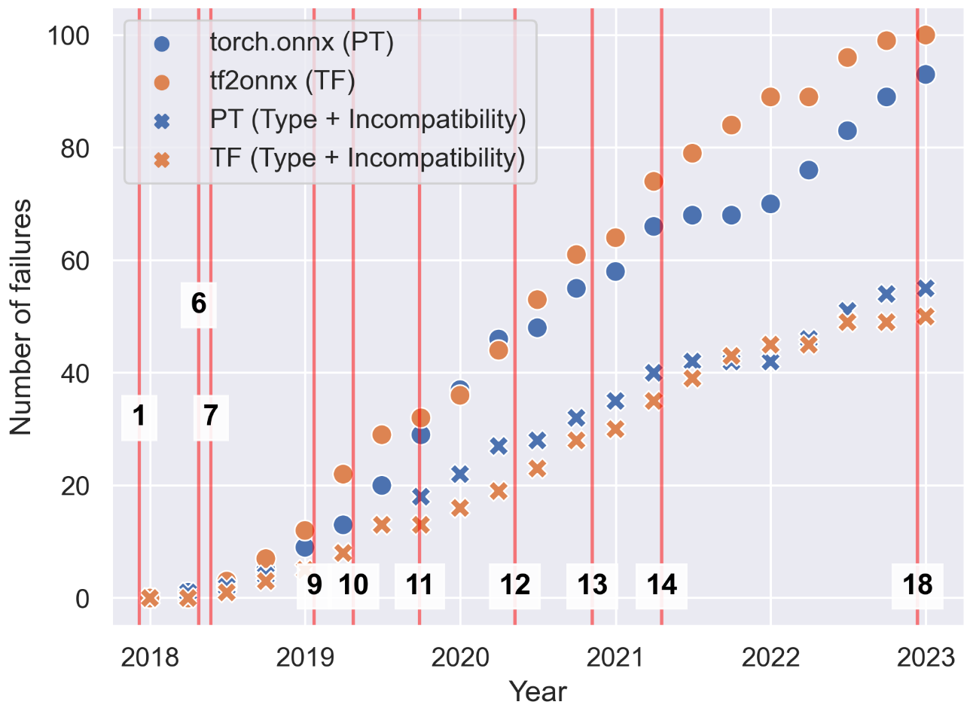
RQ2: Changes sometimes break but not too often
Weak positive correlation between changes and the number of failures (Spearman’s 𝜌 = 0.36).
Notes:
As an engineer you may be worried whether changes in the ONNX specification will be breaking for you.
We measured the number of issues that are opened between each release.
Good news: we find only a weak positive correlation between changes and the number of failures being measured.
So you don’t need to worry about this too much.

Slide 13
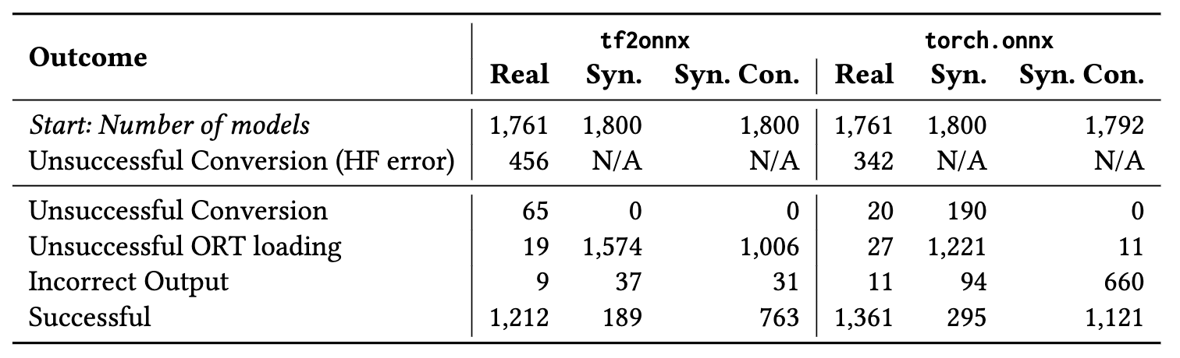
RQ3: Synthetic Models
Real models: Crashes and incorrect behavior → ∼5% of models.
Synthetic models: Reveal incorrect model behavior more often than Real models, ∼25% (822/7,192) vs. ∼1% (20/3,522).
Incorrect Output is when the difference in outputs of original and converted models are >10⁻³
Notes:
RQ1 and RQ2 are all retrospective analyses they don’t really tell us the current state of things. We were curious whether these issues occur in current versions of converters.
We tested model converters using two types of inputs, real models which were pretrained models taken from HuggingFace and synthetic models created using a random model generator called NNSmith.
Real models: Crashes and incorrect behavior → ∼5% of models. What we mean by incorrect behavior is when the original and converted models differ in outputs by a certain threshold.
Synthetic models: Reveal incorrect model behavior more often than Real models, ∼25% (822/7,192) vs. ∼1% (20/3,522).

Slide 14
Implications
For ONNX users: ONNX Failure Modes
Crashes are common
Wrong models happen too – beware!
The more unusual your model, the more likely a silent conversion failure
For Converter Developers: Testing of Converters
Model generation effective at inducing incorrect outputs (RQ3)
Model generation may be a good addition to converter test suites
Notes:
So, what are some of the implications of this study
We understand failure modes better:
Crashes are common
Wrong models can occur, it is important to keep an eye out for this --- these are often silent!
The more unusual your model the more likely there is some sort of silent conversion failure, this is the finding from the synthetic models.
We also learned that model generation can be effective at revealing when converted models behave incorrectly. This type of model generation can be an addition to converter test suites.

Slide 15
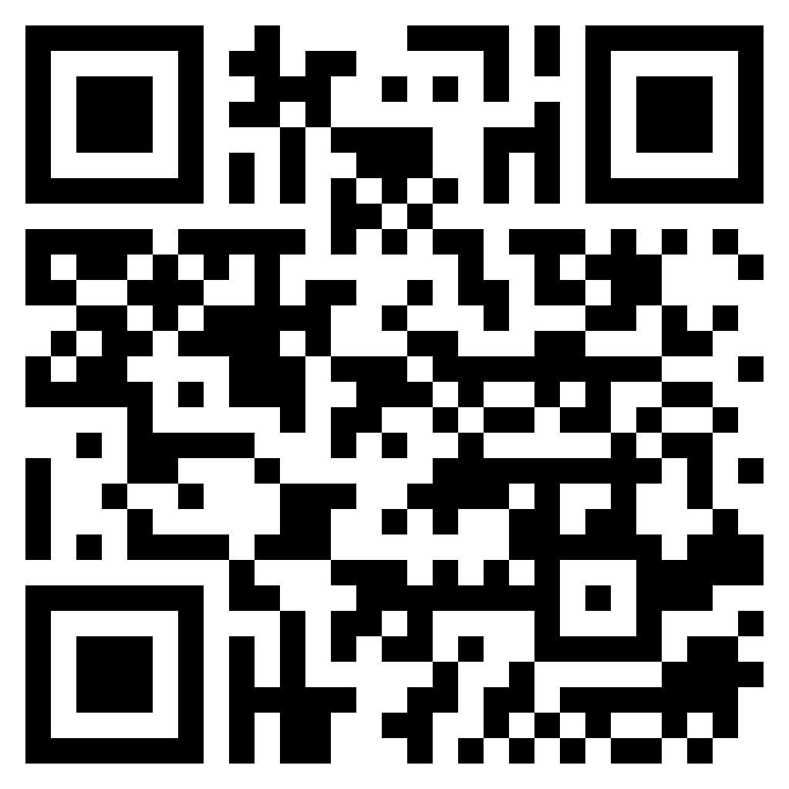
Ways you can get involved? Survey!
https://forms.gle/cqYqHAzNkCpaaonr8
Notes:
You can get involved by answering a quick survey. It is just a usage survey that asks how you use ONNX and some of your experiences with it. Here is the QR code that will take you to the survey.
This should take you approximately 2 minutes to complete.

Slide 16
Our paper: https://arxiv.org/abs/2303.17708
Other references
[1]: An Empirical Study of Challenges in Converting Deep Learning Models http://arxiv.org/abs/2206.14322
[2]: Sionnx: Automatic Unit Test Generator for ONNX Conformance http://arxiv.org/abs/1906.05676
[3]: Pre-Quantized Deep Learning Models Codified in ONNX to Enable Hardware/Software Co-Design http://arxiv.org/abs/2110.01730
[4]: ESPnet-ONNX: Bridging a Gap Between Research and Production https://arxiv.org/abs/2209.09756

Slide 17
Bonus Slides

Slide 18
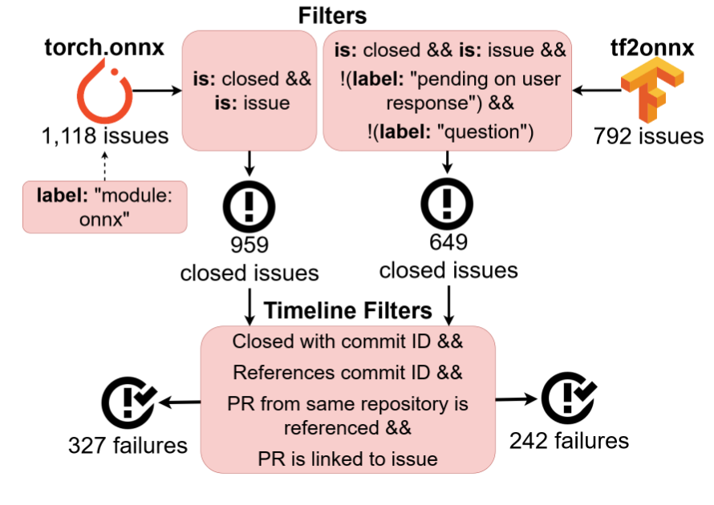
Method: Projects and questions
Notes:
We can skip this slide.

Slide 19
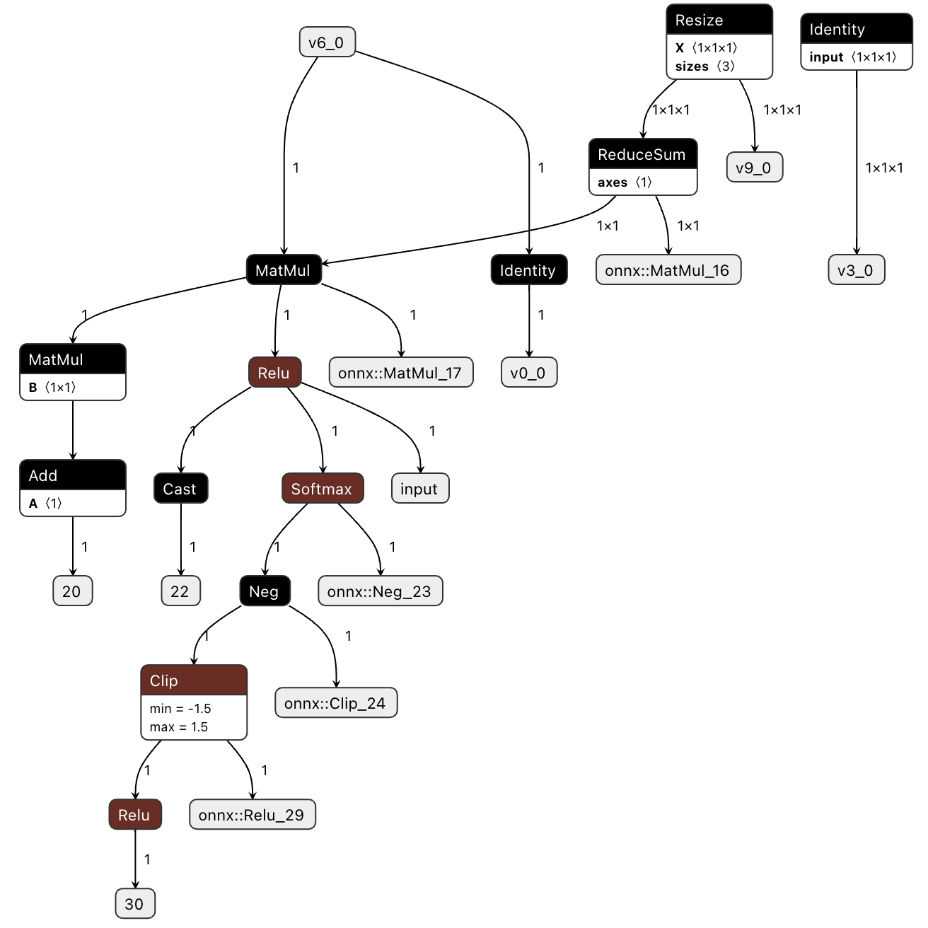
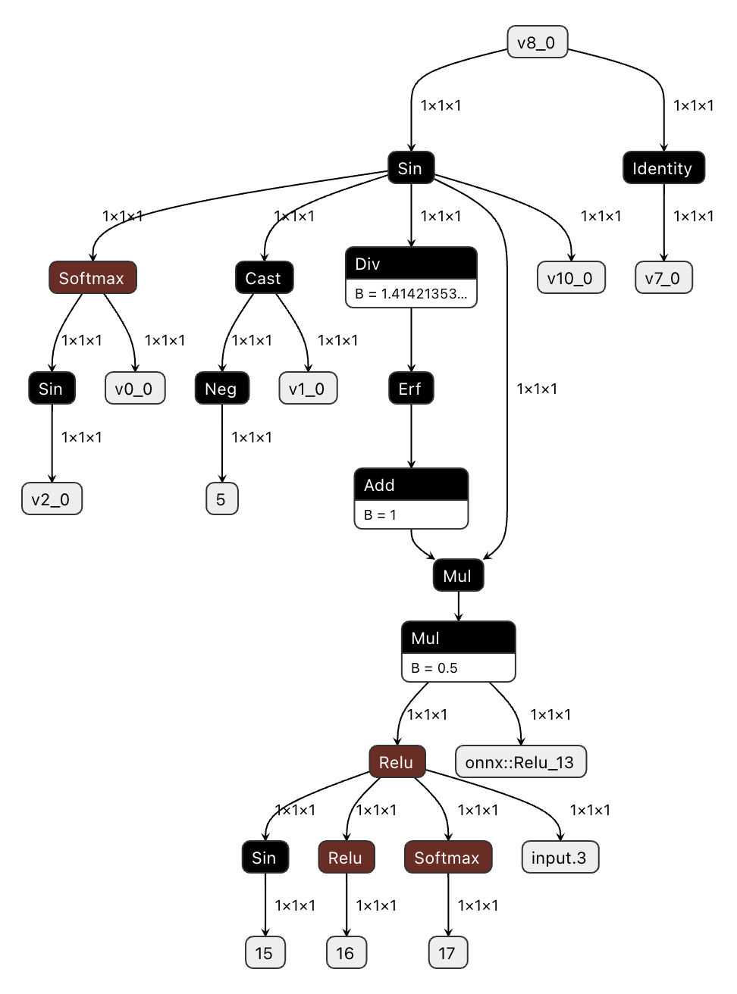
Examples of NNSmith Synthetic Models

