Slide 1

Chapter 12
Web Publishing Basics
Key Concepts
Copyright © 2013
Terry Ann Morris, Ed.D

Slide 2
Learning Outcomes
Describe criteria to consider when selecting a web host
Obtain a domain name for your website
Publish a website using FTP
Design web pages that are friendly to search engines
Submit a website for inclusion in a search engine
Determine if a website meets accessibility requirements
Evaluate the usability of a website

Slide 3
Domain Names
Establishes a Web presence for your business/ organization
  New Business
    choose domain name while selecting company name
  Established Business
    choose a domain name that relates to your established business presence

Slide 4
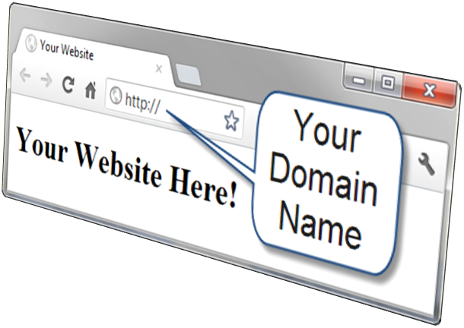
Choosing a Domain Name
Describe your business
Be brief, if possible
Avoid hyphens
TLD (top level domain name)
  .com, .net, .biz, .us, .mobi and others
  .org for non-profits
Brainstorm potential keywords
Avoid trademarked words or phrases
Know the territory (use Google!)
Verify Availability

Slide 5
Registering a Domain Name
There are many domain name registrars, including
  http://register.com
  http://networksolutions.com
  http://godaddy.com
Visit Registrar, choose name, pay with credit card or Paypal
Private registration – additional fee but personal information is kept private and out of the WHOIS database

Slide 6
Web Hosting
Some organizations administer a web server in-house and host their own web site.
Most companies use a web host provider.
  A good web hosting service will provide a robust, reliable home for your web site.
  A poor web hosting service will be the source of problems and complaints.
  Do not use free web hosting for a commercial web site.

Slide 7
Types of Web Hosting
Hosting Needs: Small to Medium Website
  Virtual Hosting
    The web host provider's server is divided into a number of virtual domains and multiple websites are set up on the same computer.
Hosting Needs: Large to Enterprise Web Site
  Dedicated Web Server
  Co-located Web Server
  Consider:
    National web host providers
    Guaranteed uptime – service level agreement (SLA)
    Bandwidth of Internet connection
    Technical Support

Slide 8
Choosing a Virtual Host
See the Web Host Checklist
Operating System
Web Server Software
Bandwidth
Technical Support
Service Agreement
Disk Space
E-mail
Uploading Files
Canned Scripts
Scripting Support
Database Support
E-Commerce Packages
Scalability
Backups
Site Statistics
Domain Name
Price

Slide 9
Publish with FTP
FTP, File Transfer Protocol
  FTP is utilized to copy and manage files and folders over the Internet
Popular FTP Applications
  Filezilla
  SmartFTP
  CuteFTP
  WS_FTP

Slide 10
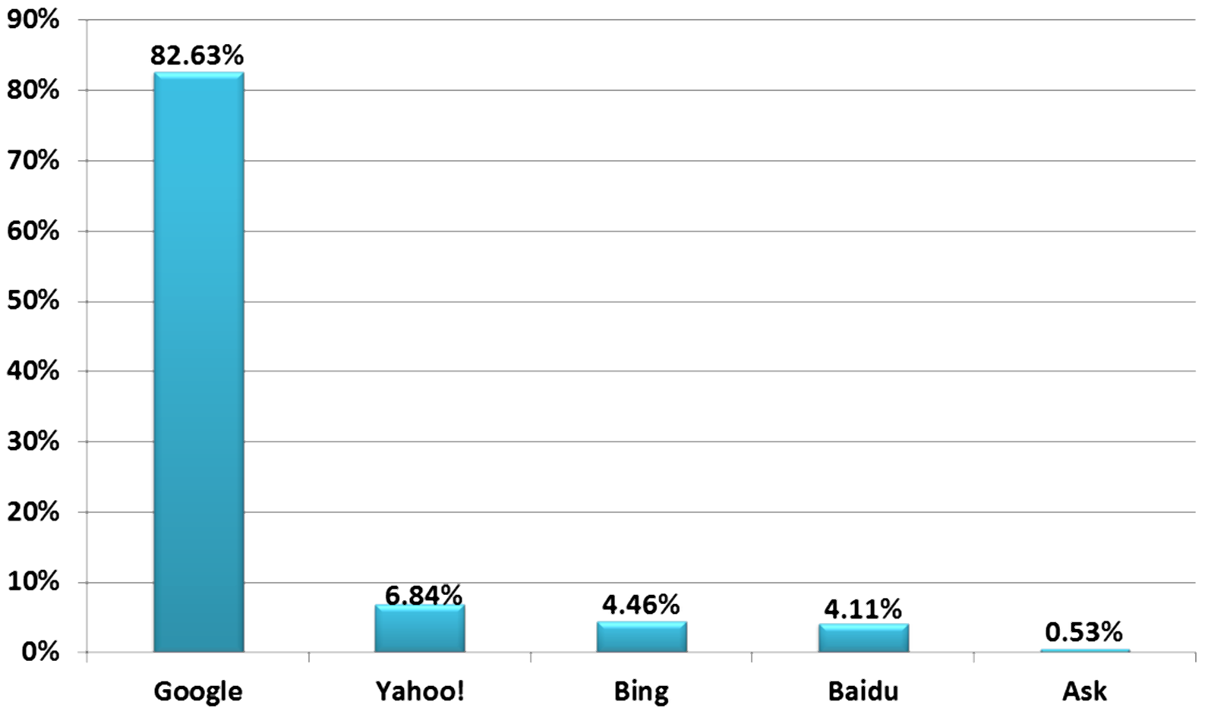
Popular Search Engines
Google, Yahoo!, and Bing — the three most popular sites used for searching the Web during a recent month.
Source: http://marketshare.hitslink.com/search-engine-market-share.aspx

Slide 11
Search Engine Robot
Also called a spider or bot
  A computer program that follows hyperlinks and “walks” the Web – accessing and documenting Web pages.
  Categorizes the pages and stores information in a database.
May access the following components of web pages:
  title,
  description meta tag
  text in headings
  other text on the page
  hyperlinks

Slide 12
Search Engine Database
Database:
  A collection of information organized so that its contents can easily be accessed, managed, and updated.
Database Management Systems (DBMSs)
  Configure and manage database
    Oracle, MySQL, Microsoft SQL Server, IBM DB2
Search Engine Database
  Contains information about web pages

Slide 13
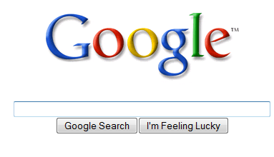
Search Engine
Search Form
The part you are most familiar with!
The search form is the graphical user interface that allows a user to request a word or phrase to search for.
The visitor to the search engine types words (called keywords) related to their search into the text box.
When the form is submitted, the data typed into the text box is sent to server-side processing that searches the database using the keywords you have entered.
The search results (also called a result set) is a list that contains information such as the URLs for web pages that meet your criteria.

Slide 14
Search Engine Results Page (SERP)
A list of items that describe web pages matching the search terms.
  Each item contains a link to a page along with additional information that might include the page title, a brief description, the first few lines of text, the size of the page, and so on.
The order the web page items are displayed in the SERP may depend on:
  paid advertisements
  alphabetical order
  link popularity
Each search engine has their own policy for ordering the search results.

Slide 15
The Meta Element
<meta>
The meta element
  A stand-alone tag
  Placed in the head section
  Attributes:
    name
    content
<meta name="value" content="value">
Meta tag used by search engines:
  name=“description”

Slide 16
Keywords Meta Tag
Example: “Acme Design”
<meta name="description" content="Acme Design, a premier web consulting group that specializes in E-commerce, web site design, web site development, and web site re-design." >

Slide 17
Search Engine Optimization (SEO)
Determine keywords
Page Title
  Include the company and/or Web site name
  Include selected keywords as approprite
Heading tags
  Include keywords
Text on page includes keywords

Slide 18
Search Engine Optimization (SEO) 2
Linking
  Provide text navigation hyperlinks
  Verify that all hyperlinks are functionig
Page Layout
  Avoid nested tables
  Use CSS for page layout
Images & Multimedia
  Configure meaningful alternate text
  Be aware that text and hyperlinks contained within multimedia may not be accessed by search engine robots

Slide 19
Search Engine Optimization (SEO) 3
Valid Code
  Validate XHTML
  Validate CSS
Content of Value
  Follow Web Design Best Practices
  Well-organized
  Meaningful & useful to your target audience

Slide 20
Listing in a Search Engine
Wait until your site is finished
Don’t submit “under construction” Web sites!
Visit Search Engine and look for “Add URL” or “Suggest URL”, or “Add your Site”, etc.
Follow the directions and fill out the form
A robot from the search engine will visit your Web site and index it
Allow several weeks and test the search engine to see if your site is listed

Slide 21
Link Popularity
A rating determined by a search engine based on:
  the number of sites that link to a particular website
  the quality of the sites that the links are from
The link popularity of your website can help determine its order in the SERP

Slide 22
Accessibility Testing
Universal Design & Accessibility
Web Accessibility Standards
  Section 508
  WCAG 2.0
Testing for Accessibility Compliance
  Automated Accessibility Testing
  Manual Accessibility Testing
Testing Reading Level

Slide 23
Usability Testing
Usability
  the measure of the quality of a user's experience when interacting with a website
Usability Testing
  Testing how actual web page visitors use a website
  Can be done at almost any stage of development
    Early – use paper and sketches of pages
    Design – use prototype
    Production & Testing – use actual pages

Slide 24
Summary
This chapter introduced you to web publishing topics: choosing a domain name, selecting a web host, and uploading files to a website.
The chapter also provided an overview of search engines, search engine submission, and search engine optimization.
Finally, the chapter provided an overview of testing the accessibility and usability of a website.

