Slide 1
Exploration for basic binary convolution unit
CS584
2024/4/24
Wenxuan Zhang

Slide 2
basic binary convolution unit
Image restoration is an important topic in image processing. Also known as image recovery, it is a technique in image processing aimed at improving the quality of a given image. When provided with a degraded or noise-contaminated image, the basic process of restoration involves reconstructing or restoring the original image using some prior knowledge of the degradation phenomenon. Binary Neural Network (BNN) known as 1-bit CNN, has been proposed and considered one of the most promising neural network compression methods for deploying models on resource constrained devices Useful
Significant performance improvements have been achieved in tasks such as super-resolution, denoising, and compression artifact reduction. Especially when running models on resource-constrained devices.

Slide 3
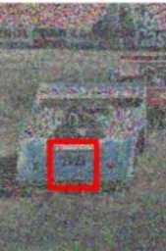


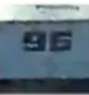

Objectives
Binary neural networks for
image super-resolution
Binary neural networks for
image denoising
BBCU_M
BBCU_L
BBCU
BBCU has achieved significant performance improvements in image denoising, super-resolution (SR), and compression artifact removal tasks.

Slide 4
Relationships with other relevant areas
machine learning
Computer vision
Image processing
Deep learning
Image restoration
classification
BBCU
CNN
Object detection
Recognition

Slide 5
Dataset
DIV2K Dataset: DIV2K is an open dataset created by Radu Timofte and Eirikur Agustsson in 2017 for Super-Resolution research. It comprises approximately 800 images sourced from various origins including films, natural landscapes, animations, and computer-generated imagery, among others.

Slide 6
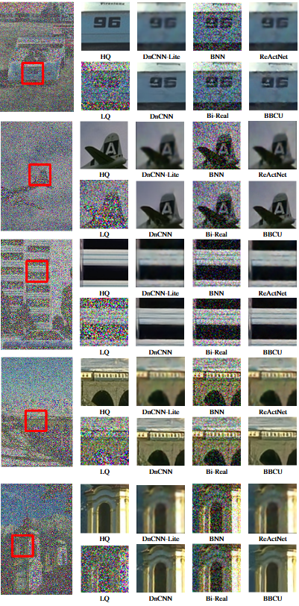
Result

Slide 7
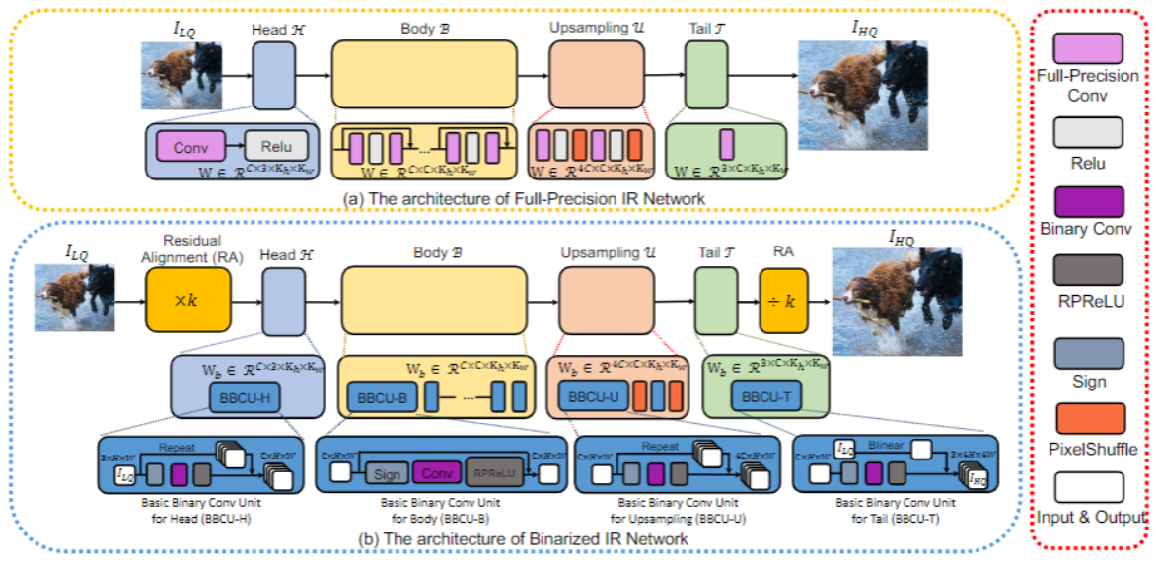
Model architecture

Slide 8
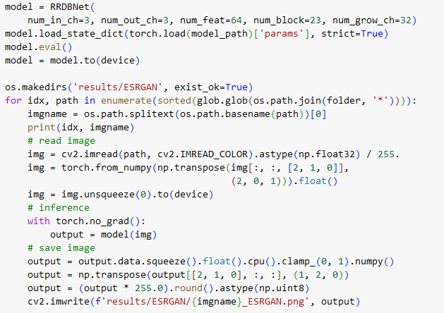
Model
RRDBNet
The first model I used is
RRDBNet model

Slide 9
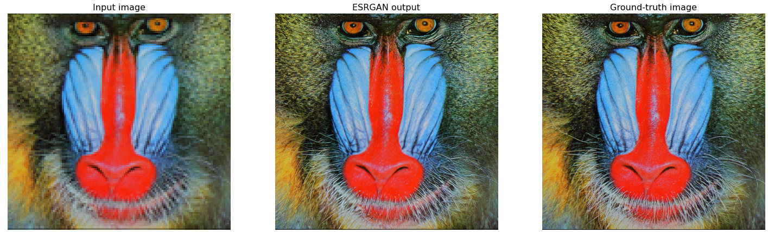
results

Slide 10
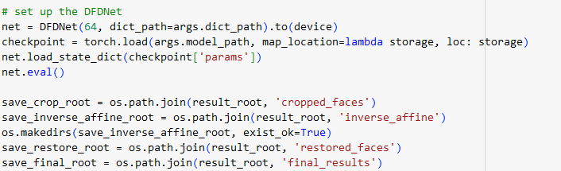
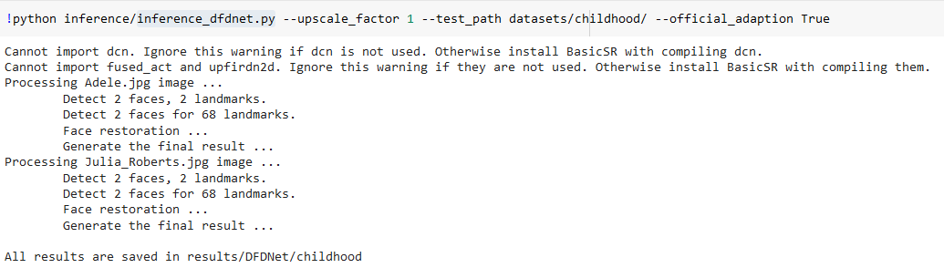
Model
inference_dfdnet.py
The second model I used is
DFDNet model
Inference with DFDNet

Slide 11
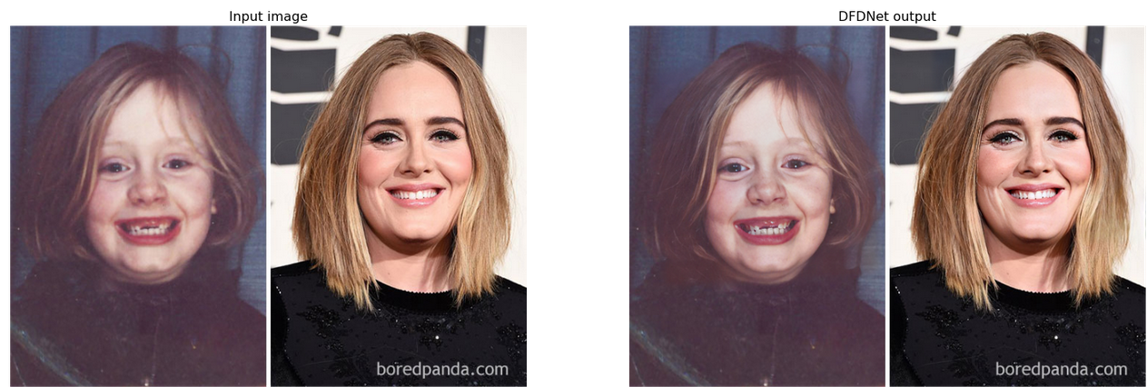
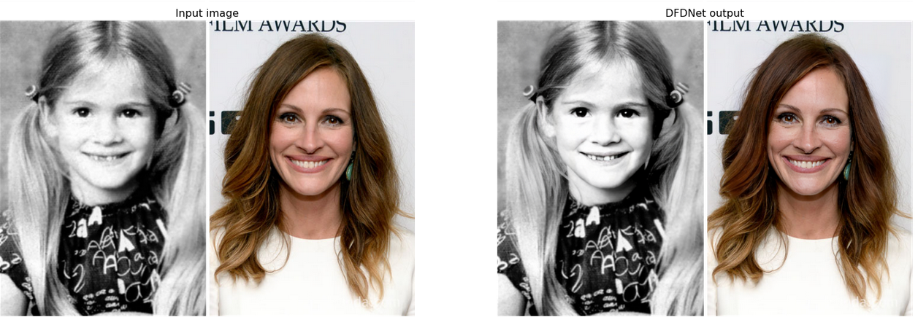
Result
Perform blind face face restoration with DFDNet

Slide 12
Has Done
To be Done
Investigation in literature.
Reproduced the core experiments as well as the experiment partition of the work.
By Apri. 26, finish the final script.

Slide 13
References
[1] Banham, M. R., and Katsaggelos, A. K. Digital image restoration. IEEE signal processing magazine 14, 2 (1997), 24–41.
[2] Bethge, J., Bartz, C., Yang, H., Chen, Y., and Meinel, C. Meliusnet: Can binary neural networks achieve mobilenet-level accuracy?, 2020.
[3] Bin Xia, Yulun Zhang, Y. W. Y. T. W. Y. R. T. L. V. G. Basic binary convolution unit for binarized image restoration network. In conference paper (2023).
[4] Jain, P., and Tyagi, V. Spatial and frequency domain filters for restoration of noisy images. IETE Journal of Education 54, 2 (2013), 108–116.
[5] Lee, C., Kim, H., Park, E., and Kim, J.-J. Insta-bnn: Binary neural network with instance-aware threshold, 2023.
[6] Liu, Z., Shen, Z., Savvides, M., and Cheng, K.-T. Reactnet: Towards precise binary neural network with generalized activation functions, 2020.
[7] Qin, H., Gong, R., Liu, X., Bai, X., Song, J., and Sebe, N. Binary neural networks: A survey. Pattern Recognition 105 (2020), 107281.
[8] Wang, H., Wang, J., Geng, Y.-C., Song, Y., and Liu, J.-Q. Quantum image encryption based on iterative framework of frequency-spatial domain transforms.
International Journal of Theoretical Physics 56 (2017), 3029–3049.
[9] Wang, Z., Cun, X., Bao, J., Zhou, W., Liu, J., and Li, H. Uformer: A general u-shaped transformer for image restoration, 2021.
[10] Yuan, C., and Agaian, S. S. A comprehensive review of binary neural network. Artificial Intelligence Review 56, 11 (Mar. 2023), 12949–13013.
[11] Zhang, K., Zuo, W., Gu, S., and Zhang, L. Learning deep cnn denoiser prior for image restoration, 2017.
[12] Zong, L. Comprehensive Study of Image Restoration Algorithms. PhD thesis,California State University, Northridge, 2014.

