Slide 1
Methods for Cleaning Qualitative Research Data (How can Python and AI help Text Mining work)
Presented by SHANG Wenxuan
2026.05.14

Slide 2
Structure
The Problem
OCR Methods
Text Denoising
AI Purpose and Boundary

Slide 3
1. The Problem

Slide 4
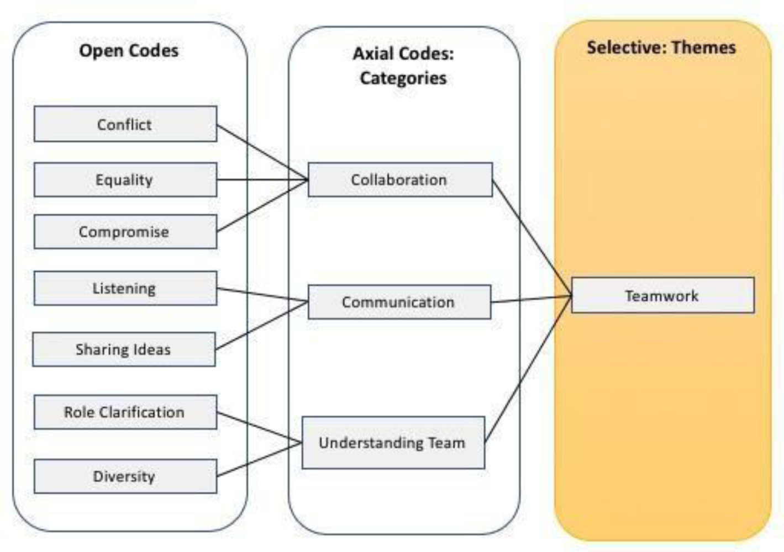
1.1 About Text Mining and Coding
It refers to systematic extraction of core issues/expressions from EIA materials.
Then, with three-level coding (open, axial, selective), transform textual data into structured analytical framework.
Network visualization and stakeholder dynamics.
Nvivo is a frequently used software for this qualitative research.
Williams, M., & Moser, T. (2019). The art of coding and thematic exploration in qualitative research. International Management Review, 15(1), 45–55.

Slide 5
1.2 File Types
(1) Printed text with a text layer (pre-processed via OCR, Word to PDF) , which can be recognized directly by Nvivo.
(2) Printed text without a text layer (image) – Cloud Vision API
(3) Handwritten text or mixed text without a text layer (image) – Gemini API (Gemini 3 Flash/Gemini 2.5 Flash Lite)

Slide 6
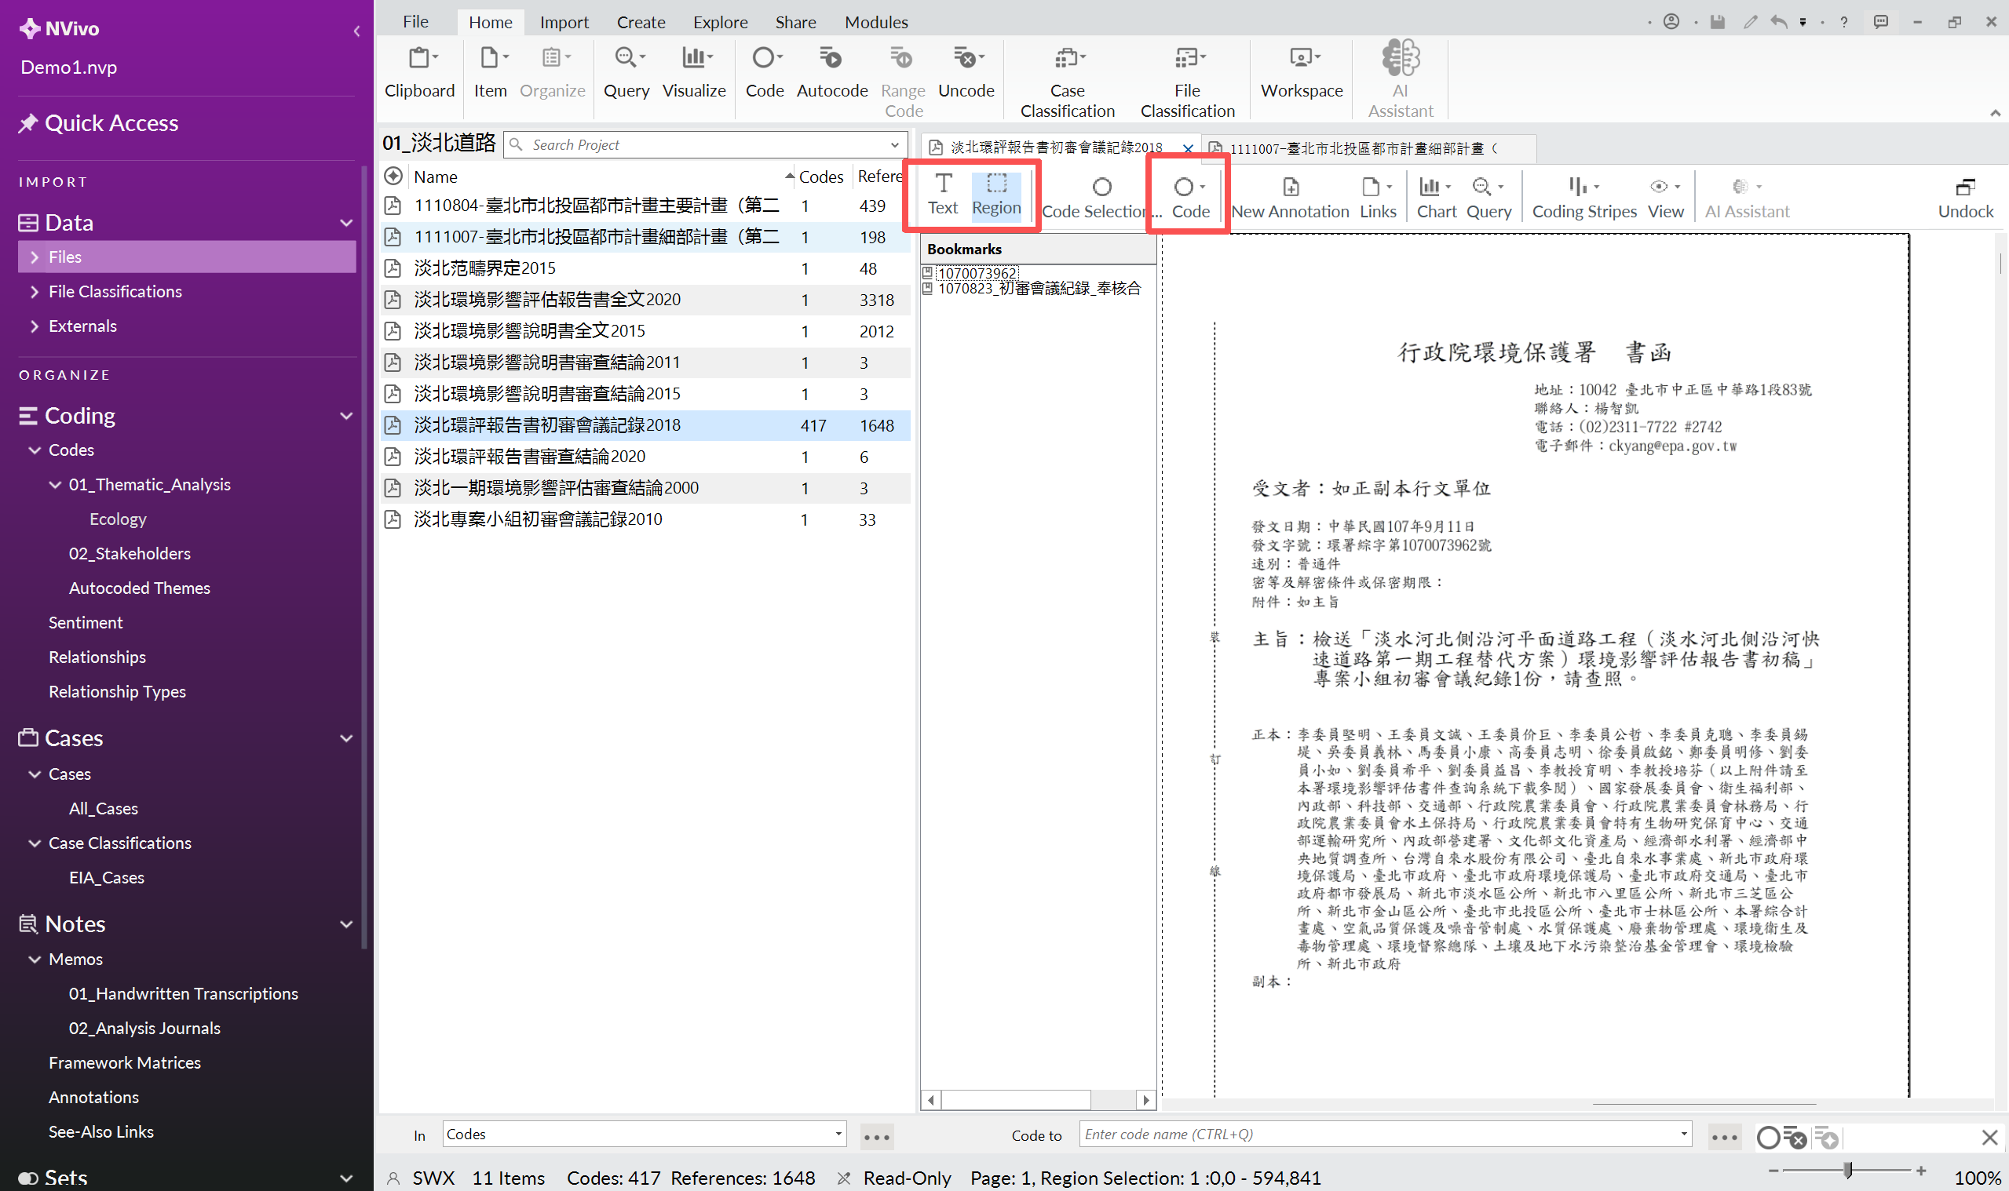
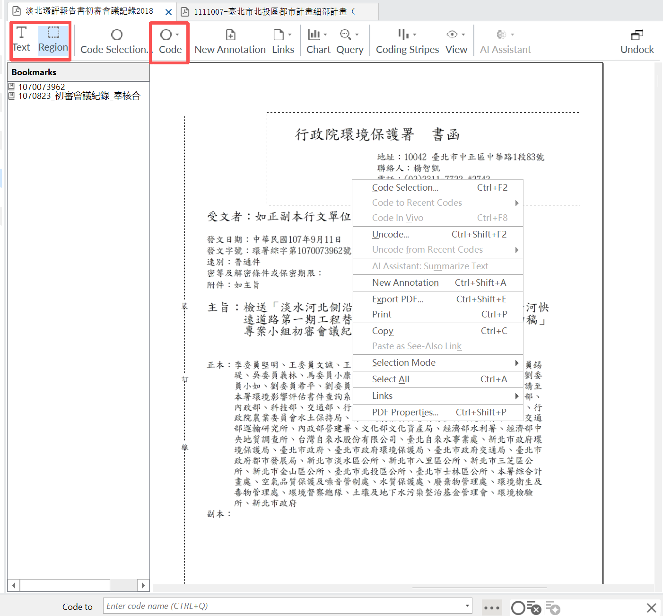
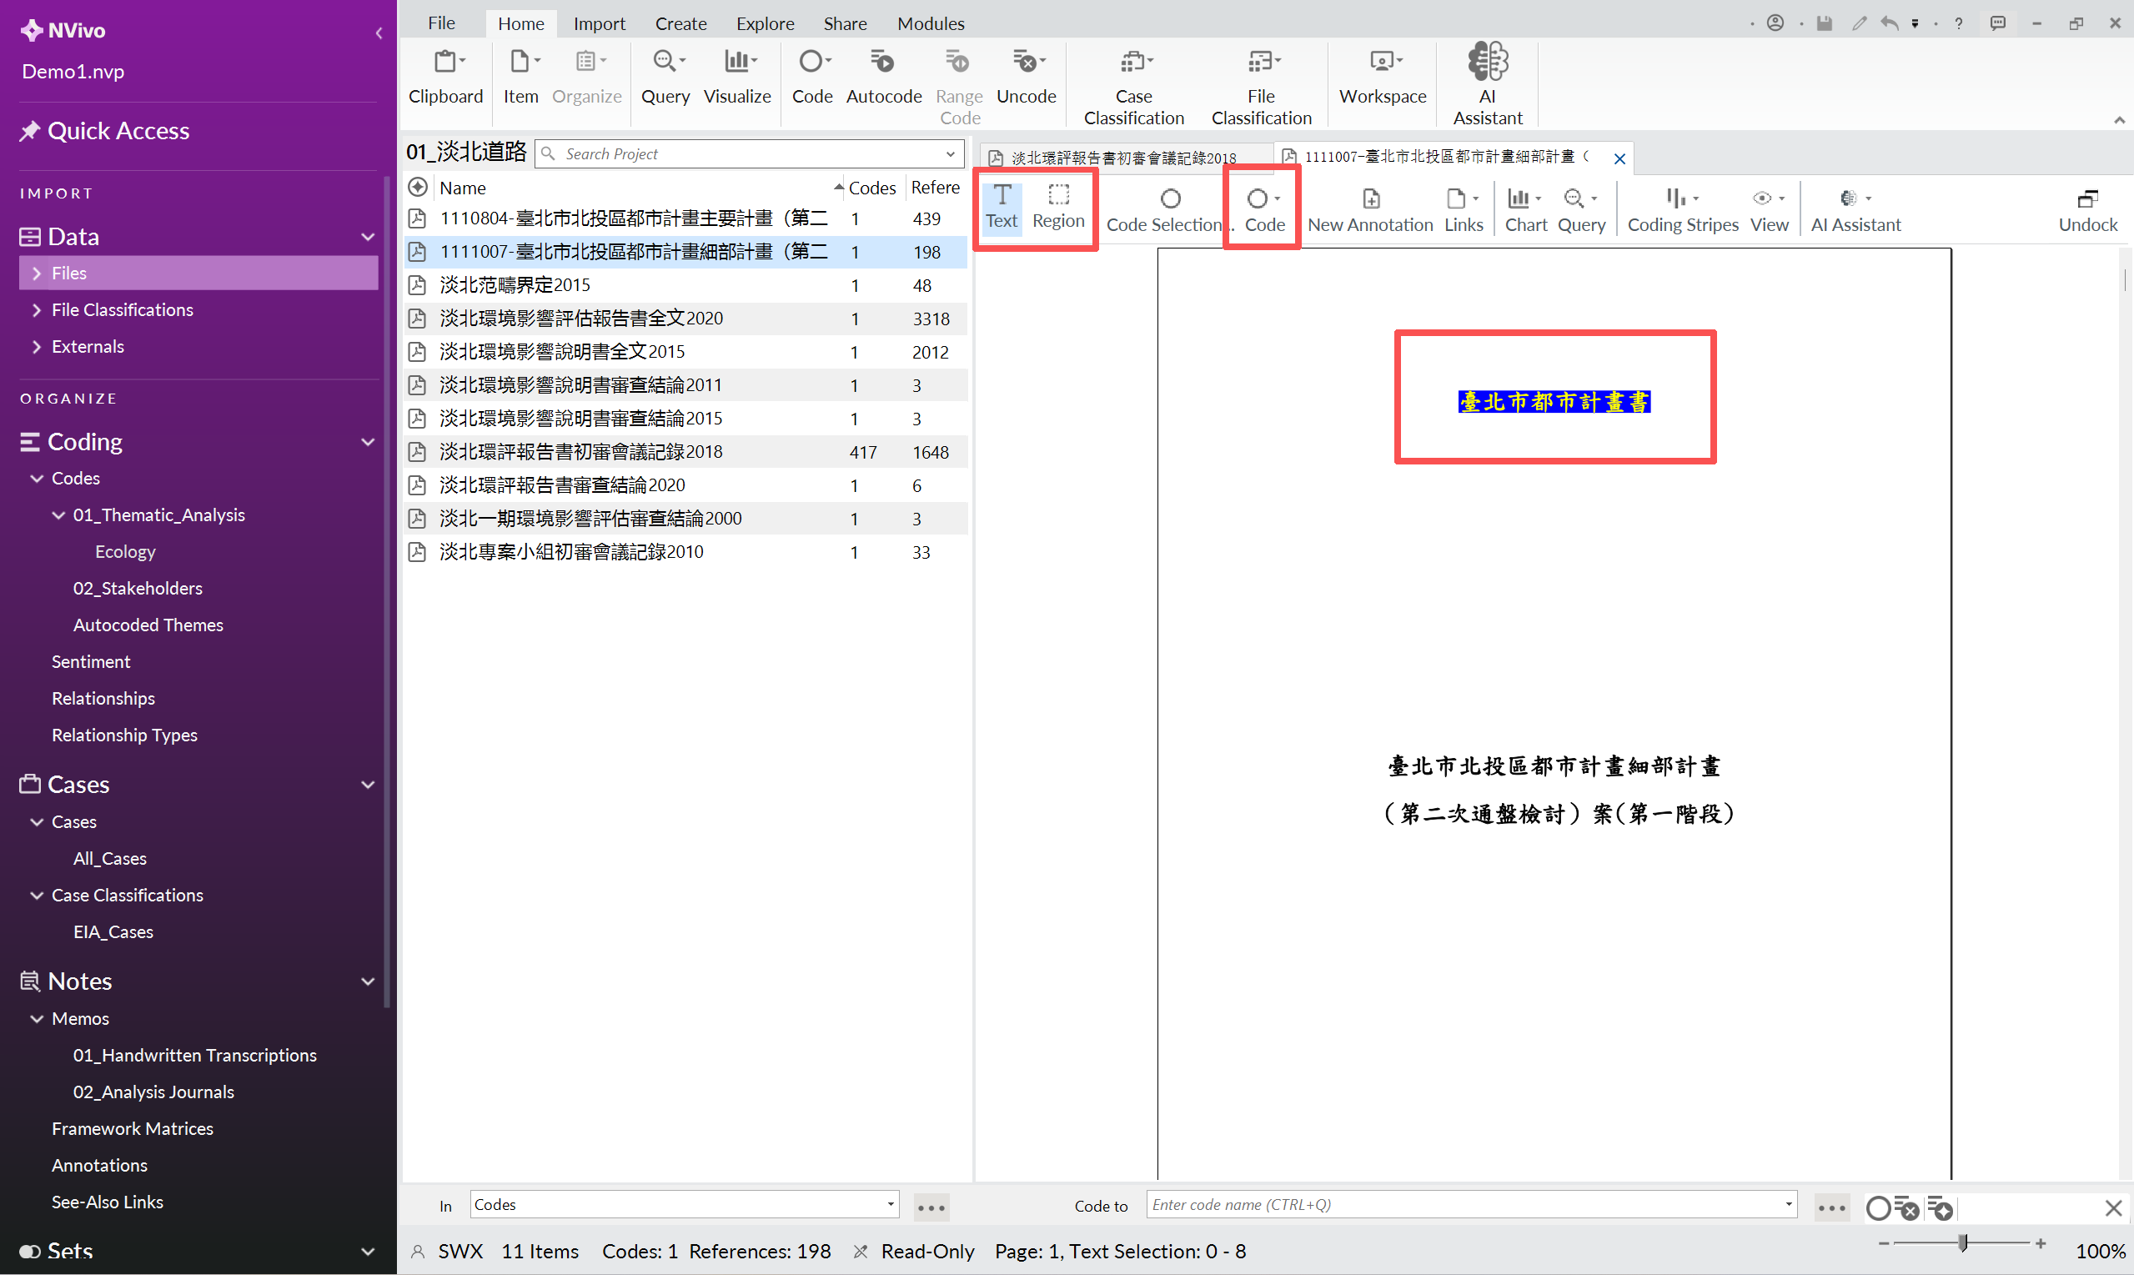
1.3 Nvivo characteristics and file corresponding conditions (1)
Nvivo do not have OCR (Text Recognition) tools.
For qualitative research and text mining, text must be recognized.
What does this mean?

Slide 7
1.3 Nvivo characteristics and file corresponding conditions (1)
Nvivo do not have OCR (Text Recognition) tools.
For qualitative research and text mining, text must be recognized.
What does this mean?
Region Coding cannot be used. Because we need automated word frequency analysis, cross-text search in the future.
Therefore,
(1) Printed text with a text layer – Nvivo no problem.
(2) Printed text without a text layer – Need OCR
(3) Handwritten text or mixed text without a text layer – Need intelligent OCR

Slide 8
1.3 Nvivo characteristics and file corresponding conditions (2)
Text noise can interfere with NVIVO
For example,
Word Frequency Pollution (High-frequency chatter: “page”; Header Title……)
Semantic Disruption (Forced Line Break; Page numbers appear in the sentence……)
Solution?
Transform into TXT file, whatever the file types (1)(2) or (3) I just mentioned. – PDF and WORD have format, while TXT is pure.
Text denoise with Python, delete those nonsense words.

Slide 9
1.4 The Problem Conclusion – What should I do?
(1) Printed text with a text layer – Transform into txt file and denoise with Python
(2) Printed text without a text layer – OCR into txt and denoise
(3) Handwritten text or mixed text without a text layer – AI OCR into txt and denoise
In conclusion, Three Steps:
OCR: (2) & (3) with different OCR tools and output TXT;
Transform (1) into TXT with Python only;
Denoise (1) (2) (3) with Python only.

Slide 10
2. OCR Methods

Slide 11
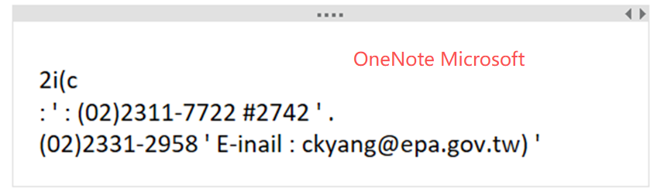
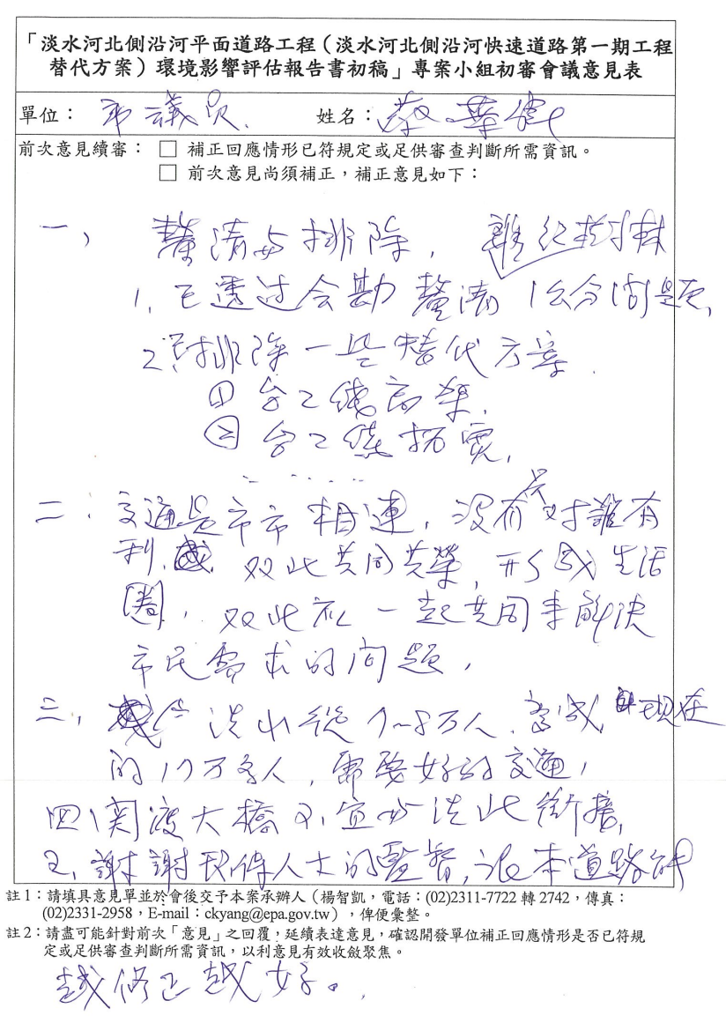
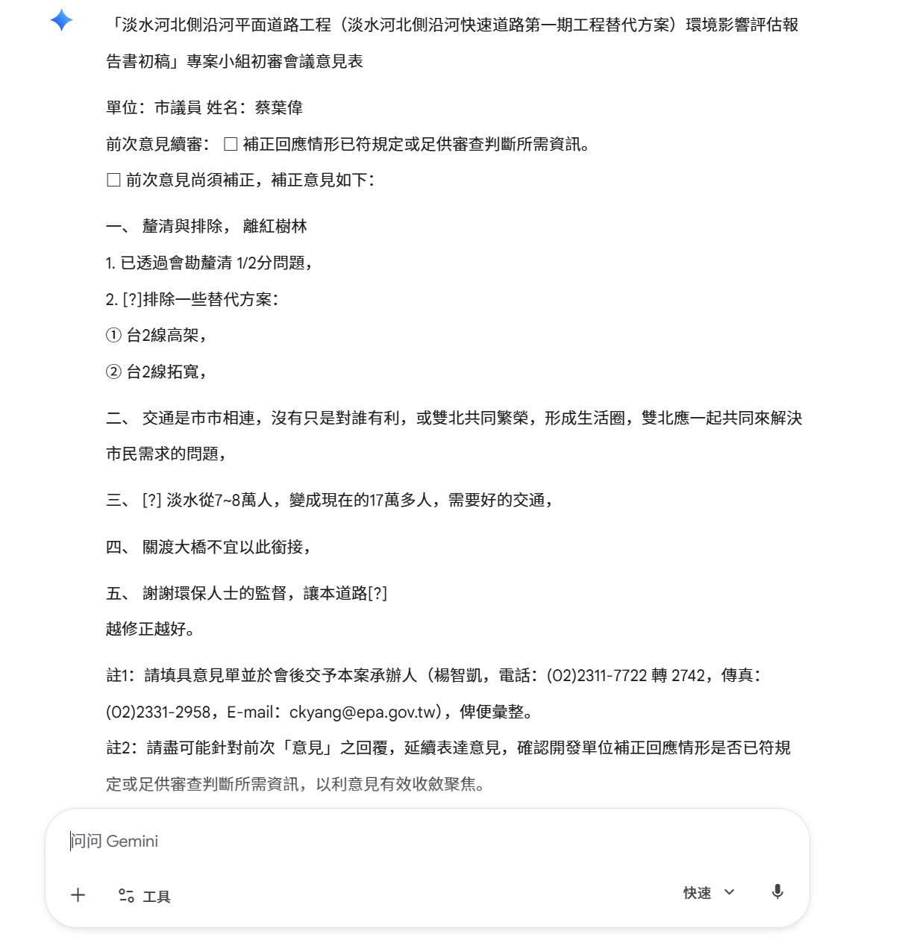
2.1 AI OCR
Traditional OCR tools cannot recognize (scribbled) handwriting. Its work is based on pixel and “checking the dictionary”.
However, AI can competent this job.
Why? HW images traning, Extract essential features; And most important: Understanding the context.

Slide 12
2.2 Python Supported AI OCR (File Type 3)
Direct AI OCR has a trouble: You cannot make screen print for thousands of times and upload to AI one by one.
But Python is naturally suited for repetitive work.
The approach:
Write a Python program which can automatically call Gemini to do this OCR job for thousands loops (until the last page).
How to call Gemini in Python? API!
Application Programming Interface:
ソフトウェアアプリケーション間の相互通信、データ交換、および機能統合を行うための、あらかじめ定義された一連の規則とプロトコル

Slide 13
2.2 Python Supported AI OCR: Preparation
Preparations
(All powered by Google, no download required.)
Sign in Google Cloud Console and create a new project.
Activate your full account in Cloud (upload a credit card, and you will get 300 USD gift card for multi uses other than Gemini.)
In Google AI Studio, Create your own API key and activate its “Gemini API” and “Cloud Vision API” function. Keep Your API Key Secret.
Upload your target files into Google Drive.
Ask Claude and get the Python program code, paste it into Google Colab (an online and AI supported development platform, no domestic Python needed) and run it. The output file will appear in Drive.

Slide 14
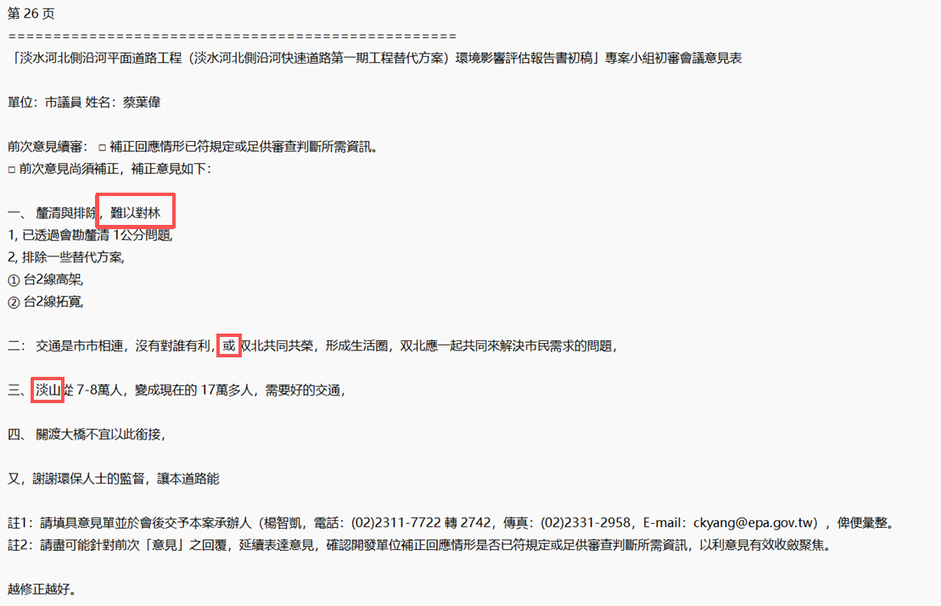
2.2 Python Supported AI OCR: Result

Slide 15
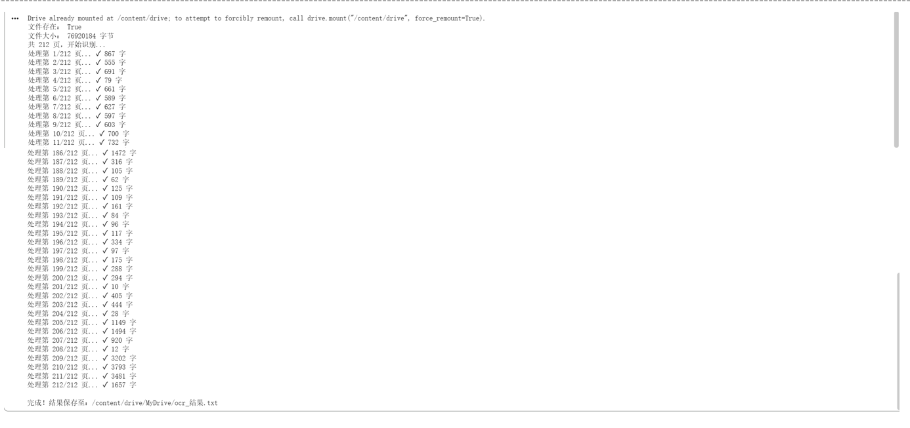
2.2 Python Supported AI OCR: Program (from Claude)
!pip install -q google-genai pymupdf pillow
from google.colab import drive
drive.mount('/content/drive')
from google import genai
import fitz
from PIL import Image
import io
import time
import os
# ===== 只需修改这两行 =====
API_KEY = “Your_Own_API_Key"
PDF_PATH = “Your_PDF_Path"
# ==========================
OUTPUT_PATH = "/content/drive/MyDrive/ocr_结果.txt"
# 确认文件存在
print("文件存在：", os.path.exists(PDF_PATH))
print("文件大小：", os.path.getsize(PDF_PATH), "字节")
client = genai.Client(api_key=API_KEY)
doc = fitz.open(PDF_PATH)
total_pages = len(doc)
print(f"共 {total_pages} 页，开始识别...")
results = []
for i, page in enumerate(doc):
print(f"处理第 {i+1}/{total_pages} 页...", end=" ")
pix = page.get_pixmap(dpi=200)
img = Image.open(io.BytesIO(pix.tobytes("png")))
success = False
for attempt in range(3):
try:
response = client.models.generate_content(
model="gemini-flash-latest",
contents=[
img,
"请识别图片中所有文字，包括印刷体和手写体。手写部分请尽力辨认，不确定的字用【？】标注。按照原文的段落结构输出，不要添加任何解释。"
]
)
text = response.text
print(f"✓ {len(text)} 字")
success = True
break
except Exception as e:
if attempt < 2:
print(f"重试中...", end=" ")
time.sleep(15)
else:
text = f"[识别失败：{e}]"
print(f"✗ 失败")
results.append(f"\n{'='*50}\n第 {i+1} 页\n{'='*50}\n{text}\n")
time.sleep(3) # 每页间隔3秒
with open(OUTPUT_PATH, "w", encoding="utf-8") as f:
f.writelines(results)
print(f"\n完成！结果保存至：{OUTPUT_PATH}")
Step 1 ツールの準備
PDF・画像・AI 用ライブラリをインストール
Step 2 Google Drive のマウント
クラウド上の研究資料へのアクセスを許可
ツールをインストールする
Step 3 パラメータ設定
API キー、PDF パス、出力先を指定
Step 4 PDF の読み込み
ファイルを開き、総ページ数を取得
Step 5 ページごとの処理(コアループ)
┌──────────────────────────────────┐
│ ① 現在のページを画像に変換 │
│ ② 画像と指示を AI に送信 │
│ ③ 認識されたテキストを受信 │
│ ④ 失敗時は最大 3 回まで再試行 │
└──────────────────────────────────┘
212 ページ繰り返し
Step 6 結果の保存
全ページの結果を .txt ファイルに集約

Slide 16
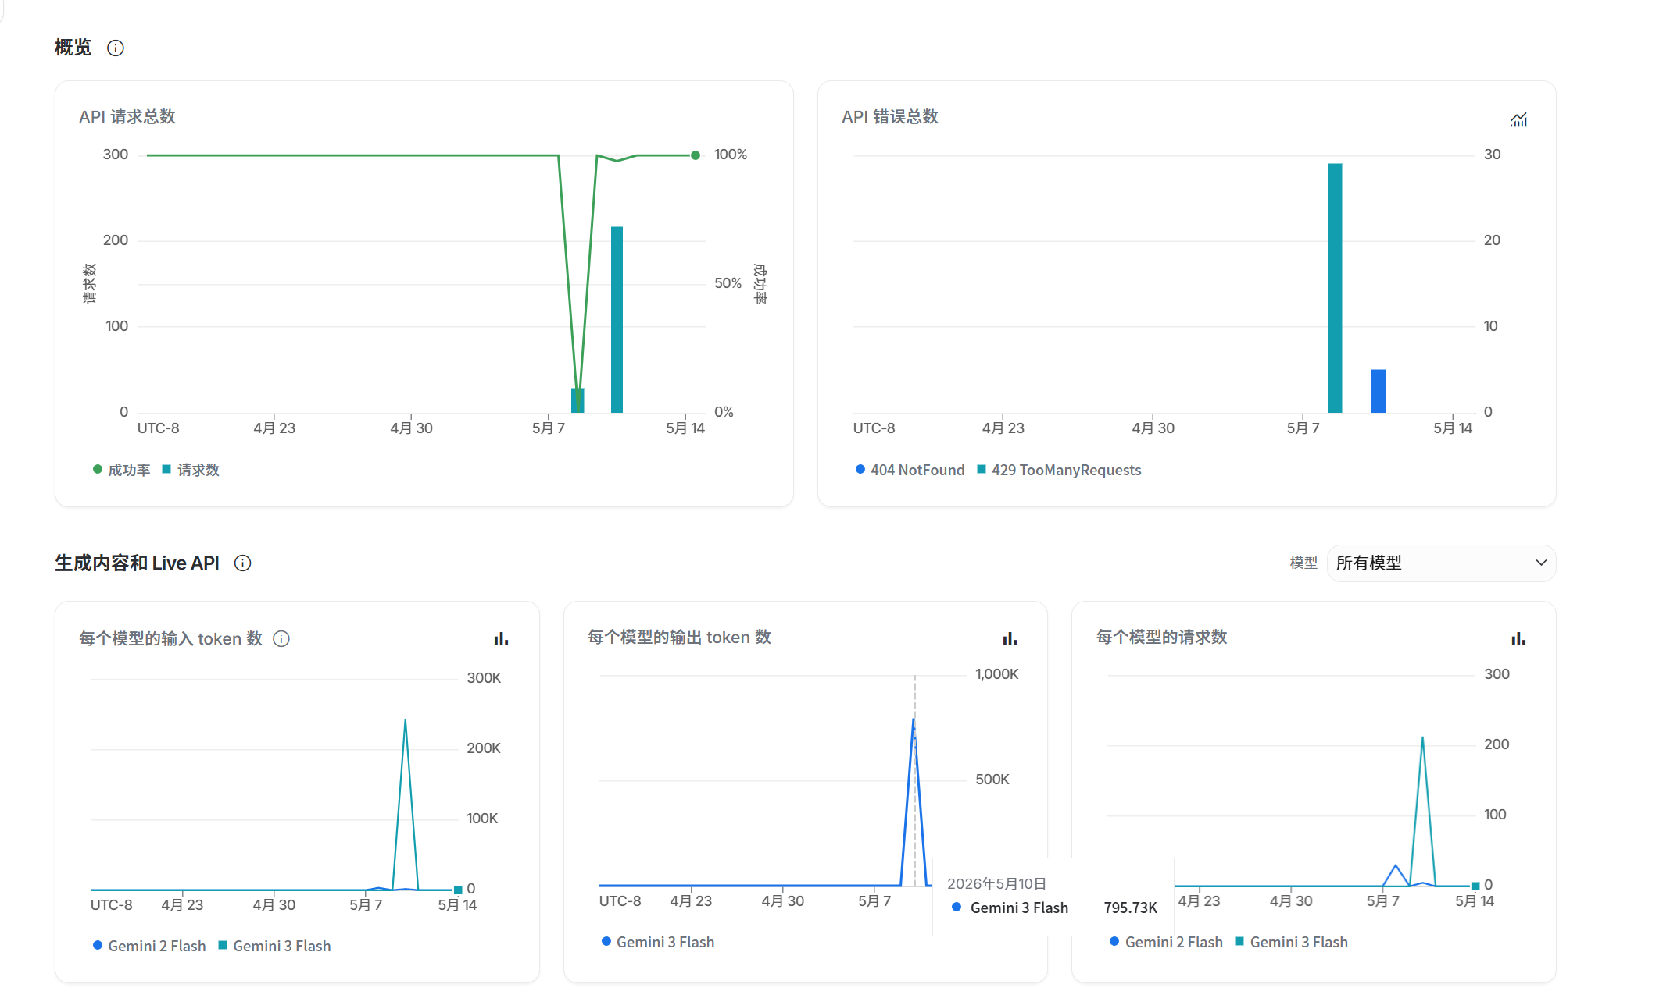
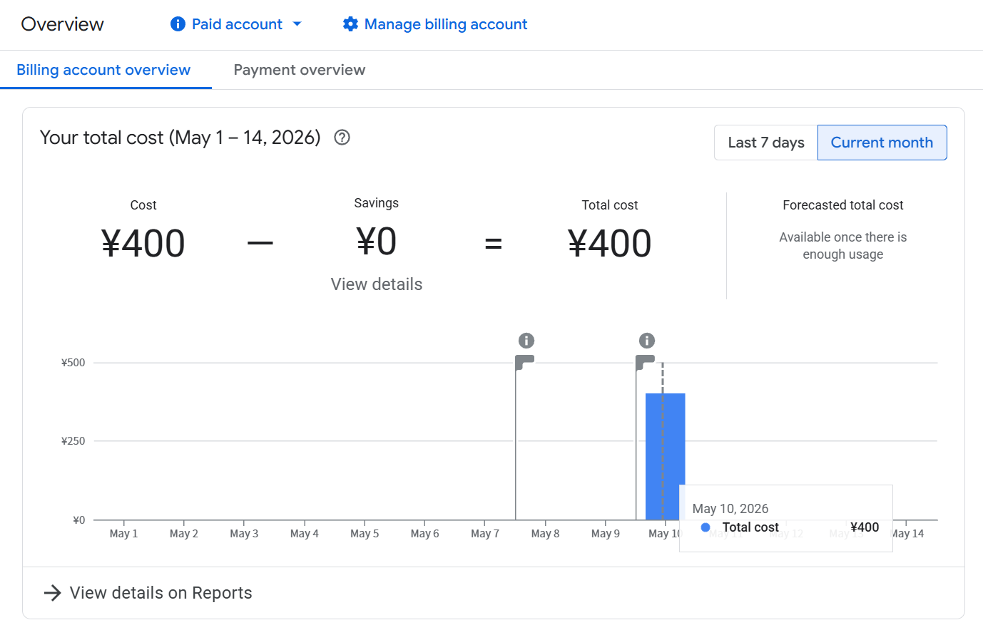
2.2 Python Supported AI OCR: Costs

Slide 17
2.3 Printed text OCR without text layer (File Type 2)
Similar with Gemini API: Write a Python program and call Cloud Vision API.
Cloud Vision API: Trained with CNN (an AI method), good at HW recognition. But it does not have an intelligent “brain”, therefore it cannot understand the context.
Advantage: Very cheap and fast, Free limits every month, Gift card is usable.

Slide 18
2.4 Printed text with a text layer (File Type 1)
The fastest and easiest process. Totally free.
With Python (pdftotext) program only, from PDF to TXT.
Accuracy Rate 100%

Slide 19
3. Text Denoising

Slide 20
3.1 What files do we have at this point?
(1) Printed text with a text layer – Changed into TXT by Python
(2) Printed text without a text layer – Changed into TXT by Cloud Vision API
(3) Handwritten text or mixed text without a text layer – Changed into TXT by Gemini API
Therefore, we get only one new type:
1. TXT files (with noise)
Next Step:
Text Denoise.

Slide 21
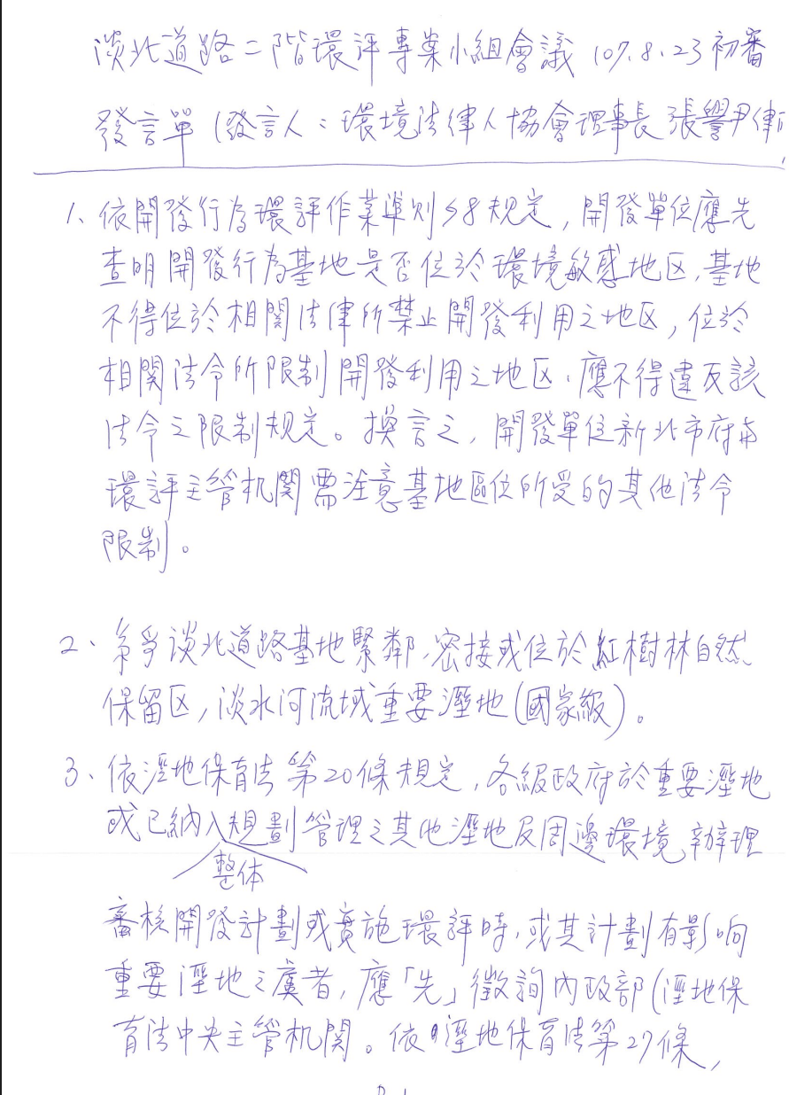
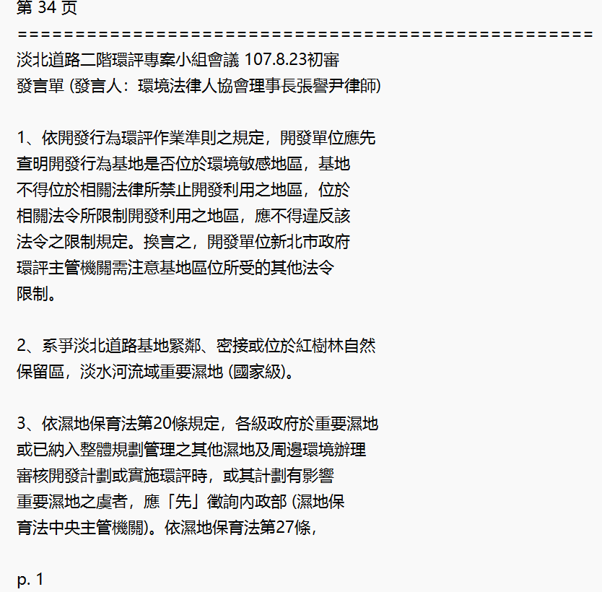
3.2 What is Text Noise?
1. Line Break: A whole sentence could be disrupted.
2. Page Number: (1) May appear in a sentence when copy, (2) and may influence word frequency statistic with fixed words “page number”
3. Duplicate title: May influence word frequency

Slide 22
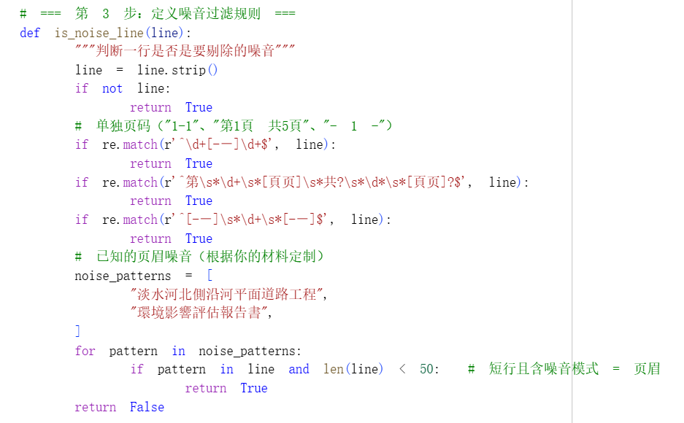
3.3 How to Denoise?
Python Only, Totally Free, No AI, API and Credit Card needed.
Concluded
by
Gemini
処理対象 | 対象コード / 正規表現 | 除外されるノイズの具体例 | 処理の仕組みと目的
1. 空白行 | if not line: (※事前に strip() を実行) | ・純粋な空行 ・スペースのみの行 ・タブ(\t)や改行(\n)のみの行 | 意味を持たない空白をフィルタリングし、テキストのデータ構造を圧縮・最適化する。
2. 標準的なページ番号 | r'^\d+[-—]\d+$' | ・1-1 ・5-12 ・10—2 | 行頭が数字で始まり、中間にハイフン（またはダッシュ）が入り、行末が数字で終わる独立した行を正規表現でマッチングして除外する。
3. 複合型のページ番号 | r'^\s*\d+\s*[頁页]\s*共?\s*\d*\s*[頁页]?$' | ・1頁 / 1 页 ・第1頁 共5頁 ・2 共 10 页 | 簡体字「页」と繁体字「頁」に両対応。「共」の文字や総ページ数はオプション（任意）とし、前後の空白(\s*)も許容するフォールトトレランスの高い正規表現処理。
4. 独立したページ番号 | r'^[-—]\s*\d+\s*[-—]$' | ・- 1 - ・—10— | ページ下部によく配置される、前後がハイフンで対称的に囲まれ、中央に数字が配置されている行全体を判定して除外する。
5. 特定のヘッダー／フッター | pattern in line and len(line) < 50 | ・淡水河北側沿河平面道路工程 ・環境影響評估報告書 | 指定したキーワードが含まれ、かつ「行の文字数が50文字未満」である場合のみノイズと判定。本文中の同キーワードを含む長い文の誤削除（過剰適合）を防ぐ論理設計。
Generated by Claude

Slide 23
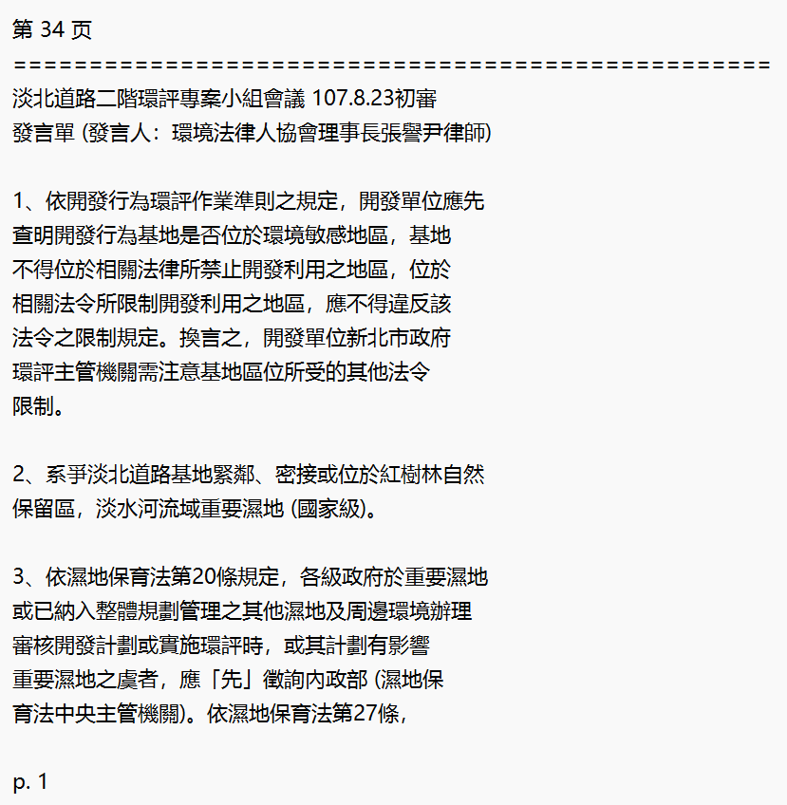
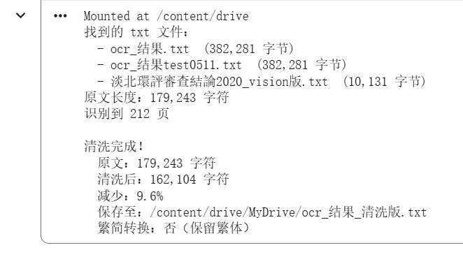
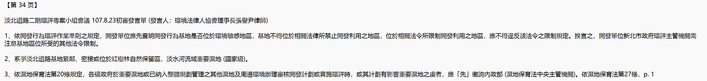
3.4 The result of text denoising
Before
Mounted at /content/drive
検出された txt ファイル:
- ocr_結果.txt (382,281 バイト)
- ocr_結果test0511.txt (382,281 バイト)
- 淡北環評審查結論2020_vision版.txt (10,131 バイト)
原文の文字数: 179,243 文字
212 ページを認識
クリーニング完了!
原文: 179,243 文字
クリーニング後: 162,104 文字
削減率: 9.6%
保存先: /content/drive/MyDrive/ocr_結果_クリーニング版.txt
繁体字/簡体字変換: なし (繁体字を保持)
After

Slide 24
4. AI Purpose and Boundary

Slide 25
4 AI Purpose and Boundary
AI’s work: Repetitive and mechanical work. - “Data Cleaning”
My work: Theoretical Work (Three level coding……)
Honestly report AI’s usage in thesis.

Slide 26
Conclusion
The problem: Nvivo need pure TXT files but I have 3 types of PDF files.
Methodology: 1. Change them into TXT with 3 methods.
2. Clean them with Python.
Pay attention to Academic Ethics.
Why Three Different Tools?
Task Best Tool Reason
─────────────────────────────────────────────────────
Extract text layer pdftotext Already digital
OCR printed text Cloud Vision Cheap & accurate
OCR handwriting Gemini API Multimodal understanding
Clean noise Python (rules) Deterministic & free
Code & interpret Researcher Theoretical sensitivity
Principle:
Match the tool to the nature of the task.
Never overuse AI; never underuse it.
(This table was generated by Claude)

Slide 27
Thank You!

