Slide 1
Intro to HTML & Javascript (with a little CSS, +libraries/frameworks)
CS171 – Lab 1
1/31/14

Slide 2
Introduction for today
HTML & CSS
Build and style a basic webpage
Javascript
Introduce & review Javascript syntax and style.
Link to libraries & start writing Javascript.
Learn about the console and how to use Chrome’s inspector tool.
Learn basic techniques to debugging Javascript
Homework 1
Get started with running a basic webserver & understanding the code

Slide 3

Before we begin
Useful development tools.
Target platform for all problem sets.
Your work (assignments, etc) must be functional in Chrome.

Slide 4
What is HTML?

Slide 5
What is HTML?
Hypertext Markup Language (HTML)
Markup language, not a programming language.
Provides instruction on how to render a page.
HTML is consists of elements built with start tags and end tags.
Start tag example: <head>
End tag example: </head>
Element example: <head> …. (stuff goes here) …. </head>

Slide 6
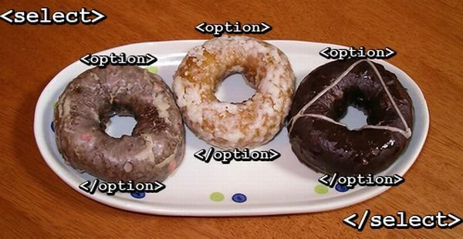

In HTML, all elements are formed via tags.
Notes:
http://i3.kym-cdn.com/photos/images/newsfeed/000/225/075/html_jokes_0000.jpg

Slide 7
In HTML, all elements are formed via tags.
HTML includes elements which include images, objects, videos, lists, links, quotes, and other items….. there are many types of tags!
(use google!)
Tags also include attributes.
Example: anchor tag.
<a></a>
Adding the href attribute allows for the creation of a link
<a href="https://www.cs50.net/">CS50</a>.
Notes:
http://i3.kym-cdn.com/photos/images/newsfeed/000/225/075/html_jokes_0000.jpg

Slide 8
HTML tags you might need to know
<title>My webpage</title>
Puts the title of the web page in the title bar of your browser.
<a href=“www.example.com”>My link</a>
Creates links! Use the href attribute to represent the url.
<img> or <img />
Indicates that an image will be shown on the page. Use the src attribute to link to the image, use the alt attribute is used to provide a short description to the image.
<p>This is a paragraph!</p>
Creates paragraph text in the document.
<h1> to <h6>
<h1>Some header</h1>
Provides header structure to your text. <h1> is the most important heading, <h2> is less important, etc
<ol>...</ol>
Creates an ordered list (like a numbered list)
<ul>...</ul>
Creates an unordered list (like bullet points)
<li>List item </li>
Creates an item that belongs to a list
<html>...</html>
Creates the entire HTML container.
<head>...</head>
Creates the header (generally where the title and links to style sheets/scripts are found)
<body>...</body>
Creates the section of html that contains content
<table>...</table>
Creates a table in the document.
<tr>...</tr>
Specifies a table row in a table.
<td>..</tr>
Specifices a table cell in a table row
<link rel="stylesheet" type="text/css" href="theme.css">
Points to an external file is linked to the current html document (often used for CSS external stylesheets)
<div>...</div>
A division of a page. Used as an additional means to provide structure to HTML.
<script>...</script>
Includes text inside this tag as script, most commonly text/javascript.
<form>..</form>
Area enclosed by this tag is an HTML form that can accept user input.
<input></input> or <input />
Used inside an HTML form and is used to accept user input or submit the input, has attributes type and label which specify type of form input element.
<!-- ... –>
HTML comment tag. Used to add text to your document that will not be displayed in the browser and is useful to document the page.
Notes:
http://www.mckremie.com/blog/2009/10/25-of-the-most-used-html-tags-and-tag-attributes/

Slide 9
In HTML, all elements can have attributes
Class attribute
class=“example_class1 example_class2”
Each element can have multiple classes, separated by spaces.
The class attribute can be applied for multiple elmenets
ID attribute
id=“example_id”
Each element can only have one class.
The id attribute should be unique for one element.
HTML elements commonly have class and id attributes.
These attributes are included inside the opening tag.
<h1 id=“main_header”>Visualization of Taxes</h1>
<a class=“navigation_link header_link”>Menu</a>
<a href="https://www.cs50.net/" id=“cs50_link” class=“menu_link”>CS50</a>
These attributes are used to ‘select’ HTML elements later through CSS / Javascript
Notes:
http://i3.kym-cdn.com/photos/images/newsfeed/000/225/075/html_jokes_0000.jpg

Slide 10

HTML follows a tree structure
Your web browser renders HTML with a Document Object Model (DOM):
Note: objects in the DOM tree can be added / removed / manipulated by Javascript
We’ll check this out later in Chrome’s element inspector
<html>
<head>
<title>My title</title>
</head>
<body>
<a href=“”>My link</a>
<h1>My header</h1>
</body>
</html>
Notes:
http://i3.kym-cdn.com/photos/images/newsfeed/000/225/075/html_jokes_0000.jpg

Slide 11
Getting Started with HTML
You don’t need to memorize all your tags!
But you should know how to use class and id attributes for HTML elements.
These attributes will help ‘label’ HTML elements so you can do things with them.
Open up your favorite text editor and create a new file called ‘index.html.’

Slide 12
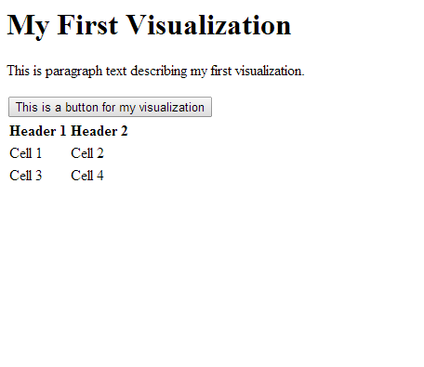
This doesn’t look that good.
<html>
<head>
<title>My First Visualization!</title>
<!-- My first visualization, created by __; 1/28/14 -->
</head>
<body>
<h1>My First Visualization</h1>
<p>This is paragraph text describing my first visualization.</p>
<button>This is a button for my visualization</button>
<table>
<thead>
<tr>
<th>Header 1</th>
<th>Header 2</th>
</tr>
</thead>
<tbody>
<tr>
<td>Cell 1</td>
<td>Cell 2</td>
</tr>
<tr>
<td>Cell 3</td>
<td>Cell 4</td>
</tr>
</tbody>
</table>
</body>
</html>

Slide 13
What is CSS?

Slide 14
What is CSS?
Cascading Style Sheets
Stylesheet language for the web, makes webpages look good.
Includes the fonts, colors, and many other properties for web pages.
CSS is applied to HTML elements, with CSS properties
Examples of CSS properties:
color:red
background-color:#fff;
padding:20px;
font-size:18px;
display:none;

Slide 15
How do you start using CSS?
Inline (inside the HTML):
<table style=“margin-top:20px;”>…</table>
In the document:
<style type="text/css">
#datatable {
margin-top:20px;
}
</style>
In a separate file:
<link href="path/to/file.css" rel="stylesheet">

Slide 16
How does external CSS work?
In a Cascading Style Sheet file you ‘select’ elements based on class and id attributes in the HTML, then apply properties.
Add ‘class’ and ‘id’ attributes to HTML elements:
Ex: <table> to <table id=“datatable1” class=”dataelement”>
Add CSS selectors to these classes/ids in the CSS document:
Using a class
.dataelement {
color:red;
}
Using an id
#datatable{ color:red; }
Add a period (.) before the class, use brackets
Add a hash (#) before the id, use brackets

Slide 17
Learning CSS
There are a lot of different types of selectors and CSS properties, we won’t have time to cover it all. (google is your friend)
CSS Demo
Create a new file called ‘styles.css’ in the same directory as the previous HTML file you worked on
Add this to your header:
<link href=“styles.css" rel="stylesheet">

Slide 18
Chrome Developer Tools
Google Chrome has a set of tools that makes styling and visualizing the HTML document easier:
Menu > Tools > ‘Developer Tools’
or
Ctrl + Shift + I
or
Right click on webpage > Inspect element

Slide 19
What is Javascript?

Slide 20
What is Javascript?
A programming language for web browsers generally executed client-side (in your web browser)
Javascript code is written in ‘scripts’ which are run when the page renders.
There are two ways to include Javascript
In the document:
<script type="text/javascript">
alert(“This is your first line of Javascript!”!);
</script>
In a separate file:
<script src=“viz.js"></script>
(this simply loads the content of the file as if it were Javascript)
A Javascript file is simply a text file with a .js extension which contains Javascript.

Slide 21
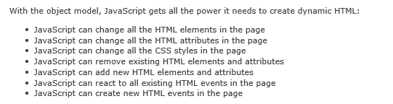
Why Javascript?
Javascript can do a lot!
Example: responding to clicks, adding svg (graphics) elements, creating elements from data, etc.
W3schools.com

Slide 22
Javascript 101
Check out the browser methods at: http://overapi.com/javascript/
If you are completely new, also refer to the tutorial at: https://developer.mozilla.org/en-US/docs/Web/JavaScript/Guide
For those experienced with programming, the syntax is similar to C and PHP.
Programming (with Javascript) can be frustrating!

Slide 23
Javascript 101 – First Steps
<script>
alert(“hello world!”);
//This is your first comment!
</script>
This is actually just HTML telling the browser that Javascript is coming.
This is a line of Javascript. Here we call the alert() function with the string “hello world!” The alert() function displays a message box in your browser.
You can create comments in Javscript by adding ‘//’ to the beginning of the line. The browser will ignore these lines.
You can include script tags anywhere in your document. The page will execute the Javascript in the order that is included in the page.

Slide 24
Javascript 101 – Functions
Functions are sets of code that are executed. To execute a piece of code, you call a function. You can also call a function with arguments.
Some functions are already defined by the browser (this is what gives us interactivity with the web browser)!
In the earlier example, we called the function alert with the argument hello world.
<script>
alert(“hello world!”);
</script>
//(the function alert is already defined in the browser)

Slide 25
Javascript 101 – Functions (cont)
Two ways to define functions in Javascript:
To run the code in the function, simply call
<script>
myfirstfunction();
</script>
function myfirstfunction(){ //some code to be executed }
var myfirstfunction = function(){ //some code to be executed }

Slide 26
Javascript 101 – Functions (cont., 2)
You don’t always need functions!
Any code in the script tag is automatically run as the page ‘reaches’ the script tag.
<script>
alert(“Hello world”);
//This code is run as the page redners
</script>
Why use functions?
To pass in arguments and prevent code redundancy/repetition.
To use functions that have already been written for you.
To make your code better! (and other reasons)

Slide 27
Javascript 101 – Variables
Javascript allows you to store variables (values) to be used and manipulated later. Creating a variable involves declaring a variable and naming the variable. Javascript is dynamically typed (so you don’t need to declare what type of value it is):
<script>
var num1 = 1;
var num2 = 2;
var string = “two”;
var bool = false;
</script>
Do you need to use var when declaring the variable for the first time?
Generally, yes. While your code may work without the ‘var’ declaration, the scope of your variable is global. Unless you know what you’re doing, always use var.

Slide 28
Javascript 101 – Variable Scope
Javascript variables have the scope in which they are declared:
<script>
var g = "global";
function go() {
var l = "local";
}
go();
alert(g); // alerts with ‘global’
alert(l); // throws a reference error
</script>

Slide 29
Javascript 101 – Basic Operations in JS
<script>
var num1 = 1;
var num2 = 2;
var str2 = “two”;
var str3 = “three”;
var bool = false;
var num3 = num1 * num2; // 2
var foo = str2 + str3; // twothree
var bar = !bool; // true
var baz = num1 + str3; // 1three
</script>

Slide 30
Javascript 101 – Arrays
Javascript allows you to create arrays which can store related values. Creating an array is similar to creating a variable:
<script>
var days = [‘Mon’, ‘Tue’, ‘Wed’]
alert(days[0]); //alerts user with ‘Mon’
var foo = days[1]+days[2]; // TueWed
alert(days.length); //alerts user with 3
</script>
Arrays are zero-indexed.
Which means that the first item in the array has an index value of zero.
Arrays have a length property.
To access the length of a list, use (arrayname).length
Notes:
Note: add push/pop/shift

Slide 31
Javascript 101 – Arrays (2)
JavaScript includes a number of methods for array manipulation:
Array.shift()
Removes the first item from an array, returns the removed element
Array.pop()
Removes and returns the last item
Array.push()
Adds one (or more) items to the end of an array
…see documentation for more.
Notes:
Note: add push/pop/shift

Slide 32
Javascript 101 – Logic and Control (1)
If statements
How it works Example
if (condition)
{
// do this
}
else if (condition)
{
//do something else
}
else
{
//do something different
}
<script>
var days = [‘Mon’, ‘Tue’, ‘Wed’];
if (days[0]==‘Mon’)
{
alert(“Monday”);
}
else if (days[0]==‘Tue’)
{
alert(“Tuesday”)
}
else
{
alert(“Wednesday”);
}
</script>

Slide 33
Javascript 101 – Logic and Control (3)
Different types of loops
How it works Example
//For loops
for(initializations; condition; updates)
{
//do something repeatedly
}
//While loops
while (condition)
{
//do something repeatedly
}
<script>
var days = [‘Mon’, ‘Tue’, ‘Wed’];
//For loop 1
for(var i in array){alert(days[i]);}
//For loop 2
for(var i=0;i<days.length;i++){
alert(days[i]);
}
//While loop var i=0;
while(i<days.length){
alert(days[i]);
i++; //Prevent infinite loops
}
</script>
Notes:
Typing, scope of variables.

Slide 34
Javascript 101 – The Console
Google Chrome has a Javascript console that makes debugging (find errors in your code) and interacting with your Javascript easier:
Menu > Tools > ‘JavaScript Console’
or
Ctrl + Shift + J
or
Right click on webpage > Inspect element > Console

Slide 35
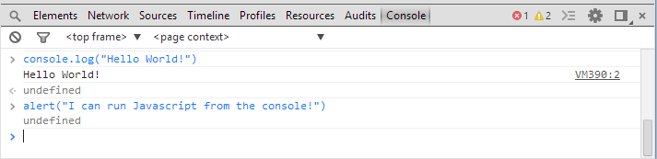
Javascript 101-Using the Console
In the console:
You will see errors that occurred while running your Javascript
Messages that you sent yourself via the console.log() function
The output from Javascript that you run in the console.

Slide 36
Javascript 101-Using the Console
The console.log function is incredibly useful.
Try it! (in the console, you don’t need to write script tags, just type each statement in)
The console is a great place to examine the structure and value of your variables. To examine data, use console.log(variable).
<script>
var days = [‘Mon’, ‘Tue’, ‘Wed’];
for(var i in days){
console.log(days[i]);
}
</script>
Notes:
Breakpoints

Slide 37
Learning basic Javascript
Open the previous HTML file
What we’re doing:
Create a <script> </script> tag in the header.
Create a function called clickFunction
clickFunction will use:
Alert
Console
Add onclick="clickFunction()” to the button element.
If you finish early: explore Javascript functions in the console

Slide 38
Recap
HTML
CSS
Javascript
A browser displays HTML, which is rendered by the browser.
Follows the specification of the Document-object Model (DOM)
Provides ‘structure’
Provides ‘presentation’ (style, layout, colors, etc)
Operates via selectors
CSS3
Provides ‘interaction’
Programming language used in web browsers

Slide 39
What is SVG?
What is SVG?
Stands for Scalable Vector Graphics, a standard for graphics in web pages.
SVG allows us to create graphic objects in markup, and also manipulate them with Javascript!
Example:
<svg xmlns="http://www.w3.org/2000/svg" version="1.1">
<rect width="300" height="100" style="fill:rgb(0,0,255);stroke-width:1;stroke:rgb(0,0,0)" />
</svg>
SVG Elements can also be styled with CSS

Slide 40
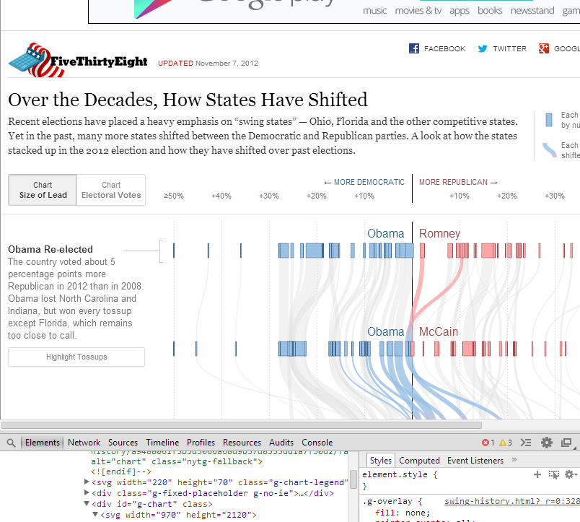
Why SVG?
SVG allows us to build visualizations!

Slide 41
Getting started with SVG
Browse the specification at: http://www.w3.org/Graphics/SVG/IG/resources/svgprimer.html
Tags you might want to try:
<rect></rect>
<circle></circle>
To get started, add this to your index.html file:
<svg xmlns="http://www.w3.org/2000/svg" version="1.1">
<rect width="300" height="100" style="fill:rgb(0,0,255);stroke-width:1;stroke:rgb(0,0,0)" />
<circle cx="80" cy="170" r="40“ fill="yellow" stroke="blue" />
</svg>
Again, SVG Elements can also be styled with CSS

Slide 42
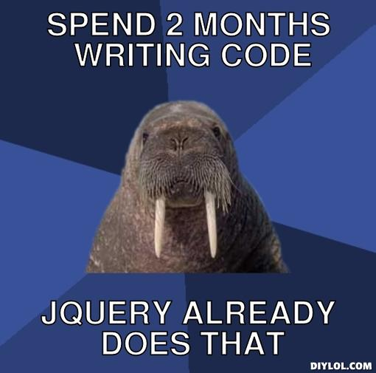
Libraries and Frameworks
Don’t waste time reinventing the wheel!

Slide 43
Libraries and Frameworks
What if someone already made libraries to make programming in Javascript easier and faster?
What if someone already created CSS stylesheets that include standards in current UI design?
jQuery
D3.js
Bootstrap
Makes DOM manipulation, animation, event-handling, and AJAX easier and simple.
Most widely used Javascript library, many plugins are built with jQuery
Extremely powerful.
“data-driven documents”
Some overlap with jQuery in terms of event handling, selection, etc.
Allows for ‘binding’ of data to elements!
Front-end framework dependent on jQuery
Focused on presentation, makes elements across the web consistent
Extremely popular. You’ll probably recognize some (modified) bootstrap when you see it.

Slide 44
Libraries and Frameworks
How do you include jQuery, d3.js, and Boostrap?
http://d3js.org/
http://getbootstrap.com/
http://jquery.com/
Include these elements in your HTML header:
<script src="http://d3js.org/d3.v3.min.js" charset="utf-8"></script>
<script src="http://code.jquery.com/jquery-1.10.1.min.js"></script>
<link rel="stylesheet" href=“http://netdna.bootstrapcdn.com/bootstrap/3.0.3/css/bootstrap.min.css">
<script src=“http://netdna.bootstrapcdn.com/bootstrap/3.0.3/js/bootstrap.min.js"></script>
These tags allow you to include the JavaScript and CSS files written by other people into your HTML document. (you can also download them locally and include them that way if you don’t always have internet connection).

Slide 45
jQuery vs d3.js + learning more
If you have already used jQuery:
There is significant overlap:
jQuery is generally used to manipulate the DOM, d3.js allows for data-binding
You could write whole books on how to use these libraries.
Search the documentation/Google on what you’re looking for. This is an important skill!
$('#foo')
.css('background', '#000')
.click(function() {})
.append($('<div></div>'));
d3.select('#foo')
.style('background', '#000')
.on('click', function() {})
.append('div');

Slide 46
Getting Started with Homework 1

Slide 47
Downloading the files
Go to https://github.com/CS171/HW1
In a location of your choice:
git clone https://github.com/CS171/HW1.git
Note: please create repository named cs171-hw1-lastname-firstname and copy the files over when you submit.

Slide 48
Downloading the files
Go to https://github.com/CS171/HW1
In a location of your choice:
git clone https://github.com/CS171/HW1.git
Note: please create repository named cs171-hw1-lastname-firstname and copy the files over when you submit.

Slide 49
Running a webserver
Navigate to the ‘HW1’ directory which you just created
Start a local web server with the following command:
python -m SimpleHTTPServer
Note: you need Python installed for this. (You probably already have this installed; if not, ask one of us for help)

Slide 50
Runninng a webserver
Navigate to the ‘HW1’ directory which you just created
Start a local web server with the following command:
python -m SimpleHTTPServer
Note: you need Python installed for this. (You probably already have this installed; if not, ask one of us for help)

Slide 51
Understanding table.html
Navigate to the ‘HW1’ directory which you just created
Visiting the following address in your browser:
http://localhost:8000/table.html

Slide 52
Understanding table.html
d3.tsv(url[, accessor][, callback])
Issues an HTTP GET request for the tab-separated values (CSV) file at the specified url.
var table = d3.select("body").append("table"),
tbody = table.append("tbody");
var rows = tbody.selectAll("tr")
.data(data)
.enter()
.append("tr");

Slide 53
Understanding table.html (2)
var table = d3.select("body").append("table"),
tbody = table.append("tbody");
var rows = tbody.selectAll("tr")
.data(data)
.enter()
.append("tr");
var cells = rows.selectAll("td")
.data(function(row) {
return d3.range(Object.keys(row).length).map(function(column, i) {
return row[Object.keys(row)[i]];
});
})
.enter()
.append("td")
.text(function(d) { return d; });
});

Slide 54
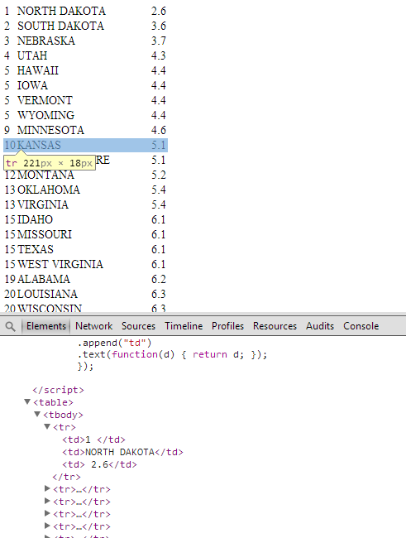
Understanding table.html (3)
var table = d3.select("body").append("table"),
tbody = table.append("tbody");
var rows = tbody.selectAll("tr")
.data(data)
.enter()
.append("tr");
var cells = rows.selectAll("td")
.data(function(row) {
return d3.range(Object.keys(row).length).map(function(column, i) {
return row[Object.keys(row)[i]];
});
})
.enter()
.append("td")
.text(function(d) { return d; });
});

Slide 55
Summary
HTML, CSS, and Javascript are the building blocks of the web experience.
SVG and d3.js make beautiful data visualization possible.

Slide 56
Questions?

Slide 57
Addendum 1: d3 vs jQuery
http://www.macwright.org/presentations/dcjq/

