Slide 1
Project title
v1
2019-01-29

Slide 2
Read summary
Sequence reads from Hi-C were aligned to mouse reference sequence (mm10) by bowtie2 with iterative trimming & alignment strategy. Redundant paired reads derived from a PCR bias, reads aligned to repetitive sequences, and reads with low mapping quality (MapQ < 30) were removed. Reads potentially derived from self-ligation and undigested products were also discarded (=<20kb with different direction pairs.)
Total usable reads = inter-chromosome + >20kb reads pairs + <20kb (same direction)
SAMPLE name | CD4 | CD4-SATB1 | CD8 | CD8-SATB1 |  | CD4 | CD4-SATB1 | CD8 | CD8-SATB1
Total read | 87,360,016 | 77,451,873 | 100,292,745 | 92,857,588 |  | 100% | 100% | 100% | 100%
Both aligned | 86,322,415 | 76,399,530 | 99,134,559 | 91,800,644 |  | 98.81% | 98.64% | 98.85% | 98.86%
Single aligned | 1,028,937 | 1,042,459 | 1,149,365 | 1,047,838 |  | 1.18% | 1.35% | 1.15% | 1.13%
Not aligned | 8,664 | 9,884 | 8,821 | 9,106 |  | 0.01% | 0.01% | 0.01% | 0.01%
no PCR duplicate | 84,470,974 | 74,697,056 | 96,813,763 | 89,488,889 |  | 96.69% | 96.44% | 96.53% | 96.37%
no repeat | 51,057,327 | 44,266,435 | 58,275,196 | 53,780,187 |  | 58.44% | 57.15% | 58.11% | 57.92%
enough quality(MapQ>30) | 38,205,722 | 32,018,497 | 43,569,098 | 41,175,573 |  | 43.73% | 41.34% | 43.44% | 44.34%
inter-chromosome | 7,557,430 | 7,338,161 | 8,831,504 | 8,773,544 |  | 8.65% | 9.47% | 8.81% | 9.45%
>20kb | 23,916,790 | 19,185,962 | 27,810,673 | 24,972,044 |  | 27.38% | 24.77% | 27.73% | 26.89%
<20kb(same direction) | 1,674,404 | 1,238,965 | 1,863,226 | 1,721,563 |  | 1.92% | 1.60% | 1.86% | 1.85%
<20kb(+ +) | 851,582 | 630,695 | 947,528 | 873,608 |  | 0.97% | 0.81% | 0.94% | 0.94%
<20kb(- -) | 822,822 | 608,270 | 915,698 | 847,955 |  | 0.94% | 0.79% | 0.91% | 0.91%
<20kb(different direction) | 5,057,004 | 4,255,343 | 5,063,598 | 5,708,315 |  | 5.79% | 5.49% | 5.05% | 6.15%
<20kb(+ -) | 4,099,585 | 3,540,424 | 4,007,477 | 4,690,364 |  | 4.69% | 4.57% | 4.00% | 5.05%
<20kb(- +) | 957,419 | 714,919 | 1,056,121 | 1,017,951 |  | 1.10% | 0.92% | 1.05% | 1.10%
Total usable | 33,148,624 | 27,763,088 | 38,505,403 | 35,467,151 |  | 37.94% | 35.85% | 38.39% | 38.20%

Slide 3
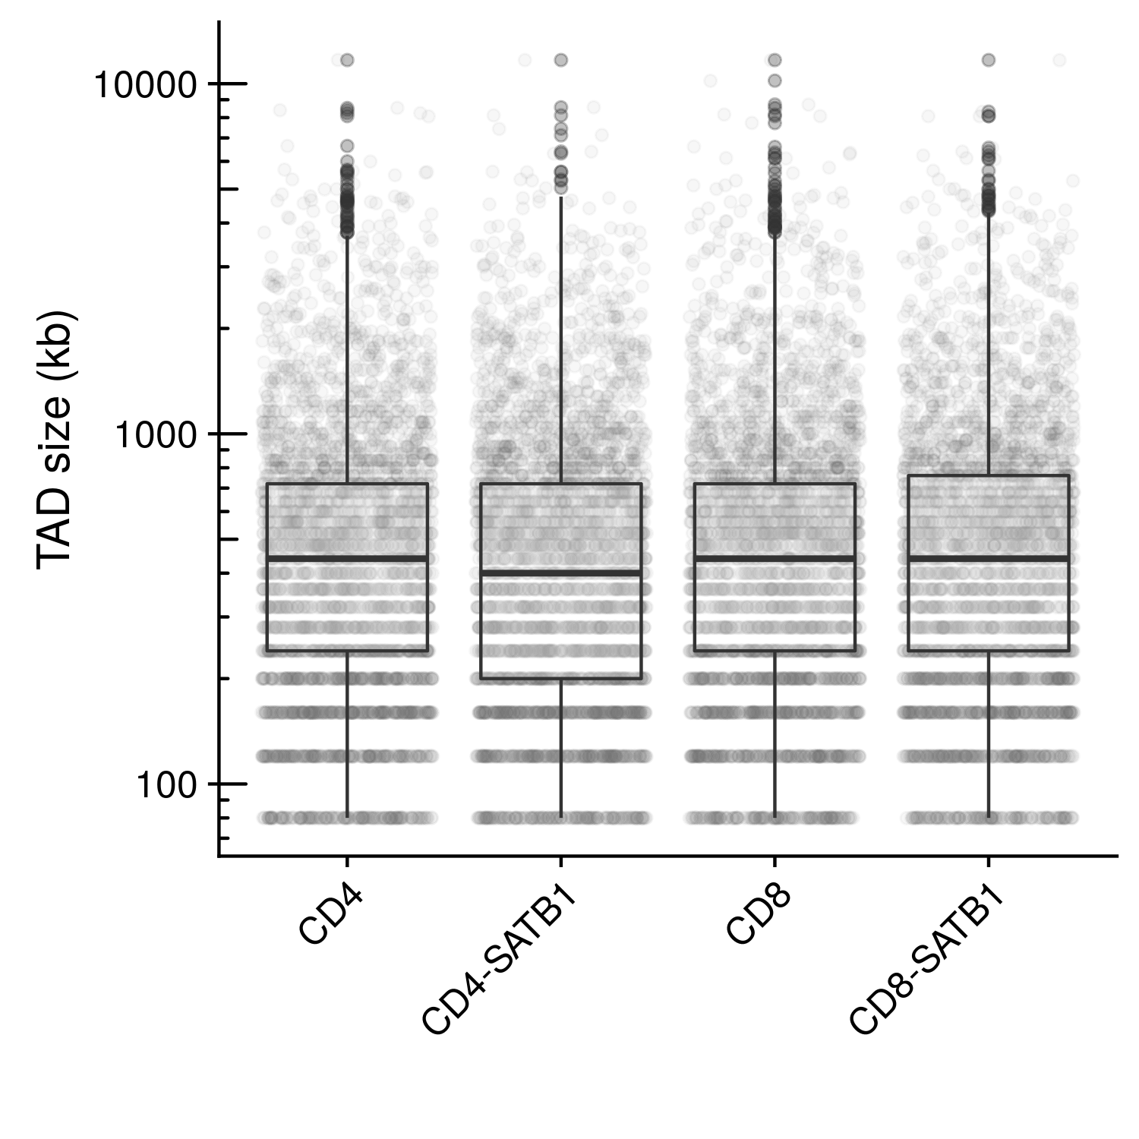
TAD size comparison
TAD border were defined using border strength scores. (Kim, K.D et al. Nat Genet 48, 1242-52 (2016).) Border strength score were calculated based on ICE normalized HI-C matrices at 40kb resolution.
TAD were defined as between TAD borders. Distribution of TAD size were compared.
Sample | Median | Average
xxx | 440000 | 629646
Average TAD size is 600~650kb

Slide 4
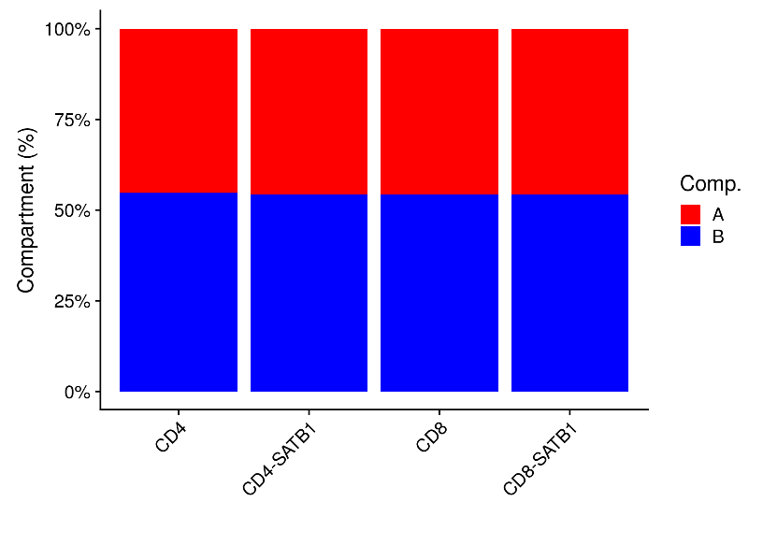
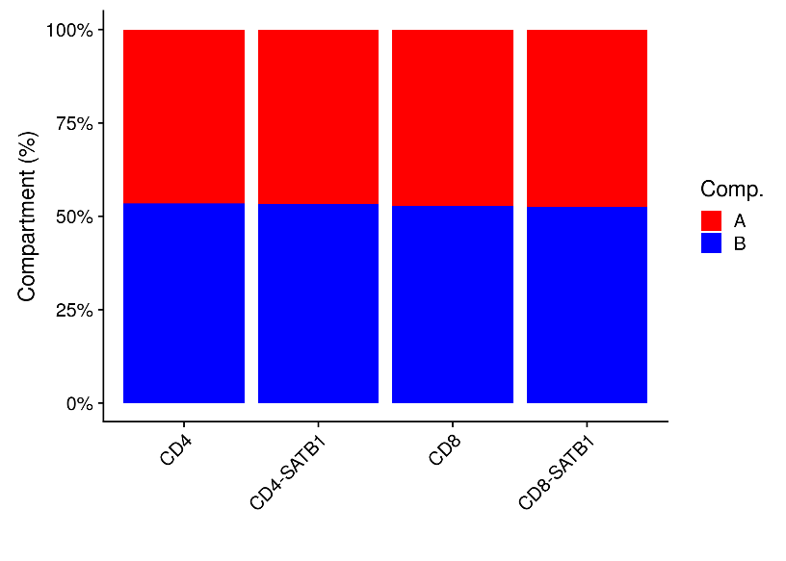
Compartment distribution
PCA scores were calculated using ICE normalized Hi-C contact matrixes at 40 kb and 200kb resolution. Region with positive PCA score were defined as Compartment A, negative PCA score were defined as Compartment B. Composition of these two compartment were compared.
 | A |  | B
Sample | n | % | n | %
xxx | 27622 | 45.29 | 33361 | 54.7
40kb resolution
 | A |  | B
Sample | n | % | n | %
xxx | 5748 | 46.6 | 6586 | 53.39
200kb resolution
Compartment B has slightly more (55%) than A

Slide 5
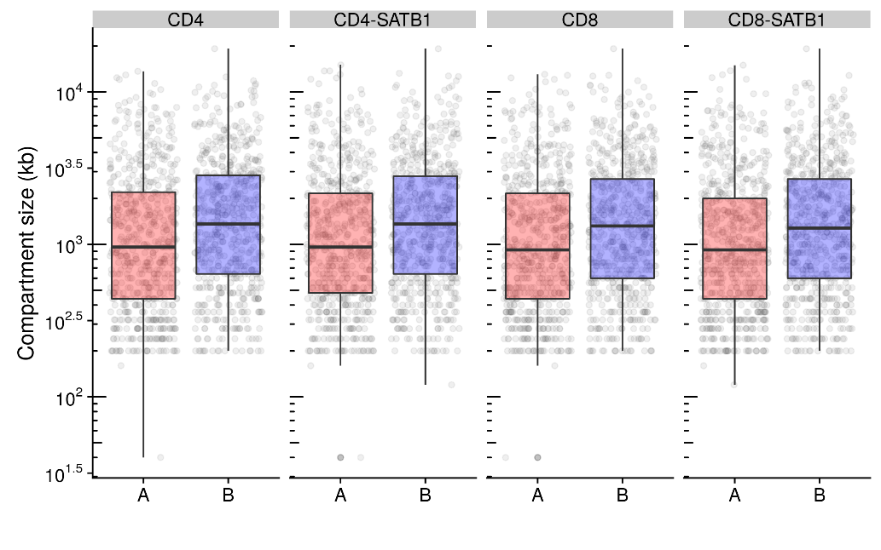
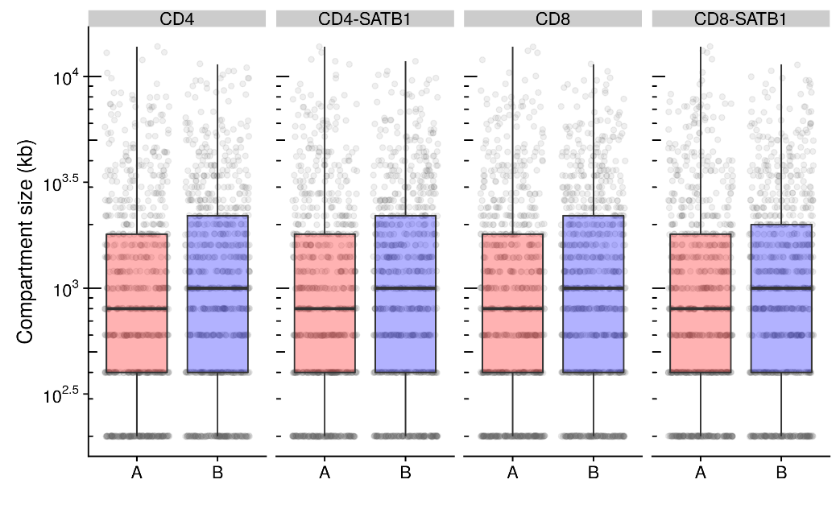
Merged compartment size distribution
Continuous compartments were merged. Distribution merged compartment size were compared.
40kb resolution analysis
 | Compartment A |  |  | Compartment B
Sample | n | Median | Average | n | Median | Average
xxx | 622 | 960000 | 1776334 | 619 | 1360000 | 2155800
200kb resolution analysis
 | Compartment A |  |  | Compartment B
Sample | n | Median | Average | n | Median | Average
xxx | 750 | 800000 | 1532800 | 780 | 1000000 | 1688718
Average merged compartment size are 1.4~2Mb

Slide 6
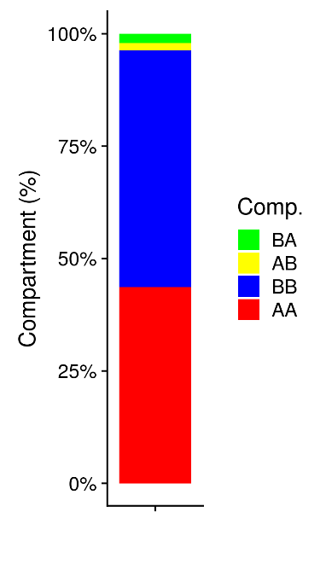
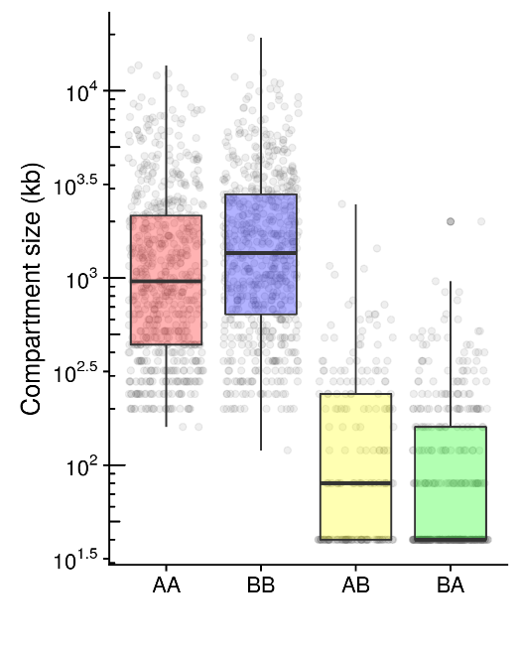

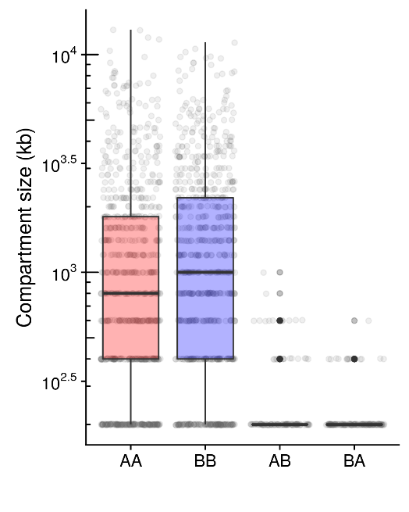
Compartment switch
Compartment difference between merged Hi-C matrices, xxx and xxx were compared. Continuous region were merged and compared size distribution.
40kb resolution
200kb resolution
comb | n | %
AA | 26,595 | 43.6
AB | 994 | 1.6
BA | 1,272 | 2
BB | 32,036 | 52.6
Total | 60897
comb | n | Median | Average
AA | 622 | 960,000 | 1,710,289
BB | 614 | 1,360,000 | 2,087,036
AB | 213 | 80,000 | 186,667
BA | 422 | 40,000 | 120,569
comb | n | %
AA | 5,568 | 45.2
AB | 173 | 1.4
BA | 182 | 1.4
BB | 6,393 | 51.9
Total | 12316
comb | n | Median | Average
AA | 753 | 800,000 | 1,478,884
BB | 770 | 1,000,000 | 1,660,519
AB | 130 | 200,000 | 266,154
BA | 165 | 200,000 | 220,606

