Slide 1
STEAM DATABASE
Team 8
Ethan Pirso, Keani Schuller, Wenya Cai, Zhiming Zhang

Slide 2
Table of contents
01
Business Overview
04
Interesting Queries
02
ERD
05
Lessons Learned
03
Logical Model
06
Future Extension
Includes overview, mission statement, and objectives
Exploration of two interesting queries
Exploration of the entity relationship diagram
Challenges, resolution, and lessons learned
Exploration of the logical model for the database
Potential future database extensions for STEAM

Slide 3
Business Overview
Steam-like platforms have revolutionized the gaming industry by providing an all-in-one solution for developers to distribute their games and for users to purchase them, download them, and play them.
These platforms also provide gamers with a community where they can review games, connect with other players, and even bundle games together for promotions.
Given the vast amount of data generated, from user playtimes and game reviews to sales and bundle discounts, there's a need for a comprehensive database system that can efficiently manage this data and support the analytics that drive these business decisions.

Slide 4
“To design and implement a scalable and efficient database system that captures the multi-faceted interactions on gaming platforms, bringing seamless user experience, improving business decisions, and fostering community growth.”
Mission Statement

Slide 5
Mission Objectives
To maintain data (enter, update, and delete) on games, including attributes like their prices and discount prices.
To maintain data (enter, update, and delete) on users, such as tracking their playtime both historically and in recent weeks.
To maintain data (enter, update, and delete) on game bundles, tracking their prices, related games, and discounts associated
To maintain data (enter, update, and delete) on game genres, tags, languages, and developers, ensuring comprehensive categorization and search capabilities.
To maintain data (enter, update, and delete) on game reviews, to ensure users can express their opinions and use these within the platform's recommendation algorithm

Slide 6
Mission Objectives
To perform searches on games based on various criteria including discounts, genres, and playtime metrics.
To perform searches on users, particularly focusing on their play preferences, genres of interest, and recommendation behaviors.
To report on aggregate data on games such as average ratings, total revenue from sales, and playtime statistics.
To report on game reviews, focusing on their helpfulness scores, recommendation statuses, and associated game details.
To report recommended games to users based on their playtime, game ratings, and genre preferences.

Slide 7
Mission Objectives
To report on trending positive game reviews for marketing and promotional purposes.
To report on users' game ownership, identifying gaps between game purchases and actual playtime.
To report on game release dates, ensuring users are informed about new and upcoming game titles.
To report insights and reports on game developers, identifying the most active and popular ones on the platform.
To report on game bundles that offer the highest discounts, helping promotional efforts and sales strategies.

Slide 8
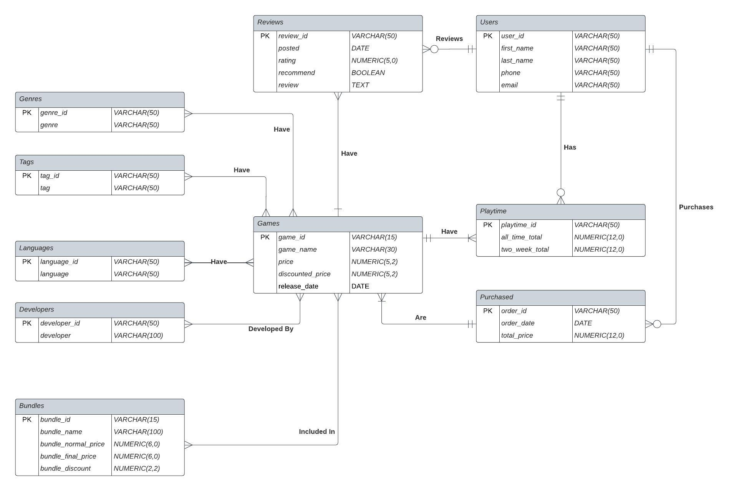
Entity Relationship Diagram
This ERD ensures that the structure and relationships between the data that must be stored in the future database are properly mapped.
The ERD contains 10 entities: Users, Games, Playtime, Purchased, Reviews, Developers, Language, Genre, Tags, and Bundles

Slide 9
Logical Model
This logical model demonstrates the primary keys and the foreign keys from each entity found in the ERD, as well as the mapping of the tables created to replace many-to-many relationships.
Users (user_id, first_name, last_name, phone, email)
Games (game_id, game_name, price, discounted_price, release_date)
Reviews (review_id, posted, rating, recommend, review, user_id, game_id)
Playtime (playtime_id, all_time_total, two_week_total, user_id, game_id)
Purchased (order_id, order_date, total_price, user_id, game_id)
Bundles (bundle_id, bundle_name, bundle_normal_price, bundle_final_price, bundle_discount)
Bundled_with ((game_id, bundle_id), game_id, bundle_id)
Genres (genre_id, genre)
Tags (tag_id, tag)
Languages (language_id, language)
Developers (developer_id, developer)
Has_genre (game_id, genre_id), game_id, genre_id)
Has_tag (game_id, tag_id), game_id, tag_id)
Has_language ((game_id, language_id), game_id, language_id)
Devolped_by ((game_id, developer_id), game_id, developer_id)

Slide 10
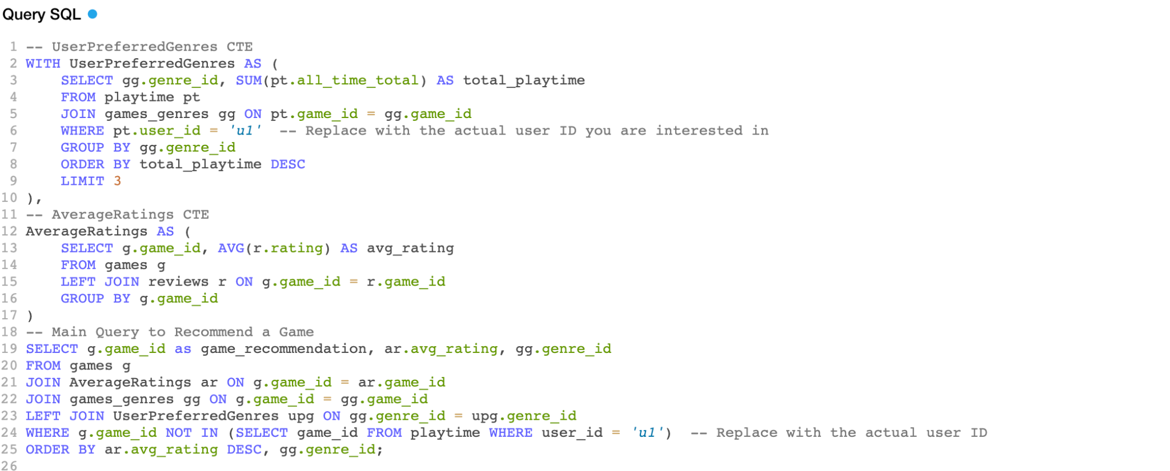
Two Interesting Queries - 1
Recommend a Game Based on User Preferences and Average Ratings
Explanation

Slide 11
Recommend a Game Based on User Preferences and Average Ratings
The query aims to recommend a game to a user based on the following factors:
1. User's Preferred Genres: The genres in which the user has spent the most time are considered their preferred genres.
2. Average Game Ratings: Games are sorted by their average ratings, calculated from user reviews.
3. Exclusion Criteria: Games that the user already owns are excluded from the recommendations.
The output will be a list of game IDs, their average ratings, and their genre IDs, sorted by the average rating.

Slide 12
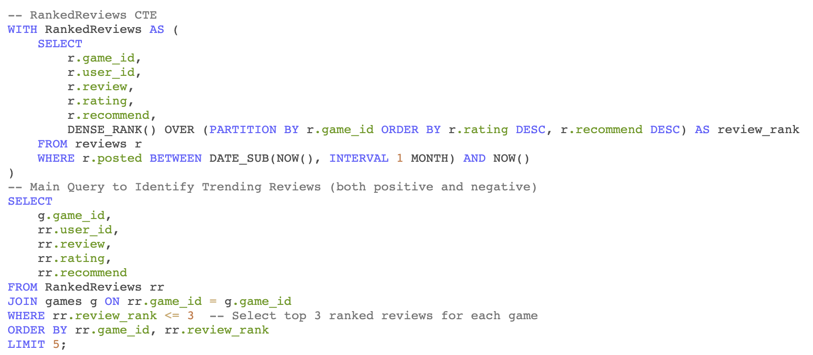
Two Interesting Queries - 2
Identify Trending Reviews for Internal Analysis and Promotion Decisions
Explanation

Slide 13
Identify Trending Reviews for Internal Analysis and Promotion Decisions
This query is designed to help the company identify games that are receiving a diverse range of reviews, both positive and negative. This information can be used for several purposes:
1. Promotion Decisions: Games that consistently receive high ratings and recommendations could be considered for special promotions or marketing campaigns.
2. Quality Assessment: Games that receive mixed reviews can be flagged for further investigation and potential improvements.
3. Market Insight: Understanding the public reception of each game can help the company make informed decisions about future developments.
By using this query, the company can gain a nuanced understanding of how each game is being received by the public, which can inform various business decisions, from marketing to product development.

Slide 14
Identify Trending Reviews for Internal Analysis and Promotion Decisions
How It Works:
1.RankedReviews CTE: This Common Table Expression (CTE) uses the DENSE_RANK() window function to rank reviews for each game. The ranking is based on both the rating and the recommendation status (recommend). Reviews with the same rating and recommendation status receive the same rank. The CTE also filters reviews to those posted in the last month.
2.Main Query: This query joins the RankedReviews CTE with the games table to bring in additional game information. It then filters the results to include only the top-ranked reviews for each game (in this case, the top 3 due to rr.review_rank <= 3). The query sorts the results by game ID and review rank, and limits the output to 5 reviews for manageability.

Slide 15
Challenges and Resolution
Scope Inclusion vs. Exclusion
HTML
Challenge
Time Constraints
Setting the scope by selecting what to include and what to exclude was challenging for the team, given that gaming platforms offer many services.
The team mitigated scope challenges by setting firm goals, and selecting functionalities that align with these goals. For this database, the importance was put on maximizing benefit for the business.
One project requirement was to create an HTML web page. However, team members had little HTML experience, needing to learn this new skill and apply it.
The team overcame this by taking the extra step to learn about HTML coding outside of class and how to create a nice HTML page to host the database.
The overall project timeline was very short, which put pressure on the team’s to create a robust database while staying on time.
Given the time constraints, the team assigned tasks and set internal deadlines to ensure the project stays on track.

Slide 16
Lessons Learned
Creating a
Work Plan
Comments are Everything
One lesson learned was the importance of creating a work plan. The team consistently checked the work plan to check deadlines, goals, and ideas.
This ensured all deliverables were on time and done according to the project goals. The team will definitely use work plans in their future projects.
Another lesson learned was the importance of comments on all queries.
By using comments to explain and organize the SQL, it was much easier for all team members to understand each individual part and created a comprehensive whole that was easily readable by all.

Slide 17
Future Database Extension
Community Integration
Database Optimization
Gaming platforms offer community pages that group together all types of discussion posts, workshops, and broadcasts. This database would benefit from an extension to include various community features: user posts including their types (artwork, guides, etc.), video broadcasts and their related metadata, as well as workshops and their locations, dates, and times
All online platforms require their database to be robust and scalable. As gaming is an enormous industry, the database would benefit from optimization tools such as Oracle’s SQL Machine Learning Software, that allows the database to optimize querying, build models, and create business intelligence dashboards.

Slide 18
Thank You!

