Slide 1
Persona Memory Selector
Behavioral examples for consistent AI role-playing
DSCI310 · Wenyu Chiou
M1 · 1/12
Notes:
Imagine an AI playing a careful, dependable colleague. A client suddenly asks for an earlier deadline. A personality instruction tells the AI what this colleague is like, but it does not show how that colleague might respond under pressure. Our project asks whether selecting suitable behavioral examples helps. We compare four ways to give the same AI information. The course contribution is data cleaning, classification, and a controlled comparison. A separate human evaluation will determine whether the answers actually fit the role. Classification accuracy alone cannot answer that question.
Source: https://huggingface.co/datasets/wenkai-li/big5_chat
Project reports generated from pinned dataset revision.

Slide 2
The deadline example
Situation: a client asks for an earlier deadline
Persona: careful and dependable
Evidence: how someone handled a similar trade-off
M1 · 2/12
Notes:
The key decision is how to respond to the request. The character could accept immediately, ask which requirements can change, or explain why the original commitment matters. Several responses may be reasonable. We want to know whether the selected examples help the AI make a choice that fits the target character and the current situation. Simply retrieving the word deadline is not enough. Equally, adding a very polite example does not necessarily improve the decision. This example explains why we score behavioral choices and speaking style separately.
Source: https://huggingface.co/datasets/wenkai-li/big5_chat
Project reports generated from pinned dataset revision.

Slide 3
Ten labels from five traits
Openness · Conscientiousness · Extraversion
Agreeableness · Neuroticism
Each trait has a high and low generation setting
100,000 synthetic records · Labels describe generation settings
M1 · 3/12
Notes:
BIG5-CHAT provides existing labels, so we do not need to invent a large annotation project before we can train a classifier. Each record has a conversation input and a target response generated under one specified personality setting. There are ten target labels in total. A label tells us what the generation process requested. It does not guarantee that every response successfully expresses the trait. It also does not measure the other four traits. Our model predicts these dataset targets, and we keep that interpretation separate from claims about real human personality.
Source: https://huggingface.co/datasets/wenkai-li/big5_chat
Project reports generated from pinned dataset revision.

Slide 4
One record, two different speakers
Context: “Why don’t we plan a fun outing for the kids this weekend?”
Target response: “Maybe we should just stick to what we’re doing and not take any chances.”
Generation label: openness_low · Training record big5-000005
M1 · 4/12
Notes:
Here is a real training record. One speaker proposes an outing for the children. The target speaker prefers the familiar routine and worries about a mess or bad weather. Its generation label is low openness. Notice that the worries could also suggest another trait. This is why we call these generation targets, not verified psychological truths. The two speakers have different names in the source. For the model, we replace those names with role markers, while keeping the original text and record identifier. That prevents a name from becoming an easy shortcut and keeps the prediction auditable.
Source: https://huggingface.co/datasets/wenkai-li/big5_chat
Project reports generated from pinned dataset revision.

Slide 5
Cleaning results
99,656 records retained
344 records excluded with recorded reasons
Missing input and missing response counts overlap
M1 · 5/12
Notes:
The raw file contains one hundred thousand records. Our cleaning procedure retains ninety-nine thousand six hundred and fifty-six. We exclude three hundred and forty-four records that lack required information. The original audit found two hundred and ninety-four missing inputs and sixty-five missing responses. These counts overlap, so adding them would give the wrong exclusion total. We keep a row-level exclusion report and never ask a language model to invent the missing text. The original file is checked against a fixed hash, which makes the source bytes reproducible.
Source: reports/selector/cleaning.json
Project reports generated from pinned dataset revision.

Slide 6
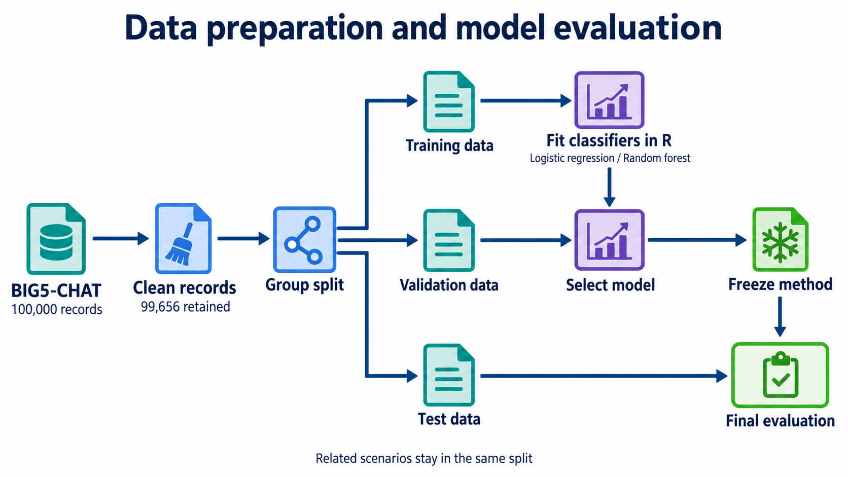
Notes:
A random split by row would be misleading. The same original scenario appears under different personality settings. If one version went into training and another into testing, the model could recognize the scenario rather than generalize. We connect records sharing an original identifier, event description, or equivalent input. Whole connected groups move together. Training data fit the model. Validation data choose between approaches. Test data remain reserved until the method is fixed. Within validation and test, we also separate questions from the examples available to retrieval, so the system cannot retrieve the answer’s own scenario.
Source: reports/selector/cleaning.json
Project reports generated from pinned dataset revision.

Slide 7
How text becomes model input
TF-IDF represents distinctive words
Fixed MiniLM embeddings represent semantic similarity
Compare response alone with context plus response
M1 · 7/12
Notes:
A statistical classifier needs numbers rather than raw paragraphs. TF-IDF creates one representation based on how distinctive each word is in the training collection. A fixed sentence encoder gives us another representation based on learned similarities between texts. We do not train that language model in this course project. We compare whether the response alone is enough or whether including the preceding context helps classification. Long text is encoded in windows instead of silently cutting off the end. Vocabulary and fitted transformations are learned only from the training portion of each comparison.
Source: https://huggingface.co/datasets/wenkai-li/big5_chat
Project reports generated from pinned dataset revision.

Slide 8
Classifying generation labels
Validation Macro-F1 (%) · Ten classes, unseen scenario groups
Offline winner: Response LR · Portable model: Response LR
M1 · 8/12
Notes:
These are measured validation results, not human personality ratings. Logistic regression using the response alone reaches 58.3 percent Macro-F1. Adding the context to the fixed embedding reaches 39.7 percent. So, with this representation and these data, more text did not improve classification. That does not make context useless: our retrieval step still uses it to find similar situations. The word-based TF-IDF baseline reaches 58.0 percent, very close to the best score. We select the highest validation score, but do not claim that this small margin proves statistical superiority. Random forest is a course comparator with a limited parameter grid. These results show why a simple baseline and a response-only comparison are necessary before choosing a more complex design.
Source: artifacts/selector/selection.json
Project reports generated from pinned dataset revision.

Slide 9
Four controlled comparisons
A Fixed persona prompt
B Vector retrieval
C Classification-aware flat ranking
D Classification and graph ranking
M1 · 9/12
Notes:
Every group uses the same target persona prompt and the same question. Group A receives no examples. Group B retrieves examples based on similarity. Group C also considers the classifier’s score for the requested trait. Group D uses a graph connecting examples with situation clusters and trait scores. The three retrieval methods start from the same fifty candidates and share the same evidence budget. Comparing C with B estimates the value of classification. Comparing D with C tests the graph’s additional value. Comparing B with A asks the more basic question of whether adding examples helps at all.
Source: https://huggingface.co/datasets/wenkai-li/big5_chat
Project reports generated from pinned dataset revision.

Slide 10
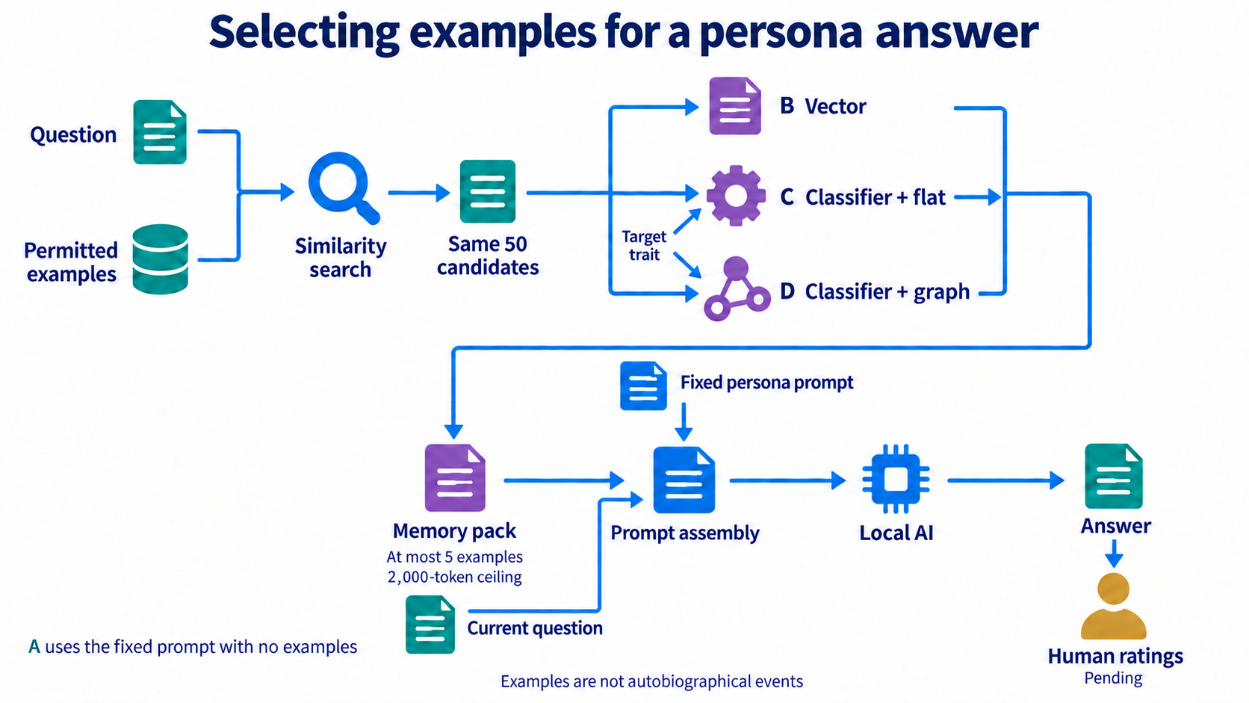
Notes:
The graph is a structure for finding examples. It is not a map of psychological causes. A situation group connects related conversation contexts, and a trait connection stores a classifier score. The selected source text becomes an evidence block next to the fixed persona instruction. The prompt explicitly says these are examples, not events the AI personally experienced. This distinction matters for Apersona. An application can later provide memories owned by a specific character, but the adapter must preserve that ownership. Public dialogue examples cannot silently become somebody else’s biography.
Source: https://huggingface.co/datasets/wenkai-li/big5_chat
Project reports generated from pinned dataset revision.

Slide 11
Measuring the answers
Two reviewers rate the same 100 blinded groups
Behavior, voice and relevance receive separate scores
Fabricated history, factual errors and invalid answers are flagged
M1 · 11/12
Notes:
The final evaluation asks two people to rate answers without seeing which method produced them. There are sixty primary-model personality situations, twenty situations for a second local model, and twenty factual or calculation controls. Each group contains four answers in random order. We score decisions and voice separately and record whether an answer invents personal history. The controls check whether personality examples interfere with ordinary useful answers. Both reviewers first discuss separate practice questions. Their real ratings remain blank until they complete the task. We cannot replace those ratings with the classifier’s own opinion.
Source: https://huggingface.co/datasets/wenkai-li/big5_chat
Project reports generated from pinned dataset revision.

Slide 12
What this project can establish
A reusable, auditable selection component
Classification results and persona effects reported separately
Human response ratings remain pending
M1 · 12/12
Notes:
The useful outcome is a component that can be inspected and reused, together with evidence about when it helps. It may turn out that classification helps but the graph adds little. In that case the simpler flat selector is a sensible integration choice. A wide uncertainty interval means we need more evidence, not that the graph has been disproved. This study uses synthetic dialogues and two local models. It cannot establish human psychological validity or universal transfer to all personalities. The current delivery includes the software and evaluation materials; any claim about better persona behavior must wait for the human ratings.
Source: https://huggingface.co/datasets/wenkai-li/big5_chat
Project reports generated from pinned dataset revision.

