Slide 1
Persona Memory Selector
Behavioral examples for consistent AI role-playing
DSCI310 · Wenyu Chiou
Automated results; human evaluation pending
M2 · 1/16
Notes:
Imagine an AI playing a careful, dependable colleague. A client suddenly asks for an earlier deadline. A personality instruction tells the AI what this colleague is like, but it does not show how that colleague might respond under pressure. Our project asks whether selecting suitable behavioral examples helps. We compare four ways to give the same AI information. The course contribution is data cleaning, classification, and a controlled comparison. A separate human evaluation will determine whether the answers actually fit the role. Classification accuracy alone cannot answer that question.
Source: https://huggingface.co/datasets/wenkai-li/big5_chat
Project reports generated from pinned dataset revision.

Slide 2
The deadline example
Situation: a client asks for an earlier deadline
Persona: careful and dependable
Evidence: how someone handled a similar trade-off
M2 · 2/16
Notes:
The key decision is how to respond to the request. The character could accept immediately, ask which requirements can change, or explain why the original commitment matters. Several responses may be reasonable. We want to know whether the selected examples help the AI make a choice that fits the target character and the current situation. Simply retrieving the word deadline is not enough. Equally, adding a very polite example does not necessarily improve the decision. This example explains why we score behavioral choices and speaking style separately.
Source: https://huggingface.co/datasets/wenkai-li/big5_chat
Project reports generated from pinned dataset revision.

Slide 3
Why scenario context matters
CAPS motivates conditional behavior
A stable persona can act differently in different situations
Graph edges express retrieval relationships
M2 · 3/16
Notes:
The cognitive-affective personality system theory is useful as a design motivation. It describes stable patterns in how a person responds to different kinds of situations. The relevant idea is not that a careful person always uses the same sentence. The pattern may change depending on uncertainty, obligations, or another person’s needs. That motivates retrieving examples matched to the current situation. Our experiment does not test the psychological theory itself. It tests whether a simple computational design inspired by context-dependent behavior improves the output of a role-playing AI.
Source: https://pubmed.ncbi.nlm.nih.gov/7740090/
Project reports generated from pinned dataset revision.

Slide 4
Evidence from earlier research
BIG5-CHAT supplies labeled examples
PersonalityEvd connects traits with supporting dialogue
ThinkPersona already studies persona graphs
M2 · 4/16
Notes:
Earlier research gives us both useful tools and limits on our novelty claim. BIG5-CHAT supplies the labels for our classifier. PersonalityEvd shows why a personality judgment should be linked to supporting dialogue and why momentary states differ from a longer-term trait. ThinkPersona already combines persona graphs with role-playing. We therefore do not claim to invent personality graphs. Our narrower contribution is to test the incremental value of a lightweight classifier and a graph in a controlled application component. The code and evaluation can be useful even if a simpler method wins.
Source: https://github.com/Hualeez/ThinkPersona
Project reports generated from pinned dataset revision.

Slide 5
Ten labels from five traits
Openness · Conscientiousness · Extraversion
Agreeableness · Neuroticism
Each trait has a high and low generation setting
100,000 synthetic records · Labels describe generation settings
M2 · 5/16
Notes:
BIG5-CHAT provides existing labels, so we do not need to invent a large annotation project before we can train a classifier. Each record has a conversation input and a target response generated under one specified personality setting. There are ten target labels in total. A label tells us what the generation process requested. It does not guarantee that every response successfully expresses the trait. It also does not measure the other four traits. Our model predicts these dataset targets, and we keep that interpretation separate from claims about real human personality.
Source: https://huggingface.co/datasets/wenkai-li/big5_chat
Project reports generated from pinned dataset revision.

Slide 6
One record, two different speakers
Context: “Why don’t we plan a fun outing for the kids this weekend?”
Target response: “Maybe we should just stick to what we’re doing and not take any chances.”
Generation label: openness_low · Training record big5-000005
M2 · 6/16
Notes:
Here is a real training record. One speaker proposes an outing for the children. The target speaker prefers the familiar routine and worries about a mess or bad weather. Its generation label is low openness. Notice that the worries could also suggest another trait. This is why we call these generation targets, not verified psychological truths. The two speakers have different names in the source. For the model, we replace those names with role markers, while keeping the original text and record identifier. That prevents a name from becoming an easy shortcut and keeps the prediction auditable.
Source: https://huggingface.co/datasets/wenkai-li/big5_chat
Project reports generated from pinned dataset revision.

Slide 7
Cleaning results
99,656 records retained
344 records excluded with recorded reasons
Missing input and missing response counts overlap
M2 · 7/16
Notes:
The raw file contains one hundred thousand records. Our cleaning procedure retains ninety-nine thousand six hundred and fifty-six. We exclude three hundred and forty-four records that lack required information. The original audit found two hundred and ninety-four missing inputs and sixty-five missing responses. These counts overlap, so adding them would give the wrong exclusion total. We keep a row-level exclusion report and never ask a language model to invent the missing text. The original file is checked against a fixed hash, which makes the source bytes reproducible.
Source: reports/selector/cleaning.json
Project reports generated from pinned dataset revision.

Slide 8
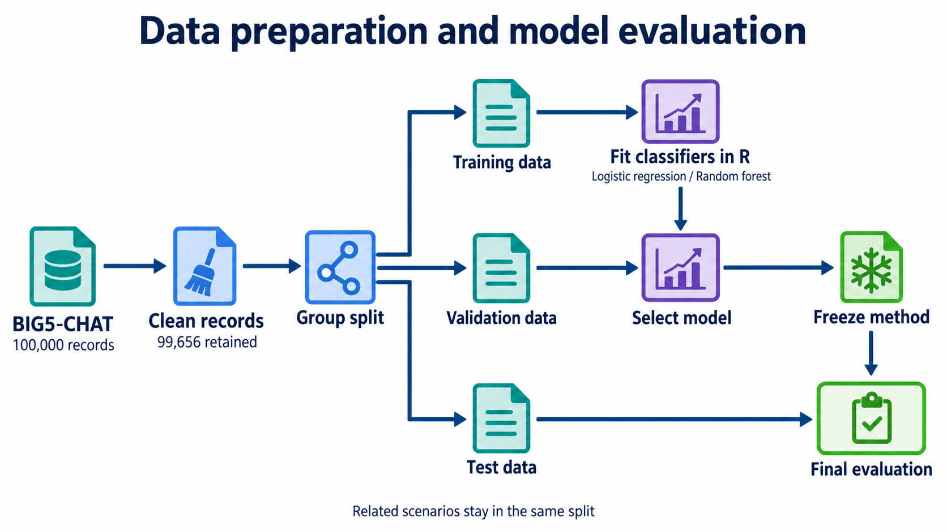
Notes:
A random split by row would be misleading. The same original scenario appears under different personality settings. If one version went into training and another into testing, the model could recognize the scenario rather than generalize. We connect records sharing an original identifier, event description, or equivalent input. Whole connected groups move together. Training data fit the model. Validation data choose between approaches. Test data remain reserved until the method is fixed. Within validation and test, we also separate questions from the examples available to retrieval, so the system cannot retrieve the answer’s own scenario.
Source: reports/selector/cleaning.json
Project reports generated from pinned dataset revision.

Slide 9
How text becomes model input
TF-IDF represents distinctive words
Fixed MiniLM embeddings represent semantic similarity
Compare response alone with context plus response
M2 · 9/16
Notes:
A statistical classifier needs numbers rather than raw paragraphs. TF-IDF creates one representation based on how distinctive each word is in the training collection. A fixed sentence encoder gives us another representation based on learned similarities between texts. We do not train that language model in this course project. We compare whether the response alone is enough or whether including the preceding context helps classification. Long text is encoded in windows instead of silently cutting off the end. Vocabulary and fitted transformations are learned only from the training portion of each comparison.
Source: https://huggingface.co/datasets/wenkai-li/big5_chat
Project reports generated from pinned dataset revision.

Slide 10
Classifying unseen situations
Frozen test Macro-F1 (%) · Model selection used validation only
Classification performance and human persona quality are separate outcomes
M2 · 10/16
Notes:
This chart compares all five classifiers on final test groups, after model selection was fixed. The response-only logistic model scores 58.8 percent Macro-F1; the TF-IDF baseline scores 58.2 percent. Context-plus-response logistic regression scores 39.9 percent. Macro-F1 gives each of the ten generation targets equal weight. The separate class tables show which labels are confused, and confidence tables compare scores with observed accuracy. These measurements answer the classification question. They do not show that the AI makes more role-consistent decisions. That application claim depends on the two reviewers and the controlled answer comparison. We keep the validation-selected model regardless of this chart, and do not treat small score differences as proof of superiority.
Source: artifacts/selector/test_metrics.csv
Project reports generated from pinned dataset revision.

Slide 11
Four controlled comparisons
A Fixed persona prompt
B Vector retrieval
C Classification-aware flat ranking
D Classification and graph ranking
M2 · 11/16
Notes:
Every group uses the same target persona prompt and the same question. Group A receives no examples. Group B retrieves examples based on similarity. Group C also considers the classifier’s score for the requested trait. Group D uses a graph connecting examples with situation clusters and trait scores. The three retrieval methods start from the same fifty candidates and share the same evidence budget. Comparing C with B estimates the value of classification. Comparing D with C tests the graph’s additional value. Comparing B with A asks the more basic question of whether adding examples helps at all.
Source: https://huggingface.co/datasets/wenkai-li/big5_chat
Project reports generated from pinned dataset revision.

Slide 12
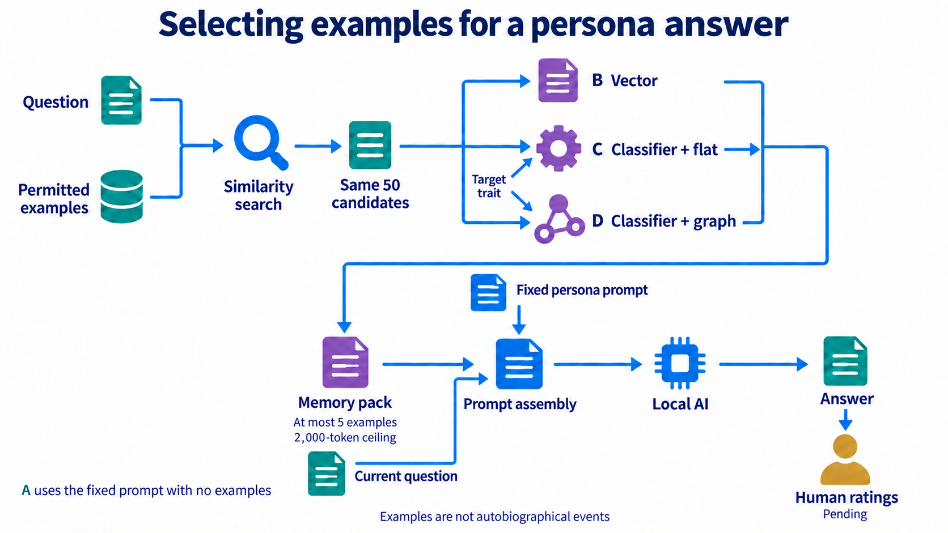
Notes:
The graph is a structure for finding examples. It is not a map of psychological causes. A situation group connects related conversation contexts, and a trait connection stores a classifier score. The selected source text becomes an evidence block next to the fixed persona instruction. The prompt explicitly says these are examples, not events the AI personally experienced. That rule keeps the experiment honest: public dialogue examples can guide a response, but they cannot silently become the character’s biography.
Source: https://huggingface.co/datasets/wenkai-li/big5_chat
Project reports generated from pinned dataset revision.

Slide 13
Measuring the answers
Two reviewers rate the same 100 blinded groups
Behavior, voice and relevance receive separate scores
Fabricated history, factual errors and invalid answers are flagged
M2 · 13/16
Notes:
The final evaluation asks two people to rate answers without seeing which method produced them. There are sixty primary-model personality situations, twenty situations for a second local model, and twenty factual or calculation controls. Each group contains four answers in random order. We score decisions and voice separately and record whether an answer invents personal history. The controls check whether personality examples interfere with ordinary useful answers. Both reviewers first discuss separate practice questions. Their real ratings remain blank until they complete the task. We cannot replace those ratings with the classifier’s own opinion.
Source: https://huggingface.co/datasets/wenkai-li/big5_chat
Project reports generated from pinned dataset revision.

Slide 14
Transfer and uncertainty
New scenario groups
A second local language model
Paired differences with scenario-level confidence intervals
M2 · 14/16
Notes:
Generalization is a claim we must define carefully. Holding out scenario groups checks whether the classifier and selector can handle contexts outside the training groups. A second language model checks whether the direction of the result survives one change of generator. It is a small transfer test, not proof about all models. For answer evaluation, the independent unit is the situation. Four answers from one situation and two ratings of one answer are related observations. We average reviewers within each condition and bootstrap paired situation differences. Main-model, transfer, and factual-control results are reported separately.
Source: https://huggingface.co/datasets/wenkai-li/big5_chat
Project reports generated from pinned dataset revision.

Slide 15
Reusable input and output
Input: question, target trait and available examples
Output: selected text, scores and original sources
Keep the flat method if graph value is unsupported
M2 · 15/16
Notes:
The reusable interface receives a question, a target trait, and the examples available in the experiment. It returns selected original text with classification scores, retrieval scores, and source references. This makes each choice inspectable: we can see which source was selected and why. Structural equation modeling remains a possible later research direction with suitable measurements. For this course, the controlled comparisons provide a clearer test. The next required evidence comes from the two reviewers, who can use the prepared anonymous rating files.
Source: https://huggingface.co/datasets/wenkai-li/big5_chat
Project reports generated from pinned dataset revision.

Slide 16
What this project can establish
A reusable, auditable selection component
Classification results and persona effects reported separately
Human response ratings remain pending
M2 · 16/16
Notes:
The useful outcome is a component that can be inspected and reused, together with evidence about when it helps. It may turn out that classification helps but the graph adds little. In that case the simpler flat selector is the supported result. A wide uncertainty interval means we need more evidence, not that the graph has been disproved. This study uses synthetic dialogues and two local models. It cannot establish human psychological validity or universal transfer to all personalities. The current delivery includes the software and evaluation materials; any claim about better persona behavior must wait for the human ratings.
Source: https://huggingface.co/datasets/wenkai-li/big5_chat
Project reports generated from pinned dataset revision.

