Slide 1
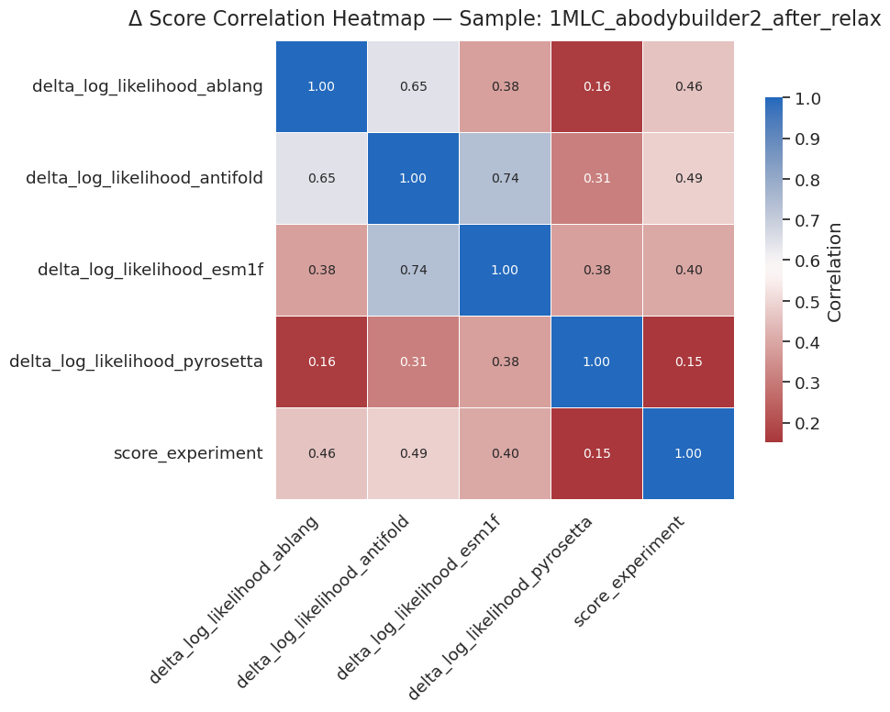
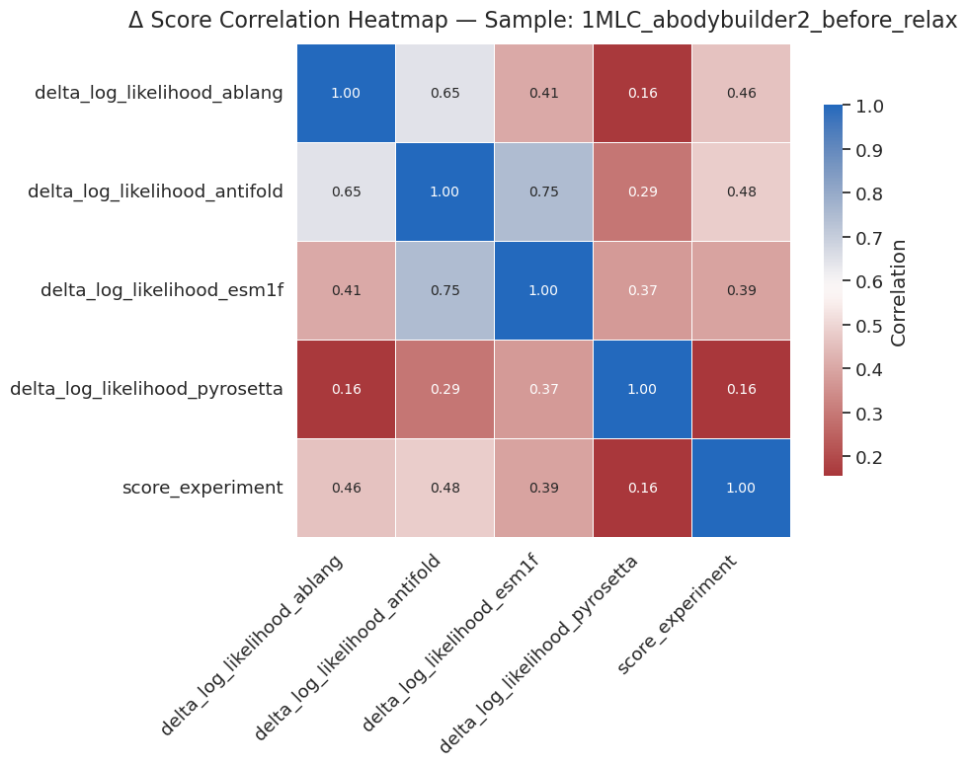
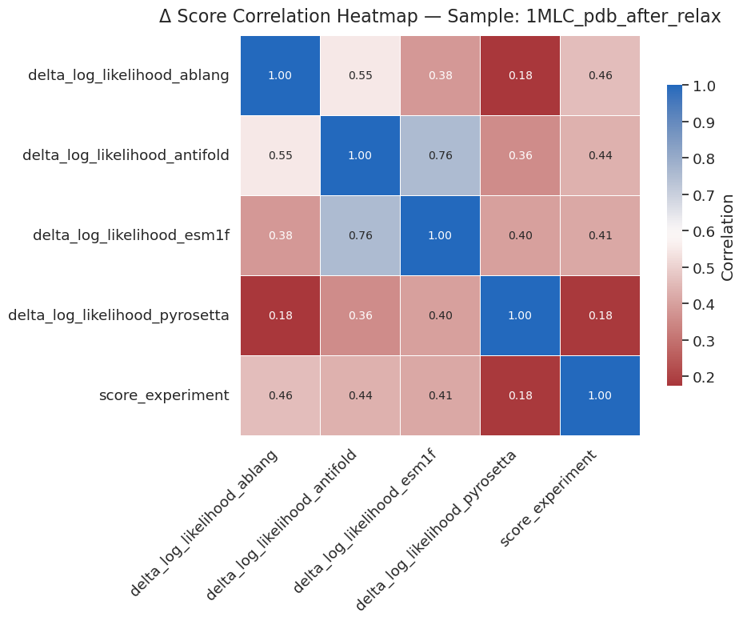
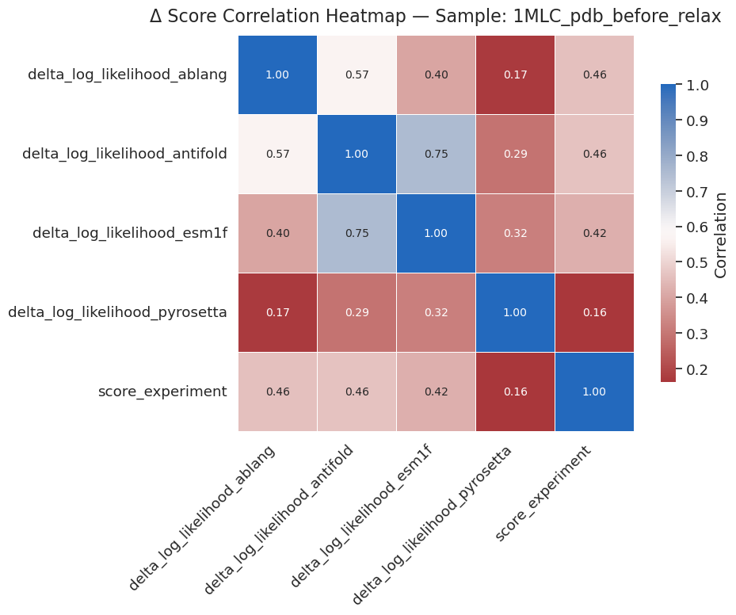
Correlation between delta log likelihood of model vs negative log-enrichment of the deep mutational scanning data (score_experiment).
Esm1f and antifold correlates well;
Pyrosetta doesn’t correlate much with any other models showing here, and experimental data.
Structure from Abodybuilder2 or pdb (1MLC, antibody-antigen complex -> remove antigen), before and after pyrosetta relax (recycle=5, Cartesian relax on side chain only), doesn’t show much difference in correlation.

Slide 2
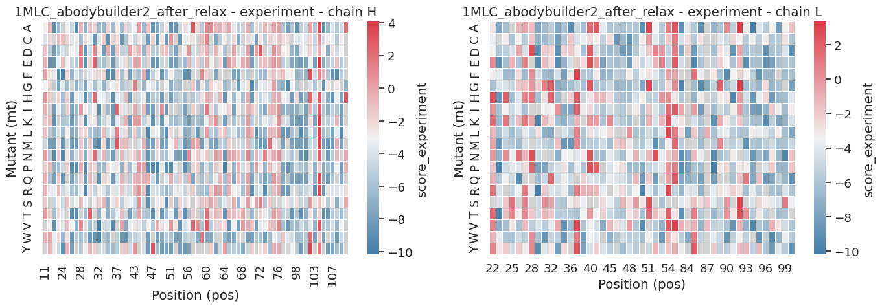
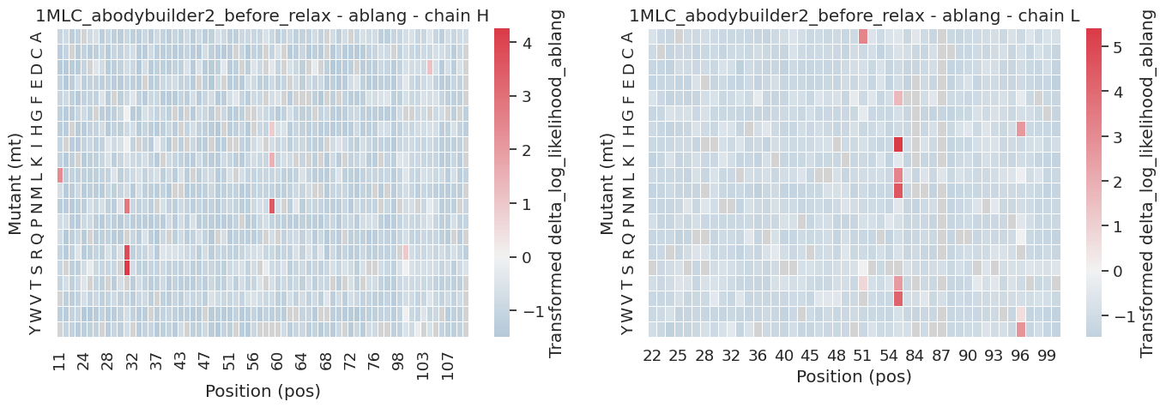
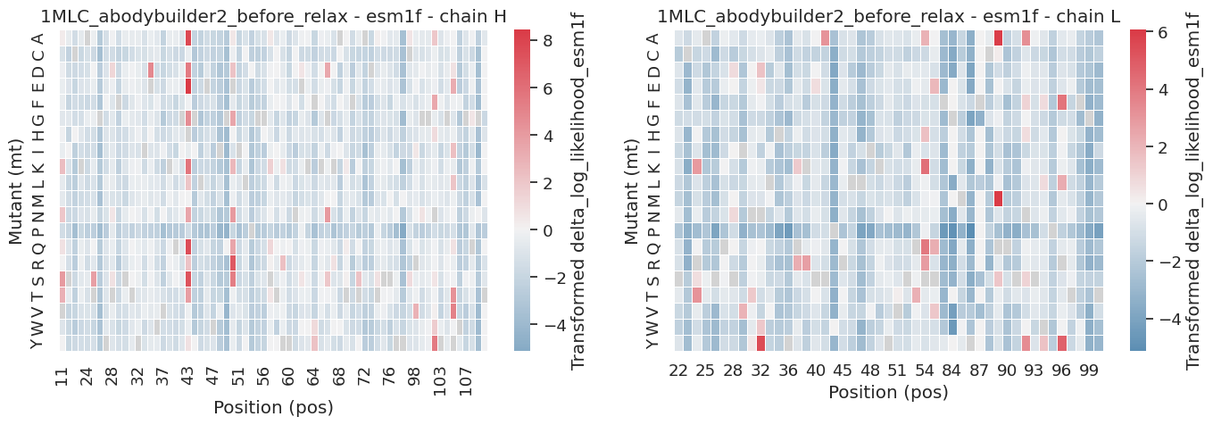
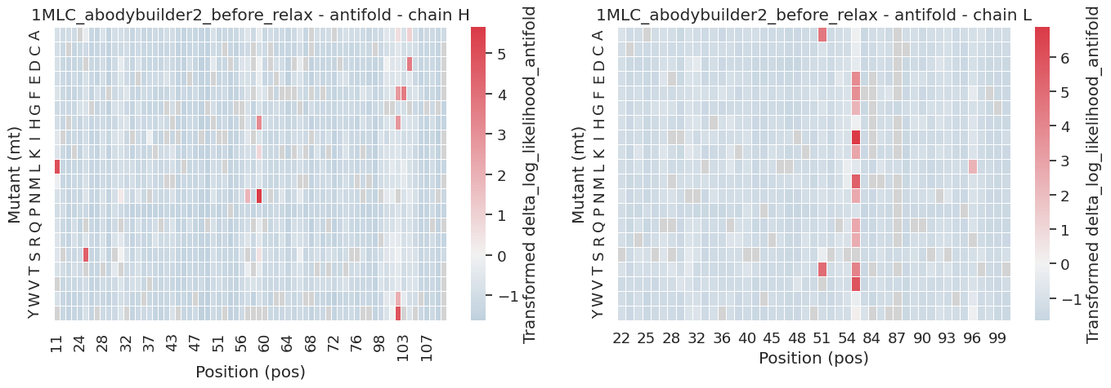
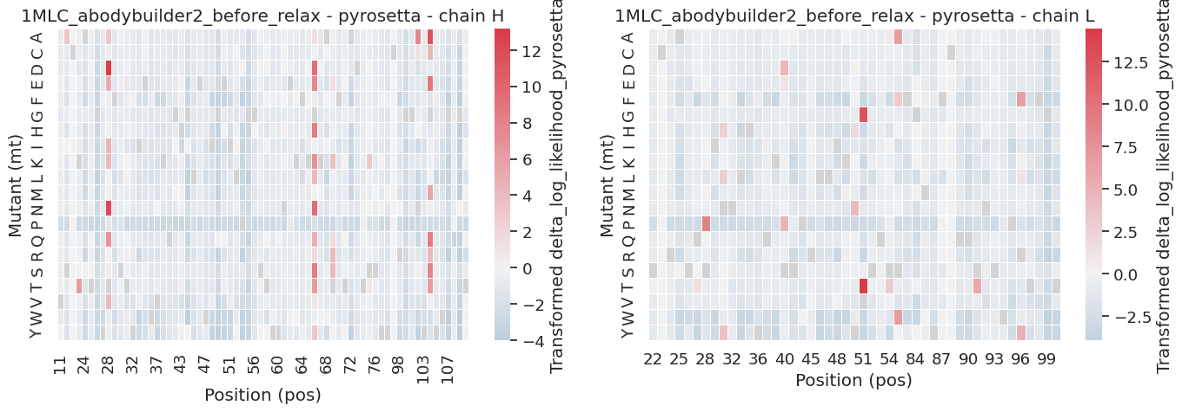
(A)
Abodybuilder2, before relax
34 Fv positions show enhanced binding upon mutation (Red).
Only a few mutations are predicted to be beneficial according to different models.
(B)

Slide 3

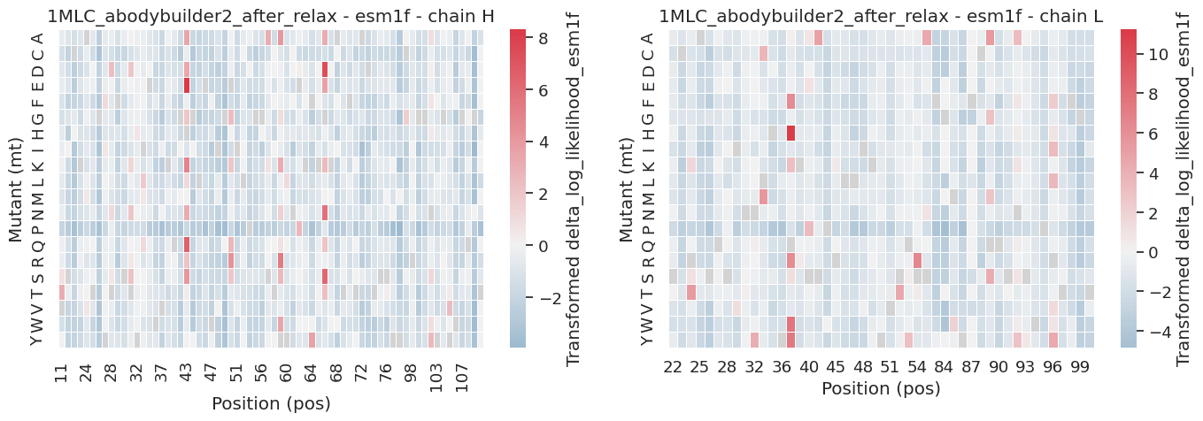
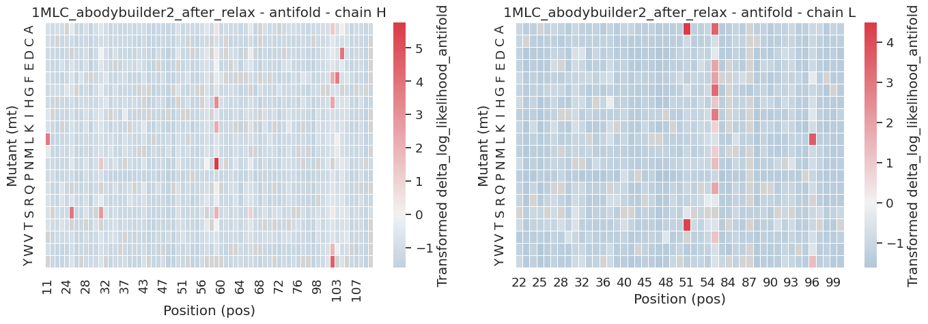
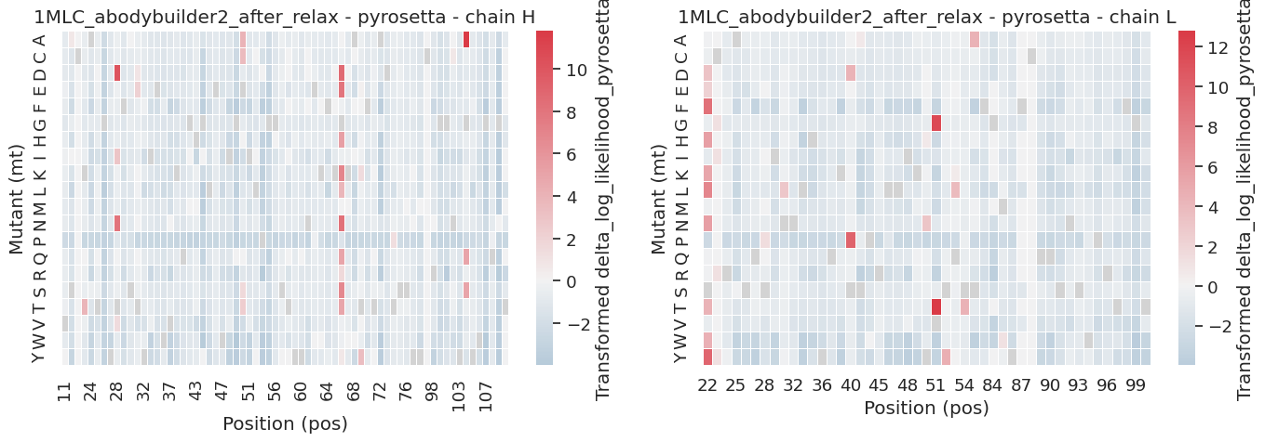
Abodybuilder2, after_relax
34 Fv positions show enhanced binding upon mutation (Red).
Only a few mutations are predicted to be beneficial according to different models.

Slide 4
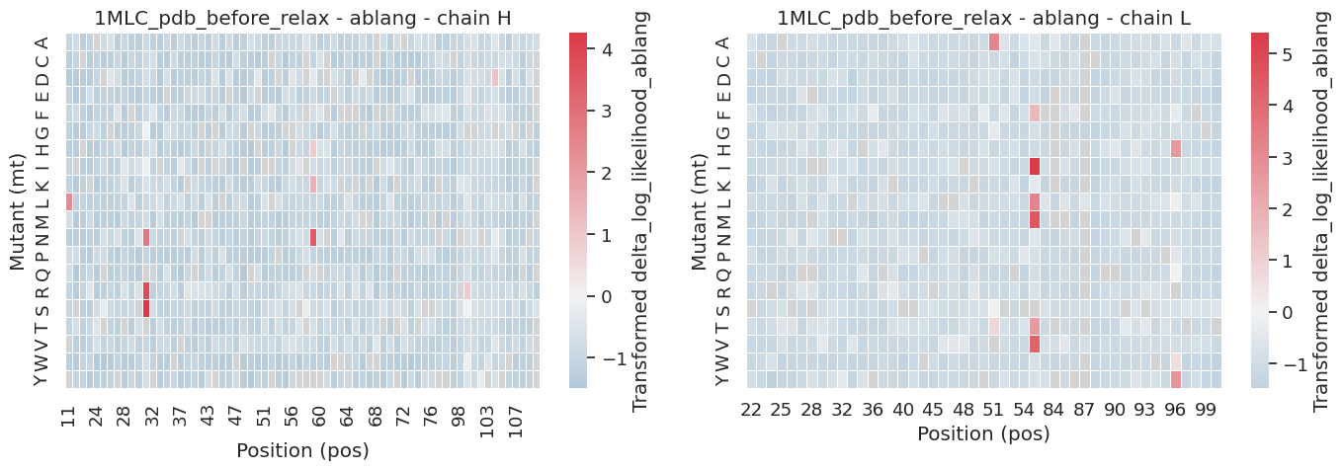
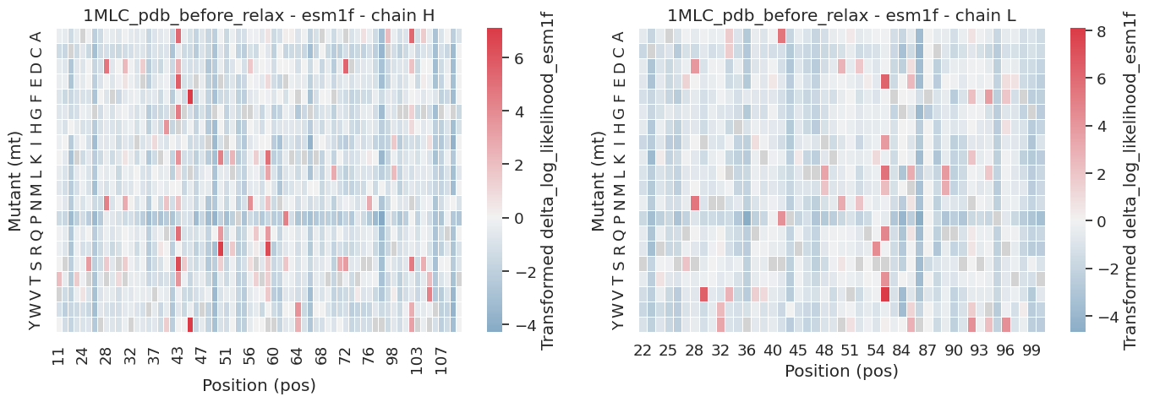
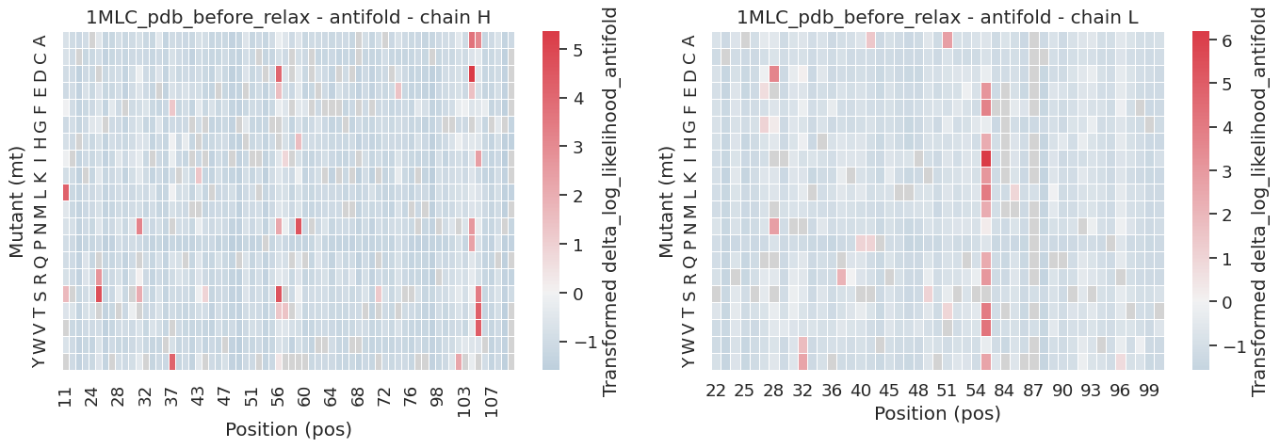
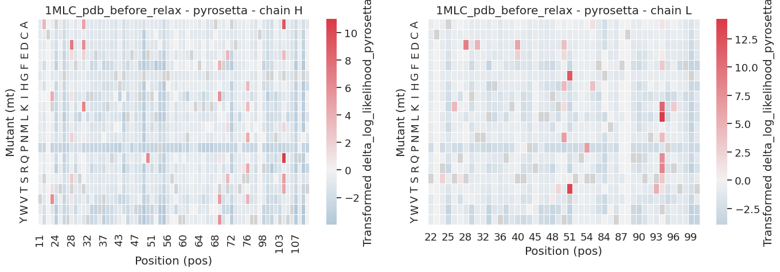
Pdb structure, remove bound antigen, before_relax
34 Fv positions show enhanced binding upon mutation (Red).
Only a few mutations are predicted to be beneficial according to different models.

Slide 5
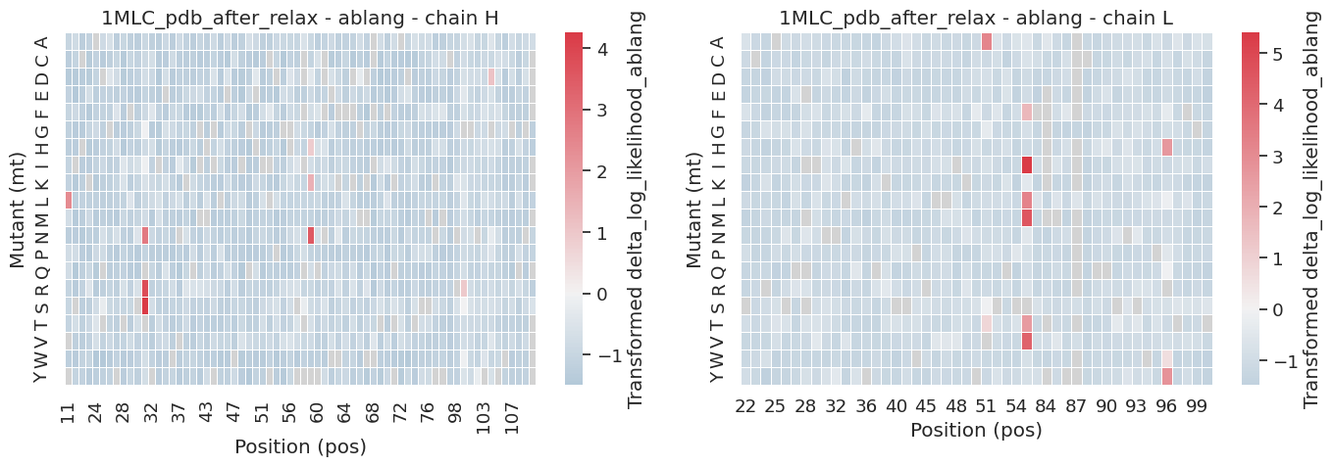
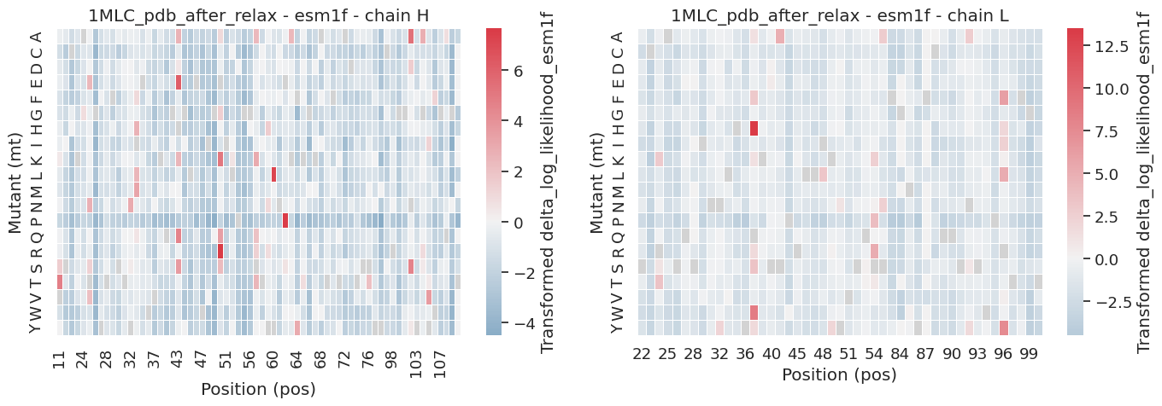
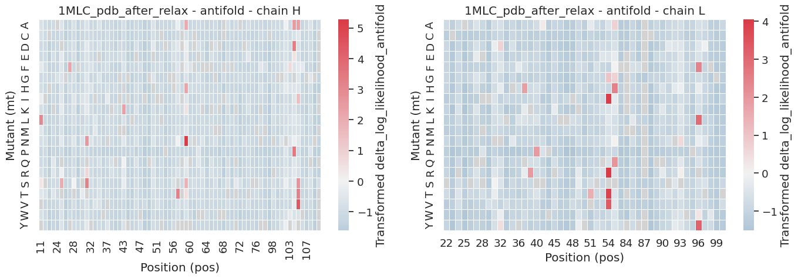
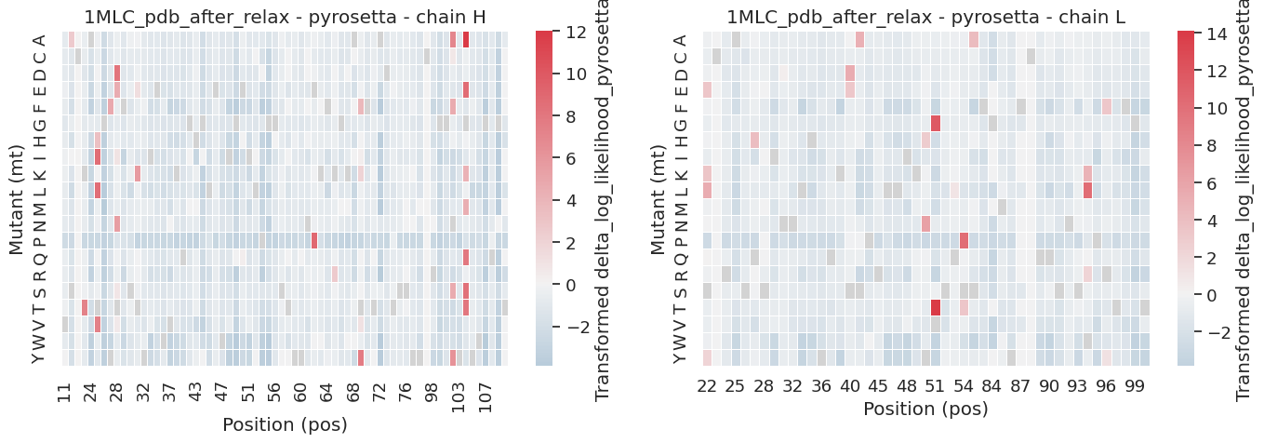
Pdb structure, remove bound antigen, after_relax
34 Fv positions show enhanced binding upon mutation (Red).
Only a few mutations are predicted to be beneficial according to different models.

