Slide 1
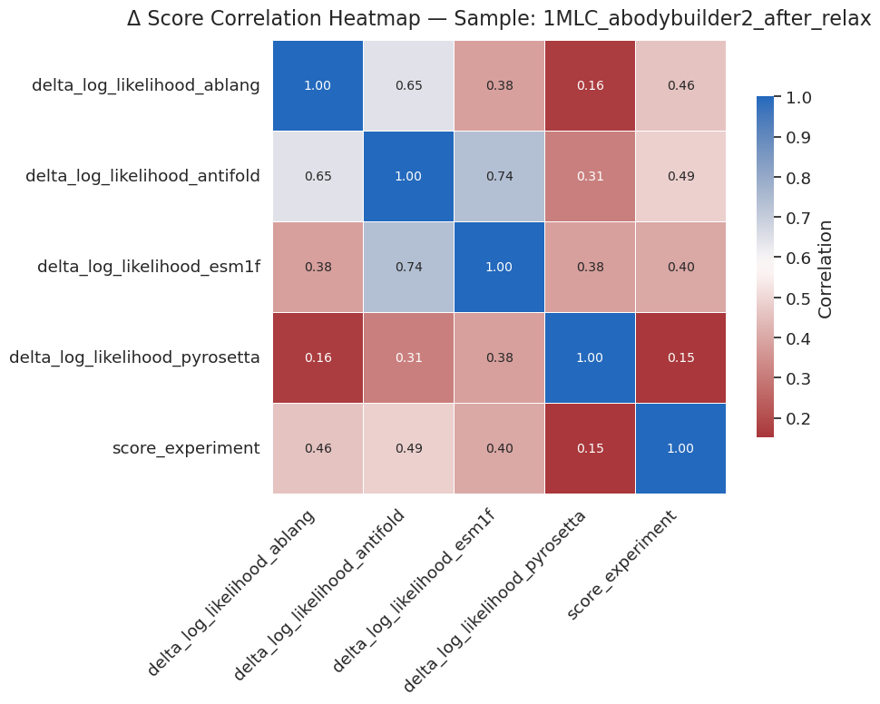
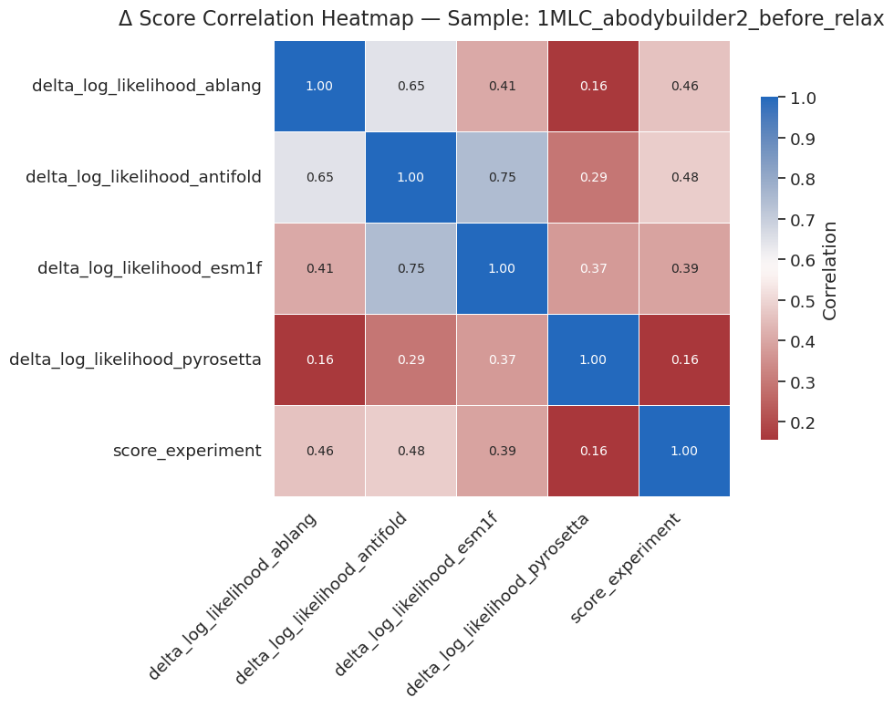
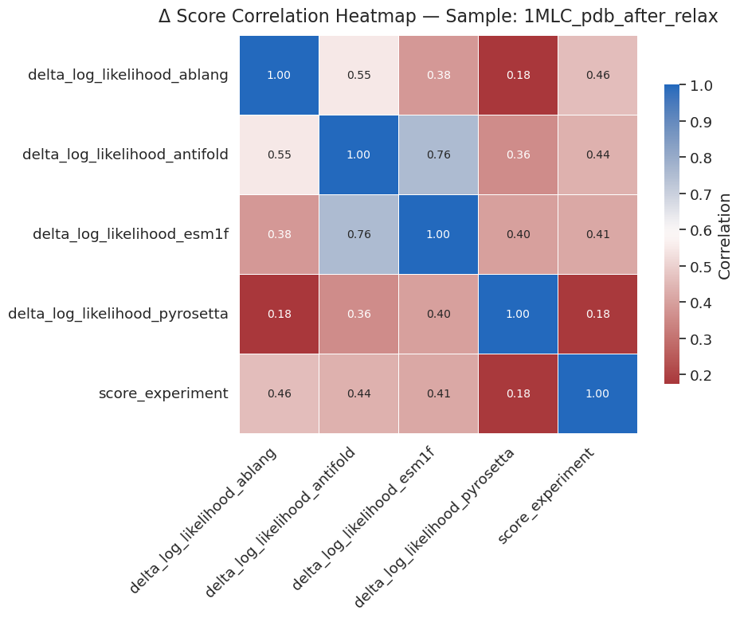
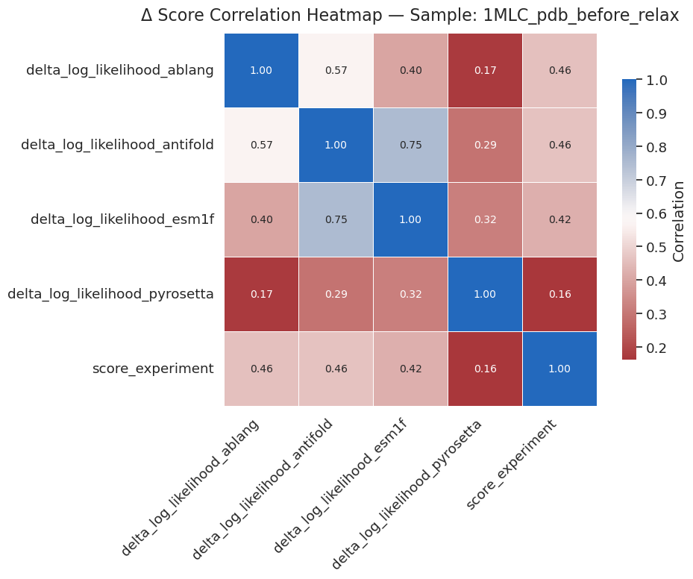
Correlation between delta log likelihood of model vs negative log-enrichment of the deep mutational scanning data (score_experiment).
Esm1f and antifold correlates well;
Pyrosetta doesn’t correlate much with any other models showing here, and experimental data.
Structure from Abodybuilder2 or pdb (1MLC, antibody-antigen complex -> remove antigen), before and after pyrosetta relax (recycle=5, Cartesian relax on side chain only), doesn’t show much difference in correlation.

Slide 2
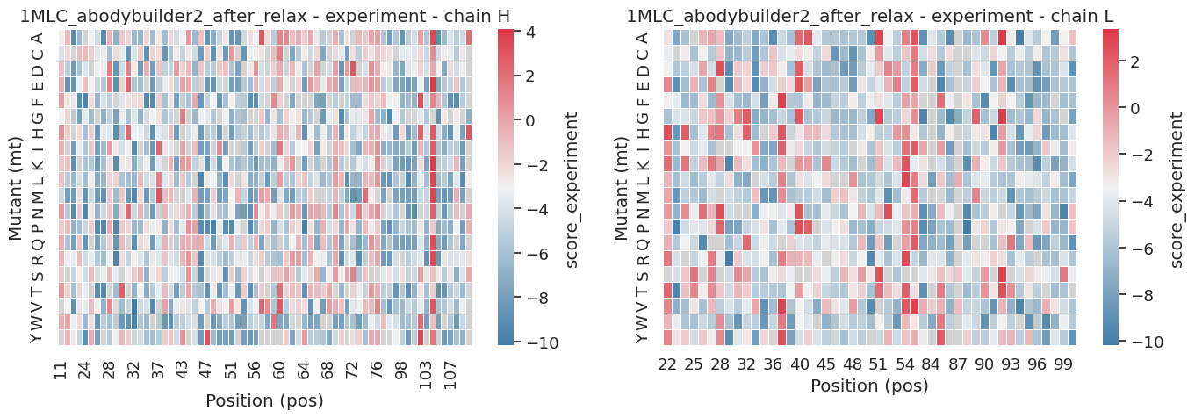
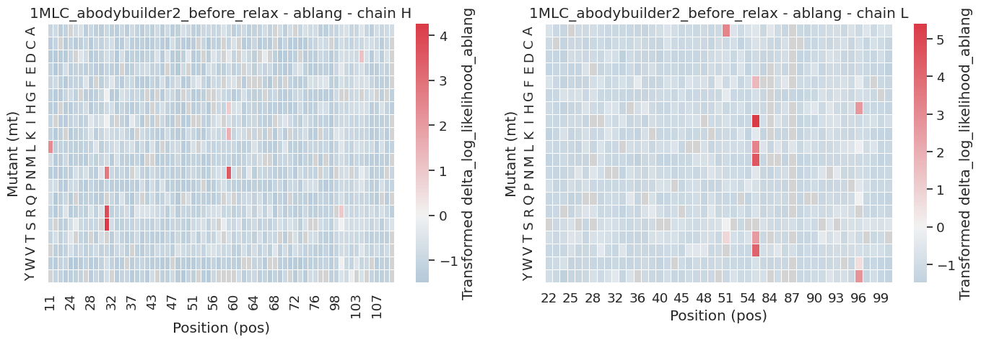
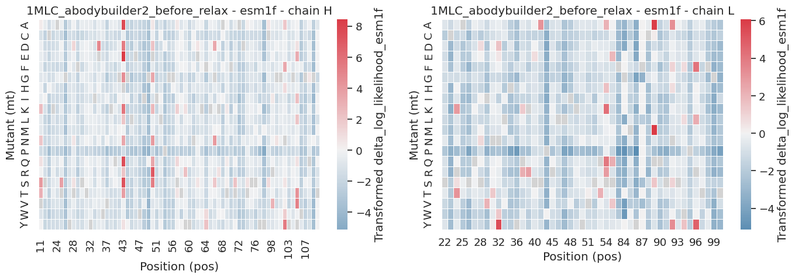
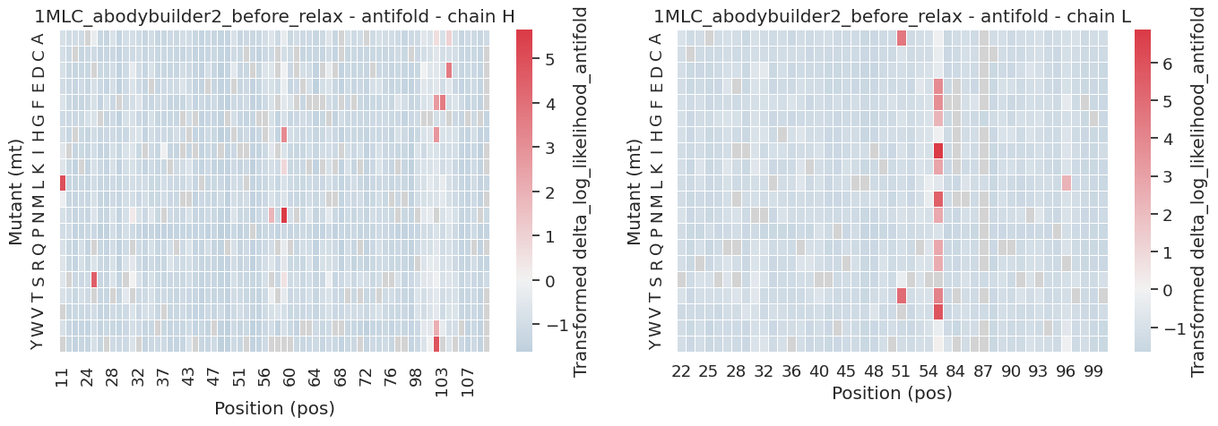
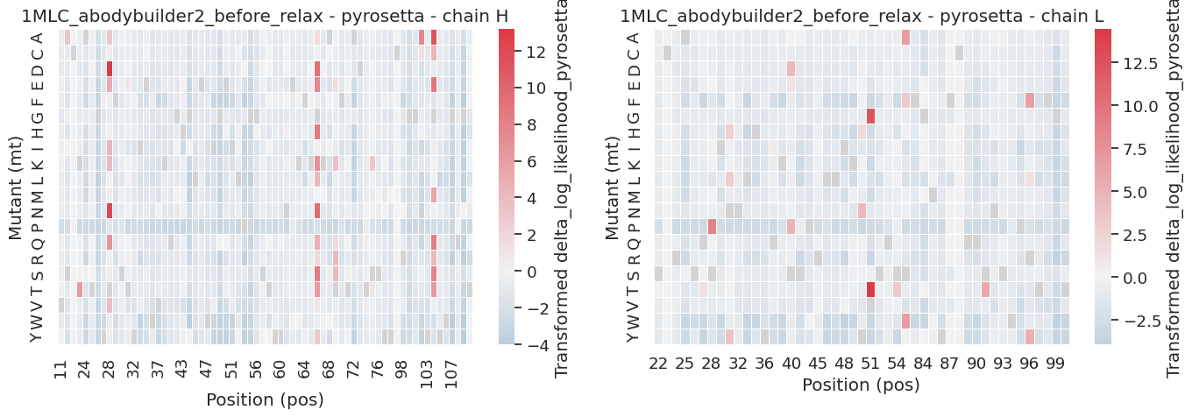
(A)
Abodybuilder2, before relax
34 Fv positions show enhanced binding upon mutation (Red).
Only a few mutations are predicted to be beneficial according to different models.
(B)

Slide 3

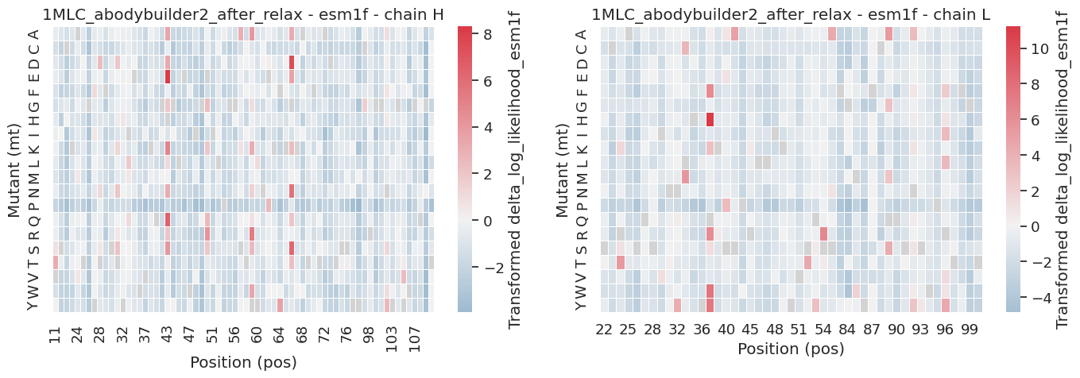
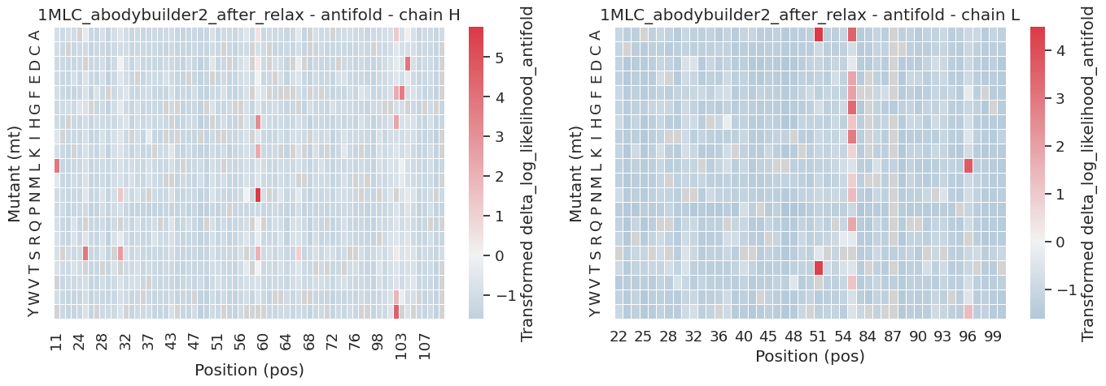
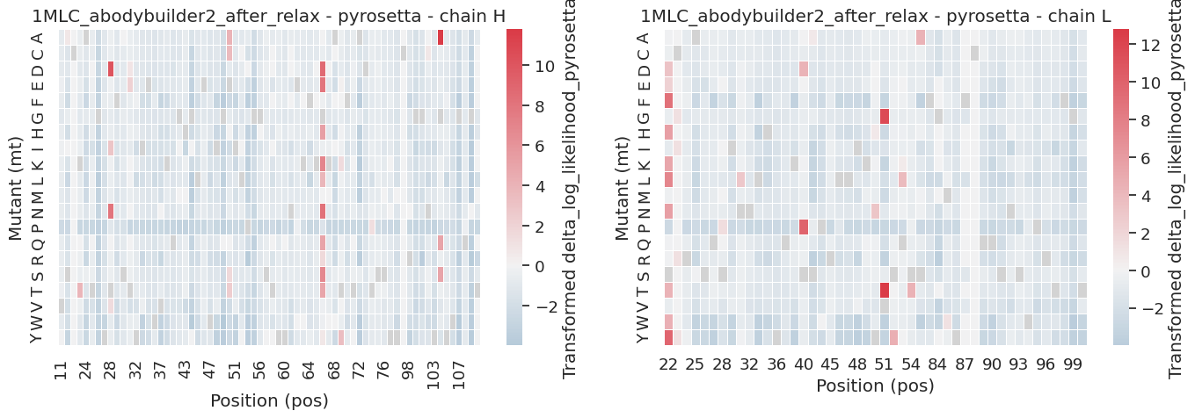
Abodybuilder2, after_relax
34 Fv positions show enhanced binding upon mutation (Red).
Only a few mutations are predicted to be beneficial according to different models.

Slide 4
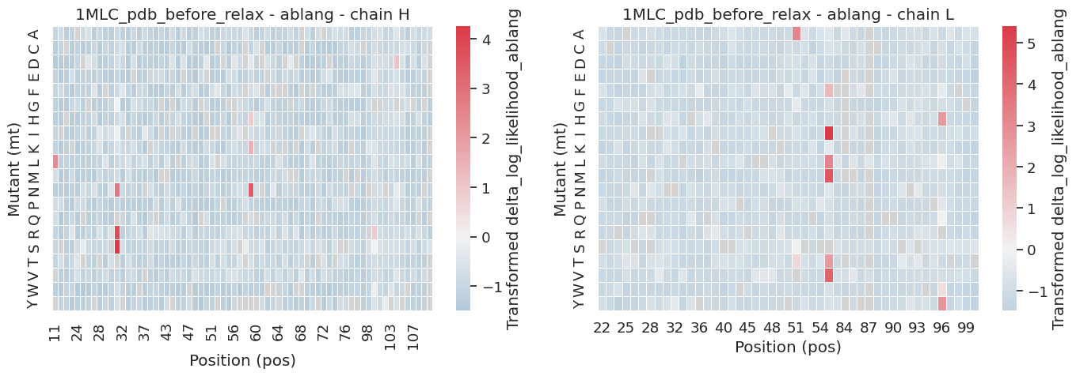
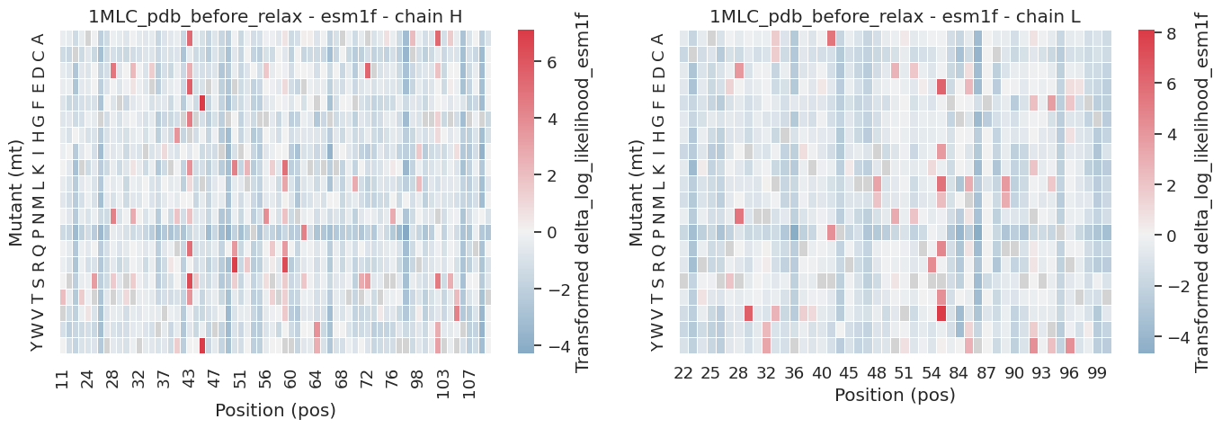
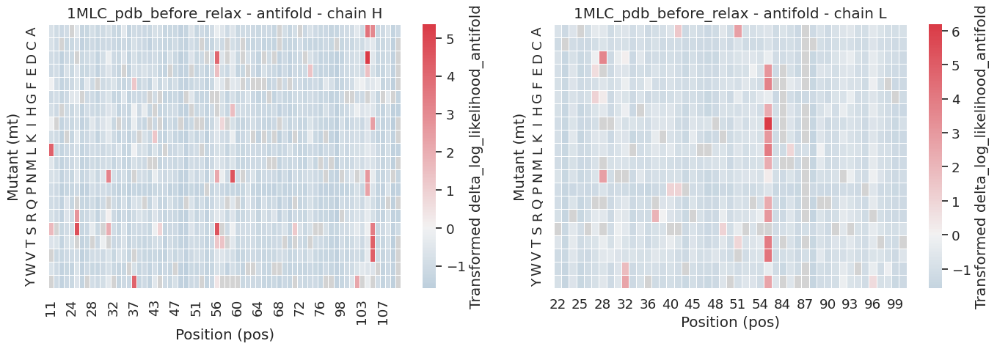
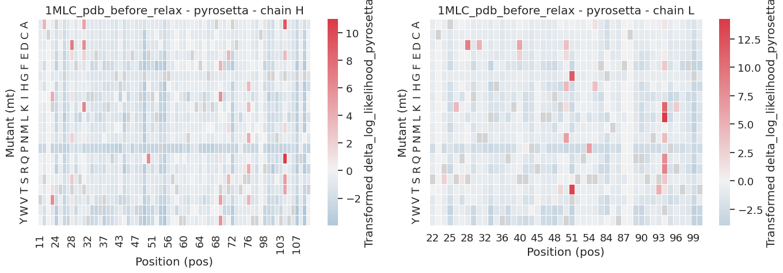
Pdb structure, remove bound antigen, before_relax
34 Fv positions show enhanced binding upon mutation (Red).
Only a few mutations are predicted to be beneficial according to different models.

Slide 5
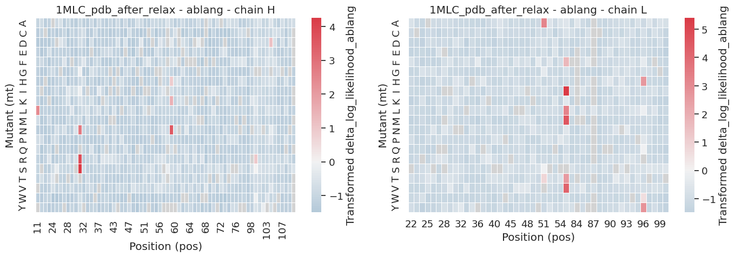
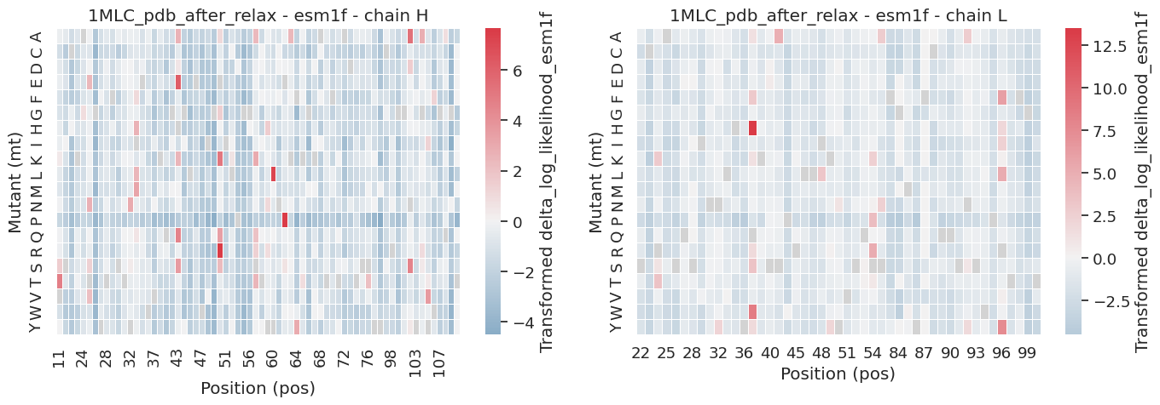
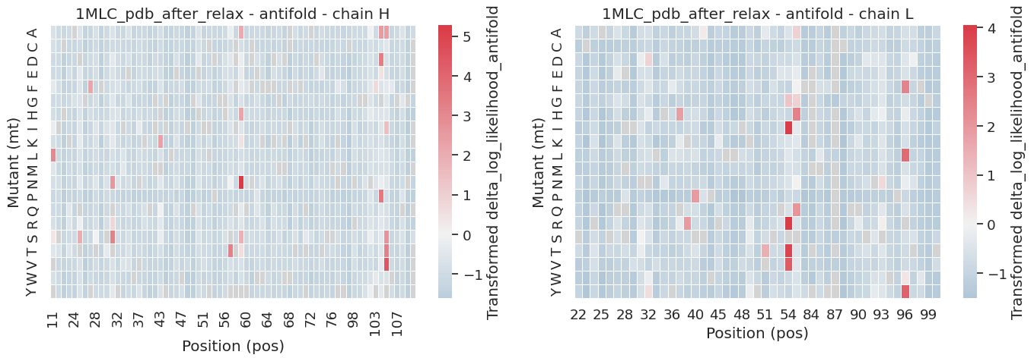
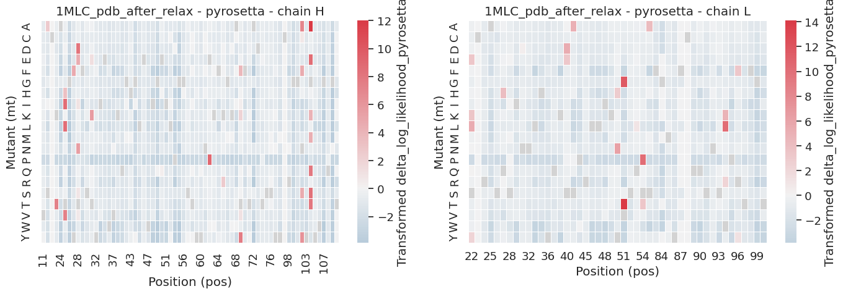
Pdb structure, remove bound antigen, after_relax
34 Fv positions show enhanced binding upon mutation (Red).
Only a few mutations are predicted to be beneficial according to different models.

Slide 6
Instead of using z-score, I used signed log to transform the delta log likelihood data to preserve the original sign (using z-score will loss it). To make the positive value more visualizable, different weights were applied for different model plots.
For ablang2 and antifold:
val = np.sign(x) * np.log1p(np.abs(x))
return val * 3 if x > 0 else val * 0.5
For esm1f:
val = np.sign(x) * np.log1p(np.abs(x))
Return val * 450 if x > 0 else val * 50
For pyrosetta:
val = np.sign(x) * np.log1p(np.abs(x))
Return val * 8 if x > 0 else val * 0.5

Slide 7
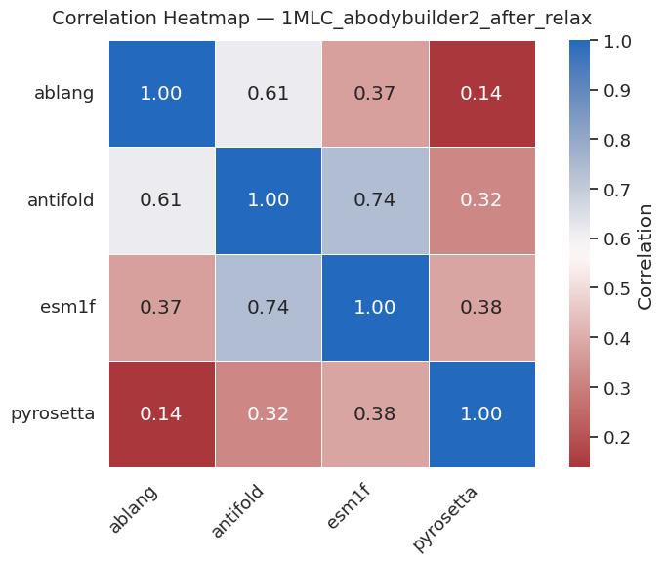
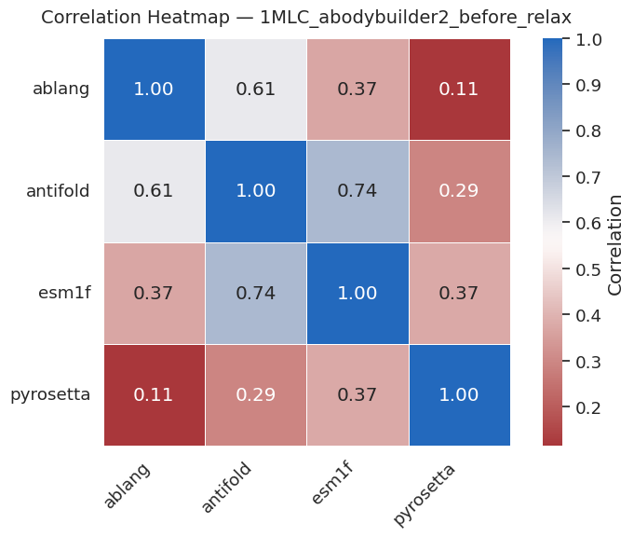
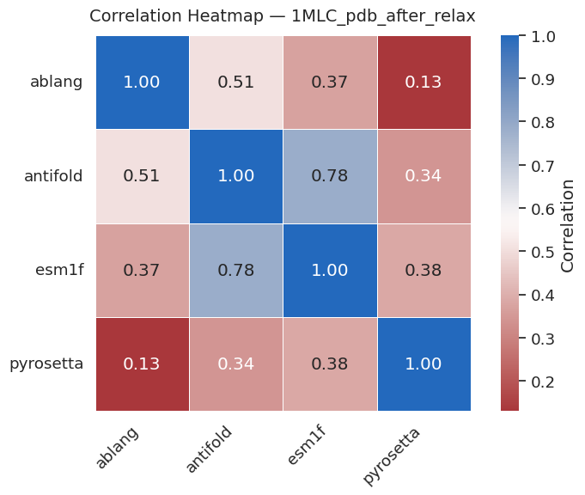
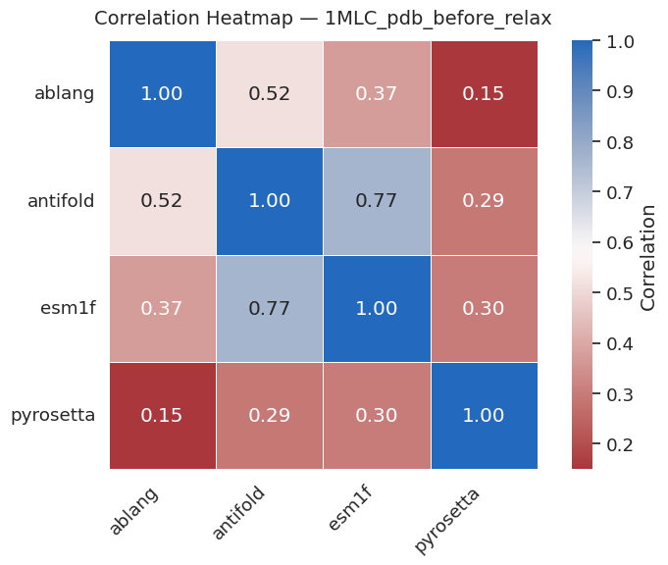

Slide 8
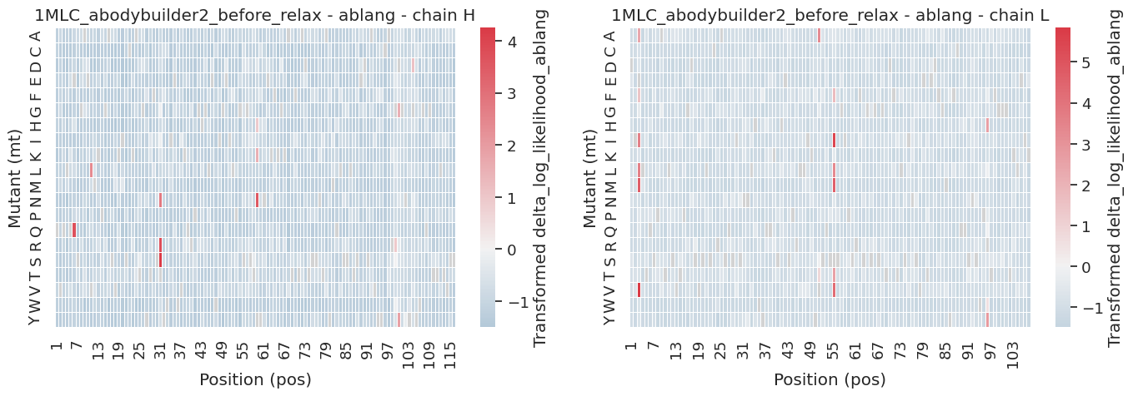

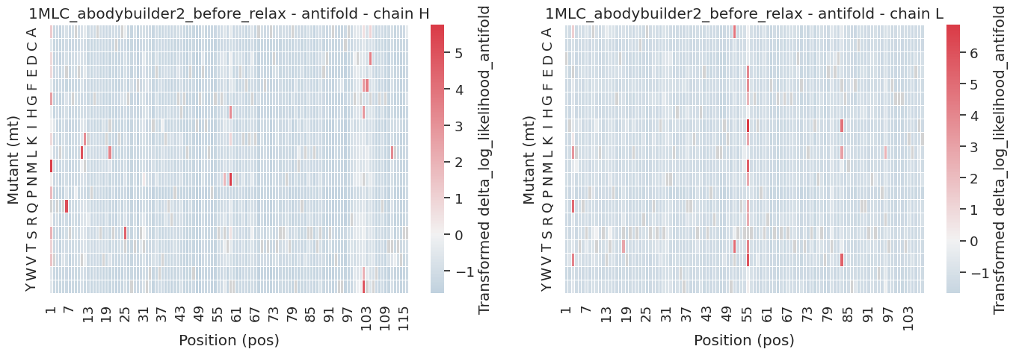
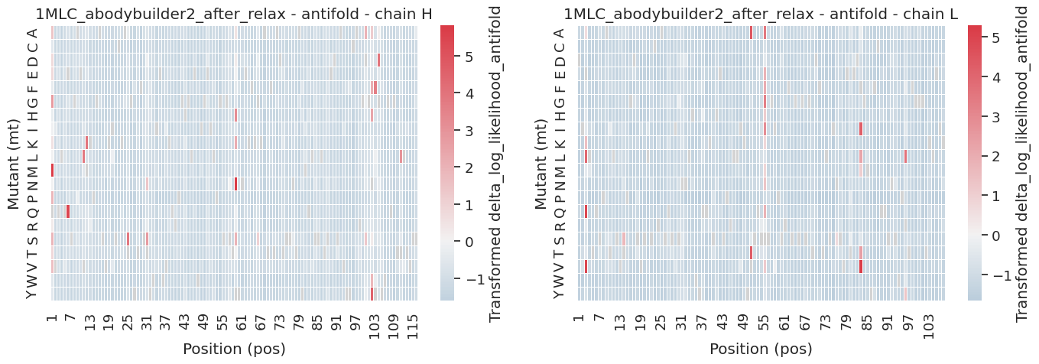
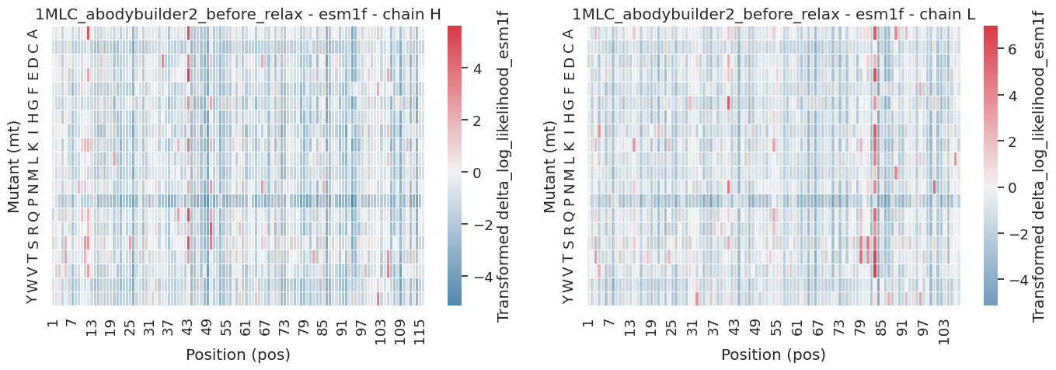
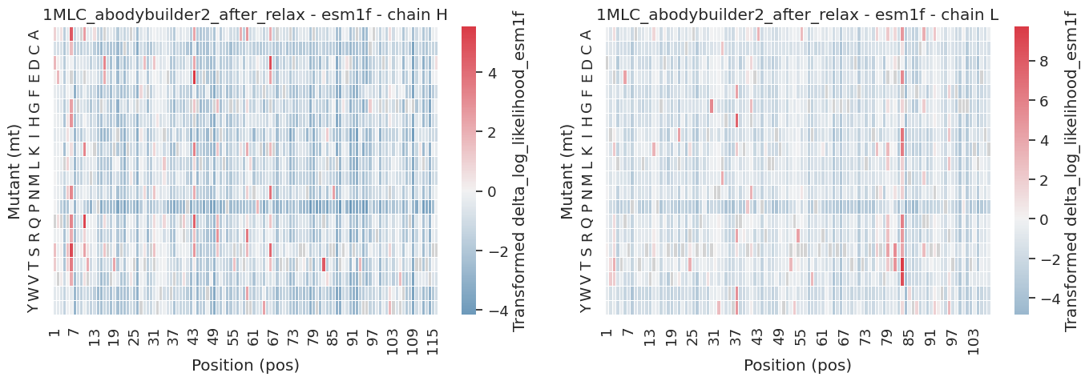
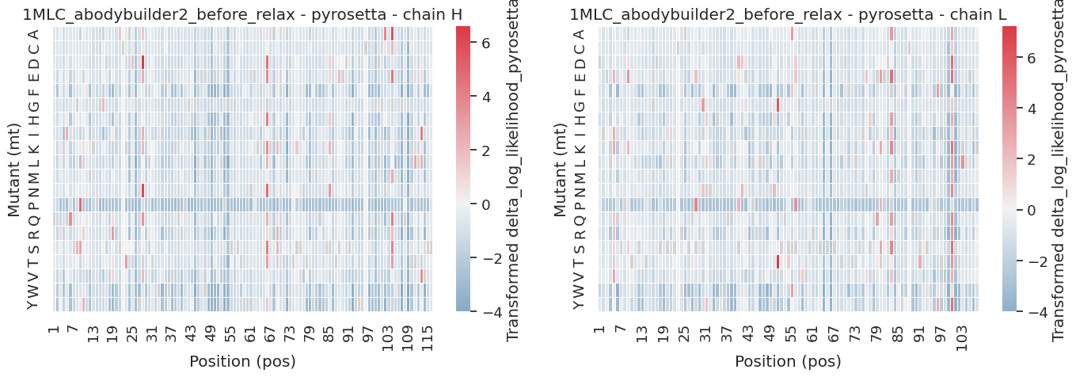
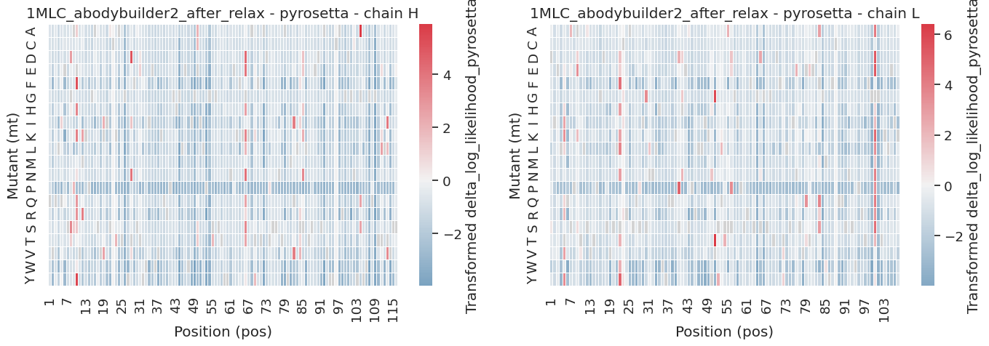

Slide 9
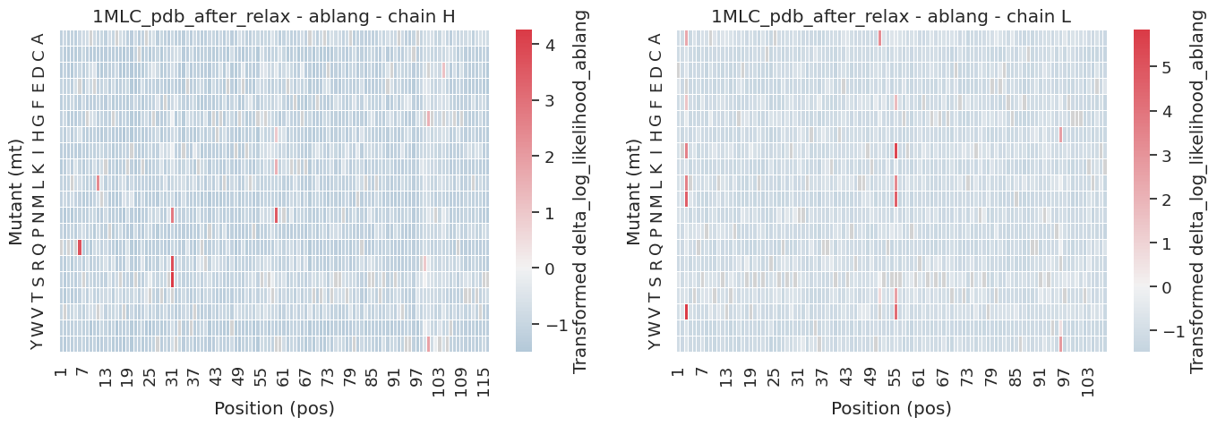
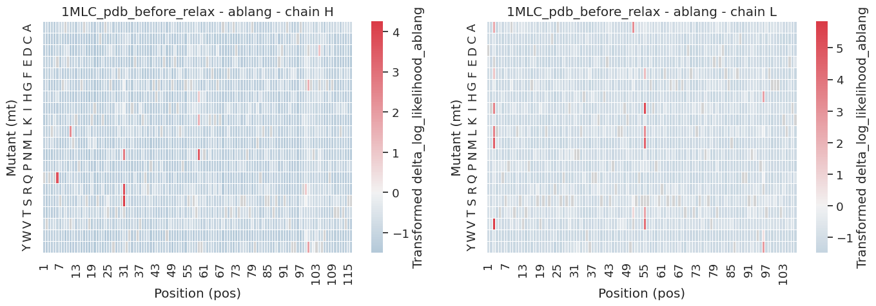
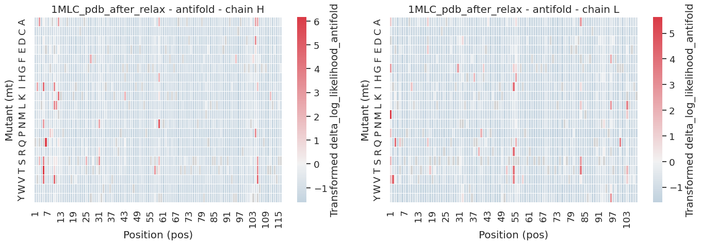
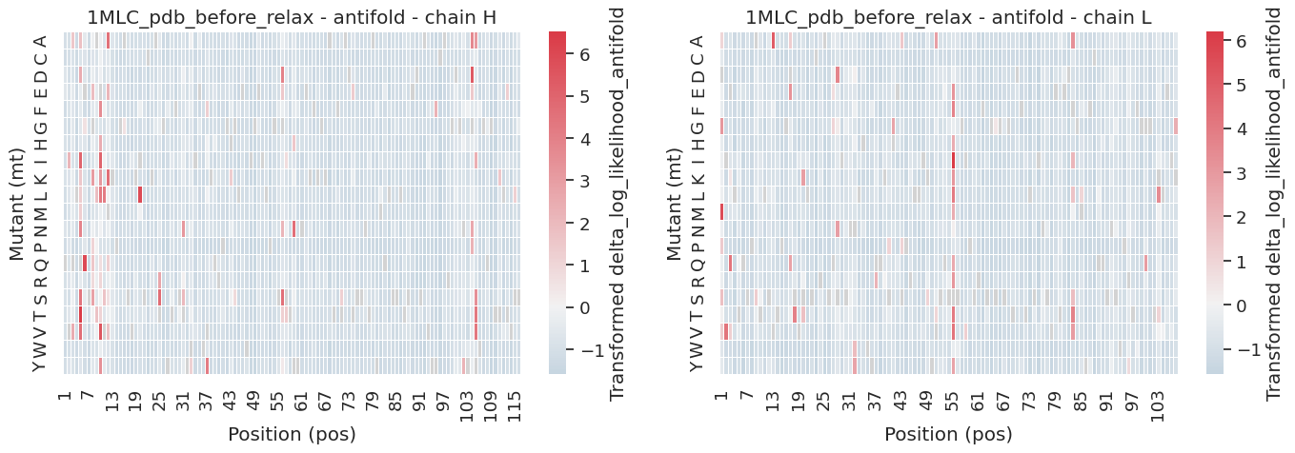
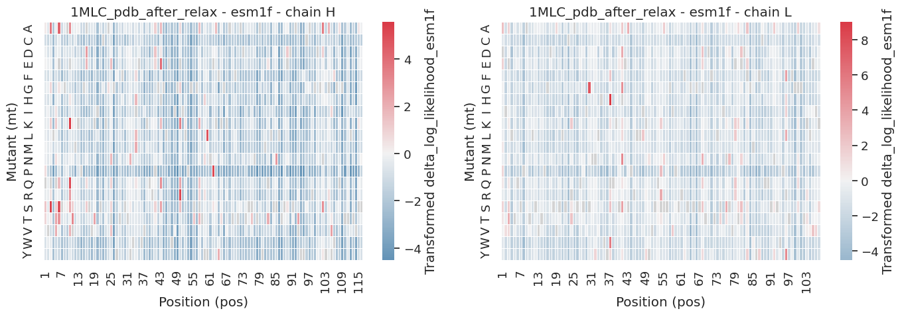
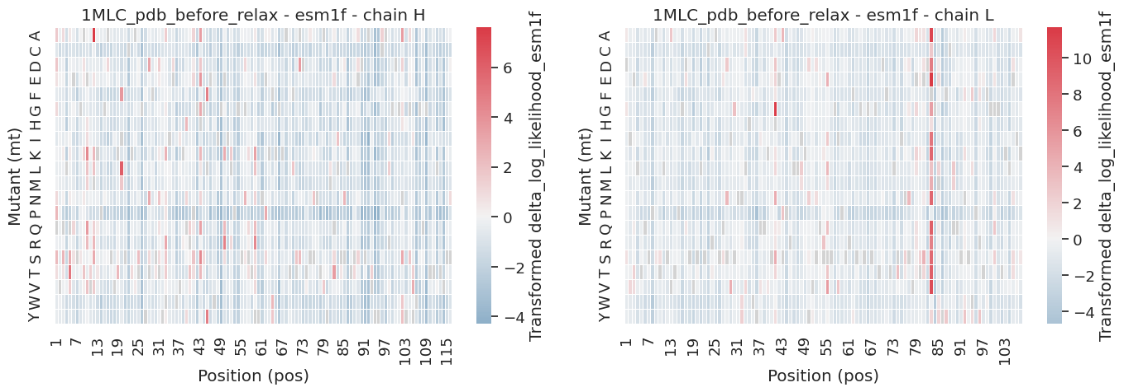
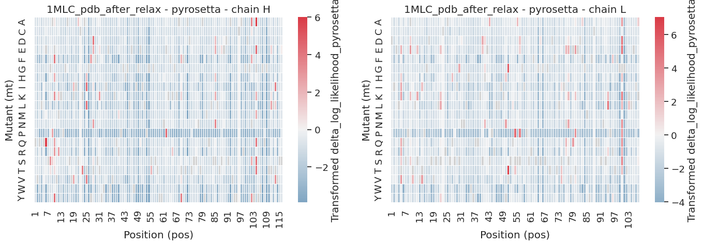
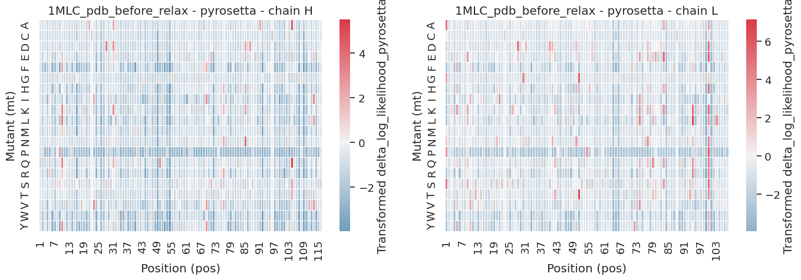

Slide 10
