Slide 1
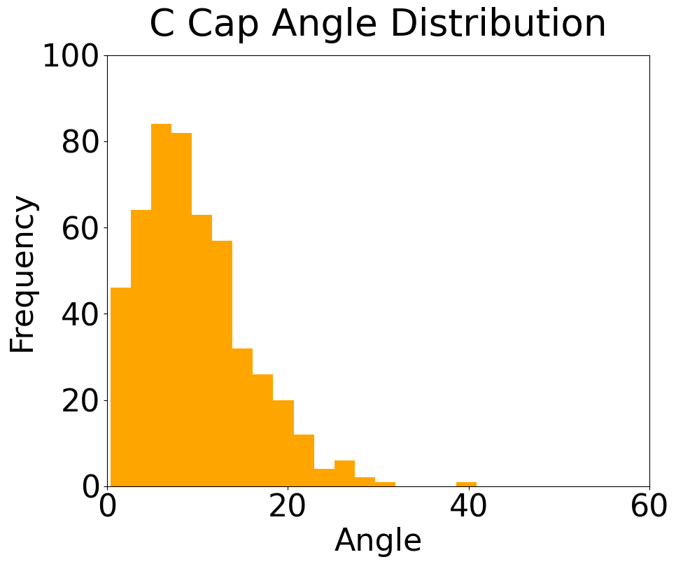
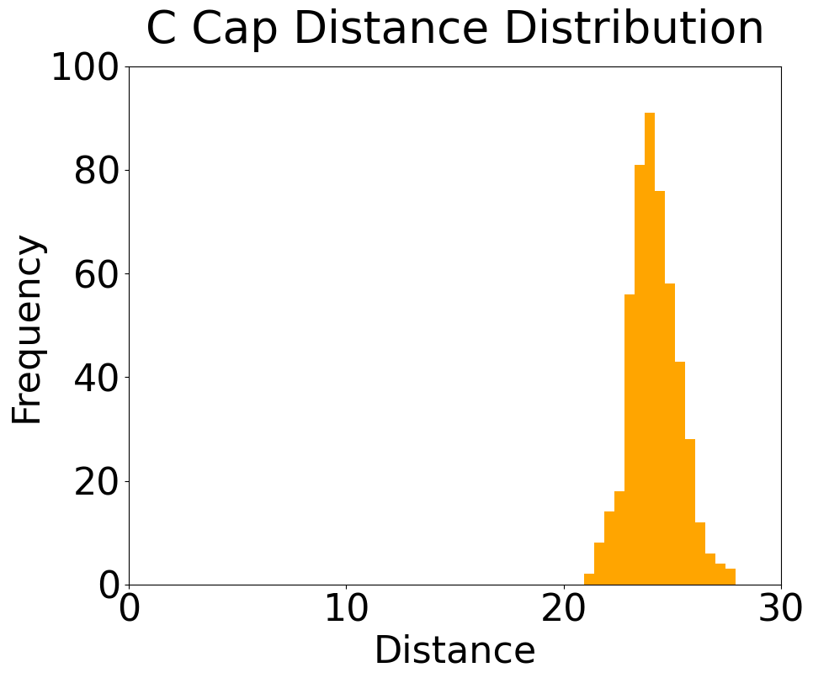
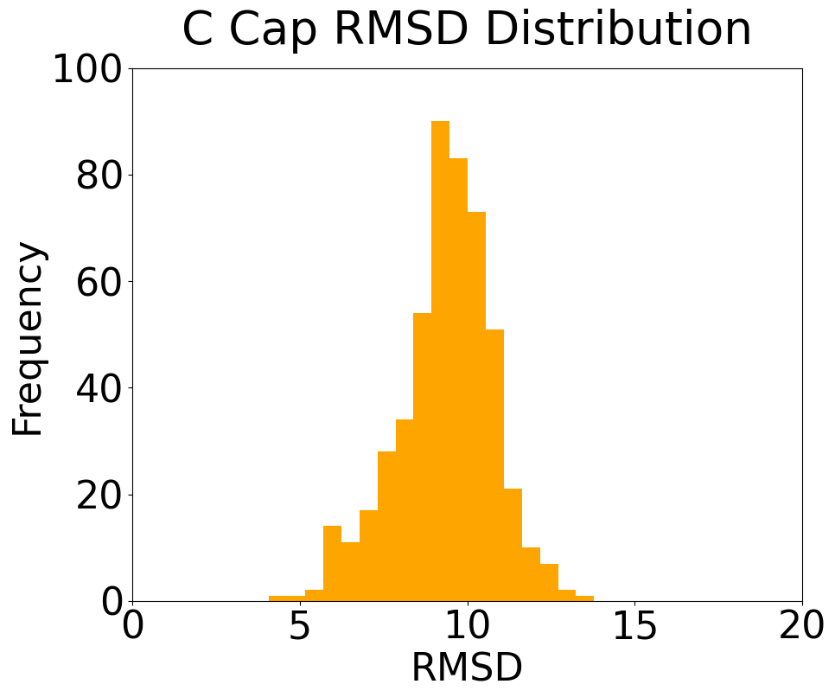
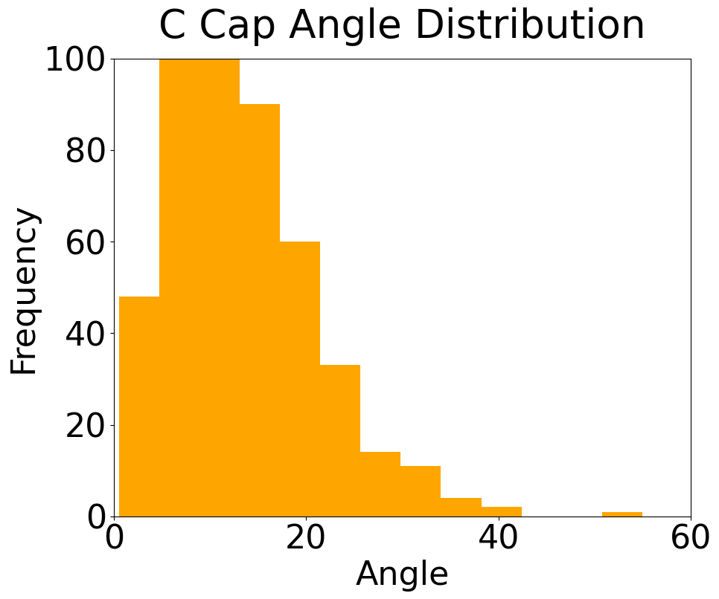
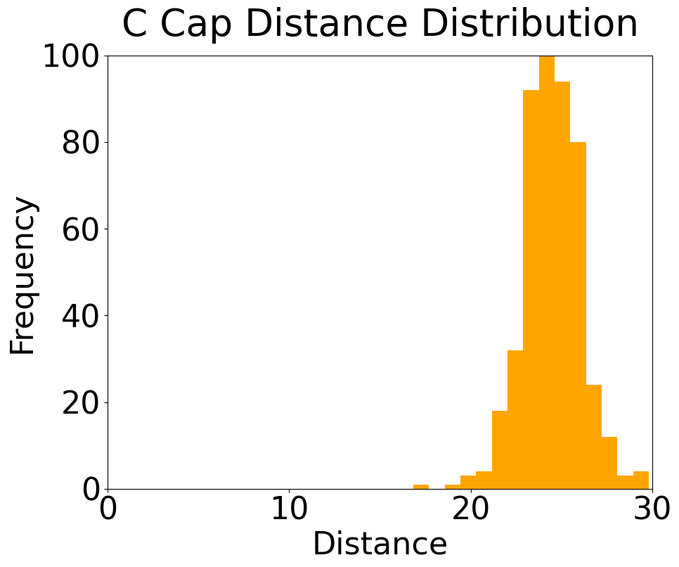
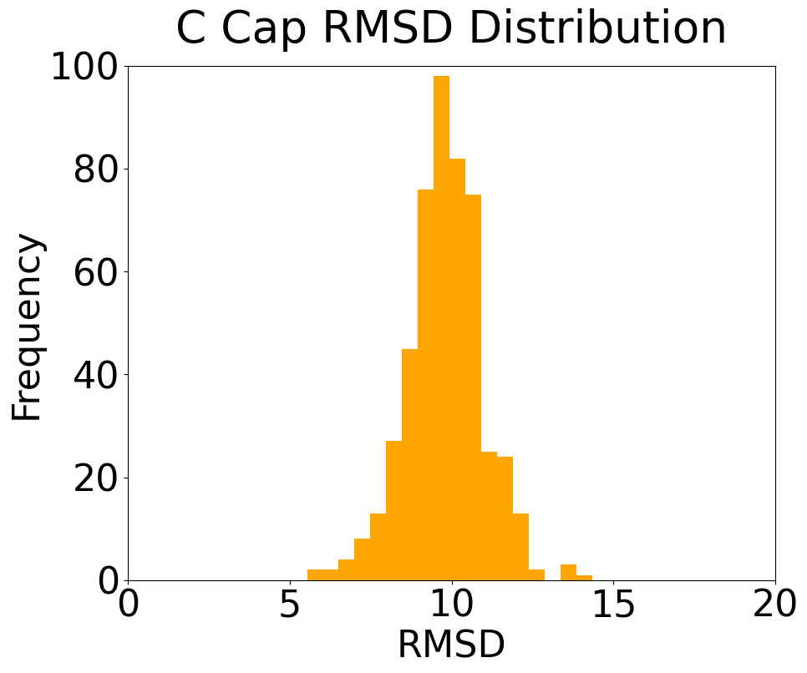
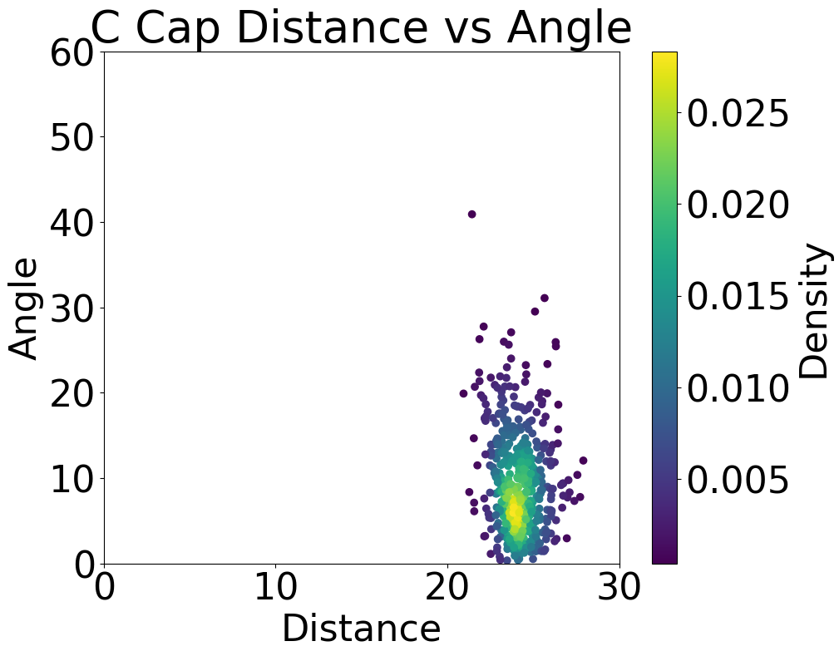
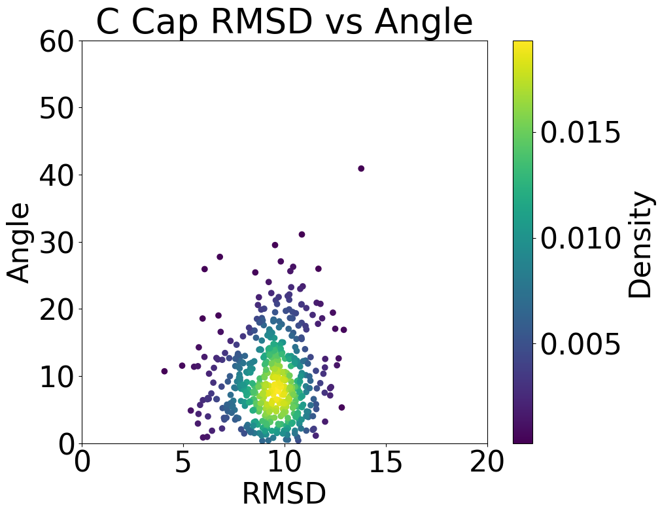
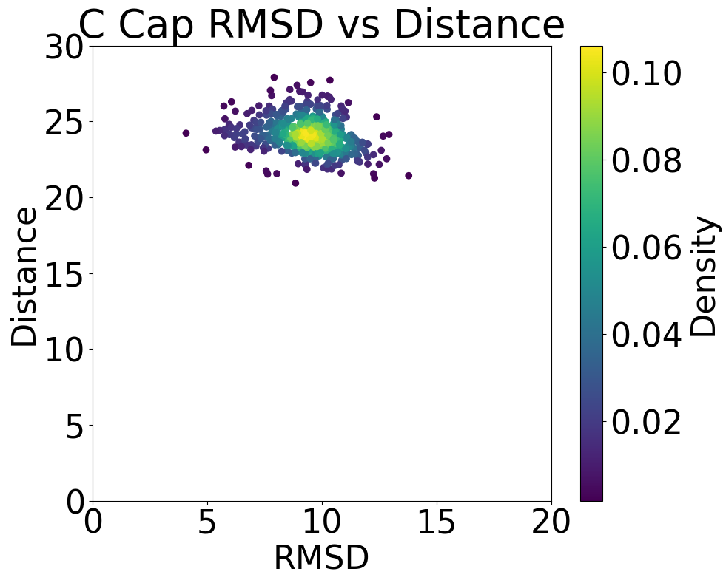
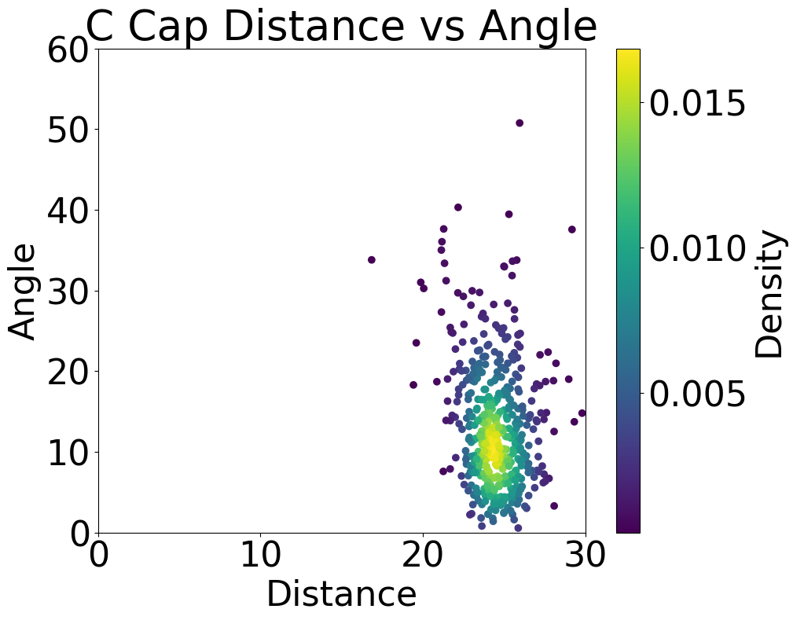
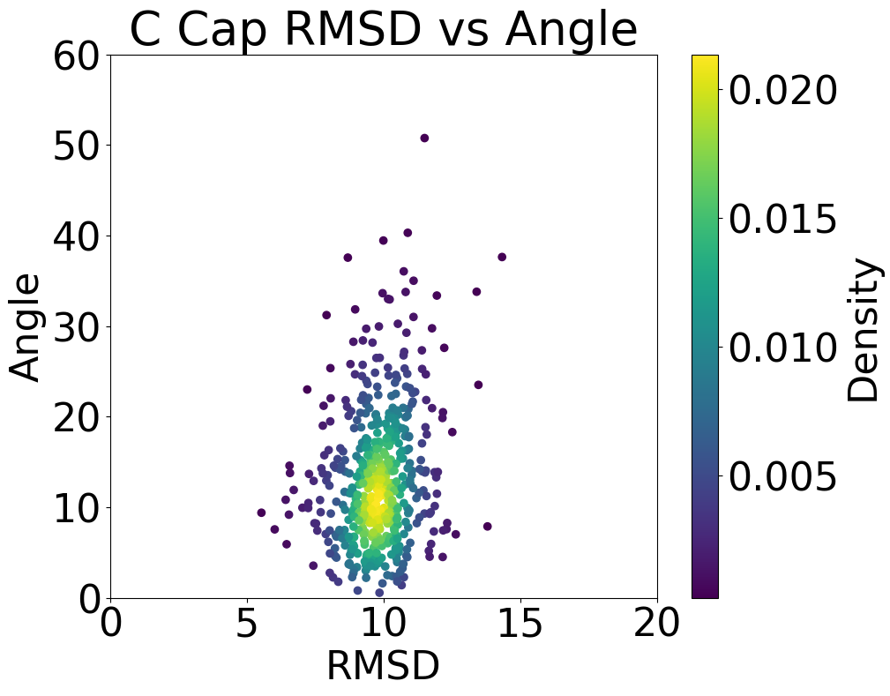
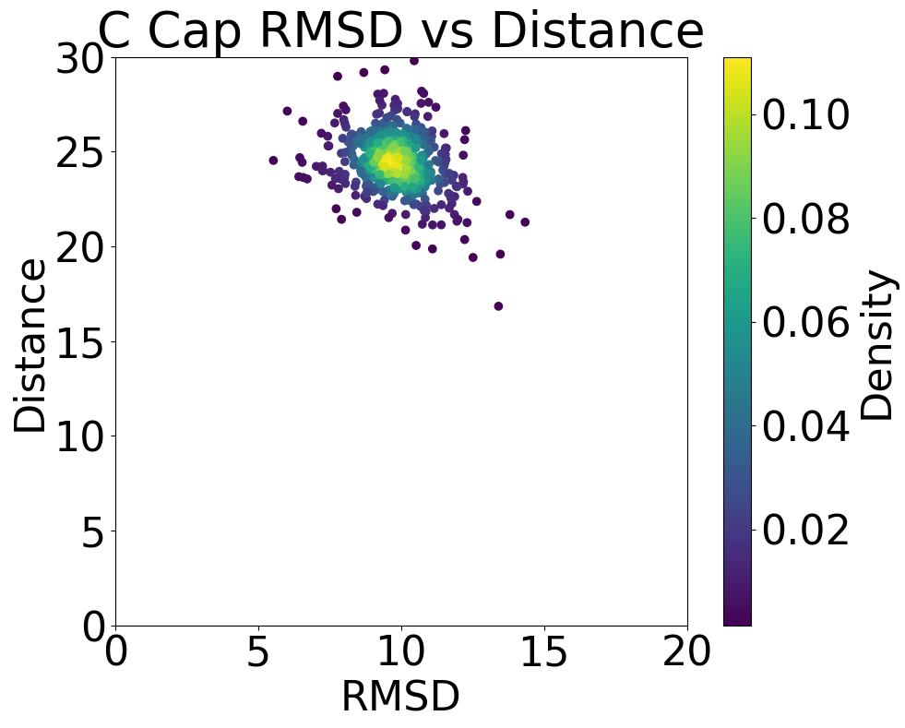
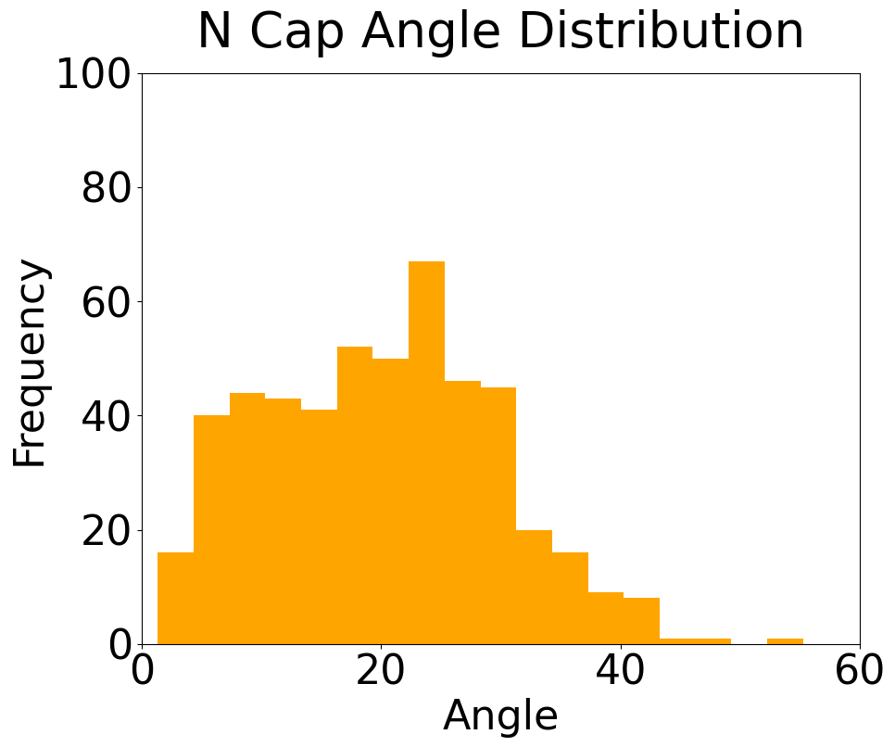
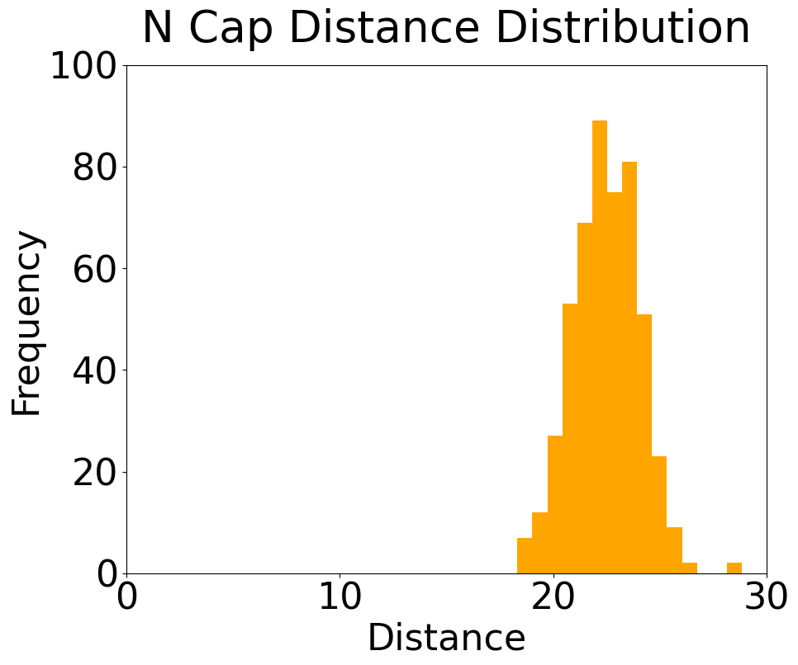
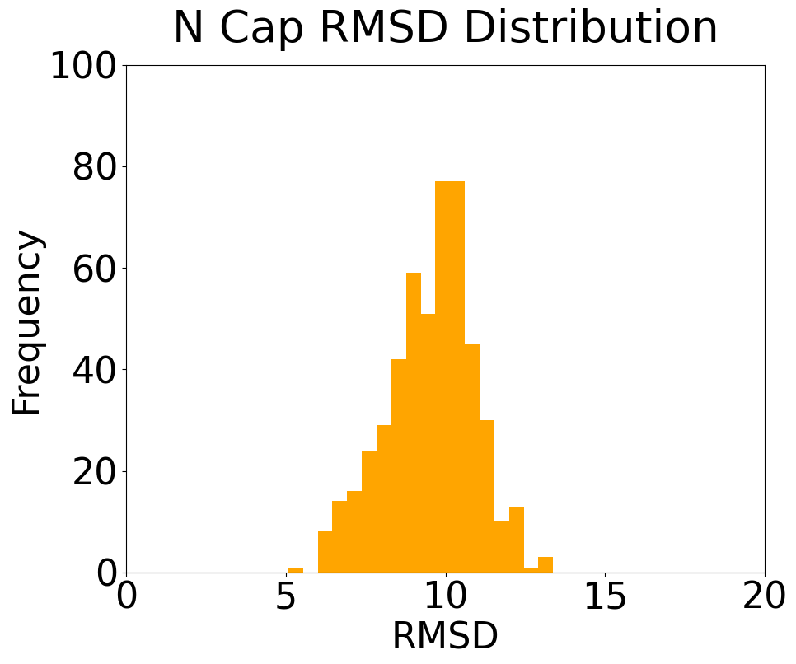
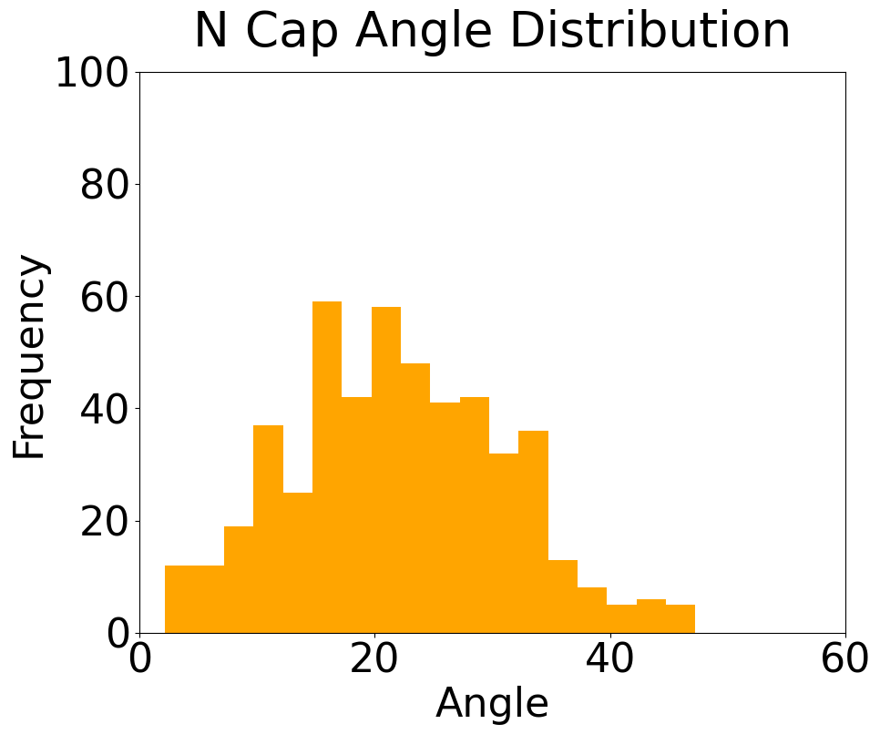
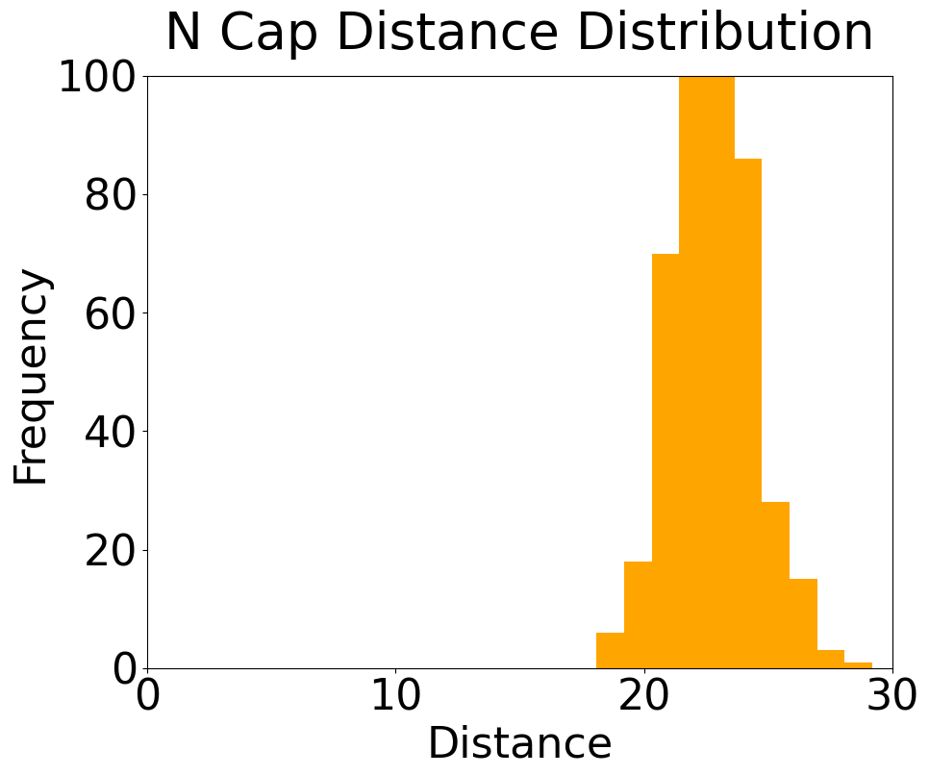
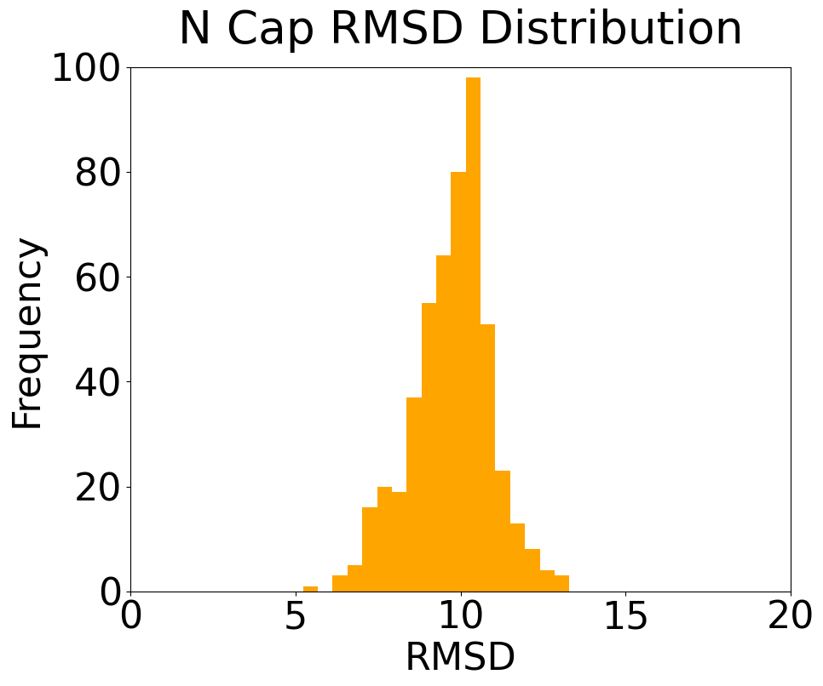
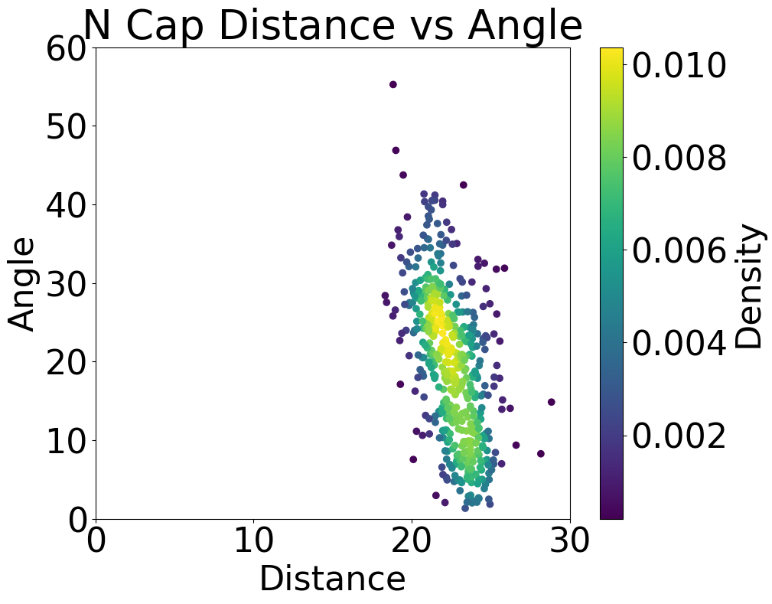
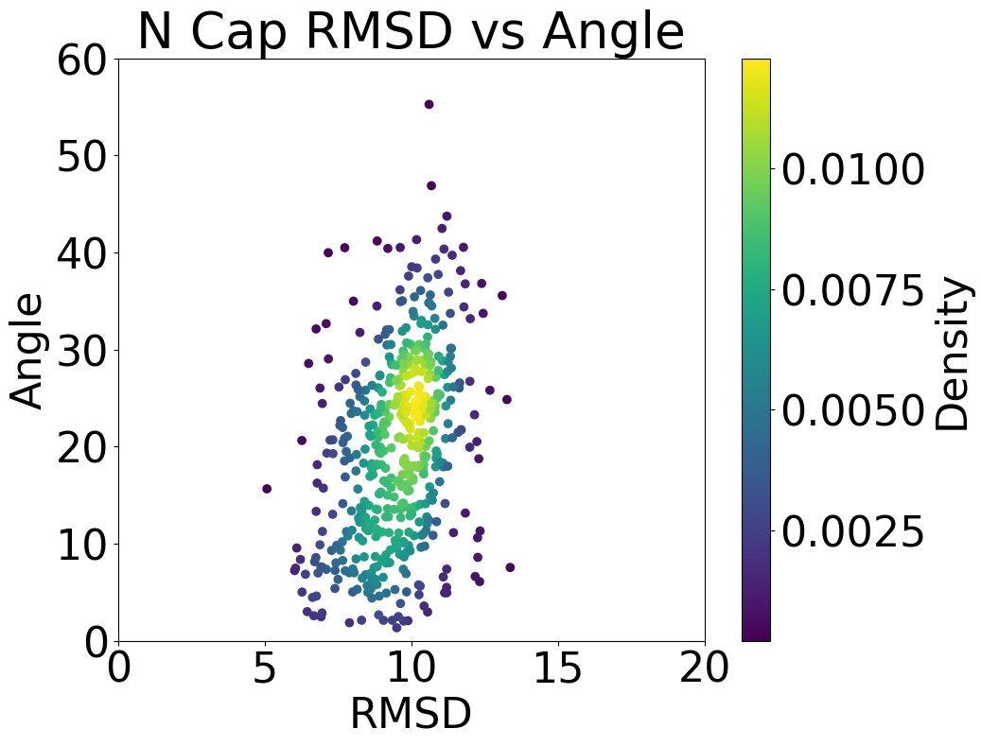
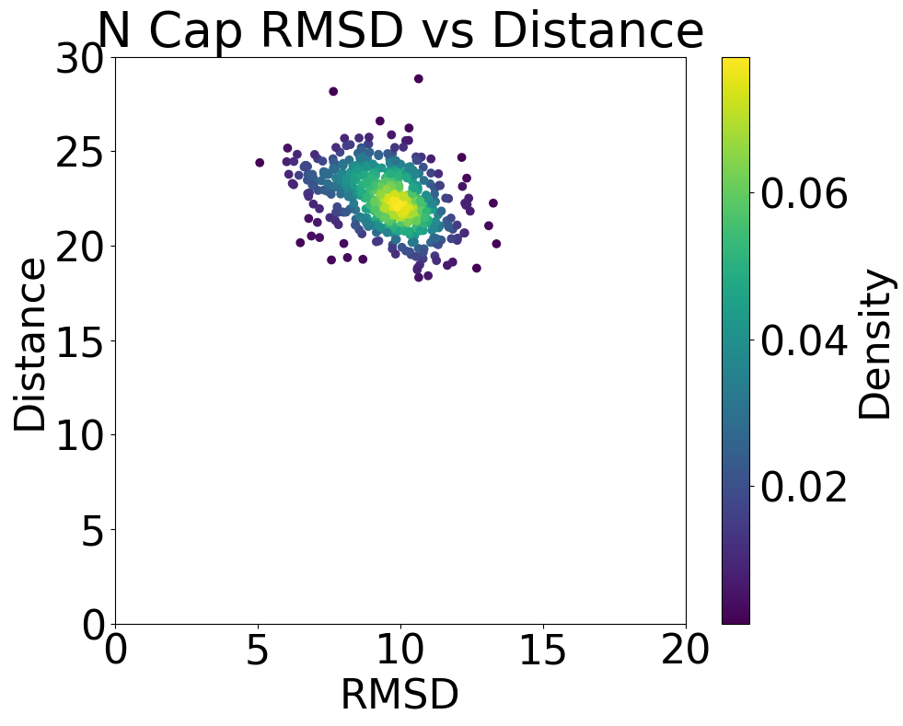
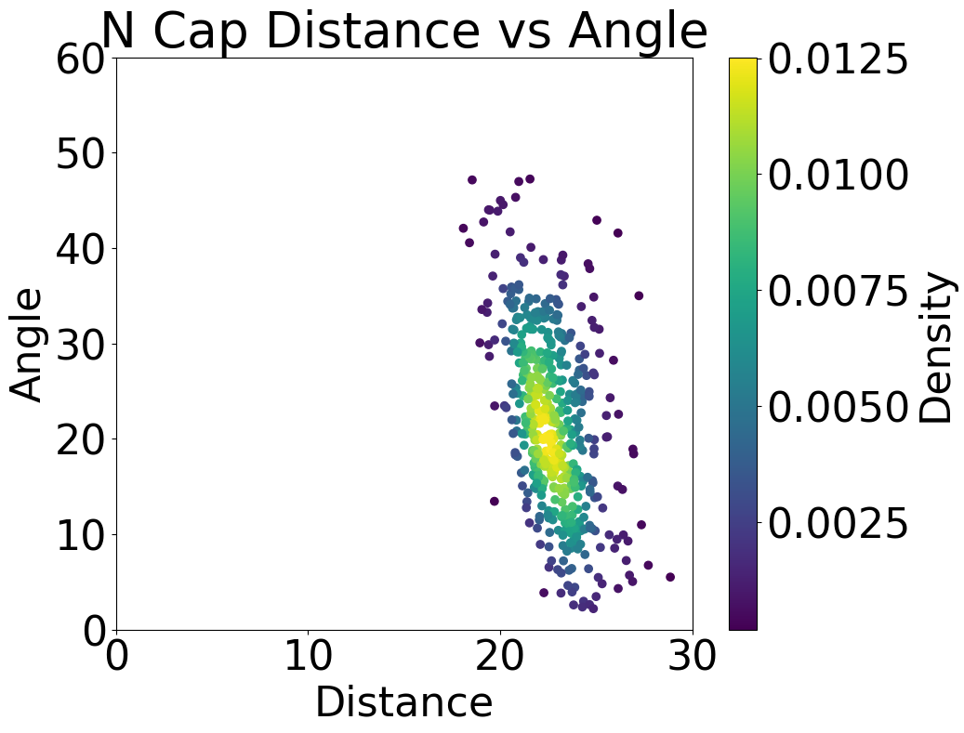
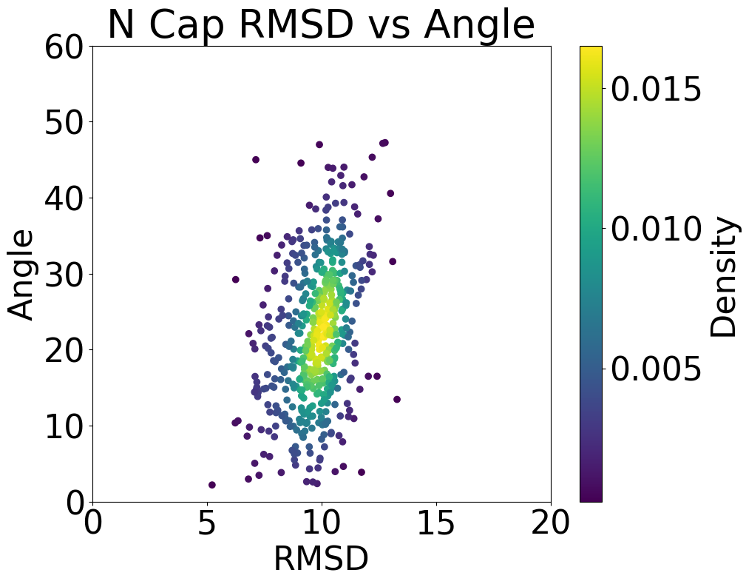
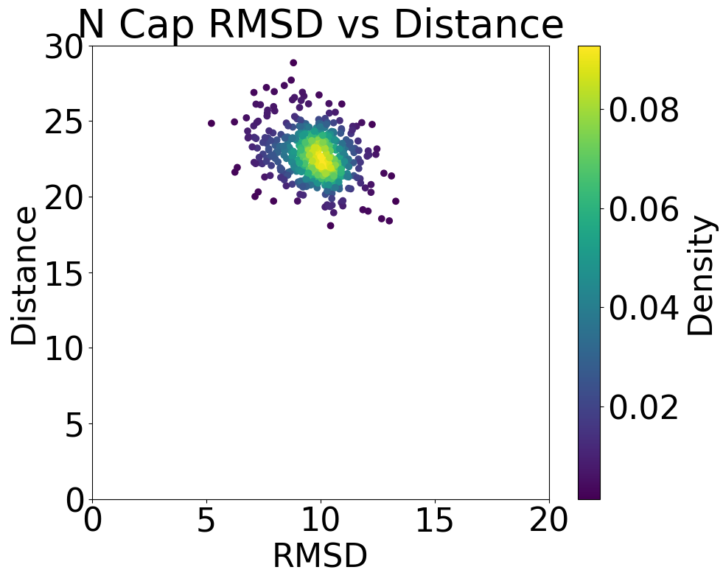
M7
M8
Pattern: [3, 3, 3, 3, 3, 3, 3, 3, 3, 3, 3, 3, 3, 3, 3, 3, 3, 3, 3, 3, 3, 3, 3, 3, 3, 3, 3, 3, 3, 3, 3, 3, 3, 3, 3, 3, 3, 3, 3, 3, 3, 3, 3, 3, 0, 0, 0, 0, 0, 0, 0, 3, 3, 3, 3, 3, 3, 3, 3, 3, 3, 3, 3, 3, 3, 3, 3, 3, 3, 3, 3, 3, 3, 3, 3, 3, 3, 3, 3, 3, 3, 3, 3, 3, 3, 3, 3, 3, 3, 3, 3, 3, 3, 3, 3, 3, 3, 3, 3, 3, 3, 3, 3, 3, 3, 3, 3, 3, 3, 3, 3, 3, 3, 3, 3, 3, 3, 3, 3, 3, 3, 3, 3, 3, 3, 3, 3, 3, 3, 3, 3, 3, 3, 3, 3, 3, 3, 3, 3, 3, 0, 0, 0, 0, 0, 0, 0, 3, 3, 3, 3, 3, 3, 3, 3, 3, 3, 3, 3, 3, 3, 3, 3, 3, 3, 3, 3, 3, 3, 3, 3, 3, 3, 3, 3, 3, 3, 3, 3, 3, 3, 3, 3, 3, 3, 3, 3, 3, 3, 3]
M8
My
version
Pattern: [0, 0, 3, 3, 3, 3, 0, 0, 3, 3, 3, 3, 0, 0, 3, 3, 3, 3, 0, 0, 3, 3, 3, 3, 0, 0, 3, 3, 3, 3, 0, 0, 3, 3, 3, 3, 0, 0, 3, 3, 3, 3, 0, 0, 3, 3, 3, 3, 0, 0, 3, 3, 3, 3, 3, 3, 3, 3, 3, 3, 3, 3, 3, 3, 3, 3, 3, 3, 3, 3, 3, 3, 3, 3, 3, 3, 3, 3, 3, 3, 3, 3, 3, 3, 3, 3, 3, 3, 3, 3, 3, 3, 3, 3, 3, 3, 3, 3, 3, 3, 3, 3, 3, 3, 3, 3, 3, 3, 3, 3, 3, 3, 3, 3, 3, 3, 3, 3, 3, 3, 3, 3, 3, 3, 3, 3, 3, 3, 3, 3, 3, 3, 3, 3, 3, 3, 3, 3, 3, 3, 3, 0, 0, 3, 3, 3, 3, 0, 0, 3, 3, 3, 3, 0, 0, 3, 3, 3, 3, 0, 0, 3, 3, 3, 3, 0, 0, 3, 3, 3, 3, 0, 0, 3, 3, 3, 3, 0, 0, 3, 3, 3, 3, 0, 0, 3, 3, 3, 3, 0, 0, 3]
M7
Tomasz
version
N cap
C cap

Slide 2
M8
My
version
Pattern: [0, 0, 3, 3, 3, 3, 0, 0, 3, 3, 3, 3, 0, 0, 3, 3, 3, 3, 0, 0, 3, 3, 3, 3, 0, 0, 3, 3, 3, 3, 0, 0, 3, 3, 3, 3, 0, 0, 3, 3, 3, 3, 0, 0, 3, 3, 3, 3, 0, 0, 3, 3, 3, 3, 3, 3, 3, 3, 3, 3, 3, 3, 3, 3, 3, 3, 3, 3, 3, 3, 3, 3, 3, 3, 3, 3, 3, 3, 3, 3, 3, 3, 3, 3, 3, 3, 3, 3, 3, 3, 3, 3, 3, 3, 3, 3, 3, 3, 3, 3, 3, 3, 3, 3, 3, 3, 3, 3, 3, 3, 3, 3, 3, 3, 3, 3, 3, 3, 3, 3, 3, 3, 3, 3, 3, 3, 3, 3, 3, 3, 3, 3, 3, 3, 3, 3, 3, 3, 3, 3, 3, 0, 0, 3, 3, 3, 3, 0, 0, 3, 3, 3, 3, 0, 0, 3, 3, 3, 3, 0, 0, 3, 3, 3, 3, 0, 0, 3, 3, 3, 3, 0, 0, 3, 3, 3, 3, 0, 0, 3, 3, 3, 3, 0, 0, 3, 3, 3, 3, 0, 0, 3]

Slide 3
M7
Tomasz
version
Pattern: [3, 3, 3, 3, 3, 3, 3, 3, 3, 3, 3, 3, 3, 3, 3, 3, 3, 3, 3, 3, 3, 3, 3, 3, 3, 3, 3, 3, 3, 3, 3, 3, 3, 3, 3, 3, 3, 3, 3, 3, 3, 3, 3, 3, 0, 0, 0, 0, 0, 0, 0, 3, 3, 3, 3, 3, 3, 3, 3, 3, 3, 3, 3, 3, 3, 3, 3, 3, 3, 3, 3, 3, 3, 3, 3, 3, 3, 3, 3, 3, 3, 3, 3, 3, 3, 3, 3, 3, 3, 3, 3, 3, 3, 3, 3, 3, 3, 3, 3, 3, 3, 3, 3, 3, 3, 3, 3, 3, 3, 3, 3, 3, 3, 3, 3, 3, 3, 3, 3, 3, 3, 3, 3, 3, 3, 3, 3, 3, 3, 3, 3, 3, 3, 3, 3, 3, 3, 3, 3, 3, 0, 0, 0, 0, 0, 0, 0, 3, 3, 3, 3, 3, 3, 3, 3, 3, 3, 3, 3, 3, 3, 3, 3, 3, 3, 3, 3, 3, 3, 3, 3, 3, 3, 3, 3, 3, 3, 3, 3, 3, 3, 3, 3, 3, 3, 3, 3, 3, 3, 3]

Slide 4
M8
My
version
Pattern: [0, 0, 3, 3, 3, 3, 0, 0, 3, 3, 3, 3, 0, 0, 3, 3, 3, 3, 0, 0, 3, 3, 3, 3, 0, 0, 3, 3, 3, 3, 0, 0, 3, 3, 3, 3, 0, 0, 3, 3, 3, 3, 0, 0, 3, 3, 3, 3, 0, 0, 3, 3, 3, 3, 3, 3, 3, 3, 3, 3, 3, 3, 3, 3, 3, 3, 3, 3, 3, 3, 3, 3, 3, 3, 3, 3, 3, 3, 3, 3, 3, 3, 3, 3, 3, 3, 3, 3, 3, 3, 3, 3, 3, 3, 3, 3, 3, 3, 3, 3, 3, 3, 3, 3, 3, 3, 3, 3, 3, 3, 3, 3, 3, 3, 3, 3, 3, 3, 3, 3, 3, 3, 3, 3, 3, 3, 3, 3, 3, 3, 3, 3, 3, 3, 3, 3, 3, 3, 3, 3, 3, 0, 0, 3, 3, 3, 3, 0, 0, 3, 3, 3, 3, 0, 0, 3, 3, 3, 3, 0, 0, 3, 3, 3, 3, 0, 0, 3, 3, 3, 3, 0, 0, 3, 3, 3, 3, 0, 0, 3, 3, 3, 3, 0, 0, 3, 3, 3, 3, 0, 0, 3]
15

Slide 5
M7
Tomasz
version
Pattern: [3, 3, 3, 3, 3, 3, 3, 3, 3, 3, 3, 3, 3, 3, 3, 3, 3, 3, 3, 3, 3, 3, 3, 3, 3, 3, 3, 3, 3, 3, 3, 3, 3, 3, 3, 3, 3, 3, 3, 3, 3, 3, 3, 3, 0, 0, 0, 0, 0, 0, 0, 3, 3, 3, 3, 3, 3, 3, 3, 3, 3, 3, 3, 3, 3, 3, 3, 3, 3, 3, 3, 3, 3, 3, 3, 3, 3, 3, 3, 3, 3, 3, 3, 3, 3, 3, 3, 3, 3, 3, 3, 3, 3, 3, 3, 3, 3, 3, 3, 3, 3, 3, 3, 3, 3, 3, 3, 3, 3, 3, 3, 3, 3, 3, 3, 3, 3, 3, 3, 3, 3, 3, 3, 3, 3, 3, 3, 3, 3, 3, 3, 3, 3, 3, 3, 3, 3, 3, 3, 3, 0, 0, 0, 0, 0, 0, 0, 3, 3, 3, 3, 3, 3, 3, 3, 3, 3, 3, 3, 3, 3, 3, 3, 3, 3, 3, 3, 3, 3, 3, 3, 3, 3, 3, 3, 3, 3, 3, 3, 3, 3, 3, 3, 3, 3, 3, 3, 3, 3, 3]
15

