Slide 1

Wenyue (Eva) Dai, 202550803
Study purpose

Slide 2
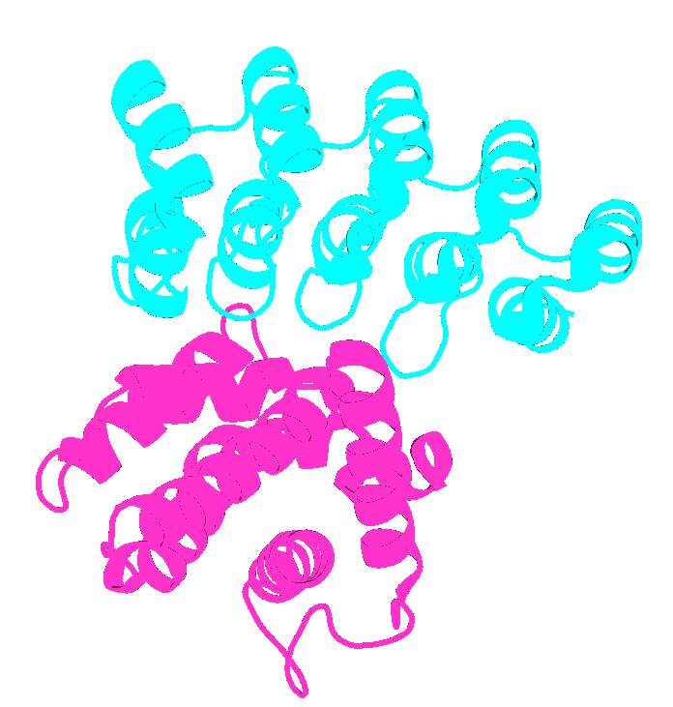
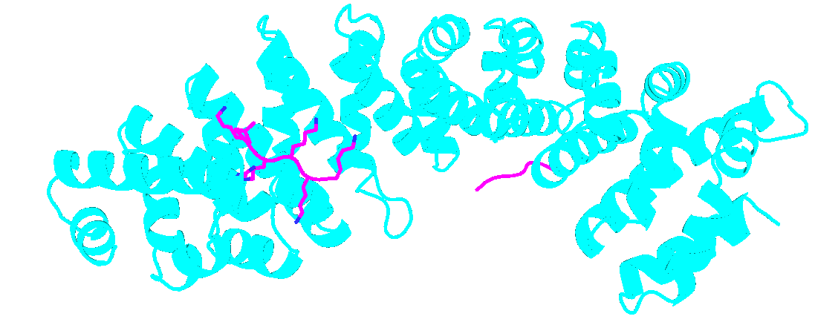
Background
Natural proteins to target IDR: Antibodies, Armadillo repeat protein etc.
Repeat protein: DARPins, tetra-trico-peptide TRP
Armadillo repeat protein,
42 residues per repeat (pr)
Pdb: 4k5b
DARPins, 33 residues pr
Notes:
DARpin rely on rigid interaction with well defined 3D surface by having this rigid pocket. But Armadillo have an extended, duperhelical grooves which is rich in charged and polar residues. Furthermore, Amardillo has an extended binding interface, so increase the chance of binding to short linear peptide.
Comparison to DARPins
DARPin: Rigid concave surface → Needs stable 3D epitope → Poor for pure IDRs.
ArmRP: Extended flexible groove → Binds linear peptide motifs → Good for SLiMs within IDRs.

Slide 3
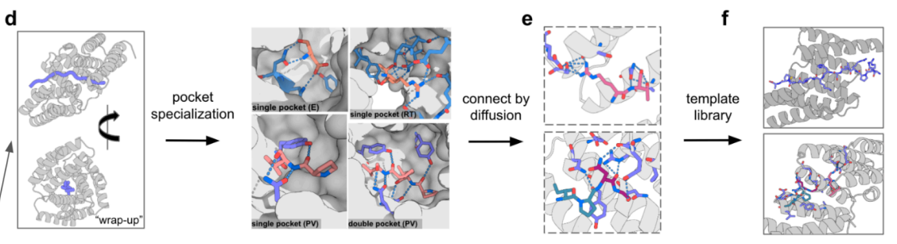
Strategy – step 1, Generation of template library
The template library should have two properties:
Each template structure should wrap around extended peptide conformation, with extensive h-bond and packing
The template library should be diverse.

Slide 4
Strategy – step 1.1, Scaffold generation
Design repeat protein that wrap around peptide in different repeating conformation

Slide 5
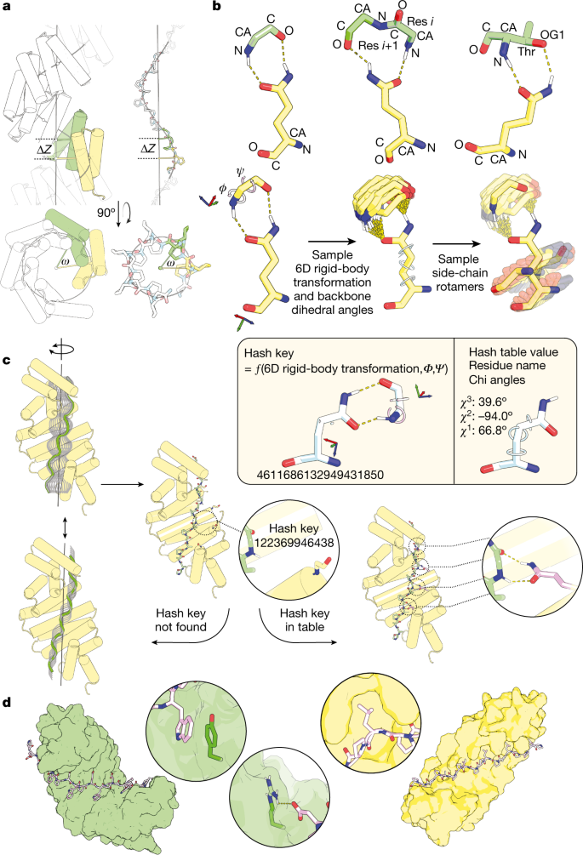
Strategy – step 1.1.1, Scaffold generation – backbone generation (parametric skeleton)
The translation (rise) along the helical axis per repeat unit;
The rotation (twist) around this axis;
The distance (radius) of the repeat unit centroid from the axis
Generated large sets of repeating-protein backbones that sampled a wide range of superhelical geometries
The helices range from 18 to 30 residues and the loops from 3 to 4 residues.
Rise between 0 and 10 Å
Twist (omega) between 0.6 and 1.0 radians
Radius of 0 to 13 Å
The backbone is usually ‘too perfect’ solely by parametric design:
Helix are perfect straight, loops are linear connection.
Missing backbone N, C, O atoms, sidechain etc
https://www.nature.com/articles/s41586-023-05909-9
Notes:
Imagine two helices with
Inter-helical distance: 10Å
Rotation: 40° relative
Parametric model show no clashes, reality show clash

Slide 6
Strategy – step 1.1.2, Scaffold generation – fragment asembly
Fragment library: Pre-computed 3-9 residue fragments from high-resolution PDB structures
For each window, calculate psi phi angle, and search in fragment library for matches
Replace parametric segment with best matching fragment
But there are too many fragment from the library to try on, how to select the best one?
Monte Carlo & Metropolis-Hastings acceptance: Use score function to evaluate each replacement,
for example, total_score = w1*steric_score + w2*rama_score + w3*hbond_score + w4*rpx_score
Steric_score: Atom-atom clashes (soft repulsive lennard-Jones)
Rama_score: Ramachandra likelihood
Hbond_score: hydrogen bonding satisfaction
Rpx_score: hydrophobic packing prior to side chain assignment
https://www.nature.com/articles/s41586-023-05909-9
Notes:
Parametric input:
Ideal φ/ψ: (-63°, -42°)
Length: 9 residues
Fragment matches:
2D3Q: RMSD 0.7Å to ideal
1XYZ: RMSD 1.2Å
3ABC: RMSD 3.4Å → rejected
Replacement process:
Superimpose 2D3Q residues 15-17 onto parametric positions i,i+1,i+2
Keep 2D3Q's atomic coordinates for residues 15-23
Score new structure: steric=0.3, RPX=0.85 → accepted
Fragment assembly ensures:
Pocket shape accuracy: Sidechains pre-positioned for ligand complementarity
H-bond networks: Fragments bring pre-optimized polar interactions
Core hydrophobicity: RPX scoring enforces natural-like packing

Slide 7
Strategy – step 1.1.3, Final filter for backbone generation
Final check the backbone topology
Loops must have been within 0.4 Å of a naturally occurring loop or be rebuilt.
Structures with helices deviating more than 0.14 Å were considered bent or kinked and were discarded.
Structures with fewer than eight helices in contact were also filtered out.
The distance between the first and the last helix was calculated and discarded long distance ones.

Slide 8
Strategy – step 1.1.4, ProteinMPNN & AF2 Filter
Sequence design was performed on each filtered backbone using ProteinMPNN, with a customized weight on certain AAs: {"A": -0.15, "G": -0.15, "M": -0.35, "P": 0.15, "E": 0.1}.
Negative – penalize
Positive – favor
Penelize A, G to force better packing with sidechain & avoid too flexible
Penelize M for steric clash and oxidation risk
Favor P: to allow loop rigidity, helix capping, enrtopic bonus (fold faster and more thermostable)
Favor E: solubility, specificity
Why not favor K/R?
IDR enriched in KR, less in E
E can form bidentate with R (only consider side chain O, not backbone)
K/R is long flexible chain, E is more compact (entropic penalty)
K/R: higher non-specific risk. cation-phi interaction
Favor expression: ribosome exiting tunnel
AF2 filter
Structural prediction was conducted by AF2(46) with PLDDT > 90, Cα RMSD < 2 Å.
https://pubs.acs.org/doi/full/10.1021/acs.jctc.9b00742
Notes:
The entropic bonus refers to a fundamental thermodynamic advantage conferred by certain amino acids (like proline) that reduce the entropy penalty during protein folding. Entropy (S): Measure of disorder/mobility. Protein folding: Transition from disordered (high S) to ordered (low S)
Entropy penalty (TΔS): Energy cost of losing disorder during folding
Why not favor D:
E's extra methylene group enables optimal positioning for bidentate interactions:
D often falls short: 85% of D-R pairs in PDB are monodentate
2. Clash risk with packed cores
E achieves bidentate: 78% of E-R pairs in PDB are bidentate
3. Solvation energy: Imagine dropping a charged magnet into a bucket of water. Aspartate need larger forces to rip off the tightly bound water (desolvation cost), while the water attached to the glutamate is more loosely packed (far away from the core) so need only smaller energy to remove the water/
4. Glutamate has more rotamer, higher chance of correct binentate

Slide 9
Strategy – step 2.1, Pocket specialization
Convert generic helical repeat scaffolds into amino acid-specific binding pockets
capable of recognizing individual residues from IDR

Slide 10
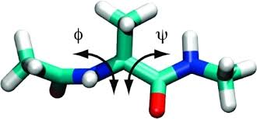
Strategy – step 2.1.1, Di-peptide binder design
Generate peptide conformation: Sample phi/psi angle from extended Ramachandran region,
and filter with Rosetta Ramachandran score to ensure no clashes. (Remember, side chain exist for peptide)
2. z-axis alignment and grid search:
Rigid dock, side chain retain initial conformatoin
Align peptide & protein along superhelical axis (z-axis)
Perform 2D grid search (rotation around z-axis + translation along z-axis)
Accept only clash-free conformations

Slide 11
Strategy – step 2.1.2, Hash table look-up
For clarity, let’s call it donor and acceptor
For donor, 6D (3*translation, 3*rotation), psi, phi angle to calculate
For acceptor, the rotamer can be calculated
Then the donor’s 6D+phi+psi are converted to hash key.
The side chain rotamer are corresponding hash value.
This process can allow fast search.

Slide 12
Strategy – step 2.1.2, Hash table look-up
Only complexes satisfying:
No steric clashes after rotamer installation
Preserved hydrogen-bond interactions
…..
https://pubs.acs.org/doi/full/10.1021/acs.jctc.9b00742

Slide 13
Strategy – step 2.1.3, ProteinMPNN & AF2 validation
After anchoring the key interacting residues from hash table
Interface design optimization:
Optimize non-anchor residues (ProteinMPNN?)
Validate hydrogen bond network
AF2 & Rosetta filter
PAE_interaction ≤10,
PLDDT > 92 for the complex,
Cα RMSD < -50,
contact_molecular_surface (CMS) > 500
BUNS (buried_unsatisfied_penalty) < 1.

Slide 14
Strategy – step 2.3, Pocket assembly to generate template library
For each dipeptide, collect 10AA binding pocket (if we want to replicate,
maybe just need to start from here? For higher flexibility),
Assemble combination of 2-6 binding pockets using diffusion.
By different combination of binding pocket, end up with 1000 template.
Each template contains protein and peptide docking complex

Slide 15
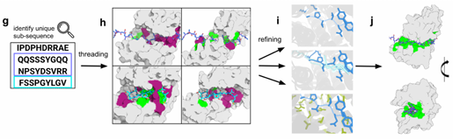
Strategy – step 2.4, Thread IDR to template library
if we want to replicate,
maybe just need to start from here?
Thread IDR sequence (8-40aa) to the peptide in the template library.
Refine with one-side / two-side/motif Rfdiffusion & ProteinMPNN
One side: only optimize scaffold
Two side: both scaffold & IDR
Motif: only keep essential binding site, rebuild the rest
Score with geometry & Rosetta score

Slide 16
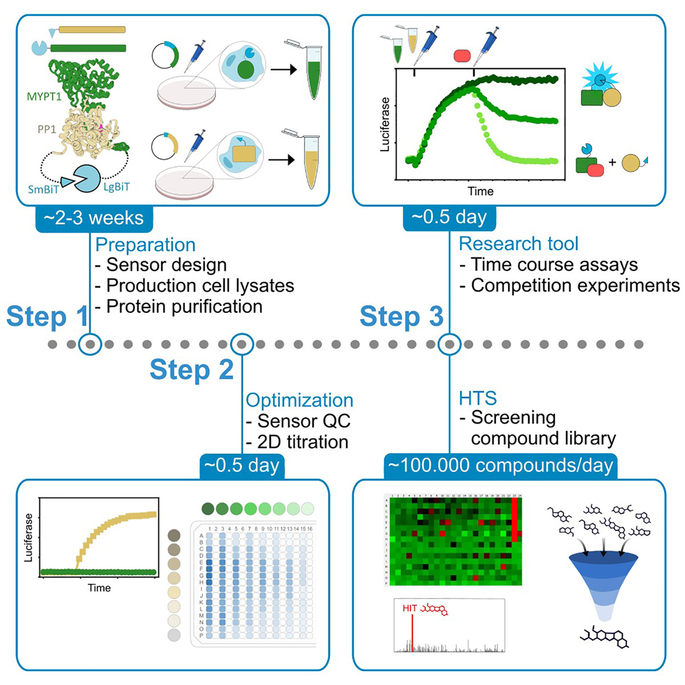
Experimental results
nanoBiT split luciferase reconstitution
1. Fuse split luciferase in IDR and designed protein separately
2. Collect cell lysate that express these two proteins
3. Mix and detect
https://star-protocols.cell.com/protocols/3761

Slide 17
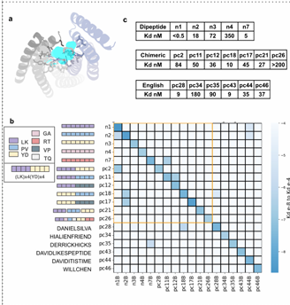
Experimental results: to synthesized peptide
nanoBiT split luciferase reconstitution
High success rate: among 18 IDR,
most designed binder kd < 100 nM
2. High specificity: 18x18 cross exam,
most only show binding to its own

Slide 18
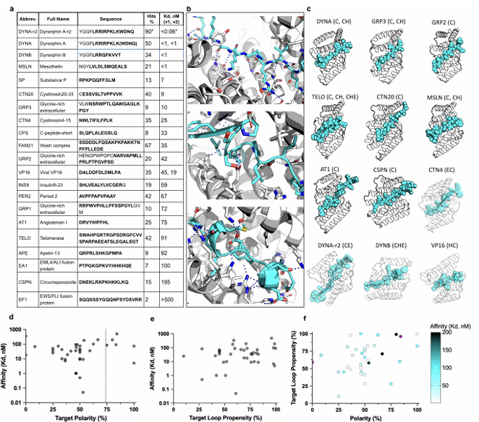
Experimental results: to native IDR
Among 21 target, 21 all successful designed
Kd range a lot
EF1 Kd > 500
DYNAr2 Kd < 0.06

Slide 19
Conclusion
A combination of physical properties selection (hash table), different diffusion strategies,
rounds of design with different hightlight are all useful and inspiring.
However, the pipeline seems to be very tedious.
Personally I am not very clear what is the essential steps, and if there is any redundancy.

