Slide 1
Weekly Paper Reading
Haoli
2018-11-03

Slide 2
Outline
Rethinking the Value of Network Pruning
RNN compression

Slide 3
Outline
Rethinking the Value of Network Pruning
RNN compression

Slide 4
Rethinking the Value of Network Pruning
A similar paper: ICLR 2019 submission
Pruning neural networks: is it time to nip it in the bud?
Three observations:
Training a large, over-parameterized model is not necessary to obtain an efficient final model.
Learned “important” weights of the large model are not necessarily useful for the small pruned model.
Pruning is actually a type of architecture search.
Empirical study
Interesting insights on pruning

Slide 5
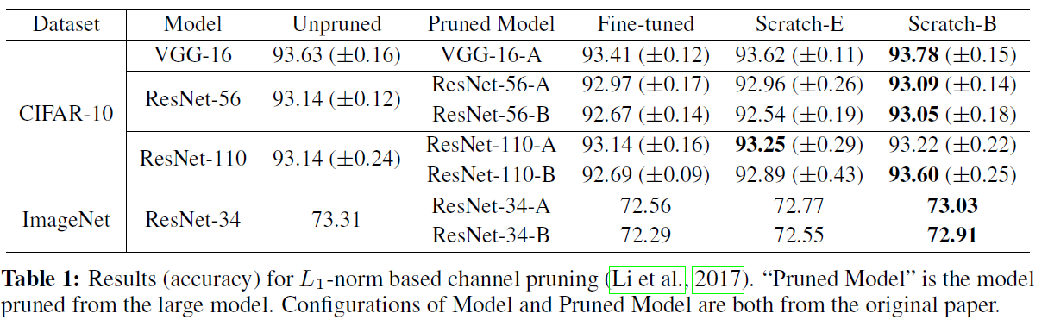
Rethinking the Value of Network Pruning
Train-prune-finetune v.s. Train a pruned model from scratch
Training a large, over-parameterized model is not necessary to obtain an efficient final model.
Learned “important” weights of the large model are not necessarily useful for the small pruned model.

Slide 6
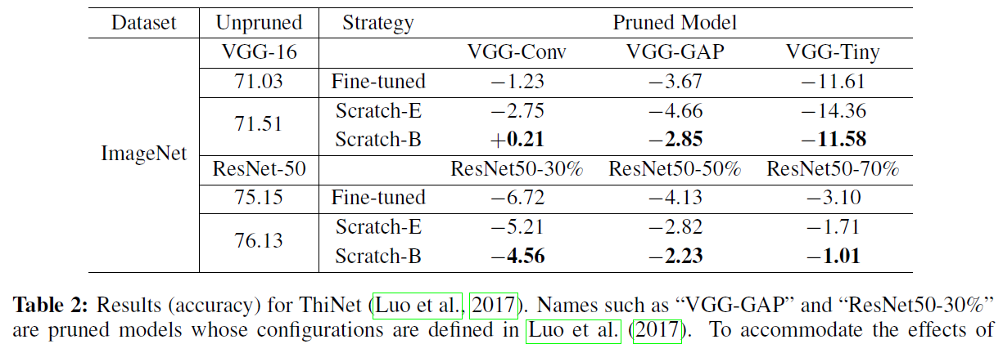
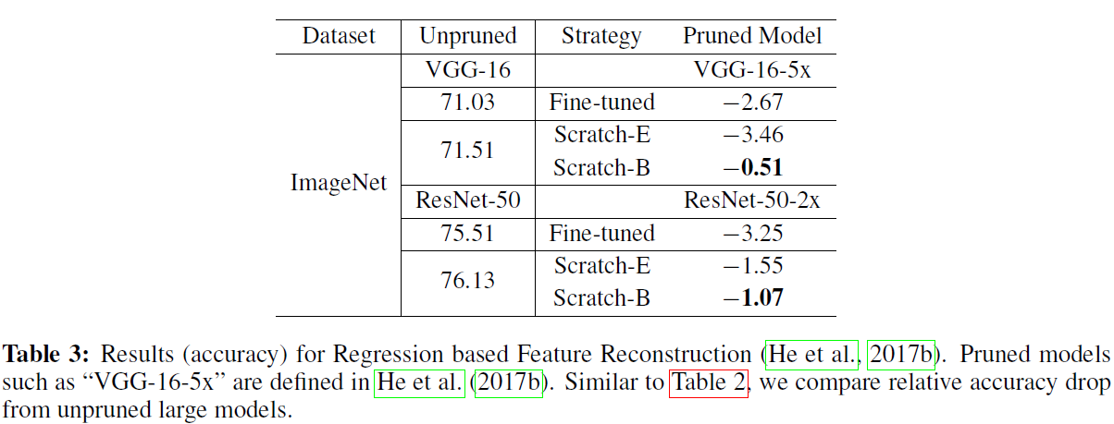
Rethinking the Value of Network Pruning

Slide 7
Rethinking the Value of Network Pruning
Questions:
The pruned architectures are found based on a pre-trained model?
Pre-train epochs + Pruned epochs from scratch v.s. Pretrain epochs + Finetune epochs
Scratch-E or Scratch-B requires much more epochs than fine-tuning.
Can we prune the model simultaneously while pre-training the original network?

Slide 8
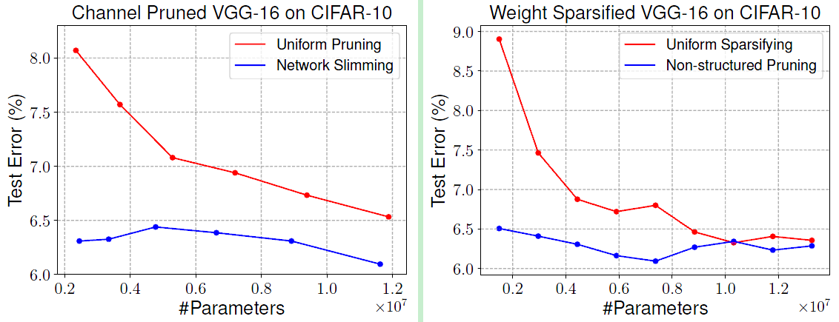
Rethinking the Value of Network Pruning
Pruning v.s. Architecture search
Random pruning vs Artificially designed pruning
Random initialization
Notes:
？ 是prune完了再随机初始化？ 还是一开始就随机初始化，边prune边train

Slide 9
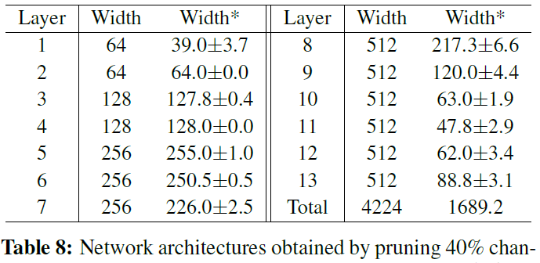
Rethinking the Value of Network Pruning
Pruning v.s. Architecture search
Implement pruning multiple times -> the result is generally consistent
Pruning is more like a architecture search rather than weight inheriting: robust to initialization
But how to discover it without pre-trained models?
Notes:
？ 是prune完了再随机初始化？ 还是一开始就随机初始化，边prune边train

Slide 10
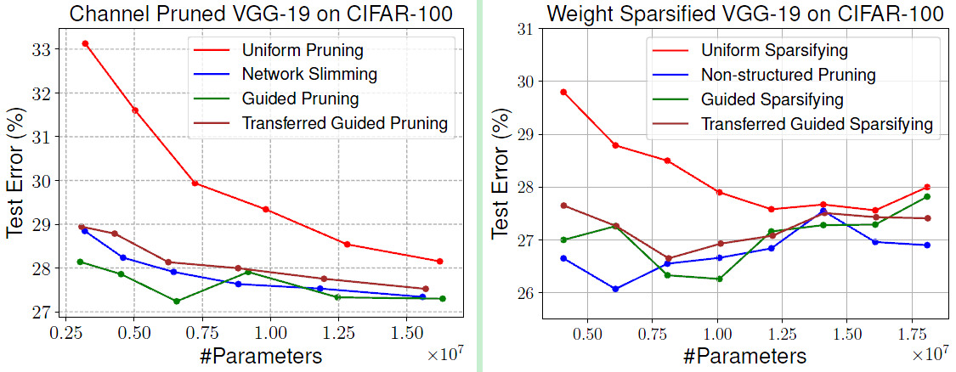
Rethinking the Value of Network Pruning
Transfer Guided Pruning
Use the patterns found on CIFAR10 to apply on CIFAR100
Can we prune/find architectures on small datasets and apply on large datasets
Underlying correlation among datasets

Slide 11
Rethinking the Value of Network Pruning
Thoughts:
Training from scratch is better than fine-tuning on pruned models?
Pruning still relies on pre-training;
What is the advantage of training from scratch? “Escape local minima from pre-trained models?”
The comparison is a little bit unfair. A lot of discussion on https://openreview.net/forum?id=rJlnB3C5Ym;
Notes:
At least training from scratch does not underperform fine-tuning significantly.

Slide 12
Rethinking the Value of Network Pruning
Interesting directions
Prune the model simultaneously while pre-train the model
Speed up the pruning;
Transfer/Guided pruning
Directly apply the architecture found on A to B;
leverage the underlying correlation among datasets to help transfer pruning

Slide 13
Outline
Rethinking the Value of Network Pruning
RNN compression

Slide 14
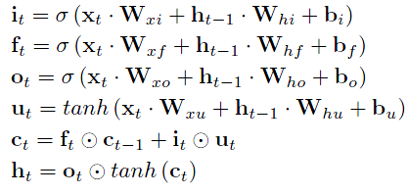
RNN compression
Much less attention has been paid to RNN;
Still investigating this direction…
Challenges:
Dependent structure; Unlike CNN;
Dimension consistency: All gates, hidden states, cell states have the save dimension
LEARNING INTRINSIC SPARSE STRUCTURES WITHIN LONG SHORT-TERM MEMORY, ICLR 2018
Notes:
Challenges in rnn compression

Slide 15
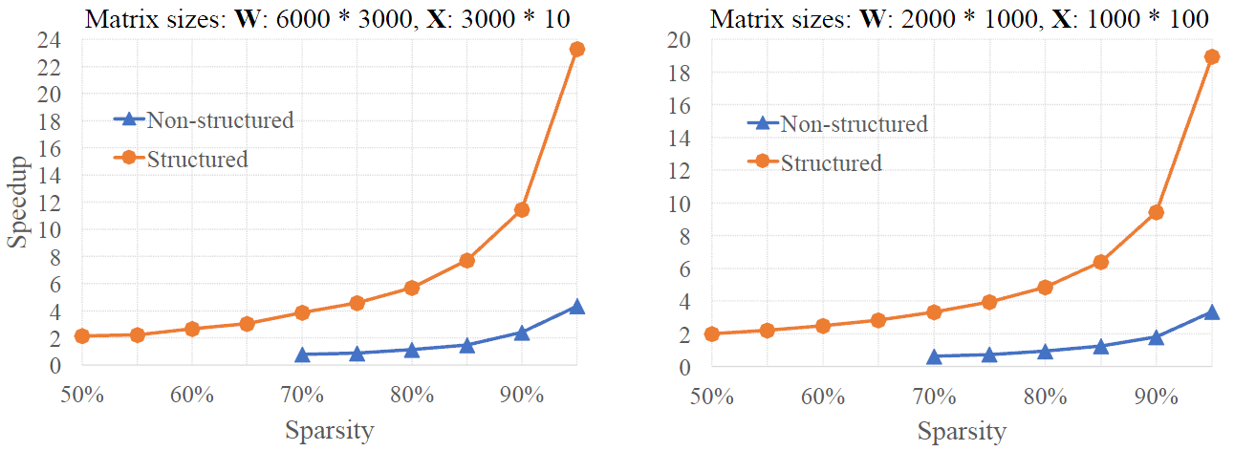
RNN compression
To resolve challenge 1
Non-structured pruning cannot lead to apparent acceleration
Prefer Structured pruning

Slide 16
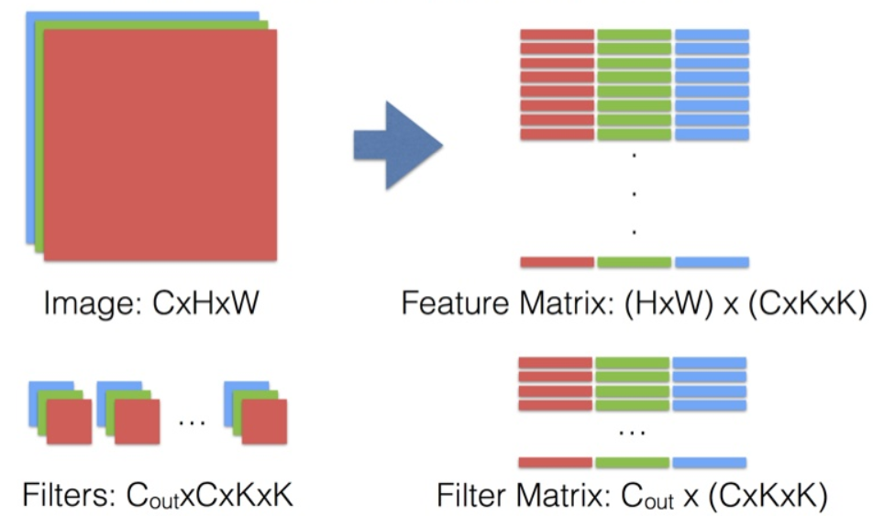
RNN compression
To resolve challenge 1
In CNN: channel pruning;
In RNN (or other dense connections): column-wise pruning

Slide 17
RNN compression
To resolve challenge 1
In CNN: channel pruning;
In RNN (or other dense connections): column-wise pruning
X
W

Slide 18
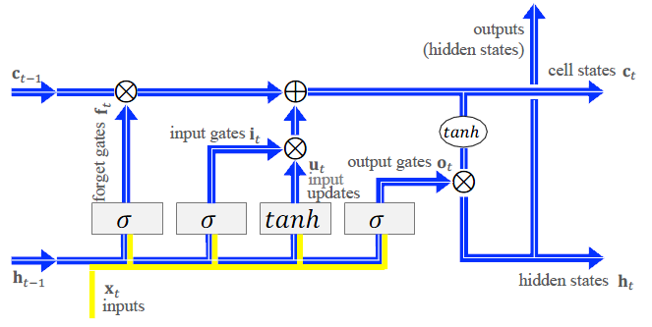
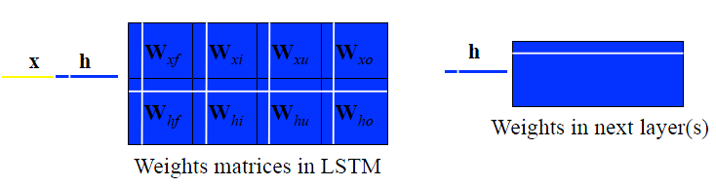
RNN compression
To resolve challenge 2:

Slide 19
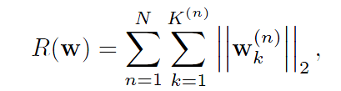
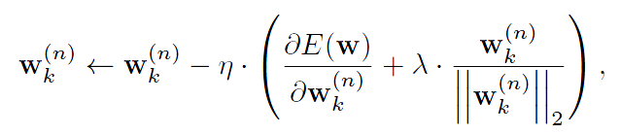

RNN compression
To resolve challenge 2:
A threshold to turn off weights to zeros
Notes:
h里面的某一维度是怎么去掉的？
如果h里的某一维度被去掉，那对应 的o,c,f,i都可以被去掉；
先有鸡还是先有蛋的过程。

Slide 20
RNN compression
Anywhere else to compress?
The embedding layer (the vocabulary size is large)
…
Papers:
[1] COMPRESSING WORD EMBEDDINGS VIA DEEP COMPOSITIONAL CODE LEARNING, ICLR 2018
[2] Learning Compact Recurrent Neural Networks with Block-Term Tensor Decomposition, CVPR 2018

