Slide 1
Weekly Paper Reading The Lottery Hypothesis
Haoli
2019-5-7
[1] THE LOTTERY TICKET HYPOTHESIS: FINDING SPARSE, TRAINABLE NEURAL NETWORKS . ICLR 2019 Best
[2] THE LOTTERY HYPOTHESIS AT SCLAE, arxiv1903

Slide 2
Overview
Empirical studies on non-structure pruning.
(pruning 是门实验科学）
Another rethinking of network pruning.
Insightful experiment design
Extensive experiments (more than 40 pages)
One implementation can be found in
https://github.com/Eric-mingjie/rethinking-network-pruning/tree/master/cifar/lottery-ticket

Slide 3
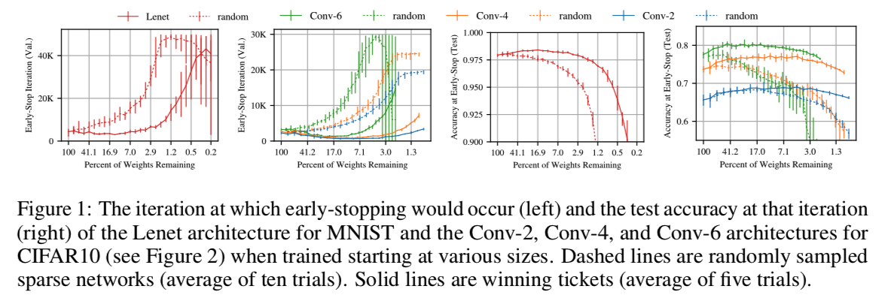
Define Wining Tickets
The Wining Tickets.
The wining tickets: some randomly initialized weights, when trained in isolation, reach the test accuracy comparable to the original network.

Slide 4
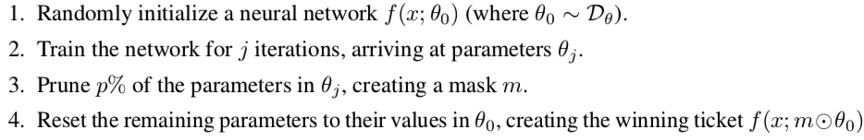
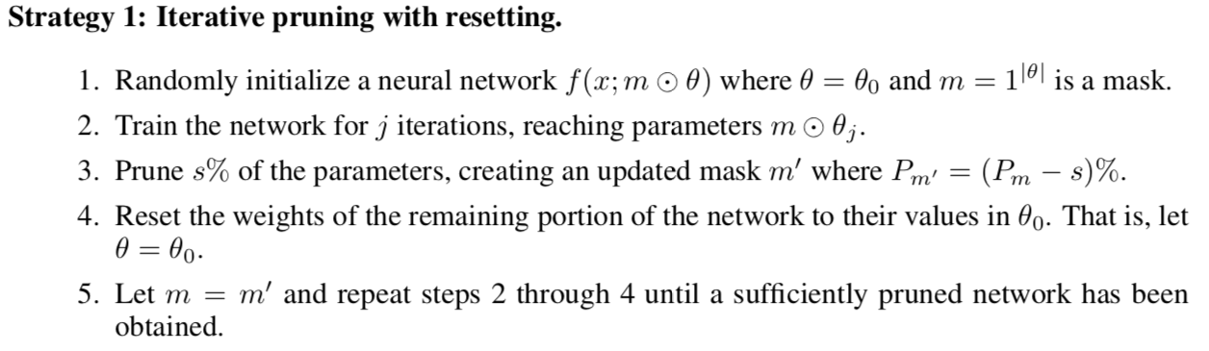
How to Identify Wining Tickets
Strategy 0: Vanilla one-shot pruning

Slide 5
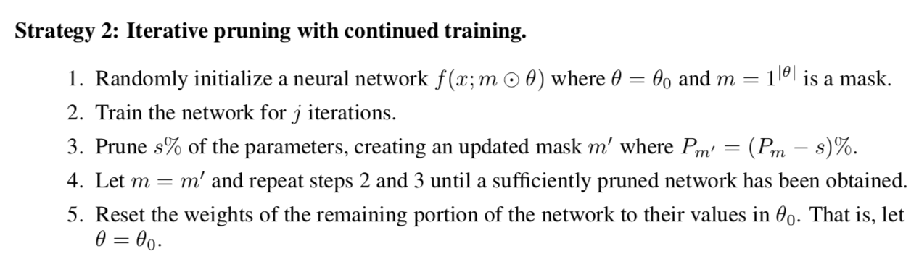
Strategies to Identify Wining Tickets
Comparisons:
Experimentally, strategy one works best;
Gradually prune a small portion of weights -> initialize ->retrain is better than one-shot

Slide 6
Experiment Tips
Deterministic experiment
Same reinitialization
Same data order/augmentation
Baselines
Original full network
Wining tickets
Random reinitialization + retraininig

Slide 7
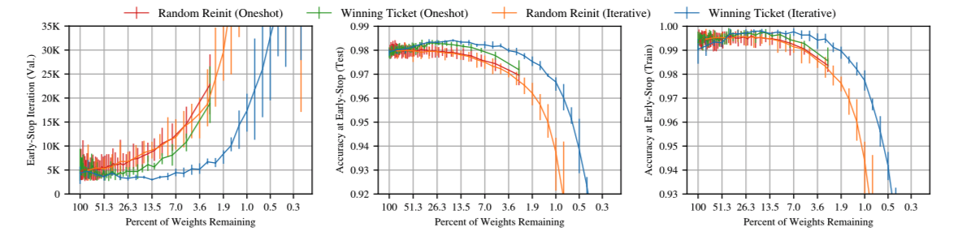
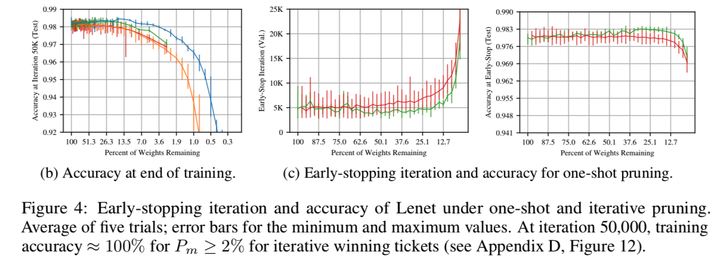
Strategies to Identify Wining Tickets

Slide 8
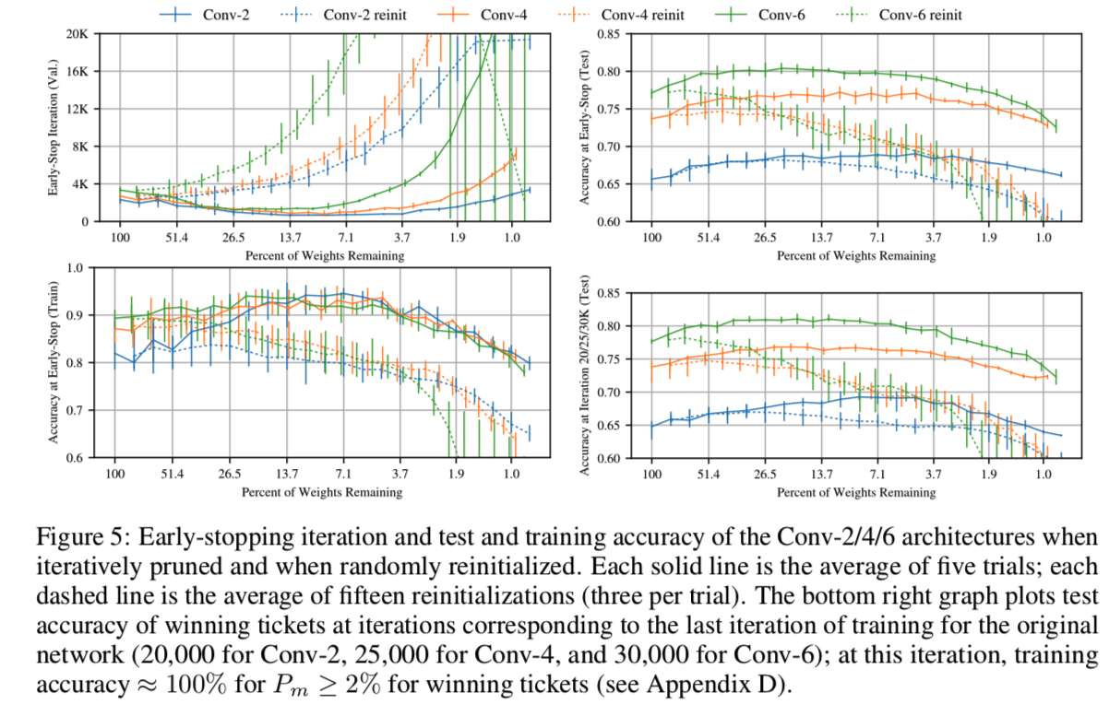
Strategies to Identify Wining Tickets

Slide 9
On larger networks
Previous experiments are demo.
How to find wining tickets on larger networks? (vgg-16 or resnet-18)?
Directly iterative pruning with default learning rates?
Warm up tricks: linearly increase learning rate in 10K steps

Slide 10
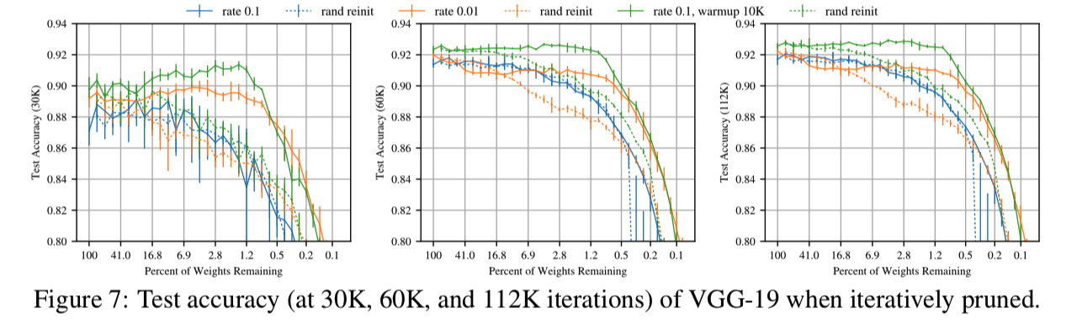
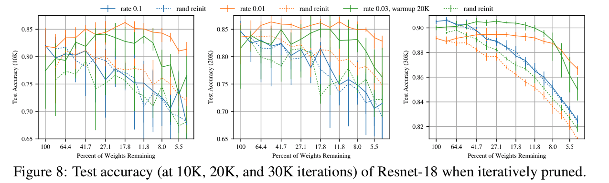
Finding winning tickets on larger networks

Slide 11
Finding winning tickets on larger networks
Discover the wining tickets only when the network gets improved (distinguish the roles of different weights)
To verify this, try (the second paper):
Do not re-initialize;
Use late-reset (initialize to stages at epoch k)
The late-reset scheme can be used on Imagenet

Slide 12
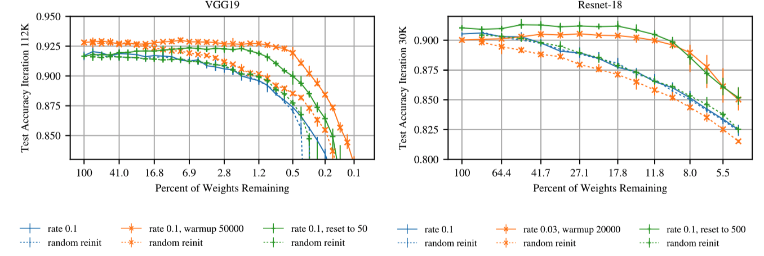
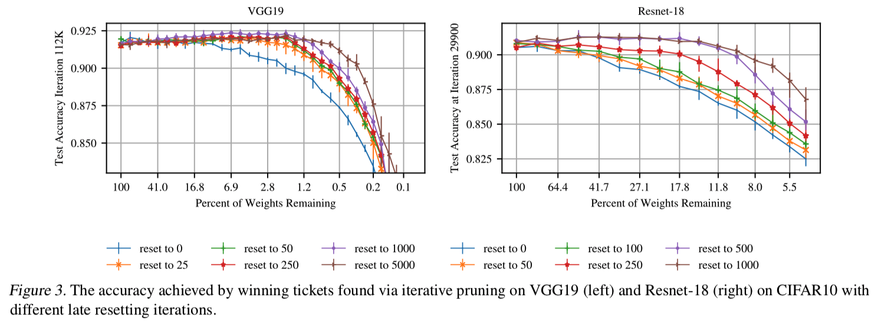
Finding winning tickets on larger networks

Slide 13
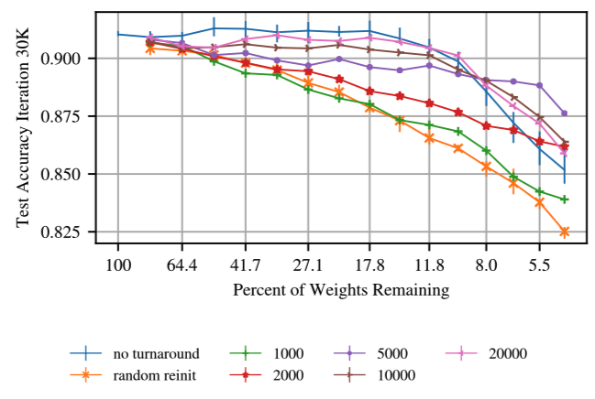
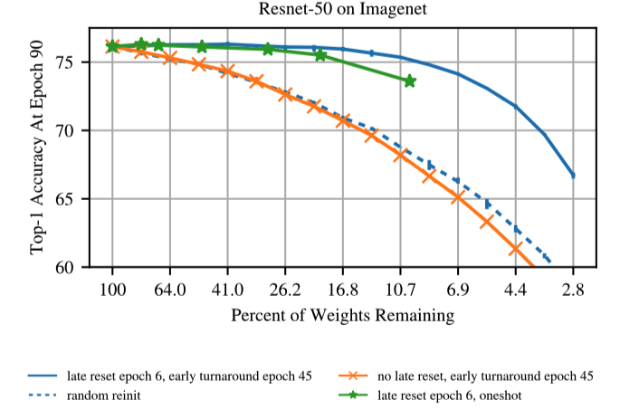
Finding winning tickets on larger networks
Too slow to reinitialize and train again until converge
(especially on ImageNet)
Trick: early turnaround: stop training after K steps

Slide 14
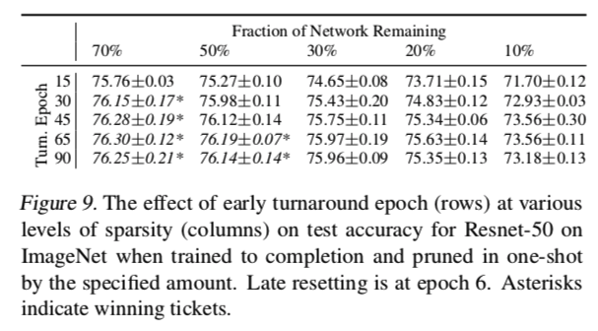
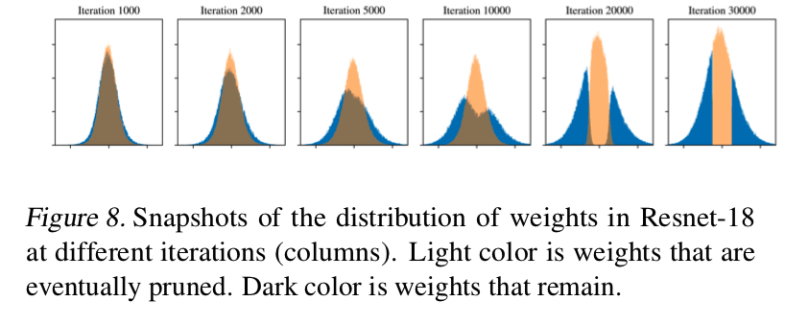
Finding winning tickets on larger networks

Slide 15
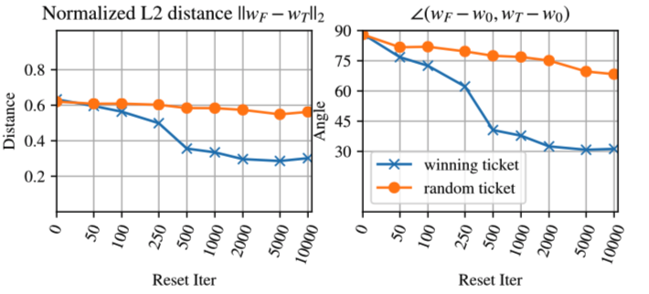
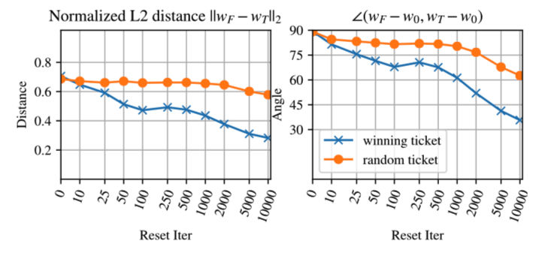
Wining tickets are stable to pruning
Find the winning tickets.
Train them in isolation v.s. train the original network: similar solution values
Resnet-18
cifar10
VGG-19
cifar10

Slide 16
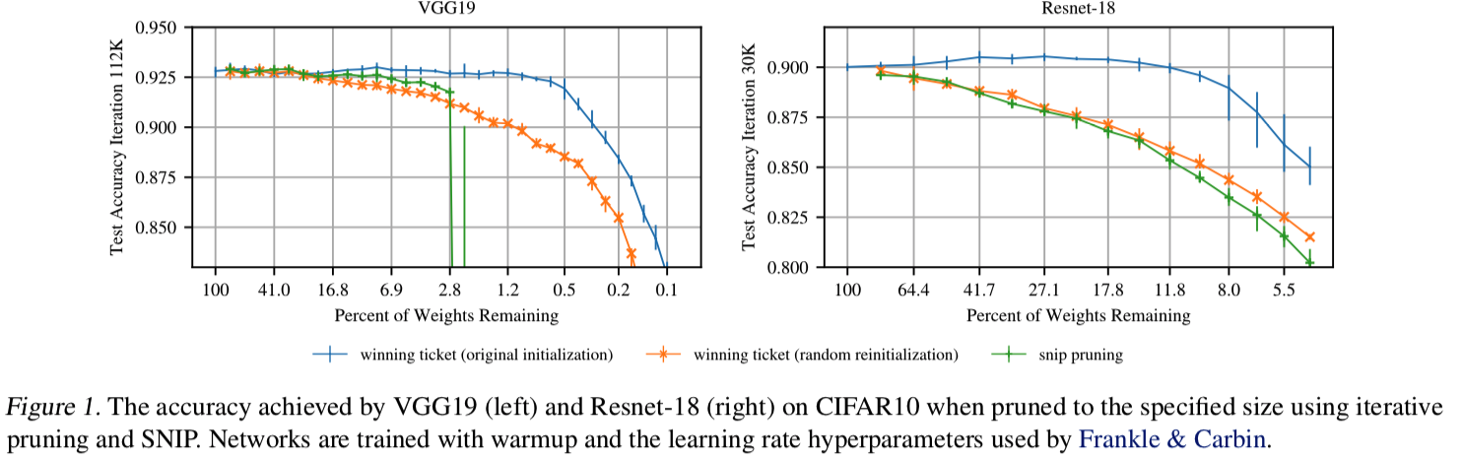
v.s. Rethinking the value of network pruning
Random initialization is equal to [Rethinking of …]
Optimizing over winning tickets is better
SRIP: an initialization-based pruning method
Pruning at the beginning is not enough to find winning tickets

Slide 17
Conclusion
Empirical study on network pruning
Initialization plays an important role in pruning
Identify important weights (as early as possible)
Cons:
Only on magnitude-based pruning
Only on non-structured pruning
The learning dynamics can be further understood by other criterions?

Slide 18
Conclusions
What can be done with wining tickets:
Discover them as early as possible -> no pretrained model needed
Transfer winning tickets from one task to multiple tasks

Slide 19
Thanks

