Slide 1
Weekly Paper Reading Adversarial Robustness Tutorial
Haoli
2019-1-6
https://adversarial-ml-tutorial.org/

Slide 2

Outline
Attack (Inner Maximization)
Projected Gradient Descent
Exactly Solving the Inner Maximization
Upper Bounding the Inner Maximization
Defence (Outer Minimization)
Adversarial Training
Relaxation-based robust training

Slide 3
Outline
Attack (Inner Maximization)
Projected Gradient Descent
Exactly Solving the Inner Maximization
Upper Bounding the Inner Maximization
Defence (Outer Minimization)
Adversarial Training
Relaxation-based robust training

Slide 4

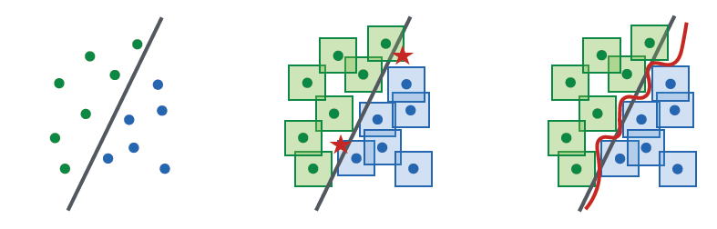

Projected Gradient Descent
Iterative PGD attack:
$$x+η⋅g$$
r
x

Slide 5
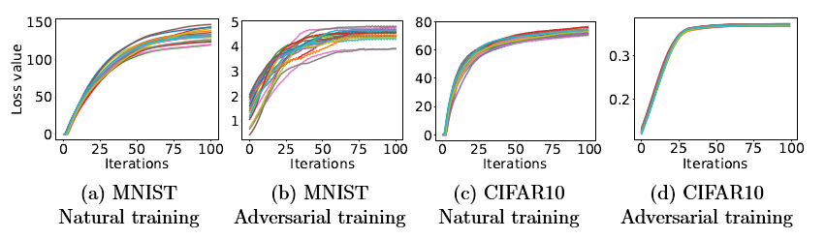
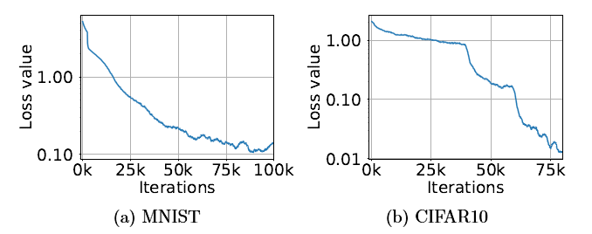
State of the Art Adversarial Training Method
Will the inner max problem converge?
Will the min problem converge and generalize?

Slide 6
Outline
Attack (Inner Maximization)
Projected Gradient Descent
Exactly Solving the Inner Maximization
Upper Bounding the Inner Maximization
Defence (Outer Minimization)
Adversarial Training
Relaxation-based robust training

Slide 7
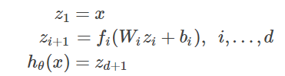
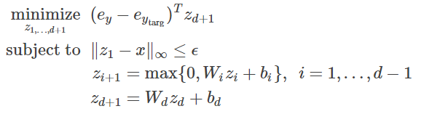
Exactly Solving the Inner Maximization
Neural Networks:
Goal:
Constrained to ReLU activations

Slide 8

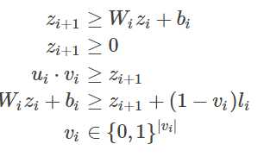

Exactly Solving the Inner Maximization
About the constraint
Turn to
$u_{i}, l_{i}$ are the upper and lower bound of $W_{i}z_{i}+b_{i}$

Slide 9
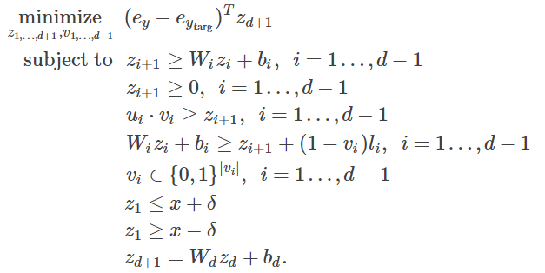
Exactly Solving the Inner Maximization
Final Integer Programming Problem:
Available packages on the shelf: cvxpy
Applied to Convolutional nets as well
Accurate, but slow

Slide 10
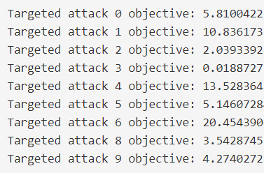
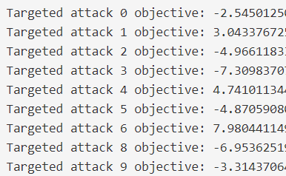

Exactly Solving the Inner Maximization
Verification
$ε=0.05$ (left) and $ε=0.1$ (right)

Slide 11
Outline
Attack (Inner Maximization)
Projected Gradient Descent
Exactly Solving the Inner Maximization
Upper Bounding the Inner Maximization
Defence (Outer Minimization)
Adversarial Training
Relaxation-based robust training

Slide 12


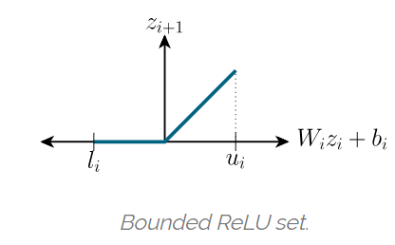
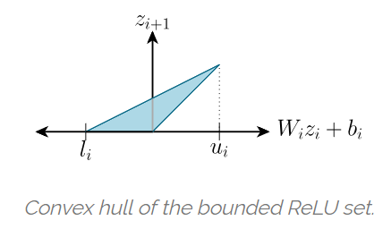
Upper Bounding the Inner Maximization
Change
Integer Programming Linear Programming

Slide 13
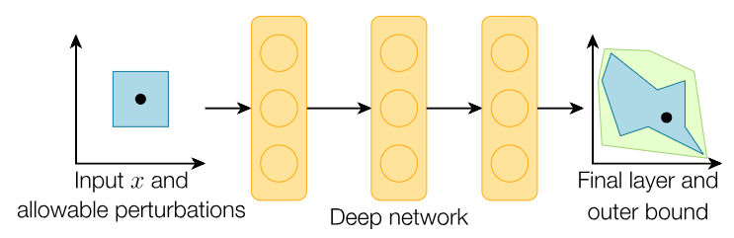
Upper Bounding the Inner Maximization

Slide 14
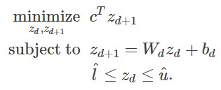

Worst Case Attack
Directly minimize over the last layer
Analytical solution
Fast to make verification
Not necessarily correspond to a real data example

Slide 15
Outline
Attack (Inner Maximization)
Projected Gradient Descent
Exactly Solving the Inner Maximization
Upper Bounding the Inner Maximization
Defence (Outer Minimization)
Adversarial Training
Relaxation-based robust training

Slide 16
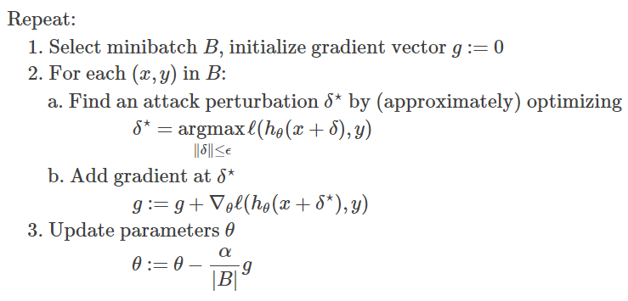
Adversarial Training
Formulation

Slide 17
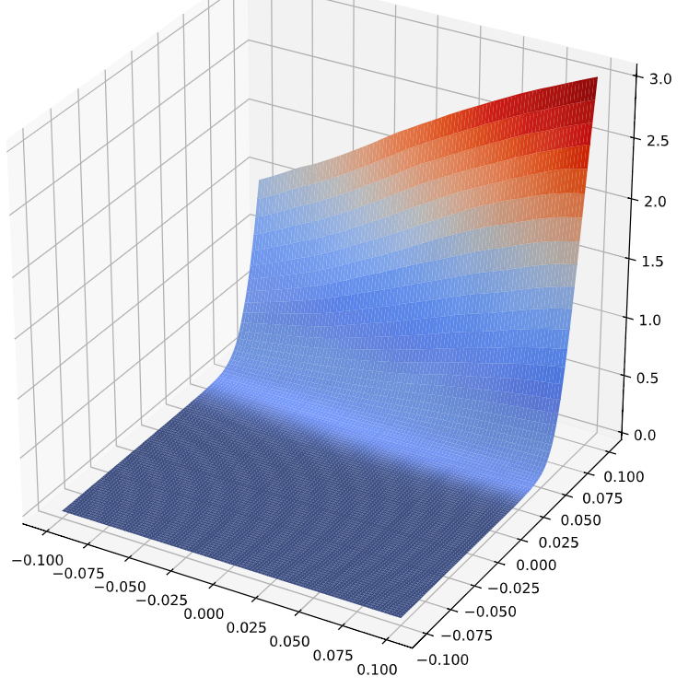
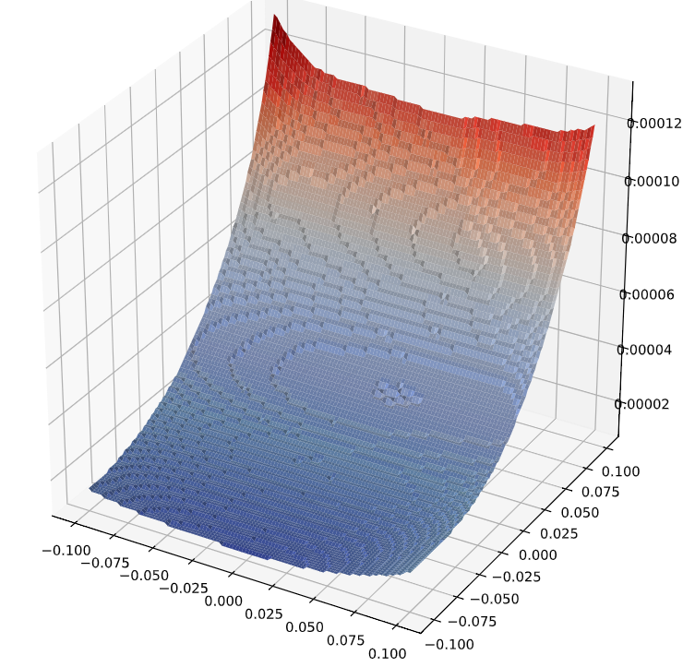
Adversarial Training
Loss Curvature

Slide 18
Outline
Attack (Inner Maximization)
Projected Gradient Descent
Exactly Solving the Inner Maximization
Upper Bounding the Inner Maximization
Defence (Outer Minimization)
Adversarial Training
Relaxation-based robust training

Slide 19
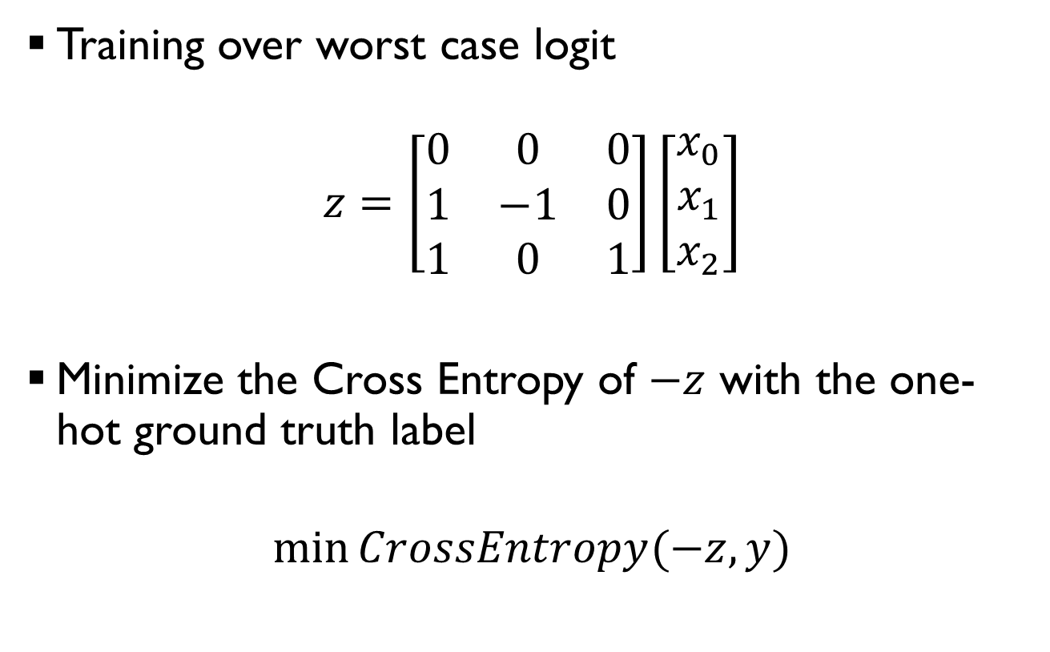
Relaxation Based Robust Training
Training over worst case logit
$$z=\left[\begin{matrix}0 & 0 & 0 \\ 1 & −1 & 0 \\ 1 & 0 & 1\end{matrix}\right]\left[\begin{matrix}x_{0} \\ x_{1} \\ x_{2}\end{matrix}\right]$$
Minimize the Cross Entropy of $−z$ with the one-hot ground truth label
$$\min{CrossEntropy(−z, y)}$$

Slide 20
Relaxation Based Robust Training
Recent trends
[NIPS 18] Fast and Effective Robustness Certification
[NIPS 18] Semidefinite relaxations for certifying robustness to adversarial examples
[ICML 18] Provable Defenses against Adversarial Examples via the Convex Outer Adversarial Polytope
[NIPS 18 workshop] On the Effectiveness of Interval Bound Propagation for Training Verifiably Robust Models
Comparison
 | Pros | Cons
Adv. Training | More accurate; Simple | Too slow
Relaxation | Quick | Approximation; Not General

Slide 21
Thoughts
Bound Propagation + Quantization
[ICLR’19] Defensive Quantization
Ternary Residual Quantization
Bound Propagation + Normalization
Layerwise Normalization
[NIPS’18] Can We Gain More from Orthogonality Regularizations in Training Deep CNNs?
Bound Propagation + Pruning?

Slide 22
Done
只是搬运工
Code and full demo at https://adversarial-ml-tutorial.org/

