Slide 1
About Batch Norms
Rundong Li
ShanghaiTech U., SenseTime

Slide 2
Papers Today
How Does Batch Normalization Help Optimization?
Scalable Methods for 8-bit Training of Neural Networks (the Range BN)
L1-Norm Batch Normalization for Efficient Training of Deep Neural Networks (the L1 BN)

Slide 3
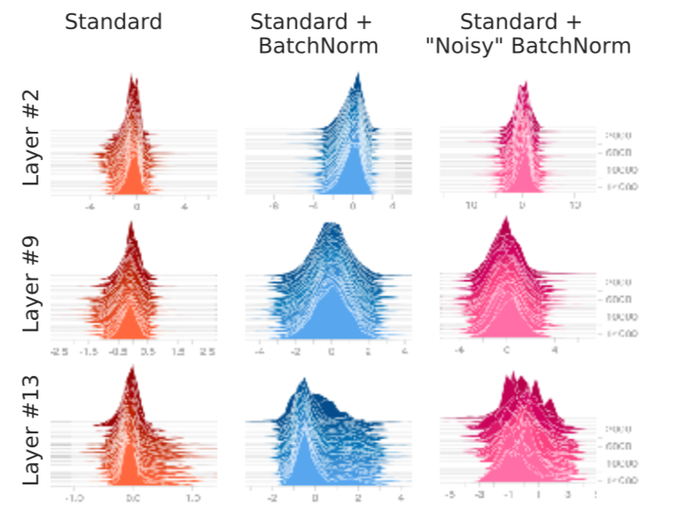
Internal Covariance Shift
ICS: change in the input distributions of internal nodes during training;
But network with BN works fine even after injecting noises to normed activations (the “noisy” BN);

Slide 4
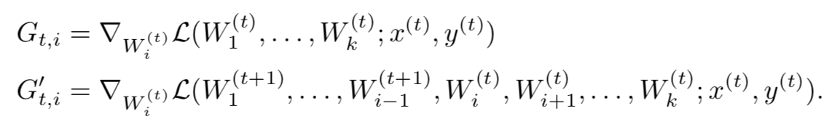
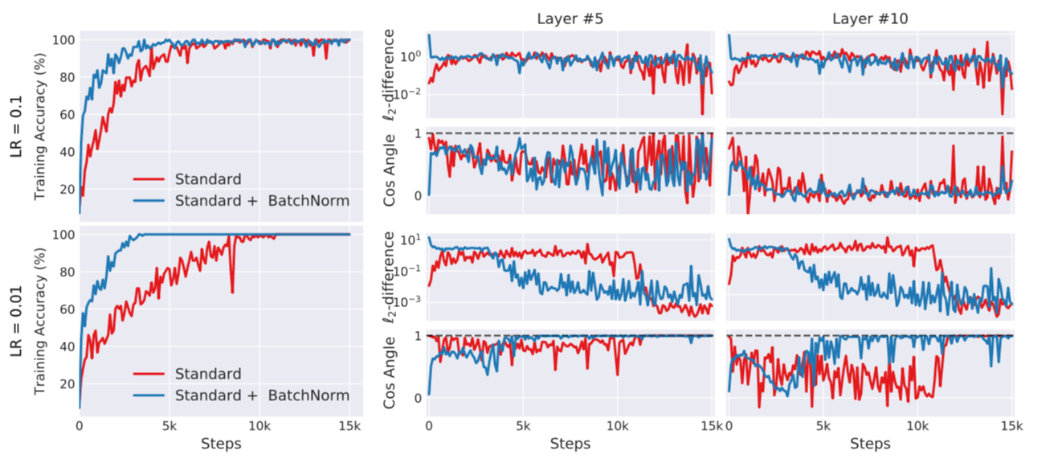

ICS w.r.t. Optimization
SGD is based on 1st order gradient: measure $‖G_{t,i}−G_{t,i}^{′}‖$
Seems BN still has nothing to do with it…

Slide 5
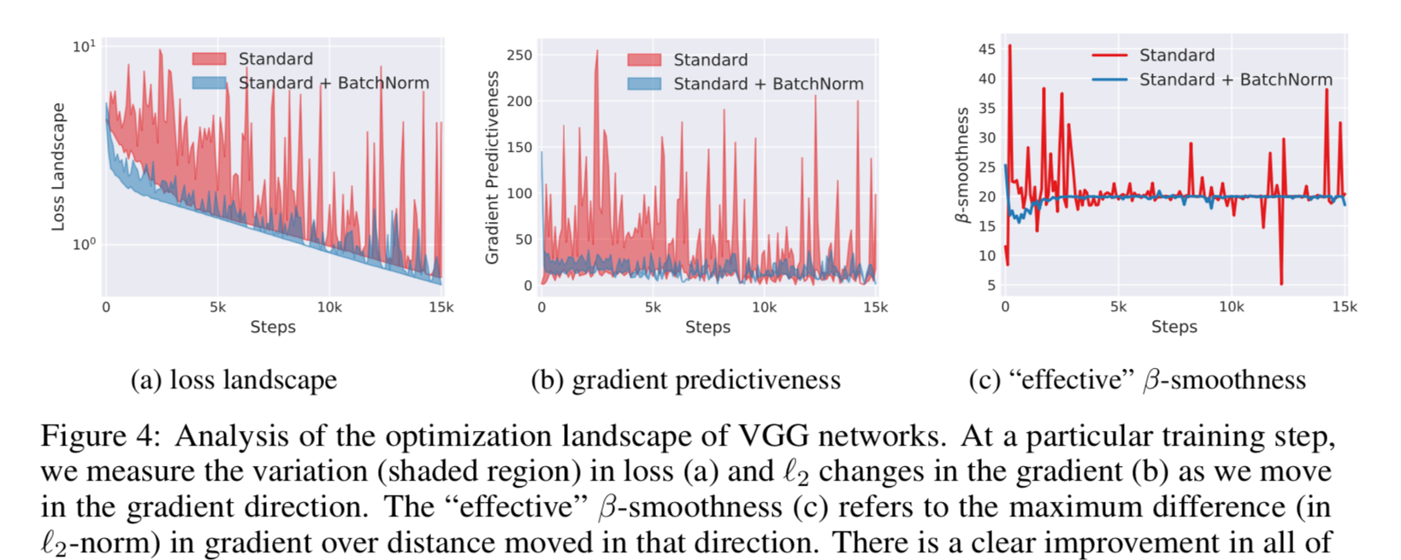
BN smooths Opt. Landscape

Slide 6
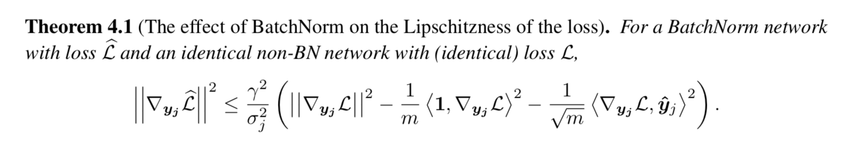
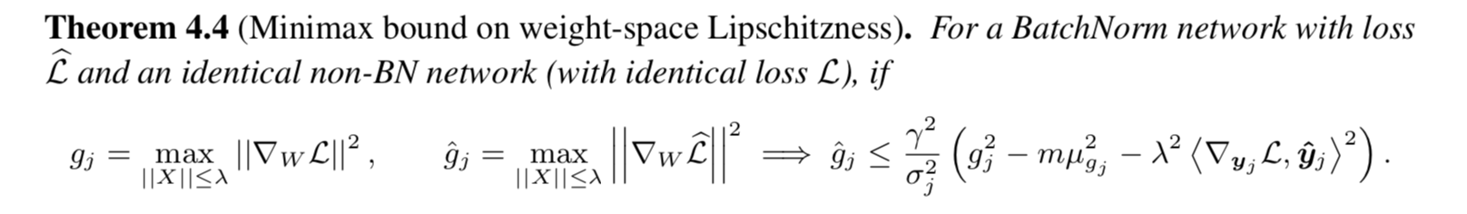
BN smooths Opt. Landscape
Gradient w.r.t. activations:
Gradient w.r.t. weights:

Slide 7
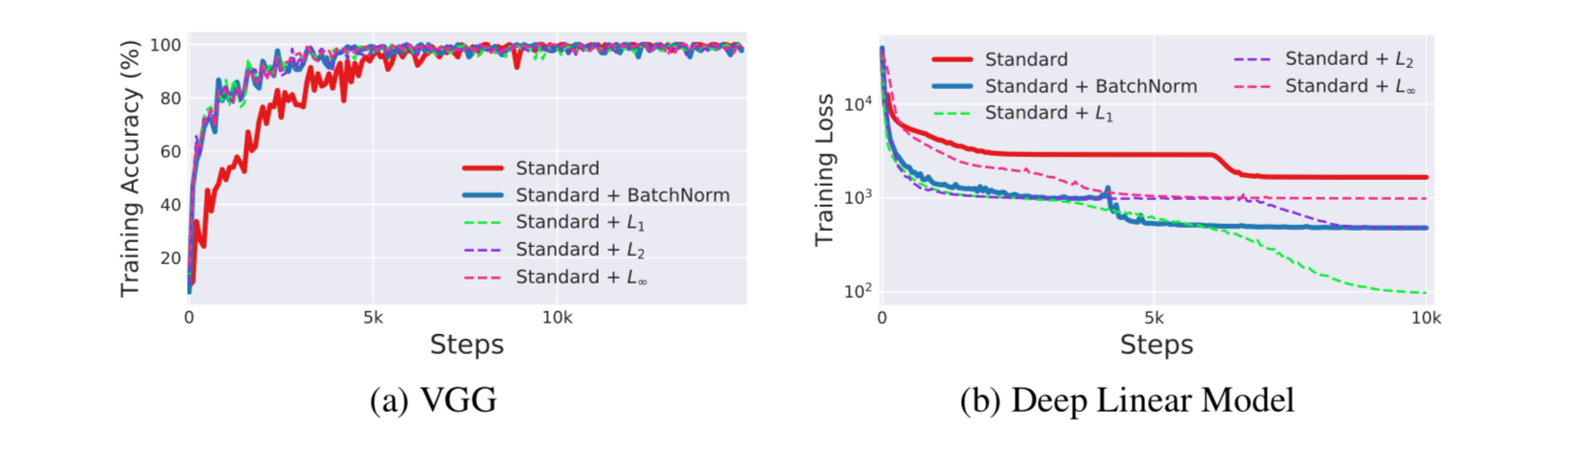
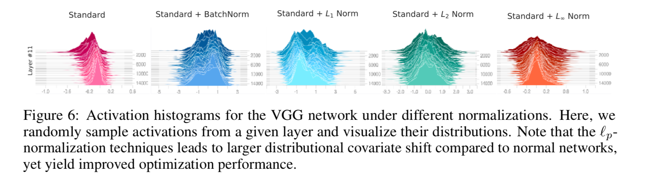
More than standard BN

Slide 8
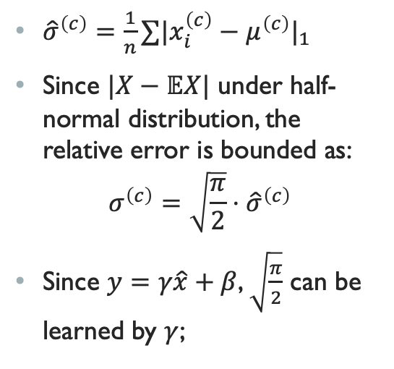
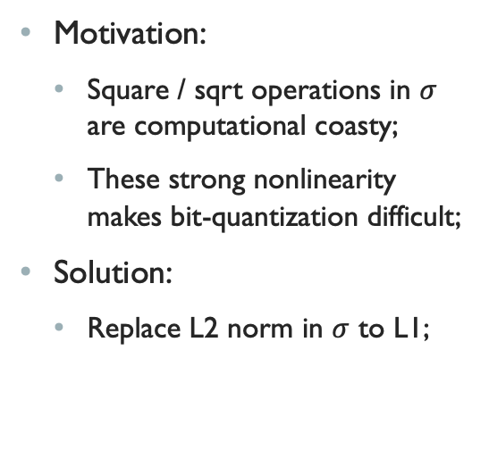
L1 BN
Motivation:
Square / sqrt operations in $σ$ are computational coasty;
These strong nonlinearity makes bit-quantization difficult;
Solution:
Replace L2 norm in $σ$ to L1;
${\hat{σ}}^{\left(c\right)}=\frac{1}{n}∑|x_{i}^{\left(c\right)}−μ^{\left(c\right)}|_{1}$
Since $|X−𝔼X|$ under half-normal distribution, the relative error is bounded as:
$$σ^{\left(c\right)}=\sqrt{\frac{π}{2}}⋅{\hat{σ}}^{\left(c\right)}$$
Since $y=γ\hat{x}+β$, $\sqrt{\frac{π}{2}}$ can be learned by $γ$;

Slide 9
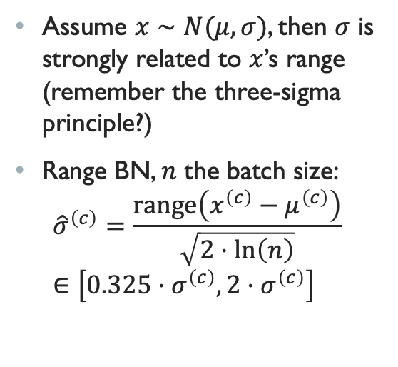
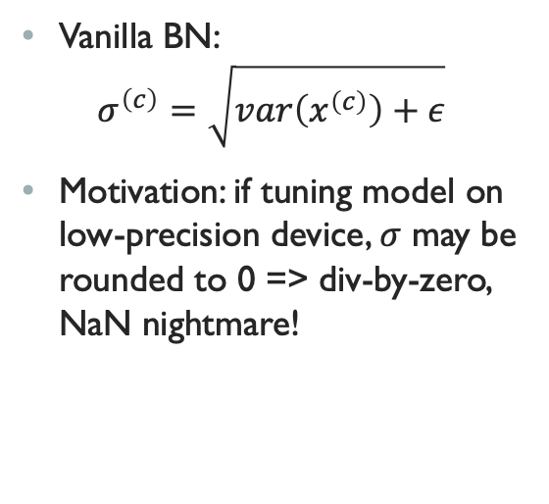
Range BN
Vanilla BN:
$$σ^{\left(c\right)}=\sqrt{var\left(x^{\left(c\right)}\right)+ε}$$
Motivation: if tuning model on low-precision device, $σ$ may be rounded to 0 => div-by-zero, NaN nightmare!
Assume $x∼N(μ, σ)$, then $σ$ is strongly related to $x$’s range (remember the three-sigma principle?)
Range BN, $n$ the batch size:
$${\hat{σ}}^{\left(c\right)}=\frac{range\left(x^{\left(c\right)}−μ^{\left(c\right)}\right)}{\sqrt{2⋅\ln\left(n\right)}}∈\left[0.325⋅σ^{\left(c\right)},2⋅σ^{\left(c\right)}\right]$$

Slide 10
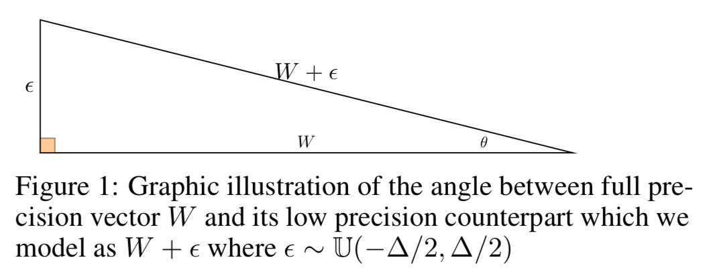
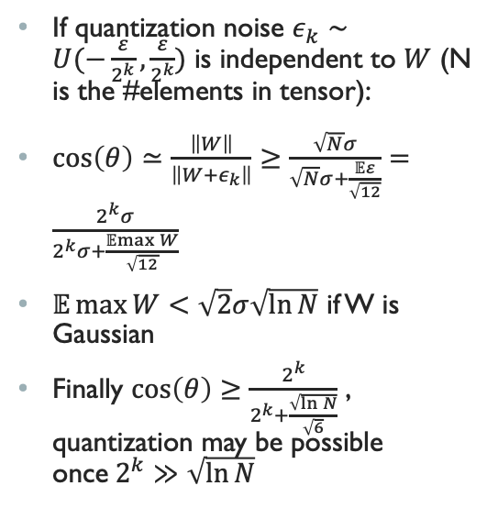
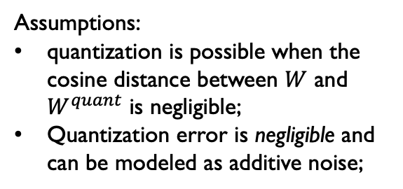
When is quantization possible?
If quantization noise $ε_{k}∼U(−\frac{ε}{2^{k}},\frac{ε}{2^{k}})$ is independent to $W$ (N is the #elements in tensor):
$\cos\left(θ\right)≃\frac{\left\|W\right\|}{\left\|W+ε_{k}\right\|}≥\frac{\sqrt{N}σ}{\sqrt{N}σ+\frac{𝔼ε}{\sqrt{12}}}=\frac{2^{k}σ}{2^{k}σ+\frac{𝔼max{W}}{\sqrt{12}}}$
$𝔼\max{W}<\sqrt{2}σ\sqrt{\ln{N}}$ if W is Gaussian
Finally $\cos\left(θ\right)≥\frac{2^{k}}{2^{k}+\frac{\sqrt{\ln{N}}}{\sqrt{6}}}$ , quantization may be possible once$2^{k}≫\sqrt{\ln{N}}$
Assumptions:
quantization is possible when the cosine distance between $W$ and $W^{quant}$ is negligible;
Quantization error is negligible and can be modeled as additive noise;

