Slide 1
Weekly Paper Reading Robust Neural Network v.s. Compressed Neural Network
Haoli
2018-12-08

Slide 2
Outline
Attack & Defense: Basic Concepts
State of the Art Defense Method
Robustness of Compressed Neural Networks

Slide 3
Outline
Attack & Defense: Basic Concepts
State of the Art Defense Method
Robustness of Compressed Neural Networks

Slide 4
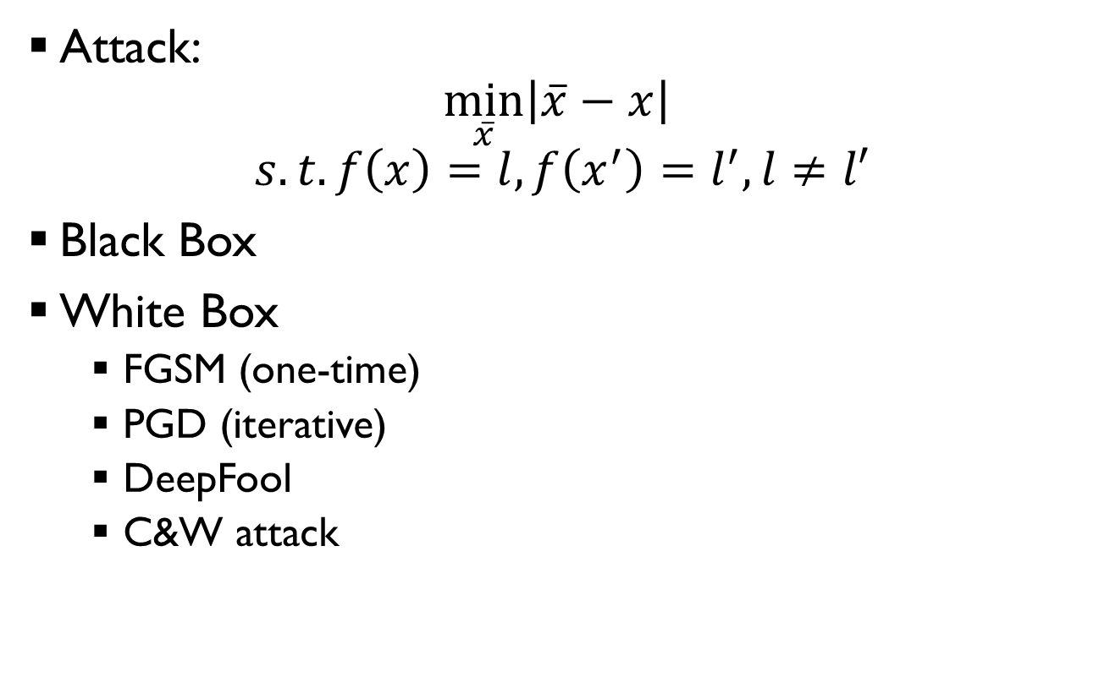
Attack & Defense: Basic Concepts
Attack: $\min_{\overline{x}}\left|\overline{x}−x\right|$
$$s.t. f\left(x\right)=l, f\left(x^{′}\right)=l^{′}, l≠l′$$
Black Box
White Box
FGSM (one-time)
PGD (iterative)
DeepFool
C&W attack

Slide 5
Attack & Defense: Basic Concepts
Defense: predict the correct label for adversarial samples
Types:
Adversarial Training
Distillation
Adversarial Detecting
For a complete survey on attack and defense
[1] Adversarial Samples: Attacks and Defenses for Deep Learning
[2] Adversarial Examples - A Complete Characterisation of the Phenomenon

Slide 6
Outline
Attack & Defense: Basic Concepts
State of the Art Defense Method
Robustness of Compressed Neural Networks

Slide 7

State of the Art Adversarial Training Method
Based on the paper: Towards Deep Learning Models Resistant to Adversarial Attacks
Basic Idea:
Robust training
Iterative PGD attack & defense

Slide 8
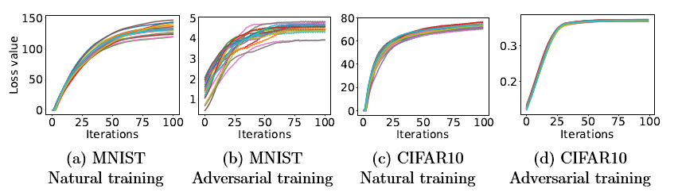

State of the Art Adversarial Training Method
Iterative PGD attack:
Will the inner max problem converge?
$$x+η⋅g$$
r
x

Slide 9

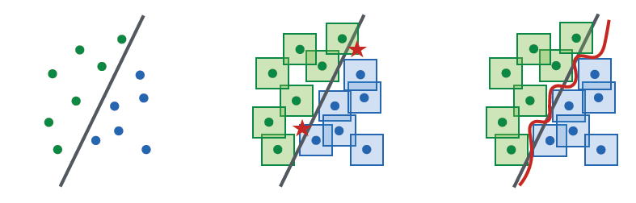

State of the Art Adversarial Training Method
Iterative PGD attack:
$$x+η⋅g$$
r
x

Slide 10
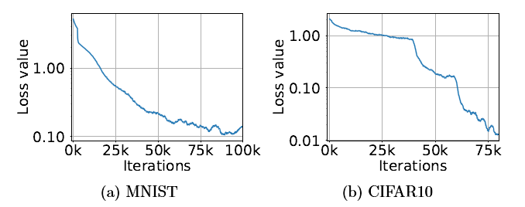
State of the Art Adversarial Training Method
Will the inner max problem converge?
Will the min problem converge and generalize?

Slide 11
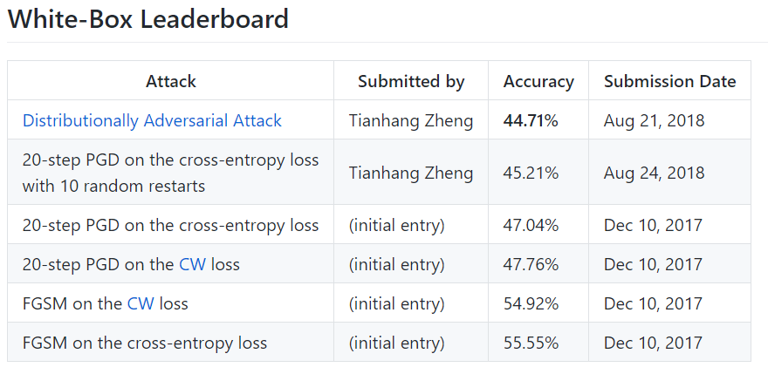
State of the Art Adversarial Training Method
White box attack on CIFAR-10, Wde Resnet
Leader board:
MNIST: https://github.com/MadryLab/mnist_challenge
CIFAR10: https://github.com/MadryLab/cifar10_challenge

Slide 12
Outline
Attack & Defense: Basic Concepts
State of the Art Defense Method
Robustness of Compressed Neural Networks

Slide 13
Robustness of Compressed Neural Networks
Conclusion: Not Sure
Limited literature

Slide 14
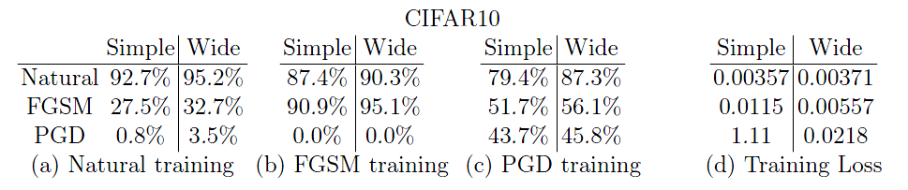
Robustness of Compressed Neural Networks
Robustness v.s. Model Size
Empirical studies

Slide 15
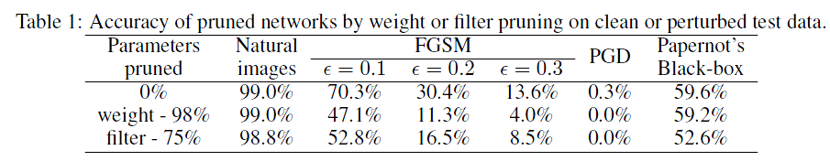
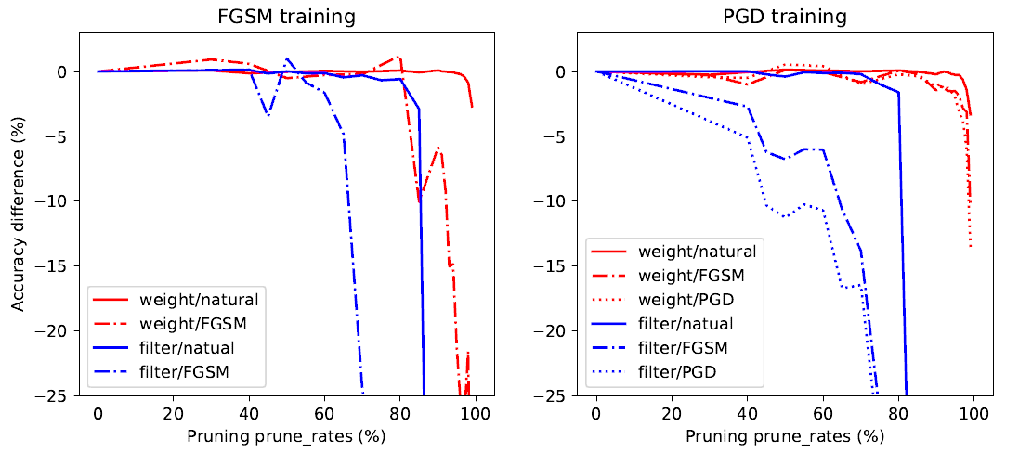
Robustness of Compressed Neural Networks
Robustness of pruned models
ADVERSARIAL ROBUSTNESS OF PRUNED NEURAL NETWORKS

Slide 16
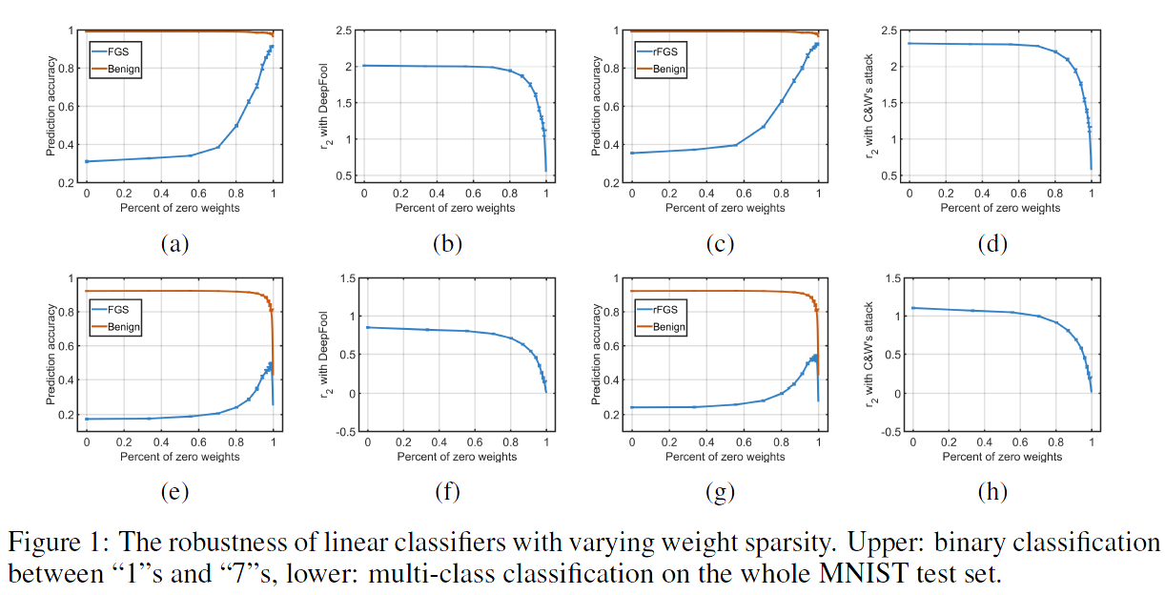
Robustness of Compressed Neural Networks
Robustness of pruned models
(NIPS 2018) Sparse DNNs with Improved Adversarial Robustness

Slide 17
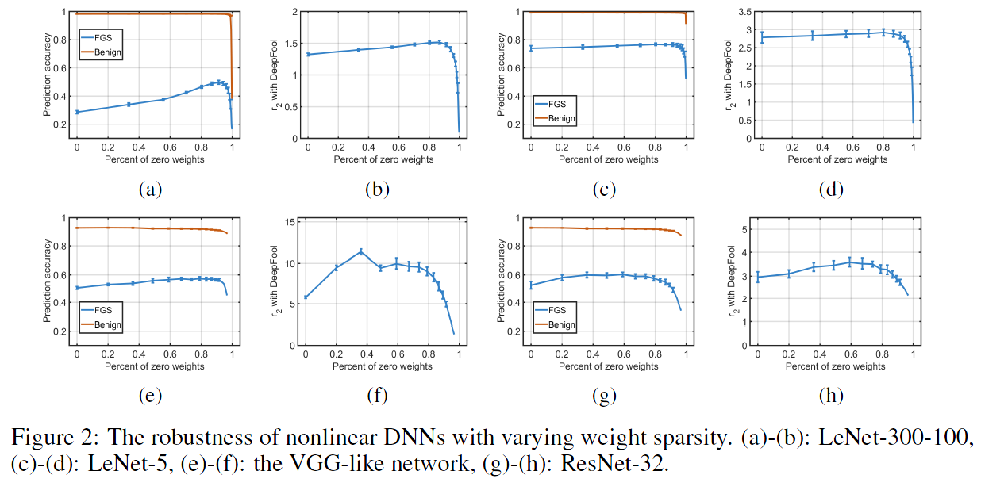
Robustness of Compressed Neural Networks
Robustness of pruned models
(NIPS 2018) Sparse DNNs with Improved Adversarial Robustness

Slide 18
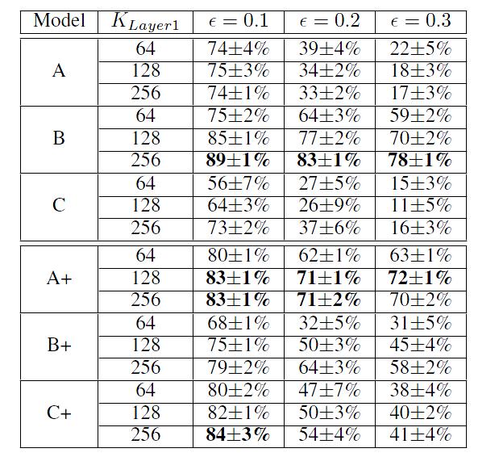
Robustness of Compressed Neural Networks
Robustness of quantized models
[ICLR2018] Attacking Binary Neural Networks

Slide 19
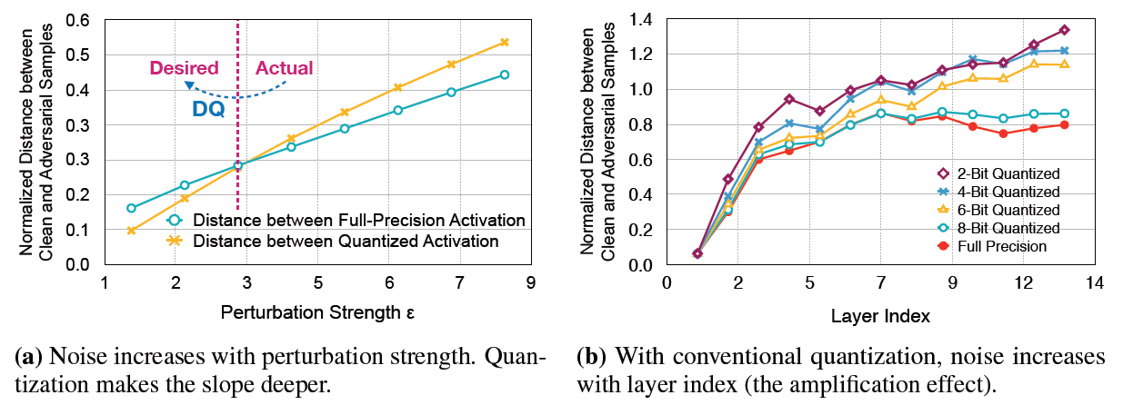
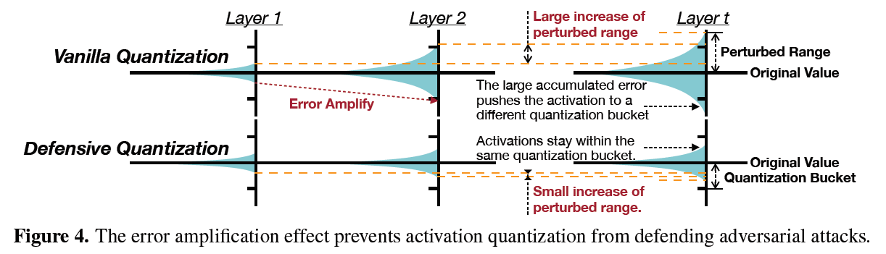
Robustness of Compressed Neural Networks
Robustness of quantized models
[ICLR 2019, 7,6,7] Defending Quantization

Slide 20
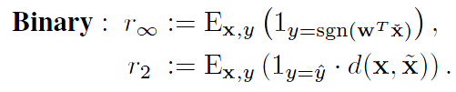
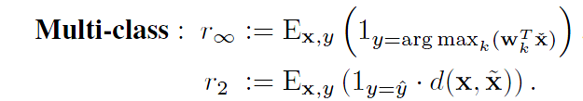
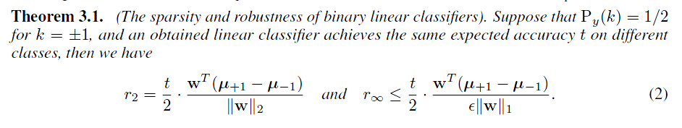
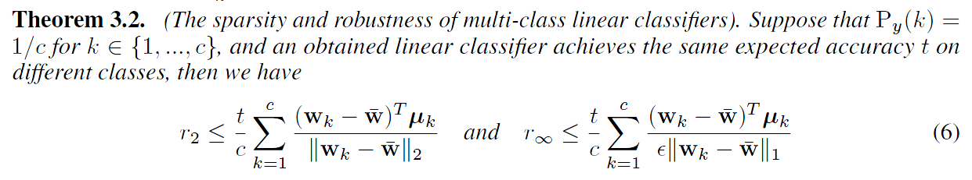
Robustness of Compressed Neural Networks
Theoretical analysis
(NIPS 2018) Sparse DNNs with Improved Adversarial Robustness

Slide 21
Robustness of Compressed Neural Networks
How to improve the robustness of compressed models?
Directly compressed to a more robust model, not compressing + adversarial training
New pruning/quantization methods that leads to robustness
Selectively add some weights/connections to significantly improve robustness?
Trade-off among: model size; accuracy; robustness

